Slide 1
Angular 2 Essentials
Learning Angular with DEV6

Slide 2


Introduction

Slide 3
Course Objectives
DEV6’s Angular 2 Essentials Course teaches developers how to use Angular 2 to create modern web applications

Slide 4

Course Roadmap
Introduction
What has Changed from AngularJS 1.x to Angular 2.0
Environmental Setup
Getting Started
Components & Directives
Pipes
Services
Dependency Injection (DI)
Lifecycle Hooks

Slide 5
Change Detection
Asynchronous Operations
HTTP, Observables, Promises
Forms & Validation
Routing
Component Styling
Testing
Deployment
Native Applications
Performance
Conclusion & Resources

Slide 6
Why use Angular 2?
Cross-platform code base
Progressive Web Apps
Mobile
Desktop
Speed and Performance
Compiled templates with code generation
Server pre-rendering
Code splitting with lazy loaded routes
Based on modern web standards
Simple creation of automated test suites
Angular CLI for fast scaffolding, testing, and deployment
Accessibility with ARIA, i18n, and built-in a11y test infrastructure
Notes:
expand on a11y and ARIA

Slide 7

What has Changed from AngularJS 1.x to Angular 2.0

Slide 8
What's Different
Language Options
ES5, ES6, TypeScript, or Dart
Controllers have changed to Components
ES6 Modules
Filters become Pipes
Angular 1 | angular.controller("MovieListCtrl", ["movieService", MovieListCtrl]);
Angular 2 | @Component({ selector: "movie-list", templateUrl: "app/movie-list.component.html"})

Slide 9
Emit() and broadcast() replaced by @Input and @Output
Shift away from Promises to RxJS Observables
No more jQuery
Digest cycle has been replaced with Zones
no more $scope.$apply()
no repeated digest cycles
no watchers
better change detection performance
Almost everything is just an ES2015 class
Notes:
replace eventing

Slide 10
Angular Face-Off
 | Goodbye | Hello
Bootstrapping | ng-app | @NgModule({ ... bootstrap: [AppComponent] })
Structural Built-In Directives | ng-repeat="cat in ctrl.cats" & ng-if="ctrl.cats.length" | *ngFor="cat of cats" & *ngIf="cats.length"
Services now act as providers | angular .module('app') .service('CatService', ... | @Component({ ... providers:[CatService] })
Notes:
fix data binding slides

Slide 11
One Way Binding | ng-bind, {{::name}} | HTML-friendly context [] <h3 [innerText]="cat.name"> </h3>
Two Way Binding | {{}} (default) | Only where explicit [(ngModel)]="cat.name"
Forms | Ng-form, ng-model | FormGroup, FormControl (can still use some of the old syntax)
Notes:
remove directive point

Slide 12

Environment Setup

Slide 13
Polyfills
A polyfill is a piece of code that provides technology that you expect the browser to have natively, providing a more uniform API landscape
You need:
ES6: Some ES6 features cannot be transpiled to ES5 and require shims to work
CoreJS: Huge library of ES2015+ polyfills and shims
ES6 Shim: Smaller library of compatibility shims
ZoneJS: Required by Angular to enable execution contexts that persist across async tasks. We will be covering it more in detail later in the course
Reflect-Metadata: Required by Angular to enable decorators and decorator metadata

Slide 14
Angular Modules
Angular ships as a collection of library modules within several npm packages beginning with the @angular prefix
@angular/core | DI, Change Detection, Core Decorators, Testing
@angular/common | Directives, Pipes, Forms
@angular/compiler | Template compiler
@angular/platform-browser | DOM Adaptors
@angular/platform-browser-dynamic | Web Bootstrap
@angular/http | Service for reading data from remote servers
@angular/router | Component Router

Slide 15
TypeScript
Installing TypeScript: npm install -g typescript
Basic TypeScript project options | - "target": "es5" - "module": "commonjs" - "moduleResolution": node"
Angular required flags to enable decorators | - "emitDecoratorMetadata": true - "experimentalDecorators": true
noImplicitAny (optional) | - Compiler will throw an error if it cannot infer the type - Enforces stricter type definitions
Notes:
be sure to talk about conflicting installs

Slide 16
Typings
Unfortunately, many libraries do not include type definitions in their npm packages so the Typings tool gives us the ability to manage and install TypeScript definitions
npm install -g typings
Like a package manager for TypeScript definitions
Manifest created in a typings.json file
The Angular modules come with their own definition files so we will add the following to start:
CoreJS, Jasmine, Node
{
"globalDependencies": {
"core-js": "registry:dt/core-js#0.0.0+20160602141332",
"jasmine": "registry:dt/jasmine#2.2.0+20160621224255",
"node": "registry:dt/node#6.0.0+20160621231320"
}
}

Slide 17
Code Styling & Linting
TSLint checks your TypeScript code for readability, maintainability, style, and functional errors
With the proper tooling, can see linting errors inline in your editor while you type
Angular 2 has an official style guide that provides developers guidelines for clearer syntax, conventions, and structuring for Angular applications
https://angular.io/styleguide
Codelyzer is a rule set extension for TSLint that enforces the style guide
It's errors will provide a link to the relevant section in the style guide
https://github.com/mgechev/codelyzer

Slide 18
Module Loaders
Module Loaders take modules with dependencies and generate static assets based on those modules
Are essential to the new configuration of Angular 2
Modules allow you to specifically declare what the dependencies are for each part of your application
Loader can intelligently deal with proper load order and optimizations
Significantly reduces the number of script tags needed to load your JavaScript files
The two main module loaders right now are: Webpack and SystemJS

Slide 19

Webpack
Works with CommonJS and AMD modules natively
Requires transpilation for ES6 modules
Considers everything a module, including your images and styles, and has a great plugin system that covers most of your needs
Can do module loading, bundling, code splitting, file transformations, linting, source maps, live-reload dev server, and more
Removes the need for most traditional task runner actions

Slide 20
Unit Testing Framework
Popular language/framework options: Jasmine, Mocha/Chai, QUnit, Cucumber
Can use each framework’s own runner or use a language agnostic solution like Karma
Karma is a unit test runner made by the Angular team that can execute your tests in many different browsers at the same time
Most popular solution in the Angular community is Jasmine tests run with Karma

Slide 21
End-to-End Testing Framework
Based on the Selenium web driver
Options:
Protractor
NightwatchJS
WebdriverIO
Each framework has its own syntax to learn
Protractor was made specifically for Angular applications by the Angular team and is the standard option in the community
Notes:
learn what NightwatchJS is

Slide 22
Some Basic Rules for Files
Define one thing per file (max 400 lines of code) because it makes it easier to read, maintain, etc.
Functions should be small so they are easier to test and promote reuse
Use consistent names for all symbols and assets (i.e. heroes.component.ts, hero-list.component.ts, hero-detail.component.ts, etc.)
Separate file names with dots and dashes
Put platform logic, including bootstrapping, in main.ts

Slide 23
Application File Structure
LIFT: Locate our code quickly, Identify the code at a glance, keep the Flattest structure we can, and Try to be DRY (Don’t Repeat Yourself)
All of our application’s code should be in a folder called app
Components should have four files (*.html, *.css, *.ts, *.spec.ts)
All shared files are to be put in a common folder
src
index.html
main.ts
app/
app.component.css
app.component.html
app.component.spec.ts
app.component.ts
cats/
cats.component.ts
cat-list.component.css
cat-list.component.html
cat-list.component.spec.ts
cat-list.component.ts
common/
spinner.component.ts
app-config.service.ts
nav-bar.component.ts

Slide 24
New App Structure vs. Angular 1.x App Structure
The modular design of our code also expresses itself in our file structure
Files are no longer organized by object type (Components, Services, etc.)
All files that relate to an entity are located next to each other (no more separate tests folder)
app.js has been replaced by main.ts as your app bootstrap location
app
index.html
scripts/
app.js
controllers/
mainController.js
otherController.js
directives/
mainDirective.js
otherDirective.js
services/
userService.js
itemService.js
views/
mainView.html
otherView.html

Slide 25
Angular CLI
Angular CLI is a Scaffolding tool (based on the ember-cli project) with the goal of getting you set up quickly
Sets up your entire project environment for you with TypeScript, a module loader (Webpack), dev environment, unit (Karma) and end-to-end (Protractor) tests, and production build scripts
Can generate stub files for angular elements, including unit tests, based on the Angular Style Guide
Has artifacts for offline app support and progressive web apps
Still in Beta and doesn’t have a lot of the flexibility that enterprise clients require. For that reason, we don’t recommend using it for production yet

Slide 26
Debugging
Console errors are much clearer in Angular 2 then they were in Angular 1
Angular Augury is an open sourced Google Chrome Dev Tool extension for debugging Angular 2 applications
It visualizes the application through component trees and visual debugging tools, making it easy to understand your errors
https://augury.angular.io/
Notes:
research this

Slide 27




Code Editors
Can use any code editor you like, however one with TypeScript support built in is recommended
Visual Studio / Visual Studio Code
Atom
WebStorm
Sublime Text

Slide 28

Getting Started

Slide 29
Our First Component
The root component for our application
Contained in a TypeScript file with a .ts extension
Import the @Component decorator from @angular/core
@Component a decorator function supplies Angular with all of the information it needs to create the component
// app.component.ts
import { Component } from '@angular/core';
@Component({
selector: "my-app",
template: "<h1> Hello, World! </h1>"
})
export class AppComponent {}

Slide 30
@Component decorator function takes an object literal that provides metadata to Angular that tells it how to create and use the component
selector: A simple CSS selector string for an HTML element
template: An HTML template string
A Component class provides data and actions for the view template
Exported from the module to be used elsewhere

Slide 31
Bootstrapping
Used to instantiate an Angular application in a main.ts file
Import the platform constructor function from @angular/platform-browser-dynamic
Import our root app module class from app.module.ts
Call bootstrapModule() with the root app module class as the first argument
import {platformBrowserDynamic} from ‘@angular/platform-browser-dynamic’;
import {AppModule} from ‘./app/app.module.ts’;
const platform = platformBrowserDynamic();
platform.bootstrapModule(AppModule)

Slide 32
NgModule
All applications require at least one module declaration
List dependencies and providers
The main module requires a component to instantiate the first view
Can precompile or lazy load entire modules
import {NgModule} from ‘@angular/core’;
import {AppComponent} from ‘./app/app.component.ts’;
@NgModule({ imports: [BrowserModule], declarations: [AppComponent], bootstrap: [AppComponent] });

Slide 33
index.html
Base HTML5 document as our browsers entry point
Load JavaScript polyfills, libraries, and our application code
How this is done is dependent on your module loader
Load any global CSS style sheets
Place an element tag in the <body> that matches your root component selector

Slide 34
DEMO
"Hello World" using a Dumb Component
Notes:
Walk through the Hello World process. Component -> Bootstrap -> index.html

Slide 35
EXERCISE
Getting Started

Slide 36
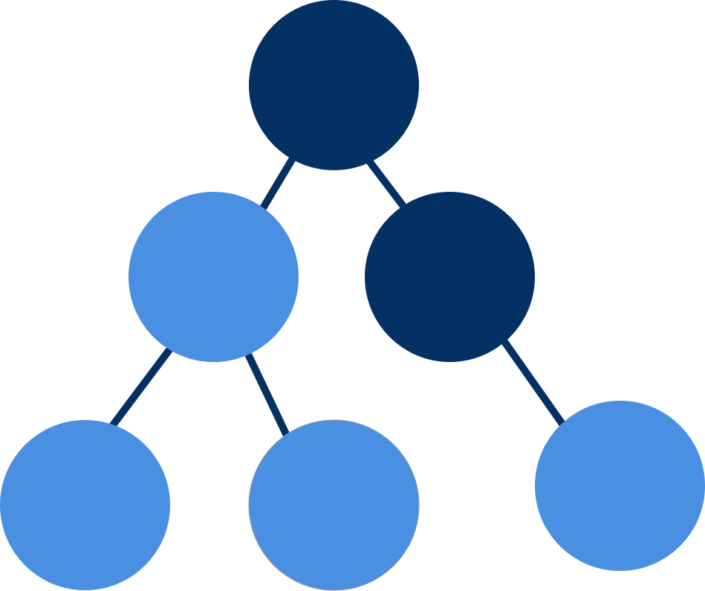
Components

Slide 37
Introduction to Components
Contain application logic that controls the view
Provide code reusability and consistency within the application
Components have three major responsibilities
Manage the model and the application data used by the view
Implement methods needed by the view for things like submitting data or hiding/showing sections of the UI
Manage data related to the state of the view like what item of the list has been selected or what has just been inputted in the form

Slide 38
Component Architecture
There are three main types of components:
Display (Dumb) Components | - Highly reusable - Mainly interested in the display of the UI - Should contain minimal-to-no business logic - Gets its data from parent components, not services - Sends user interactions as events to parent components
Business (Smart) Components | - Contain the business logic for the app - Consume display components - Communicate with services for application data flows - Send data to display components and handle their events
Routing / Layout Components | - Consume business components - Handle routing configuration and execution - Templates mainly contain router outlets - Provide the layout structure for your business components

Slide 39
Components in AngularJS 1 to Angular 2
Angular 1 | - 2 separate files of a Controller and a Template - Linked through a router or ng-controller
Angular 2 | - Component identifies its template right away, can still be 2 files - Use Metadata to connect component class and template
Could create Angular 2 style components using element directives in Angular 1
Components in Angular 2 really are just directives with a template

Slide 40
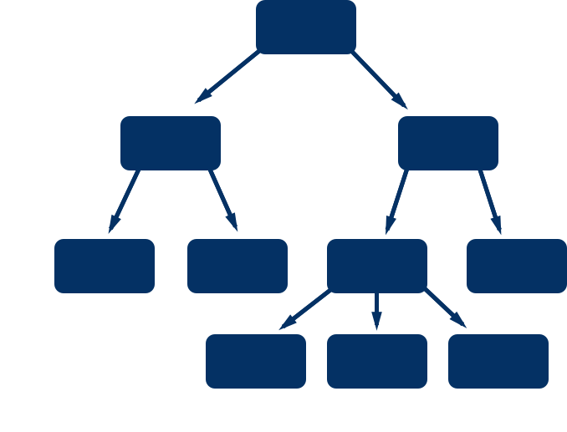
Component Hierarchy
Angular 2 Applications are made up of a hierarchy of components
The root component contains the descendants of all the components used in the application
This kind of structure is predictable, simple to traverse, and you can easily see what has been impacted when a change is made
Components are self contained but do need to exchange data
Exchanging data can happen as long as the child component is willing to receive data or a parent component listens for it

Slide 41
Nested Components
Components may contain other components called child components or nested components
To use a component inside another component:
Add the child component’s element tag in the parent’s template
Can access the child, if necessary, through @ViewChild or @ContentChild
We can also project external content inside of our component using the <ng-content> element

Slide 42
Code Example - Nested Components
// app/app.ts
import { Component } from '@angular/core';
/** Nested Component */
import { FriendsComponent } from 'app/friends.component';
@Component({
selector: 'my-app',
template: ` <div><h1>Hello from the {{ componentName }}.</h1><my-friends #friends></my-friends></div>`
})
export class AppComponent {
componentName: 'AppComponent'; @ViewChild(FriendsComponent) friends: FriendsComponent;
}

Slide 43
TypeScript Decorators
Wrappers used to extend, alter, or document parts of our classes without subclasses or altering method bodies
Decorators are identified with the @ prefix
Decorators are just special functions that are called at runtime
Decorators can be used to annotate classes, properties, methods, and parameters
Most Angular 2 classes have one or more TypeScript decorators to provide configuration and metadata

Slide 44
Adding Data
Class properties expose data to be used in the view
Properties that are not intended to be used in the view should be marked private
JavaScript doesn’t have enforced private members so it is possible to use a private member in a view
Only enforced by TypeScript at compile time
More of a developer contract for code clarity
Data is accessed in the view using either Property Binding [ ] or Interpolation {{ }}
class PersonComponent { firstName = ‘John’ }
<p>Hello {{firstName}}!</p>
<input [value]="firstName">

Slide 45
Adding Behaviour
Class methods expose behaviour to be used in the view
Methods are also public by default but can be marked private
Methods are called in the view using Event Binding ( )
class GreeterComponent { greet(){ ... }}
<button (click)="greet()"> Say Hello </button>

Slide 46
Inputs
Allow you to pass data into a component from a parent component
Created using the @Input decorator on a public property
@Input decorator is imported from @angular/core
class PersonComponent { @Input() name: string; }
The given property name is now available as an attribute binding target on the component tag
<person [name]="person.name"></person>
The external input name can be aliased by adding a string argument to @Input
class PersonComponent { @Input('firstName') name: string; }
<person [firstName]="person.name"></person>

Slide 47
Outputs
Allow you to emit an event with an optional payload that a parent component can bind to
Created using the @Output decorator on a public property
@Output decorator is imported from @angular/core
Property must be an instance of an EventEmitter
The same external name aliasing rules apply as @Input
class PersonFormComponent { @Output() submitted = new EventEmitter() }
<person-form (submitted)="submitFormData($event)"></person-form>

Slide 48
Event Emitter
Manages and fires custom events
Based on Observables
Imported from @angular/core
Event is fired with the emit() method
Any event payload can be supplied as an argument to emit()
The events payload can be accessed by the parameter $event on the components output event handler

Slide 49
View Child
Access sub-components or DOM elements using @ViewChild
@ViewChild can take either a directive/component type or selector string
Directive/Component Type: Will bind a reference to a directive or component with that type if found
Selector String: Will return an element containing the matching template variable
Template variable is a reference to an DOM element or directive within a template
Direct DOM manipulation (i.e. jQuery) is discouraged in Angular 2, this provides a way around that

Slide 50
Code Example - Adding Data
@Component({
selector: 'some-cmp',
template: '<child-cmp [data]=myData (dataChange)=onDataChange></child-cmp>',
})
class SomeCmp {
public myData: { id: 1 };
onDataChange(data) {
this.myData = data;
}
}

Slide 51
DEMO
Components, ViewChild, Inputs and Outputs
Notes:
Nested and projected content, property scope with projected content, Inputs, Outputs, externally triggering a ViewChild component method

Slide 52
EXERCISE
Components

Slide 53

Templates

Slide 54
Introduction
Templates are used to render the components view
HTML is the language of Templates
<script> tags are not allowed and are ignored
Template filenames use the .html extension
Templates are linked to components through the decorator, that can be done two ways
Inline Templates
External Template

Slide 55
Inline vs. External
Inline | - Assign a string to the template decorator property - Tip: Use ES6 template strings for easier multi-line code layout - Use an external template if over 3 lines long - Downside: Most IDEs can’t do separate syntax highlighting inside string literals | @Component({ selector: 'hello-header', template: `<h1>Hello!</h1>` })
External / Linked Templates | Webpack will need you to inline your template using require syntax Other module loaders can use templateUrl Can use module.id to maintain relative paths outside of webpack | @Component({ selector: 'hello-header', template: require(‘./header.component.html’) })

Slide 56
Introduction to Data Bindings
Without Angular, a developer would have the responsibility to push data values into HTML controls and turn user responses into actions and value updates
Instead Angular supports data binding which is a mechanism to coordinate parts of a template with parts of a component
Add binding markups to the template HTML to tell Angular how to connect both sides
There are two types of data binding:
Component to DOM
DOM to Component

Slide 57
Data Binding Types
Component to DOM | - Interpolation and Property Binding - One-way data binding: the value only goes from a component data property to a target element property
DOM to Component | - Event Binding takes the information when a user has interacted with a page and brings that back to the component
Both | - Two-Way Binding is used when you want to update data as soon as it has been changed by the user

Slide 58
Interpolation
Converts the value of a given expression into a string
Defined using double moustache/curly brackets around a template expression {{expression}}
Can be used between HTML element tags and within attribute assignments

Slide 59
Template Expressions
Template expressions produce a value
Written in a similar language as JavaScript
Restrictions:
Assignments (= and += and -=)
The new operator
Chaining (, and ; )
Increment and decrement operators (++ and --)
Bitwise operators (| and &)
Anything in the global namespace like window or document

Slide 60
New Template Expression Operators
Pipe operator ( | )
We will discuss this later in the course
Safe Navigation Operator (?.) i.e. {{vehicle?.name}}
A way to guard against null and undefined values in a property path
Angular will crash if it encounters a null pointer error
If the value to the left of the operator is null or undefined, the app won’t crash and the interpolation will be left blank

Slide 61
Template Expression Guidelines
Should not change an application’s state, only the value of the target property
Essential to Angular’s unidirectional data flow policy
Executing template expressions should be quick
Statements should be simple
Confine business logic to the component itself where it will be easier to develop and test
Should always return the same value if dependencies haven’t changed (Idempotence)
Free of side effects and improves Angular’s change detection performance

Slide 62
Property Binding
Sets a property of a view element to the value of a template expression
Commonly used to set an element property to a component property value
Binding the source to an image | <img [src]="catImageUrl">
Disabling a button | <button [disabled]="isUnchanged">Save</button>
Setting a property of a directive | <div [ngClass]="classes"></div>
Optionally, you can use the canonical bind-prefix | <img bind-src="catImageUrl">

Slide 63
Template Bindings
There is a distinction between an HTML attribute and a DOM property
Attributes | - Are defined in HTML documents - Initialize DOM properties and then are discarded - Can not change
Properties | - Are defined by the DOM - Can change

Slide 64
Not all attributes map to a property of the same name, though most do
It is crucial to understanding how Angular binding works
<input type="text" value="Bob">
This example creates a corresponding DOM node with a value initialized to "Bob"
If a user changes "Bob" to "Sally", the DOM element value property changes but the HTML attribute value does not
The HTML value attribute specifies the initial value
Template bindings work with properties and events and not attributes

Slide 65
Event Binding
Registers a template statement that gets evaluated when an event happens
Reacts to a user’s actions like keystrokes, mouse movements, and clicks
Consists of a target event name in parenthesis on the left and a quoted template statement on the right
(event)="templateStatement"
Can optionally use the canonical on-prefix
on-event="templateStatement"
<button (click)="submitForm()">Save</button>
<button on-click="submitForm()>Save</button>

Slide 66
Template Statements
Responds to an event raised by a binding target like an element, component, or directive
Has a side effect. Updates the application state
Uses a language that is similar to JavaScript
Typically used to invoke a method on a component
Have the same restrictions as Template Expressions

Slide 67
Two-Way Binding
Combines property binding and event binding together to ensure that the view and model stay in sync
Consists of a special target attribute directive on the left surrounded in the “banana-in-a-box” syntax and a template expression on the right
<input [(ngModel)]="person.name">
[(ngModel)] is just syntactic sugar for
<input [ngModel]="person.name" (ngModelChange)="person.name=$event">
We could even implement ngModel ourselves with
<input [value]="person.name" (input)="person.name=$event.target.value" >
Can optionally use the canonical bindon-prefix
<input bindon-ngModel="person.name">

Slide 68
Structural Directives
Alters the layout of our application by adding, removing, and replacing elements in DOM
Consider the consequences of creating and destroying elements vs hiding and showing them
Free up resources when not in use
Could introduce performance lag if initialization of component is expensive

Slide 69
*ngIf & *ngFor
*ngIf takes a boolean and conditionally creates a section of DOM
<cat-detail *ngIf=”selectedCat”></cat-detail>
*ngFor repeats a section of DOM for every item in an iterable
<div *ngFor=”let cat of cats”>{{cat.name}}</div>
The DOM node and children represent the template to repeat with the local variable reflecting the current value in the iterable

Slide 70
DEMO
Bindings and Built-in Directives
Notes:
Bindings, *ngIf, difference between visibility and removal of elements, *ngFor, *ngSwitch

Slide 71
EXERCISE
Templates

Slide 72

Custom Directives

Slide 73
Kinds of Directives in Angular
Components
A component is a directive with a template and is the most common one
Structural Directives
Change the DOM layout by adding and removing DOM elements
Attribute Directives
Change the behaviour or appearance of an element

Slide 74
Building an Attribute Directive
Create a class and decorate it with @Directive from @angular/core
Specify an attribute selector in the @Directive config object
@Directive({ selector: ‘[myDirective]’ })
ElementRef is available through the constructor and gives the directive access to the DOM node that it has been used on through its nativeElement property
Add an event listener to the host element using the @HostListener decorator
@HostListener decorates a controller method (the event handler) and takes an event name string as an argument
This writes the listener for us, detaches it properly when the directive is destroyed, and reduces our interaction with the DOM API directly
@HostBinding provides similar functionality for element properties

Slide 75
Code Example - Building an Attribute Directive
export class HighlightDirective {
private defaultColor = 'red';
private el: HTMLElement;
constructor(el: ElementRef) { this.el = el.nativeElement; }
@Input('myHighlight') highlightColor: string;
@HostListener('mouseenter') onMouseEnter() {
this.highlight(this.highlightColor || this.defaultColor);
}
@HostListener('mouseleave') onMouseLeave() {
this.highlight(null);
}
private highlight(color: string) {
this.el.style.backgroundColor = color;
}
}

Slide 76
Asterisk Effect
The asterisk in front of structural directives like *ngIf and *ngFor isn’t just convention, it actually has meaning to the compiler
When the compiler sees an asterisk it wraps that element in an HTML5 <template> tag and moves the associated directive to it
The following two code snippets are functionally the same, in fact the compiler converts the first version to the second for us
Angular uses the contents of the <template> to know what to render
<p *ngIf="condition">
Show me if true!
</p>
// Or can be written like this
<template [ngIf]="condition">
<p>Show me if true!</p>
</template>

Slide 77
Building a Custom Structural Directive
Similar to building an attribute directive, but with a few extra pieces to be able to deal with the template contents
Inject TemplateRef to get access to the template in our directive
Inject ViewContainerRef to render our template
@Input() set myUnless(condition: boolean) {
if (!condition) {
this.viewContainer.createEmbeddedView(this.templateRef);
} else {
this.viewContainer.clear();
}
}

Slide 78
DEMO
Custom Attribute and Structural Directive
Notes:
Walk through custom hoverHighlight attribute directive and unless structural directive

Slide 79

Pipes

Slide 80
Introduction to Pipes
Takes in data as input and transforms it to a desired output
Simple functions that format data for display
Used in template expressions with the input data on the left of a pipe operator ( | ) and the pipe function name on the right
{{ birthday | date }}
Pipes can take arguments separated by a :
{{ birthday | date: ‘longDate’ }}
Pipes can be chained together
{{ birthday | date: ‘longDate’ | uppercase }}

Slide 81
Built-in Pipes
DatePipe | - Formats a date value to a string based on the requested format | {{ birthday | date: 'short' }} // 9/3/2010, 12:04 PM
UpperCasePipe | - Formats an input string to uppercase | {{ user.name | uppercase }} // JOHN
LowerCasePipe | - Formats an input string to lowercase | {{ user.name | lowercase }} // john
DecimalPipe | - Formats a number to the localized format - Requires a polyfill for the ECMA Internationalization API | {{ itemCount | number }} // 1,000
CurrencyPipe | - Formats a number as the given currency - Requires a polyfill for the ECMA Internationalization API | {{ price | currency: 'CAD': true }} // CA$36.34

Slide 82
PercentPipe | - Formats a number as a local percent - Requires a polyfill for the ECMA Internationalization API | {{ grade | percent }} // 35%
JSONPipe | - Transforms any input value using JSON.stringify | {{ personObj | json }} // {"name": "John"}
SlicePipe | - Creates a new list or string containing only a subset of the elements | <li *ngFor="let cat in cats | slice:1:3"></li> // returns cats[1] && cats[2]

Slide 83
Custom Pipes
A class decorated with pipe metadata
@Pipe decorator imported from @angular/core
@Pipe must define a name that is a valid JavaScript identifier for use in our templates
Implements the PipeTransform interface’s transform method that accepts an input value followed by optional parameters and returns the transformed value

Slide 84
Code Example - Custom Pipe
import { Pipe, PipeTransform } from '@angular/core';
@Pipe({ name: 'exponentialStrength' })
export class ExponentialStrengthPipe implements PipeTransform {
transform(value: number, exponent: string): number {
let exp = parseFloat(exponent);
return Math.pow(value, isNaN(exp) ? 1 : exp);
}
}

Slide 85
Pure vs. Impure Pipes
Pure Pipes | - Pipes are pure by default - Only detects changes in either a primitive input value (String, Number, Boolean, Symbol) or an object reference (Date, Array, Function, Object) - Will not detect changes within objects (date change, add to an array, object property changes)
Impure Pipes | - Executed during every component change detection cycle - Could be called as often as every keystroke or mouse-move which can make them expensive - Can be tuned impure by adding pure: false in the @Pipe decorator

Slide 86
DEMO
Built-in and Custom Pipes
Notes:
Built in pipe, built in pipe with argument, custom pipe

Slide 87
EXERCISE
Pipes

Slide 88

Services

Slide 89
Building a Service
Services live in their own file named name.service.ts
Building Blocks
Import the Injectable decorator from @angular/core
Exported class definition decorated with @Injectable
Any application code you need inside the class
// name.service.ts
import { Injectable } from "angular/core";
@Injectable() export class NameService {
getName(){return(cat.name)}
}

Slide 90
DEMO
Export Services, Methods, Data, and Functions
Notes:
Walk through an unconsumed service file

Slide 91
EXERCISE
Services

Slide 92

Dependency Injection (DI)

Slide 93
DI in Angular
Dependency Injection is wired into the Angular framework and used everywhere
DI is Hierarchical and follows the Component tree
The bootstrap function and every Component have their own injector
A provider registered on a parent injector is available to all child injectors

Slide 94
Register the Service Provider with Angular
Angular creates a single instance of the service class called a singleton and holds onto it
Angular provides a built-in injector
Register our service with an injector which creates a container of created service instances
If the component needs a service, the component describes the service as a dependency
The injector then injects the service class instance once the instance is instantiated
This process is called Dependency Injection

Slide 95
Since Angular manages this instance, the service class can be viewed publicly outside the component
This is the recommended way to use services
No longer requires a local variable to hold constructor args
Inside Component
constructor(private myService: MyService) {}

Slide 96
Injectors & Providers
Injectors | - Expose APIs to create instances of dependencies - Maintain a set of service instances that it created - Can create a new service instance from a provider
Providers | - A recipe that tells the injector how to create an instance of dependency - Takes a token and maps that to a provider definition object - We register providers with injectors - Most often the provider is a class definition

Slide 97
@Injectable Decorator
Provides metadata so a service can consume other dependencies as injectables
For those that are familiar with Angular 1, it is similar to $inject, though $inject no longer exists
Technically not required if service does not have any dependencies
It is recommended to use @Injectable in every service for future proofing and consistency
@Component contains all of the @Injectable functionality and more

Slide 98
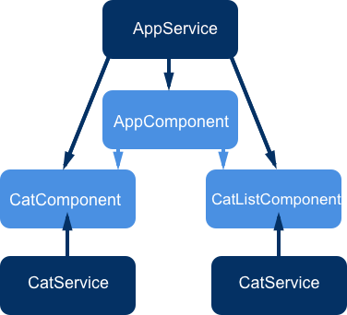
Registration
Providers are registered with the bootstrap function or an individual component
Register with the bootstrap function for environment level configuration
Register with the top level component for all application related dependencies (services)
You can have multiple instances of a service if you provide it in multiple places

Slide 99
Code Example - Registration
@NgModule({
declarations: [CatCardComponent],
providers: [MyService],
bootstrap: [AppComponent]
})

Slide 100
Injecting Dependencies
Dependencies are requested for injection using an explicit constructor function
Dependencies are defined as constructor properties with explicit types
constructor(private userService: UserService) { }
The private keyword is a TypeScript shorthand that creates and initializes a private property
Angular will use the type definition to lookup the service instance that it requires
Constructors should be as thin as possible. Primarily used for basic property initialization
If a component needs to make a request for data through a service we won’t do that in the constructor for testability reasons, we will instead use a Lifecycle Hook

Slide 101
Code Example - Injecting Dependencies
import { Injectable } from '@angular/core';
import { mockCatList } from './mock-cats';
import { Logger } from '../logger.service';
@Injectable()
export class CatService {
constructor(private logger: Logger) { }
getCats() {
this.logger.log('Getting cats ...');
return mockCatList;
}
}

Slide 102
DEMO
Data Injection to see the consumption of a service
Notes:
Just shows setup of DI hooks with a service. Data consumption with ngOnInit will be done in the next section. Service is injected into multiple levels of the component tree

Slide 103

Lifecycle Hooks

Slide 104
Component LifeCycle
A Component has a lifecycle managed by Angular
Angular performs these tasks:
Creates it
Renders it
Creates and renders its children
Checks it when its data-bound properties change
Destroys it before removing it from the DOM
Lifecycle hooks give developers visibility into these key moments and act when they occur on the component or directive
Some other parts of Angular have their own lifecycle hooks, like the router

Slide 105
The Most Common Hook
We want to keep our constructor functions thin and light
To help with that we will being doing the heavy lifting of initializing our components with the ngOnInit() lifecycle hook
Angular will automatically call a class method named ngOnInit for you at the right time, you just need to define it
This is where we will call our services to fetch data (possibly over a network)
Use the OnInit interface from @angular/core for tooling safety
import { OnInit } from '@angular/core';
export class AppComponent implements OnInit {
ngOnInit() {
this.getCats();
}
}

Slide 106
Interfaces for Lifecycle Hooks in Angular
Every lifecycle hook has a corresponding interface that our classes can implement
Taken from @angular/core, the interface names are the same as the lifecycle method names without the ng prefix
Each interface defines a single lifecycle method
While not required at runtime, they are highly recommended to gain the benefits of strong typing and editor tooling

Slide 107
All Lifecycle Hooks
Directive and Component lifecycle hooks:
ngOnChanges() | - Called after data-bound input properties are set - Receives a changes object of current and previous values
ngOnInit() | - Initializes the component or directive after Angular initializes the data-bound input properties
ngDoCheck() | - Detects and acts on changes that Angular can or won't detect on its own - Called every change detection run (quite frequently!)
ngOnDestroy() | - Cleanup stage just before Angular destroys the directive/component - Unsubscribe observables and detach event handlers

Slide 108
Component only lifecycle hooks
ngAfterContentInit() | - After Angular projects external content into a component view
ngAfterContentChecked() | - After bindings of projected external content are checked
ngAfterViewInit() | - After the component view is created
ngAfterViewChecked() | - After the bindings of the component's view are checked

Slide 109
LifeCycle Sequences
ngOnChanges() | - Will be called before ngOnInit() - Called when a data-bound input property's value changes
ngOnInit() | - After the first ngOnChanges()
ngDoCheck() | - Checks during each Angular change detection cycle
ngAfterContentInit() | - After projecting content into the component
ngAfterContentChecked() | - After every check of projected component content
ngAfterViewInit() | - After initializing the component's views and child views
ngAfterViewChecked() | - After every check of the component's views and child views
ngOnDestroy() | - Just before Angular destroys the directive/component

Slide 110
DEMO
ngOnInit, ngOnChanges, ngAfterViewInit, ngOnDestroy
Notes:
Use ngOnInit to load list data. Use lifecycle reporter component and buttons to show when events are fired (constructor, OnInit, DoCheck (use empty click button), OnChanges (use increment button), OnDestroy

Slide 111
EXERCISE
Lifecycle Hooks

Slide 112
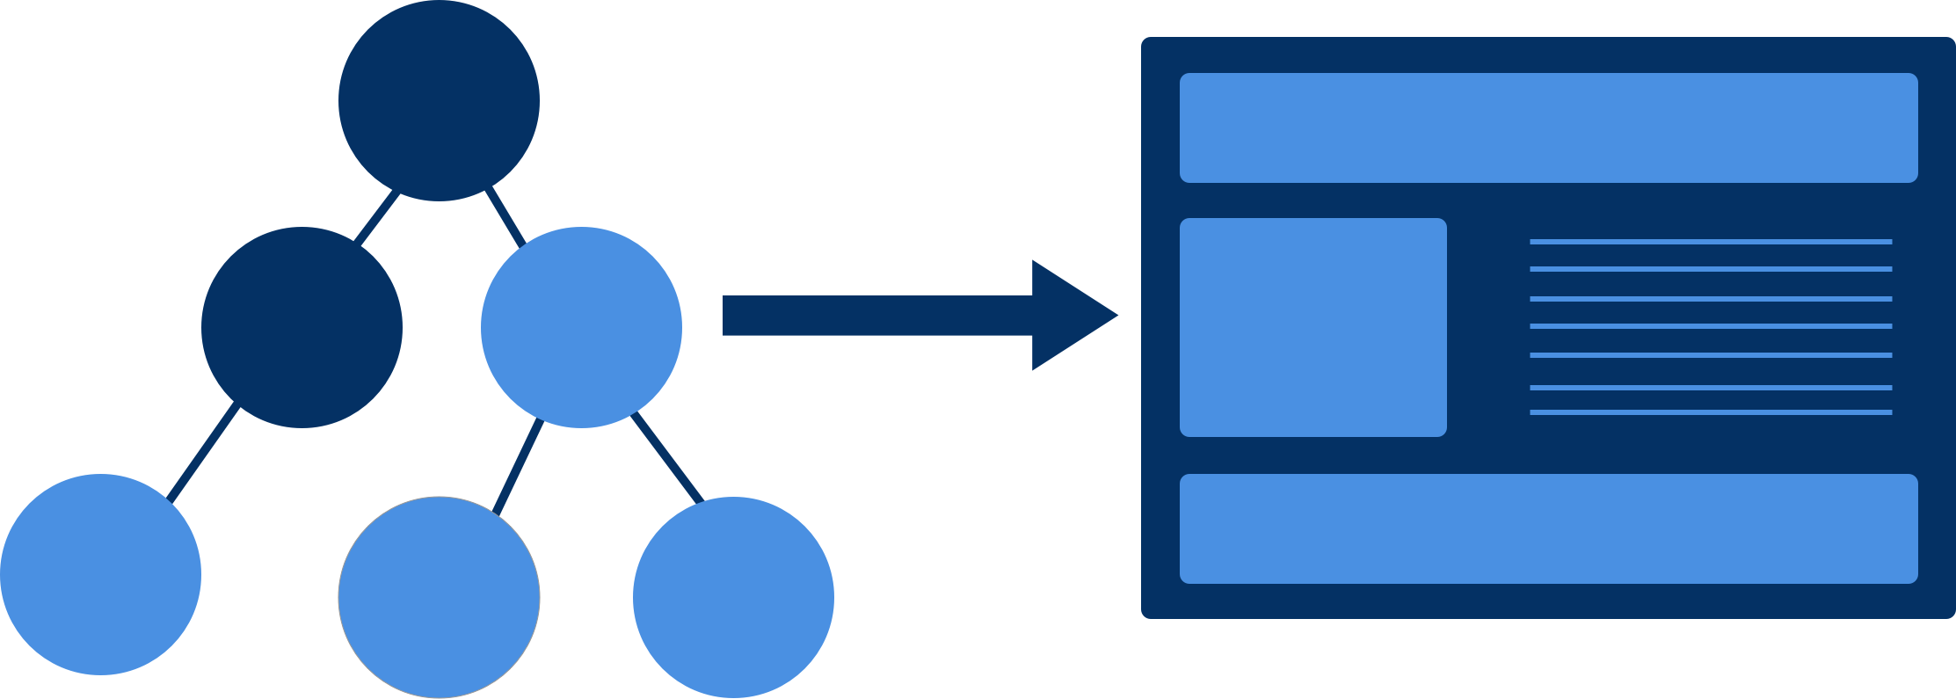
Change Detection

Slide 113
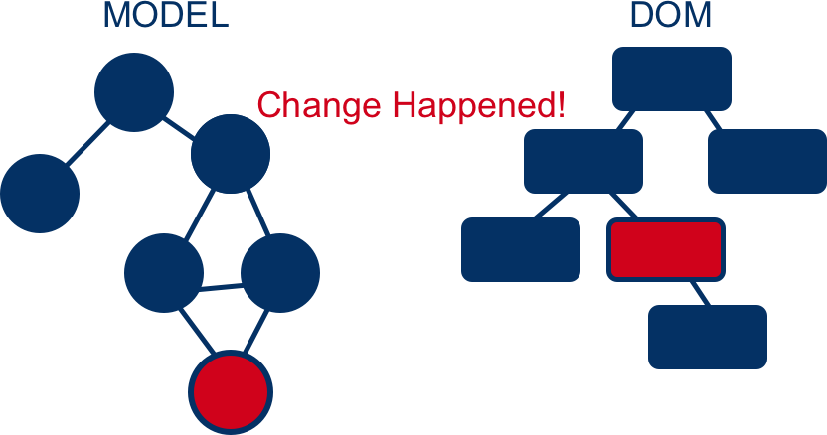
What is Change Detection?
Takes the internal state of a program and makes it visible to the user
States can be any kind of JavaScript data structure
When a change happens to the state, it can affect anything on the DOM
Change detection is the mechanism that determines when the view needs to be updated

Slide 114
What Causes Change?
There are three main things that change state
Events: clicks, keypresses, mouse moves
XHR: fetching data from a remote server
Timers: setTimeout, setInterval
All of these are asynchronous
Whenever asynchronous operations are performed, our application state has probably been changed so Angular needs to update the view
How do we know when async tasks are complete?

Slide 115
Zone.js
Standalone library created by the Angular team
A Zone is an execution context that persists across async tasks
Zones allow us to add hooks into the browser’s event loop
Monkey patches the browser’s async API to track all async tasks and know when they are complete
Every Angular app runs all of its code in its own zone, called ngZone
ngZone tracks all of the async activity in the application and will run change detection when it is complete

Slide 116
Event Loop
Call Stack | - Single threaded main application execution context
MicroTask Queue | - Run after the call stack is clear - Browser spec for certain actions like Promise callbacks - Allow certain tasks to run async but faster than a full event loop cycle - Change detection runs when this queue is cleared
Web APIs | - Concurrent tasks provided by the browser - Place callbacks on the Task/Callback queue when finished - MacroTask Queue: Scheduled or recurring tasks (setTimeout, XHR, setInterval)
Task / Callback Queue | - Hold code waiting to be picked up by the event loop
Event Loop | - When the stack is empty, takes the first thing off the Task Queue and puts it on the stack for execution

Slide 117
How does Change Detection work?
Every component gets its own change detector that is responsible for checking and updating its template bindings
Always starts from the root component and flows down through the tree
Stable after a single pass and Angular will throw an error in development if our components cause any additional side effects
Because JavaScript objects are mutable, Angular will need to check every binding every time for the whole tree

Slide 118
Performance
Can go through hundreds of change checks in a few milliseconds
Each change detector is custom created at runtime to be highly optimized for browser VMs providing a 3-10x performance boost over Angular 1
Change detection will not update your model, only the component tree and resulting DOM
If we provide Angular with some guarantees about when an object changes, using immutables or observables, we can increase our performance even more

Slide 119
Mutables vs. Immutables
Mutables
Are able to change their value without changing their reference
All objects in Javascript are mutable except for primitives
Immutables
Cannot be changed in place. They must return a new version of themselves which changes their reference
Can accomplish this through immutable programming patterns or immutable object libraries like Immutable.js
If we use Immutables, Angular can do a much faster reference equality check instead of also checking the contents of the object

Slide 120
Change Detection Strategy with OnPush
Set components to only depend on their input properties for change detection
Change detection will only run if an input reference changes
Can skip entire subtrees when properties don’t change
We do this by setting the change detection strategy to OnPush
@Component({ …
changeDetection: ChangeDetectionStrategy.OnPush
})
Lends itself to application model strategies like Redux
Single state object that gets pushed down through the root component

Slide 121
Observables
Observables give us certain guarantees of when a change has happened
Unlike immutable objects, they give us no new references when a change is made but fire events that can be subscribed to instead
When using the OnPush strategy we will need to manually mark a component and its branch for change detection in the observable subscription block
Inject ChangeDetectorRef and use markForCheck()

Slide 122
Code Example - Observables
constructor(private changeDetector: ChangeDetectorRef) {}
ngOnInit() {
this.clickEventStream.subscribe( () => {
this.counter++;
this.changeDetector.markForCheck();
})
}

Slide 123
But I Don't Want to Use These New Things
Angular does not force any style of model on you
Immutables and Observables are just options that you can use that are optimized further by the framework
Standard mutable change detection performance if already fast enough for most use cases
You can mix and match change detection strategies and model value types in your component tree

Slide 124
DEMO
Change Detection Strategies
Notes:
Show change detection differences between default and OnPush. Highlight mutable vs immutable data workflows

Slide 125
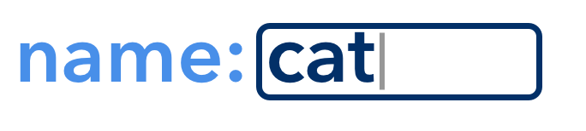
Forms & Validation

Slide 126
Introduction to Forms
Based on standard HTML5 form markup
Angular adds features like
Two-way data binding
Change tracking
Validation
Error handling

Slide 127
Form Types & Segments
Template Driven | - Similar to Angular 1 - Everything except the model object is done in the view template - Simple to work with and built in automatically
Partially Model Driven/ Partially Reactive | - More advanced. Requires importing additional form directives - Form control structure and validations move to the component class - Input elements, data binding and error messages stay in view template
Model Driven/ Fully Reactive | - Most advanced. Requires only additional form directives - Control all of the form logic and data from the component class - Just hook up the form controls to DOM elements by name in the view template - Allow for more customization and easier unit testing but require more developer configuration

Slide 128
Creating a Form
Write out an HTML5 form template in a component
Add ngModel on the input elements with two way data binding to control the model values
Define a unique name to each input with the name attribute
Event-bind to the ngSubmit directive on your <form> tag to call a component method when the form is submitted
<form [ngSubmit]=“onSubmit()”>
<div class="form-group">
<label for="name">Name</label>
<input type="text" class="form-control" required [(ngModel)]="model.name" name="name">
Nam e: {{model.name}}
</div>
<button type="submit" class="btn btn- default">Submit</button>
</form>

Slide 129
Hidden Form Magic
<form> is not just a tag, it’s also the ngForm directive
Keeps track of all of the input controls in the form
Knows the validation state of all inputs and therefore the form as a whole
ngModel does more than just allow two-way data binding
When paired with the name attribute, registers the input control with ngForm
Runs validators against an input and keeps track of its state
Does not have to be used with data binding or inside a <form> tag

Slide 130
Seeking Validation
Add the novalidate attribute to our <form> tag to disable native browser validation checking
Add an HTML5 validator attribute to the input, like required or maxlength
ngModel will also validate against the input type (text, email, URL)
Validation state will update dynamically as a user interacts with the input
Angular will add the following CSS classes to reflect the state
Control has been visited: ng-touched / ng-untouched
Control’s value has changed: ng-dirty / ng-pristine
Control’s value is valid: ng-valid / ng-invalid

Slide 131
Prevent Submission of an Invalid Form
We want to be able to use the form validity state to disable a form submit button
Need to get a reference to the ngForm directive class using a template variable
<form [ngSubmit]=“onSubmit()” #myForm=“ngForm”></form>
We can now use that template variable to disable our submit button
<button type="submit" [disabled]=“!myForm.valid">
Submit
</button>

Slide 132
Displaying Validation Messages
We need to get a reference to the individual formControl we want our error messages to reference
We will use a template variable with ngModel like we did with ngForm
<input type="text" [(ngModel)]="person.firstName" name="firstName" required #firstName="ngModel">
We set if our message is hidden based on the validity of the input
<div [hidden]=”firstName.valid || firstName.pristine”>First name is required</div>

Slide 133
Class-Driven Forms
Angular has introduced new classes, FormGroup and FormControl, to allow more programmatic configuration of forms.
Easier to test validation use cases
Still have to bind to HTML controls within the template

Slide 134
Form Builder
Used to quickly declare forms within components
Injected through constructor
Takes a form config that is converted to groups and controls
Can specify initial values and validator sets
constructor(private
fb:FormBuilder) {
let form:FormGroup =
this.fb.group({ ‘name’: [‘Ted’,
Validators.required],
‘email’: [‘’,
[Validators.required,
CustomEmailValidator]]);
};

Slide 135
Reusing Forms
If we clear a form’s model programmatically, it will not reset the state of the form automatically for us
We must also reset the ngForm to its initial state
Can be done by recreating the form through code, or accessing the form through a template variable, and calling form.reset()

Slide 136
DEMO
Form tag, ngModel, 2-way binding, submit
Notes:
Highlight ngSubmit, novalidate, template variables, validation setup, that disabling the submit button will prevent ngSubmit from firing with the enter key

Slide 137
EXERCISE
Forms & Validation

Slide 138

Promises

Slide 139
Creating A Promise
Promise is a global object in ES2015
Create an instance of a new Promise and pass the constructor an executor function that will do your async work
The executor function has two parameters resolve and reject which are functions that can take arguments
You must call one of these parameter functions in your executor function to resolve or reject the created promise instance
new Promise((resolve, reject) => {
if (requestSuccessful) {
resolve("Success!");
} else {
reject("Failed!");
}
});

Slide 140
DEMO
ES6 Promises and how to use them
Notes:
Demo service conversion to promises. Show both new Promise and Promise.resolve(). Show promise consumption in PeopleListComponent

Slide 141
EXERCISE
Promises

Slide 142

Observables

Slide 143
Introduction to Observables
Observables are represented as streams or collections over time
Another way to manage asynchronous data flow
Based on the Reactive Extensions (ReactiveX) and implemented using the RxJS library
Proposal put forward to add Observables to future versions of JavaScript
They’re lazy meaning nothing will happen until you subscribe to it
They can also be unsubscribed from and retried if failed unlike Promises

Slide 144
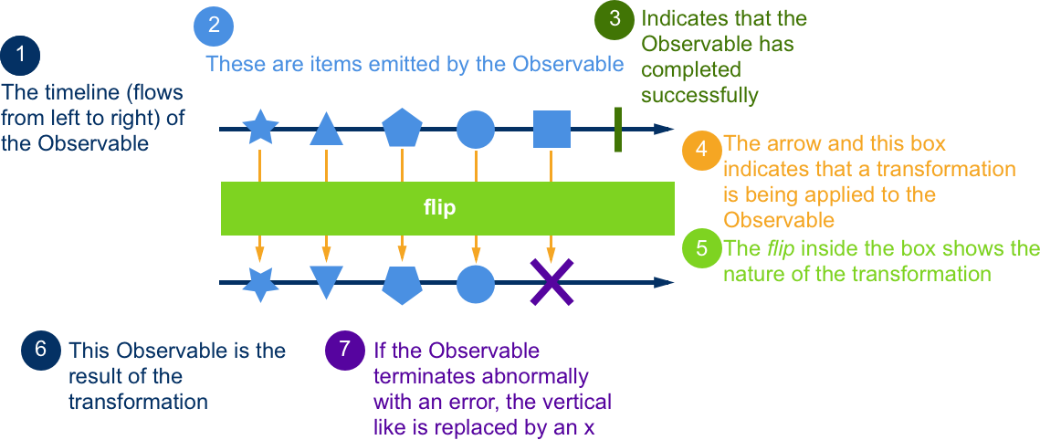

Slide 145
Observables vs. Promises
Observables and promises are both asynchronous
Promises are useful when getting a single value asynchronously
Observables are useful when getting one or multiple values asynchronously
You can turn anything into an Observable
Observables are cancellable, promises are not
Observables can be retried, promises cannot

Slide 146
Creating an Observable
There are many ways to create an Observable based on what you want to make an observable from
Call a static method on the Observable class to get an observable instance
of() | Convert arguments to an observable sequence
from() | Creates an observable sequence from an array-like or iterable object
fromEvent() | Creates an observable sequence by adding an event listener to the matching element
fromPromise() | Converts a promise to an observable sequence
interval() | Creates an observable sequence that produces a value after each period
...and many more

Slide 147
Subscribing to an Observable
In order to get data out of an Observable you have to subscribe to it
Call the subscribe() method of an observable and supply three possible function
This defines an observer for our observable collection
subscribe() returns a Subscription that you can cancel and clean up with unsubscribe()
You should unsubscribe from your observables (ngOnDestroy) in order to prevent memory leaks
You can create an observable and observer in one with new Subject()
next | called for each value in the collection with the value as an argument
error | called when an error is propogated with the error value as an argument
complete | called when the observable is complete

Slide 148
What are operators?
Operators are methods of an observable instance that transform the collection values before they get to the subscriber
Operators can be chained, passing the value from one to the next before proceeding with the next value in the collection
Different from array operators (like map or filter) which process the entire array at each step, but feel similar
Because of this difference, operators make larger observable stacks faster to process

Slide 149
Different Types of Operators
filter() | emit only those items from an observable that pass a predicate test
map() | transform the items in the collection by applying a function to each of them
catch() | recover from an onError notification by handling the error state and continuing the sequence
flatMap() | projects each element in the sequence to another observable sequence and then merges the resulting sequences into one
toPromise() | allows you to convert an observable sequence to a promise
scan() | apply an accumulator function to each item and return each intermediate result
reduce() | apply an accumulator function to each item and return the final result onCompleted

Slide 150
DEMO
Create an Observable, Subscribe, Handle Errors
Notes:
Conversion of people array in service to observable. Show subscription and unsubscribe in PeopleListComponent

Slide 151
EXERCISE
Observables

Slide 152

HTTP

Slide 153
Introduction to HTTP
Communicate with a server using HTTP
Optional Angular module: @angular/http
Supports the following HTTP-based web APIs
XMLHttpRequest (XHR)
JSONP
Fetch

Slide 154
Http Setup
Need to import the HttpModule from @angular/http into the module where it is required
We can now inject the Http service class within this module and all child modules
No more interceptors
import { HttpModule } from "@angular/http";
@NgModule({
imports: [HttpModule]
})

Slide 155
Making a Request
Inject the Http service and call the appropriate method (get, post, put, patch, delete, head)
Each method takes a URL, a body string if appropriate, and an optional request options object
If you are working with JSON over-the-wire you will need to JSON.stringify your data yourself
private catsUrl = ‘http://cat-api.com/cats’;
constructor(private http: Http){}
getCats(): Observable<Cat[]>{
return this.http.get(this.catsUrl)
}

Slide 156
Headers & Request Settings
By default Angular does not set any headers for you
Can override Http provider, or just RequestOptions provider to handle Http interception functionality.
@NgModule({
providers:[
{provide: Http, useClass: CustomHttpClass},
{provide: RequestOptions, useClass:
CustomRequestOptions }]
});

Slide 157
Consuming an Http Response
The Http service methods return an observable with the response object
Call the map() method to transform the response into the data we want
In order to get data from the response object, we need to tell it what format we want it in by calling the appropriate method
.json() will return a JSON object
.text() will return the body string
Make sure that you subscribe to your observable to receive the data
If you need to use a Promise instead, you can convert the observable to one using toPromise()
getCats(): Observable<Cat[]>{
return this.http.get(this.catsUrl)
.map(response => response.json())
}
return this.http.get(this.catsUrl)
.toPromise()
.then(response => response.json())

Slide 158
Async Pipes
Subscribes to a Promise or an Observable and returns the latest value it has emitted
When a new value is emitted, the async pipe marks the component to be checked for changes
An impure pipe
When the component is destroyed, the pipe unsubscribes automatically to avoid potential memory leaks

Slide 159
DEMO
Get Data with Observables, Async Pipe
Save Data and Http with Promises
Notes:
Providers setup and default request options in main.ts, CRUD commands in PeopleService, PeopleListComponent converted to async pipe

Slide 160
EXERCISE
HTTP

Slide 161

Routing

Slide 162
Angular's Component Router
Transforms the browser URL to the appropriate component tree
Uses HTML5 pushstate URLs instead of "hash" URL style routes by default
test.com/home vs test.com/#/home
Can handle nested/child routes
Can handle route parameters, query parameters, and more
Can handle lazy loaded routes

Slide 163
Setup
Contained in its own package, @angular/router
Need to set the <base href="/"> tag as the first child in the <head> to tell the router how to compose navigation URLs

Slide 164
Defining Routes
All of the routes for a module are defined in a single array
Each route is represented by a Route object that has a path string and normally a component
const routes: Routes = [ { path: ‘dashboard’, component: DashboardComponent } ]
Paths never start with a /
Define the root route with an empty string as the path
Routes can define route parameters
{ path: ‘items/:id’, component: ItemDetailComponent }

Slide 165
Modular Routes
Must be created as ModuleWithProviders
Use RouterModule to generate these from Routes object
forRoot() declares the module with the full router service. Only required once per app
forChild() will add all of the new routes to the existing route service

Slide 166
Route Config Example
import { Routes, RouterModule } from '@angular/router';
import { CatsComponent } from './cats.component';
import { ModuleWithProviders } from './@angular/core';
const routes: Routes = [{
path: 'cats',
component: CatsComponent
}];
export const catRouting: ModuleWithProviders = RouterModule.forRoot(routes);
@NgModule({ imports: [catRouting]; })

Slide 167
Router Directives
To get our route content to display we need to use the <router-outlet></router-outlet> component
Will inject the template for the defined component for the route in this tag
RouterLink: attribute directive that generates an href attribute for you for links
Takes an array of route segments
< a [routerLink]="['items', item.id, 'details']>Details</a>
// /items/3/details
RouterLinkActive: attribute directive that adds the given class names to the element when the matching routerLink is active
Takes a string or array of string class names to apply
<a [routerLink]="['details']" [routerLinkActive]="'active'">Details</a>

Slide 168
Navigating Programmatically
We can also navigate from inside a component method
Inject the Router into your component
In your controller method call navigate() on the router
navigate() also takes an array of route segments like RouterLink
import { Router } from ‘@angular/router’;
...
export class CatsComponent {
constructor(private router: Router) {}
seeDetails(cat) {
this.router.navigate([‘/cats’, cat.id]);
}
}

Slide 169
Accessing Route Parameters
Inject ActivatedRoute to get a reference to the current route
The params property on ActivatedRoute is an Observable that returns a map of route param keys and their string values
If you are expecting a value other than a string, you will need to convert it to that data type
id: Observable<number>;
constructor(private route: ActivatedRoute) {
this.id = route.params.map(params => +params[‘id’]);
}

Slide 170
ngOnInit() {
this.sub = this.route.params.subscribe(params => {
let id = +params['id'];
this.heroService.getHero(id)
.then(hero => this.hero = hero);
});
}
ngOnDestroy() {
this.sub.unsubscribe();
}
Be sure to unsubscribe from the observable before Angular destroys the component
ActivatedRoute.snapshot.params returns static initial values if required
Can be problematic if the router reuses a component instance (i.e. navigating from one details page to another)
Can alternately inject ActivatedRouteSnapshot if Observable is not required

Slide 171
Child Routes
Use the following syntax to define child routes in our route configuration
Child paths are relative to their parents
ItemsComponent is our Routing Component. All of the child components will be rendered in its <router-outlet>
Our ItemsComponent won’t need a selector because we will only ever be navigating to it
{
path: 'items',
component: ItemsComponent,
children: [{
path: ':id',
component: ItemDetailComponent },
{ path: '',
component: ItemListComponent }
]
}

Slide 172
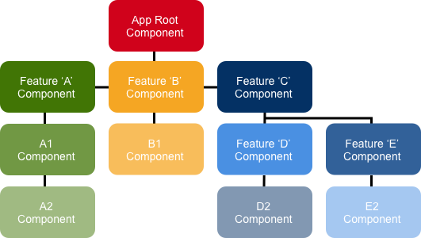
Feature Structure & Child Routes
Each feature area in its own folder
Each area with its own area root component
Each area root component with its own router outlet and child routes
All declared within a feature module

Slide 173
Guards
Allow us to hook into the Router lifecycle to do things like
Require certain authentication rules to view a route
Pre-fetch data before displaying a component
Prompt a user to save pending changes before navigating somewhere else
CanActivate: Mediate navigation to a route
CanDeactivate: Medicate navigation away from the current route
Guards are classes that implement certain named functions. Their return values control the router behaviour
return true | Observable<true>, the navigation process continues
return false | Observable<false>, the navigation process stops and doesn’t change state

Slide 174
Guards
Added to the route configuration
Must be added to DI in the same module as the route that requires it
CanDeactivate is checked first from the deepest child route to the root
CanActivate is checked next from the root to the deepest child route

Slide 175
DEMO
Router, Child Routes, and Guards
Notes:
Walk through app routes file and routeProviders setup. Demo AppComponent as routing component. Demo child routes for People feature. Walk through PeopleComponent as routing component and provider for PeopleService

Slide 176
EXERCISE
Routing

Slide 177
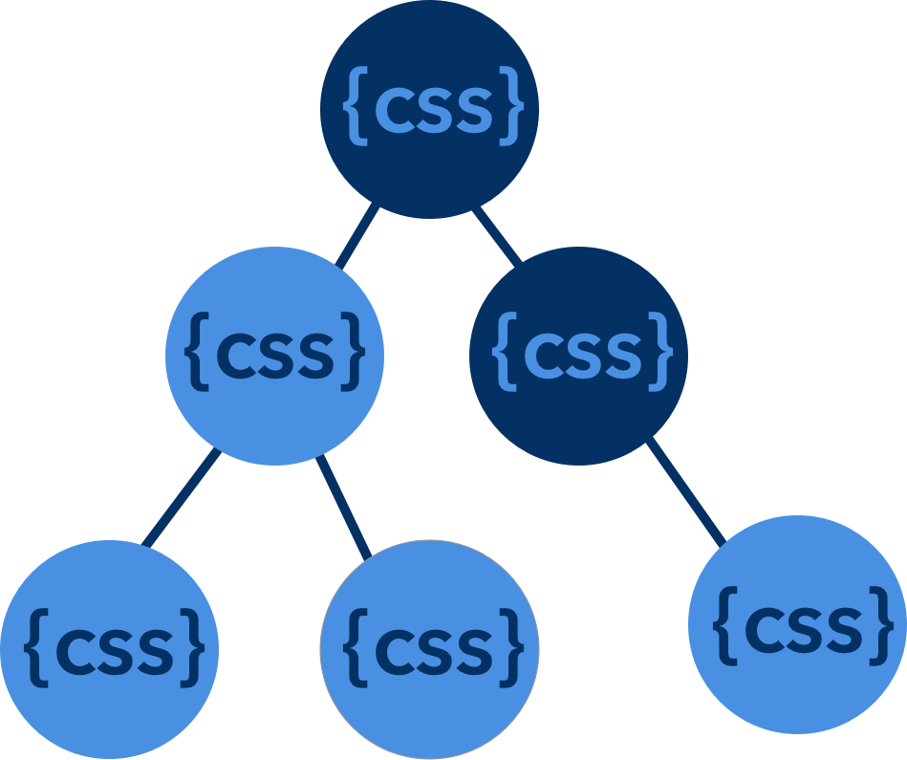
Component Styling

Slide 178
Introduction to Angular CSS Styling
Can apply everything we know about CSS stylesheets, selectors, rules, and media queries to our Angular applications
Two levels of CSS Styling with Angular 2 applications
Global Styling
Component Styling
Global styling works like any other web app
Getting away from Global and more into Component Styling where possible

Slide 179
Introduction to Component Styling
Differs from global styles because
Specify content for each component
Rules are local to the component, won’t collide with global rules or other components
Component’s styles cannot be changed by global styles by default
Separating CSS code leads to neater projects
Component styling better follows the overall encapsulation pattern of components
Works by using either native Shadow DOM APIs or Angular’s emulated Shadow DOM

Slide 180
Shadow DOM
Shadow DOM is included in the Web Components standard by W3C
Refers to the ability to include a subtree of DOM elements
Allows DOM implementation to be hidden from the rest of the document
Encapsulates all HTML, CSS, and JavaScript to prevent leakage
Think of it like an exclusive code sandbox

Slide 181
Encapsulation Modes
CSS styles are encapsulated into the component’s own view and do not affect the rest of the application
There are three states of view encapsulation
The encapsulation mode is set per component in its metadata
encapsulation: ViewEncapsulation.Native

Slide 182
Native | - The browser’s native shadow DOM is attached to the component’s host element - The component view and styles are rendered inside the Shadow DOM - Limited browser support
Emaluated (default) | - Tries to emulate Shadow DOM to scope our styles - Assigns a dynamically generated unique ID attribute to the component and pre-processes our rules to scope them to that ID - Processes styles are injected into the <head>
None | - No view encapsulation or scoping - Angular adds the rules to the global styles in the <head>

Slide 183
Special Shadow DOM Selectors
:host | :host(.active) { border-width: 3px; } // This only applies when the host element has the active class | - Pseudo-class selector - The only way to target the host element <my-component></my-component> - The host element requires a display value as it is hidden by the browser by default - Use the function form to apply host styles conditionally by including selectors inside parentheses
:host-context | :host-context(.theme-light) h2 { background-color: #eef; } | - Pseudo-class selector - Used to apply styles based on a condition outside a component’s view - Will apply the styles when the given class is on any ancestor of the component host element all the way up to the document root - It works just like the function form of :host()

Slide 184
/deep/ | :host /deep/ h3 { font-style: italic; } :host >>> h3 { font-style: italic; } | - Can only be used in emulated view encapsulation - The /deep/ selector forces a style down through the component tree into all the child component views - Applies both to the view children and the (projected) content children - Can also use the >>> alias instead

Slide 185
Loading Styles
Style strings in Component Metadata | - Add styles array property in the @Component decorator - Takes an array of style strings | @Component({ ... styles: ['h1 {font-weight: normal;}']})
Style URLs in Metadata | - Use this to load styles using external CSS files - Add an array of style URL strings to the styleUrls property in @Component - The URL is relative to the application root | @Component({ ... styleUrls: [‘./cat-details.component.css']});
Inline Style in Template | - Define the styles in the template between <style> tags | @Component({ ... template:`<style>h1 {color: yellow;}</style><h1>CATS</h1>`})

Slide 186
Link Tags in Template | - Embed <link> tags into the component’s HTML template - The link tag’s href URL is relative to the application root | @Component({ ... template: `<link rel="stylesheet" href="app/cat.component.css"> ...});
CSS @imports | - Use the standard CSS @import rule in your styles - File URL is relative to the CSS file into which we are importing | @import 'cat-details-box.css

Slide 187
DEMO
@Component Styling, Shadow DOM, Special Selectors
Notes:
Show inclusion of global styles in main.ts (Webpack specific workflow). Show h3 style encapsulation. Show native emulation mode. Show no emulation mode and global style overrides

Slide 188
EXERCISE
Component Styling

Slide 189

Component Animations

Slide 190
Introduction to Angular 2 Animations
Delivered with @angular/core
Same kind of native performance as CSS animations
Based on Web Animations API (polyfill required for some browsers)
Animations are defined inside Component metadata
Timeline based on component states
Gives us the ability for robust CSS control
Multi DOM level animations are still available
The ability for sequencing, chaining, staggering
Able to unit test your animations

Slide 191
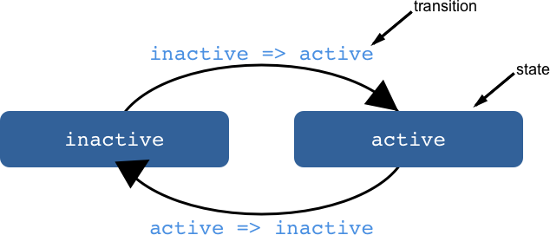
State & Transitions
Animations are defined as logical states and the transitions between them
State definitions specify the end styles
Attach the animation to an element in the template with the @triggerName syntax
<li @catState='cat.state'
(click)='cat.toggleState()'>
{{cat.name}}
</li>

Slide 192
When the same timing is for both directions of a transition, use the <=> syntax
transition(‘inactive <=> active’, animate(‘100ms ease-out’))
Can define temporary styles inline in the transition
Element receives one set of styles immediately and is then animated to the next
When a transition finishes, none of these styles will be kept because they’re not defined in a state
trigger('catState',
state('inactive', style({ transform: 'scale(1)')),
state('active', style({ transform(1.1)’})),
transition('inactive => active', animate('100ms ease-in')),
transition('active => inactive', animate('100ms ease-out')
)

Slide 193
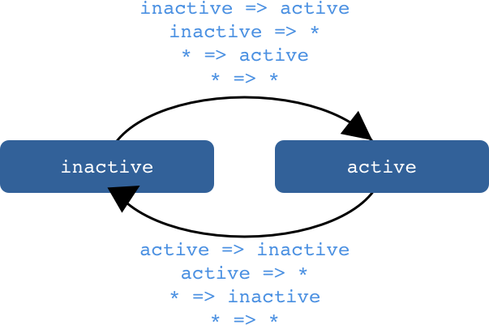
WildCard State
The wildcard state matches any animation state, and is represented by an asterisk (*)
Useful for defining styles and transitions that should apply regardless of state
The active => * transition applies when the element’s state changes from active to anything else
The * => * transition applies when any change between two states take place

Slide 194
The void State
void is a state that applies when an element is not attached to the view
Useful for defining enter (void => *) and leave (* => void) animations
Can be combined with other state transitions for more flexibility
void => inactive <=> active => void
animations: [ …
transition('void => *', [style({
transform: 'translateX(-100%)'}), animate(100)])
transition('* => void', [animate(100, style({
transform: 'translateX(100%)'})) ])
]

Slide 195
Animatable Properties & Units
Animate any property that the browser considers animatable
Includes positions, sizes, transforms, colors, borders, etc.
Positional properties can have an explicit unit value ('50px', '3em', '100%' )
If no units are given, pixels are assumed

Slide 196
Automatic Property Calculation
Common for elements to have widths and heights that depend on their content and the screen size
Angular does these calculations for you with the * property value
Values are computed at runtime and plugged into the animation
Can finally do dynamic height/width animations with ease
trigger('shrinkOut', [
state('in', style({height: '*'})),
transition('* => void', [
style({height: '*'}),
animate(250, style({height: 0}))])
])

Slide 197
Animation Timing
Duration | - Controls how long the animation takes from start to finish - Plain number, in milliseconds: 100 - In a string, as milliseconds: '100ms' - In a string, as seconds: '0.1s'
Delay | - Controls how long to wait after the animation triggers before the transition begins - Define one by adding it in the same string following the duration ('0.3s 200ms')
Easing | - Function controls how the animation accelerates and decelerates over time - Add the easing name as the third value if there is a delay ('0.2s 100ms ease-out') or as the second value if not ('0.2s ease-in-out'),

Slide 198
Keyframes
Animation keyframes define more intricate animations that go through one or more intermediate styles in between
Each keyframe specifies an offset that defines which point in the animation the keyframe applies
An offset is a relative number between zero (beginning) and one (end)
Defining offsets for keyframes is optional, they will be evenly distributed
An entrance animation with bounce:
transition('void=> *', [animate(300, keyframes([
style({ opacity: 0, transform: 'translateX(-100%)', offset: 0 }),
style({ opacity: 1, transform: 'translateX(15px)', offset: 0.3 }),
style({ opacity: 1, transform: 'translateX(0)', offset: 1.0 })
]))
])

Slide 199
Parallel Animation Groups
Configure different timings for animations that happen in parallel
Use animation groups in transitions to define an array of animations that will be triggered at the same time
Applied to the same element in parallel but run independent of each other
group([
animate("1s", { background: "black" }))
animate("2s", { color: "white" }))
])

Slide 200
DEMO
Creating Animations, Keyframes, Parallel Animations
Notes:
Walkthrough of component animations on app component

Slide 201

Testing

Slide 202
Introduction to Testing
Angular has always been designed to be easily testable, Angular 2 makes it even easier
Able to run Unit tests, End-to-End tests, and more
Using ES Modules lets us test just the parts of the code we are interested in
Since most of our code is ES6 classes, testing setup is simplified
Dependency Injection allows us to easily replace dependencies with mocks for true test isolation if required

Slide 203
Test Tooling
Jasmine | - Jasmine is a BDD style JavaScript testing framework baked right into the Angular 2 testing module - Provides assertions, mocking, stubbing, and more
Karma | - Test runner created by the Angular team that can run your code in multiple browsers - Requires a testing framework like Jasmine to actually write the tests
Protractor | - Test runner created by the Angular team that can run End-to-End tests for your application - Based on the Selenium Web Driver / Selenium Server - Uses a testing framework like Jasmine and it’s own DSL to write the tests
Configuration details of your testing suite will be dependent on your build environment and module loader

Slide 204
Unit Test Setup
Install npm packages for Karma and Jasmine as dev dependencies
npm install --save-dev jasmine-core karma karma-jasmine karma-chrome-launcher
Add and configure a karma.conf.js file in the root of the project (node_modules/.bin/karma init)
Unit test files will live next to the file they are testing with a *.spec.ts extension
Additional setup will be required to have karma run your test files through your module loader in order to convert them to ES5 and assemble the referenced files
Run your tests with karma start

Slide 205
Angular Specific Unit Test Setup
Our tests will require adjustments to our polyfills and Angular itself
It is common to do all of this in a shim file that Karma references
We will require the following polyfills
Our ES6 polyfill
The main Zone.js module and long-stack-trace-zone, jasmine-patch, async-test, fake-async-test, and sync-test
RxJS

Slide 206
Some base browser test providers need to be set on the @angular/core/testing module
Need to initialize the TestBed for the browser
var testing = require("@angular/core/testing"), browser = require("@angular/platform-browser-dynamic/testing"); testing.TestBed.initTestEnvironment( browser.BrowserDynamicTestingModule, browser.platformBrowserDynamicTesting());

Slide 207
Jasmine Fundamentals
All jasmine operators are available as globals in your test files
Each test file should have at least one describe function that identifies the file holding the test(s)
describe() | - Provide context for a suite of tests - Takes a title string and a function containing one or more specs
it() | - Describes a test case or spec - Takes a title string and a function containing one or more expectations
expect() | - Runs an assertion that compares the given value with a matcher - Compares the actual value (expect()) to the expected value (matchers) and returns a boolean expect(actual).toBe(expected)
beforeEach() | - Runs a given function before every it() statement in that describe block

Slide 208
Jasmine Matchers
Some default matchers
toBe(instance)
toEqual(value)
toMatch(pattern)
toBeDefined() / toBeUndefined()
toBeTruthy() / toBeFalsy()
You can write your own custom matcher or add a matcher library

Slide 209
Angular Test Helpers
TestBed | Allows you to declare a module to run the tests in configureTestingModule() is similar in syntax to NgModule Use createComponent() to instantiate a component in the given module configuration Cannot make modifications to TestBed once this is called
ComponentFixture<T> | Can access class instance Can access injector to spy on provided elements Can trigger change detection Can access DOM elements

Slide 210
Zones & Testing
Enables two new test helper functions to make dealing with async tests easier
async() | - Wraps an it() test function - Creates a new zone - The test will automatically complete when all async calls in this zone are done - Can also wrap an inject() call
fakeAsync() | - Allows more control by running the test in a zone that can simulate the async passage of time synchronously - Have to manually execute microtasks with flushMicrotasks() - Calling tick() simulates the passage of time for any timers in the zone. Can take an argument in milliseconds - Will warn you if you get to the end of the test and still have tasks pending

Slide 211
E2E Test Setup
Install npm packages for Protractor globally or as a dev dependency
npm install -g protractor
Will install protractor and webdriver-manager binaries
webdriver-manager will manage Selenium Server for you
Run webdriver-manager update to install selenium server
Run webdriver-manager start to begin an instance of the server

Slide 212
Add and configure a protractor.conf.js file in the root of the project
Need to specify the selenium server address, where your specs are, and that you are using the jasmine framework
Test files can live in each feature folder, or in a separate e2e folder
Use the extension *.e2e.ts
Make sure that you have your development server running to test against
Run your tests with protractor

Slide 213
Writing an E2E Test
Uses the describe and it syntax from the Jasmine framework
browser is a global variable created by Protractor which is used for browser-level commands such as navigation
Use window.getAngularTestability(el).whenStable(callback) in your protractor tests to know when a page is stable and decrease flakiness and race conditions

Slide 214
DEMO
Karma, Jasmine, and Protractor
Notes:
Unit tests for people service, component class and fixture tests for app component, basic e2e test

Slide 215
EXERCISE
Testing

Slide 216
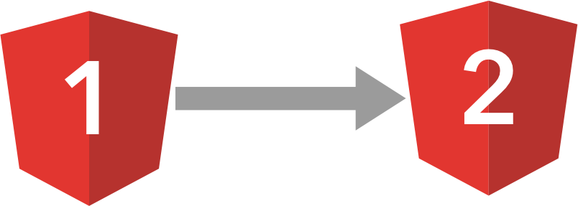
Upgrading from
1.x to 2.0

Slide 217
Introduction to Upgrading
Angular 1 applications can be incrementally upgraded to Angular 2
Angular 2 comes with built-in tools for migrating Angular 1 projects
May require two steps based on the state/age of your application: Refactor Angular 1 to Angular 2 style, upgrade from 1 to 2
Angular 2’s upgrade module is designed to make incremental upgrading seamless
Runs both frameworks side by side so you can port components over one by one

Slide 218
Project Preparation
Use the most recent version of Angular 1.5
Highly suggested to have a robust test suite
Follow the Angular 1 Style Guide
One component per file
The Folders-by-Feature Structure
Use a Module Loader and ES Modules to help manage many small source files
Switch from Bower to NPM

Slide 219
Switch to TypeScript
All of your code will “just work” to start, or you might find some hidden bugs that have been there the whole time
Change your file extensions to *.ts and start adding new language features if desired
Add typings type definitions
Services and controllers can be converted to classes
Use Component Directives
Remove lower-level features like ng-controller, ng-include, and scope inheritance
Element directives with a template and a controller bound to an isolate scope
Can use the component API from Angular 1.5 to make this easier

Slide 220
Upgrade Adapter
Available from @angular/upgrade
The UpgradeAdapter runs both versions of Angular at the same time and manages interactions between them
Start with the simplest services (fewest dependencies) then work through services, components, etc., and finishing with the application bootstrap
Will have to register new Angular 2 components with the Upgrade adapter as you go along
Many different transform tools available to upgrade Angular 1 code to be used by Angular 2 code or downgrading Angular 2 code to be used by Angular 1

Slide 221
EXERCISE
Upgrading (Optional)

Slide 222

Deployment

Slide 223
Deployment Good Practices
Convert your source files to JavaScript
Bundling
Smaller number of larger files
HTTP 1.1 has a small concurrent request limit
Reduces number of server requests
Small Files and HTTP/2
Protocol improvements to reduce overhead and perform parallel requests
Larger number of smaller files loaded in parallel
Only supported in browsers over HTTPS

Slide 224
Minification
Removes unnecessary characters
Uglification
Can shorten variable names and remove orphaned code
Tree Shaking with ES Modules
Removes unused code imports from your bundles
Compression
Have your server send gzip compressed versions

Slide 225
Angular Production Mode
enableProdMode() disables Angular’s development mode and turns off assertions and other checks within the framework
Imported from @angular/core
Must be called before bootstrap
Usually guarded by an environment variable

Slide 226
EXERCISE
Deployment

Slide 227

Native Applications

Slide 228
Introduction to Native Applications
Allow us to wrap our web applications as an executable for specific platforms
Can take advantage of operating system features, hardware, and other software installed on the platform
Allows for alternative distribution channels (App Store, Google Play, Software Download)
Still use web technologies at their core to allow code base reuse

Slide 229

Apache Cordova
Most popular native wrapper for mobile
Loads your HTML/CSS/JS in a native Web View
Plugins allow you to communicate with native features like accessing the Contacts list or Camera, using just JavaScript
Cordova command-line runs on Node.js
Supports iOS, Android, and some Windows Phone and BB10

Slide 230

Ionic 2
Ionic 2 uses Cordova and provides a UI framework that mimics native UI
Easy to use with Angular 2 because it is built on top of Angular 2
Has a CLI that can bootstrap an Ionic Angular 2 project for you
Easy to configure what style of UI should be presented across iOS, Android, Windows Phone, and Web

Slide 231

React Native
Developed by Facebook for React. Rendering adaptor has been created to use it with Angular 2
Library of UI components that get compiled to native code (Swift, Java)
Allows developers to use the same base JavaScript code on either iOS or Android
Able to abstract away the use of a DOM as the primary rendering model
Shown to be more performant than using a Web View because the device is running native code
Supports iOS and Android

Slide 232

NativeScript
Library of UI components that get compiled to native code (Swift, Java)
Specifically made with Angular 2 and TypeScript in mind
Able to write styles with CSS
Able to access native APIs using JavaScript
Can load plugins from npm, CocoaPods, and Gradle
Supports iOS, Android, and Windows (work in progress)

Slide 233
Progressive Web Apps
A progressive web application is built with mobile flexibility in mind
Your application should gain more features when the device allows
Built entirely on the latest web standards
Web App Manifest
Gives devices information on how to install your web application to the home screen
App Shell
Architecture idea that a portion of your application should load instantly to give your users feedback while the remainder loads

Slide 234
Service Workers
Incredibly powerful execution context that can allow offline loading, push notifications, and more
mobile.angular.io is the Angular Mobile Toolkit which provides guides to using these technologies

Slide 235

Electron
Electron is a framework for creating native applications with JavaScript, HTML, and CSS
Electron Application Runners enable you to create desktop Applications with pure JavaScript and native APIs
Built on top of an embedded Chromium web browser and Node server
Can take advantage of modules for web, Node, and Electron specifically
Supports Windows, OS X, and Linux

Slide 236

Performance

Slide 237

Angular Universal
Allows you to pre-render your initial view on the server
Once the initial view is loaded on the client, the full application is loaded in the background
User interactions are captured during the load process and are replayed once the app is fully initialized
Greatly decreases the time to first view
Can provide a version of your application that is readable by web crawlers

Slide 238
Web Workers
Multi-threading for web applications
Standard has been around, but rarely used, since IE10
Run your JavaScript code in another browser thread
Do not have access to the DOM or rendering in the worker
Angular 2 has been created with simple Web Worker support in mind

Slide 239
Run Code Outside the Angular Zone
Change detection gets triggered for everything that gets done in ngZone
If you are running a heavy process that is impacting rendering performance, you could run it in its own zone
Inject ngZone into your component
ngZone.runOutsideAngular() takes a function to run outside ngZone
ngZone.run() takes a function that gets run inside ngZone

Slide 240
Precompiling
Precompiling your templates at build time significantly reduces your app size
3x faster bootstrap times and 8x faster compilation times
Angular usually does this dynamically at runtime
Can remove the dynamic compiler from your vendor code and just ship the compiled (JavaScript) templates

Slide 241
DEMO
Running code outside Zones
Notes:
Show change detection differences when running code inside and outside the ngZone

Slide 242

Conclusion & Resources

Slide 243
What We've Covered
Understood the Environment Setup of Angular 2 Applications
Basics of Components, Templates, Directives and Services
Understood the role of Pipes
Gained knowledge about Dependency Injection, Component Lifecycle Hooks, and Change Detection
Covered Promises, Observables, and HTTP
Covered Template Based Forms & Validation
Covered Component Styling and Animation
Understood Testing
Began an exploration of Upgrading, Deployment, Native Applications, and Performance Optimizations

Slide 244
Resources
Angular Docs https://angular.io/
Angular Style Guide https://angular.io/styleguide
Ng-Conf Talks https://www.youtube.com/watch?v=J5Bvy4KhIs0&list=PLOETEcp3DkCq788xapkP_OU-78jhTf68j
John Papa articles/blogs https://johnpapa.net/angular-2-first-look/
Angular 2 Cheat Sheet https://angular.io/docs/ts/latest/guide/cheatsheet.html
Pluralsight has two Angular 2 courses
John Papa: https://app.pluralsight.com/library/courses/angular-2-first-look/table-of-contents
Deborah Kurata: https://app.pluralsight.com/library/courses/angular-2-getting-started/table-of-contents

Slide 245
Further Learning with Courses from DEV6
TypeScript
Meteor
Node
MongoDB

Slide 246
Feedback
Please fill out the student survey located at the following link
www.metricsthatmatter.com/toronto01

