Slide 1

Weather App
Presented by
DEVADHARSHINI D 43130085 (SIST-2027-JFS-ST02)
B.E.ECE

Slide 2
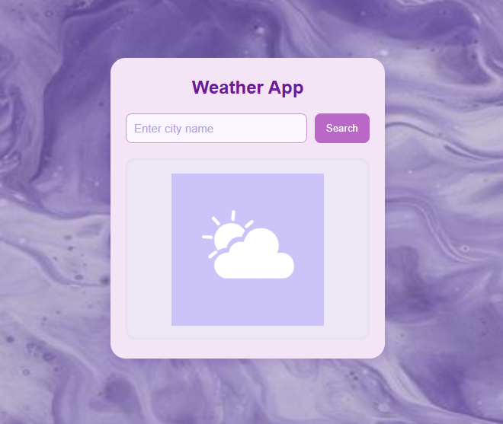
Abstract
The Weather App is a simple web-based application that displays real-time weather information for any city. It uses the OpenWeatherMap API to fetch temperature, humidity, and weather conditions.

Slide 3
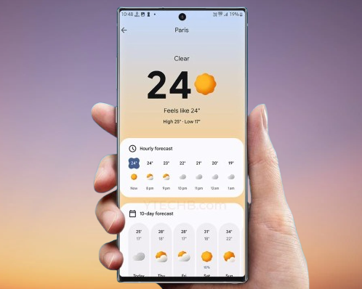
Existing System
In existing systems, users often rely on multiple applications or websites for weather updates. Most of these are either heavy, cluttered, or require user login.

Slide 4
Proposed System
This is an elegant, responsive, and user-friendly weather app
It displays real-time weather data without any login or complex setup.
It focuses on simplicity and visual appeal while using live API integration for accuracy.

Slide 5
Advantages
Provides live and accurate weather data
Easy to use and understand
No installation or login required
Lightweight and responsive with clean pastel-purple theme

Slide 6

Disadvantages
Requires an internet connection to fetch data
Depends on external API (OpenWeatherMap)

Slide 7


Hardware Requirements
Any system with internet access
Browser-supported display (mobile, tablet, desktop)

Slide 8
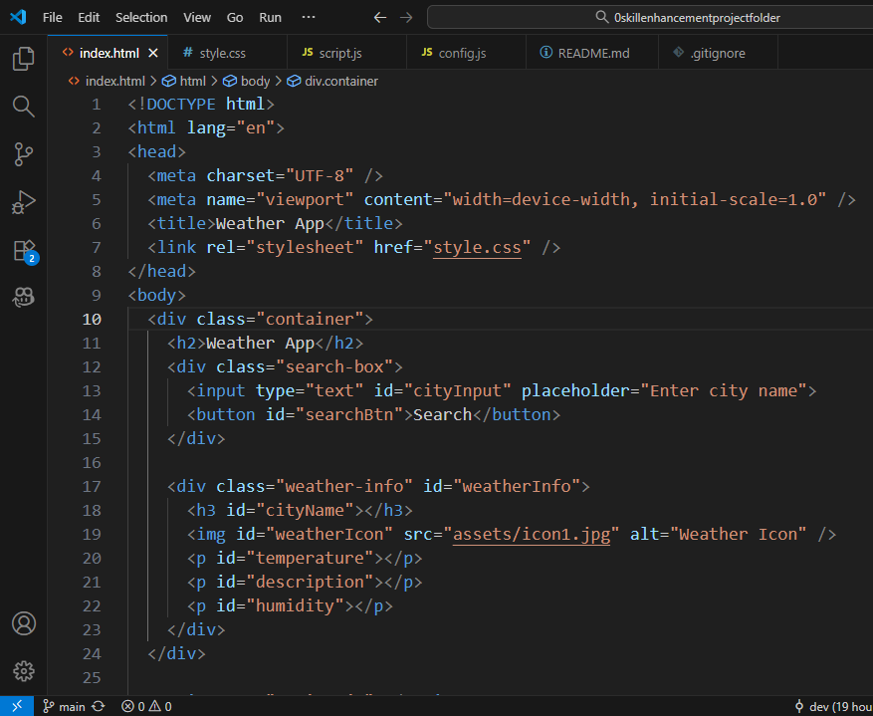
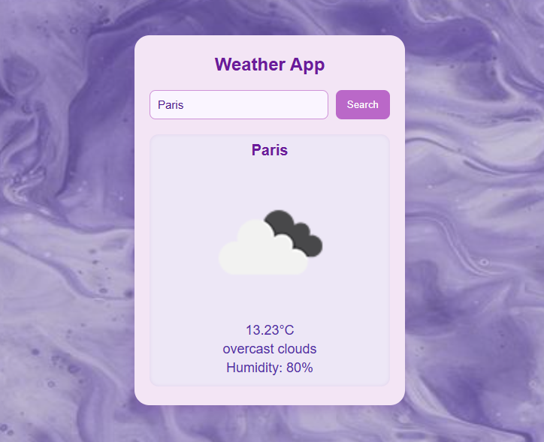
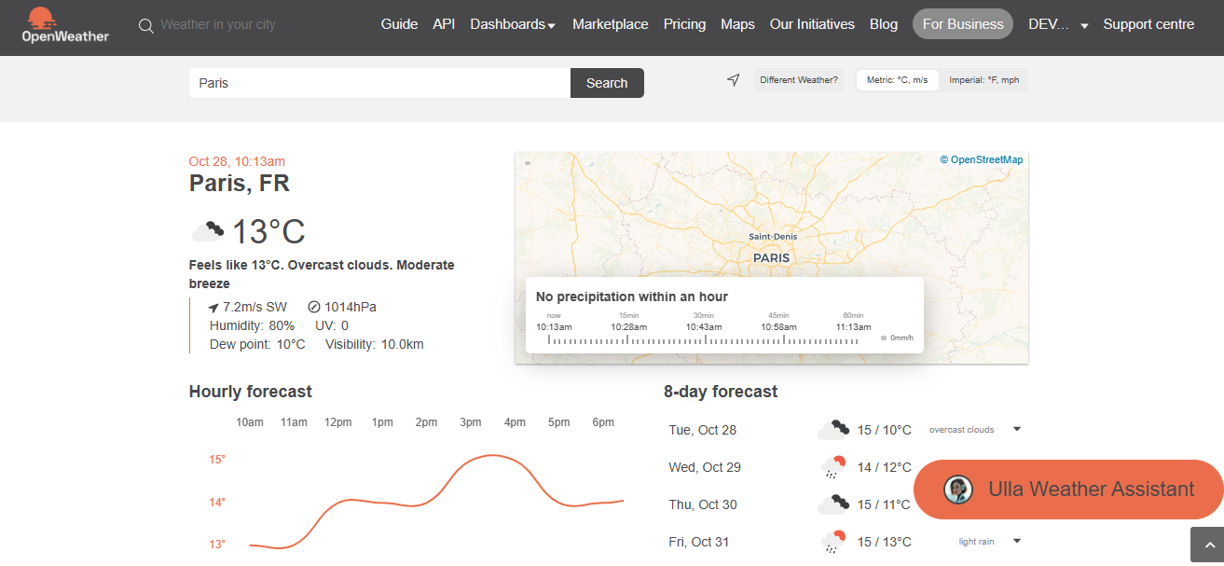
Software Requirements
HTML, CSS, JavaScript
Web Browser (Edge, Chrome, etc.)
OpenWeatherMap API

Slide 9
Module Description
UI Module: Handles layout and styling using HTML & CSS.
API Module: Fetches data from OpenWeatherMap API.
Data Display Module: Updates weather details like temperature, humidity, and icon dynamically.
Error Handling Module: Alerts users if the city is invalid or network fails.

Slide 10

Sample Output
Example
City: Paris
Temperature: 13.23°C
Description: Overcast clouds
Humidity: 80%

Slide 11

Conclusion
The Weather App demonstrates a simple yet powerful integration of frontend technologies with an external API. It highlights essential concepts like data fetching and responsive design.

Slide 12

Thank You

