Slide 1
λ
μ
Performance Engineering Lab · 17M15CS122
Network Protocol
Performance Analyzer
Queuing-theory based simulation of network packet queues using SimPy — validated against theory, with TCP vs UDP analysis.
Team: Abhijeet Kumar (22803029) · Viyom Shukla (22803030) · Devang Dixit (22803031)
Submitted to: Dr. Shikha Jain, Associate Professor, Dept. of CSE · JIIT Sector 62, Noida

Slide 2
Why analyze network queues?
Introduction
As traffic grows, packets wait in buffers and queues before transmission. When the arrival rate approaches link capacity, queues build up — causing higher delay, more packet loss, and lower throughput.
A single-server queue (M/M/1)
arrivals λ
service μ
Our approach Combine queuing theory (M/M/1, M/M/c) with discrete-event simulation (SimPy) to reproduce and validate real network behaviour in a controlled, repeatable way.
server
ρ = λ / (c·μ) Traffic intensity — the fraction of capacity in use. Must stay below 1 for a stable queue.
Delay: packets wait longer in the buffer
Packet loss: full buffers drop arrivals
Throughput: useful data rate falls

Slide 3
Objectives
What the project sets out to do
1
2
3
Understand the importance of queuing analysis in computer networks.
Implement & simulate single-server (M/M/1) and multi-server (M/M/c) models.
Validate simulation against theory — Little's Law and Erlang-C.
4
5
6
Evaluate throughput, average delay and packet loss.
Compare TCP vs UDP behaviour under varying traffic loads.
Identify the queue configuration that performs best for a given load.

Slide 4
How it works — the analysis pipeline
Workflow
1
Traffic
Generation
2
Queue
Modelling
3
Packet
Processing
Poisson arrivals at rate λ
M/M/1, M/M/c, M/M/c/K
Exp. service; drop if full
4
Data
Collection
5
Performance
Evaluation
6
Protocol Compare
& Visualization
Per-packet statistics
Metrics vs theory
TCP vs UDP · graphs

Slide 5
Modular implementation
Each module = one stage of the pipeline
traffic_generator.py
Poisson arrivals & exponential service times
Three ways to run it
queue_models.py
SimPy engine for M/M/1, M/M/c, M/M/c/K
Interactive web app
theoretical.py
Closed-form formulas — Little's Law, Erlang-C
streamlit run app.py — live sliders & graphs
metrics.py
Throughput, delay, loss, utilisation + validation
Menu-driven CLI
python main.py --demo
protocol_comparison.py
TCP vs UDP behaviour under load
Google Colab notebook
visualization.py
Matplotlib graphs & reports
one click, self-contained, runs anywhere

Slide 6
Queuing models
Three models, from simple to realistic
M/M/1
M/M/c
M/M/c/K
Single server
infinite buffer
c parallel servers
infinite buffer
c servers, finite
buffer of size K
Baseline: one link,
no packet loss
Effect of adding
capacity (Erlang-C)
Buffer overflow →
packet loss
Validated with queuing theory: Little's Law (L = λ·W) couples number-in-system to delay; Erlang-C gives the probability an arrival must wait. Simulation reproduces both to within ~1–2%.

Slide 7
Performance metrics measured
The four numbers that describe the network
→
W
×
ρ
Throughput
Average Delay
Packet Loss
Utilisation
Packets successfully
served per second
Time in system:
waiting + service
Fraction of arrivals
dropped (buffer full)
Fraction of time the
server(s) stay busy
pkts / s
W = Wq + 1/μ
P(block)
ρ = λ/(c·μ)
Every scenario prints a Simulation-vs-Theory table so the two can be cross-checked.

Slide 8
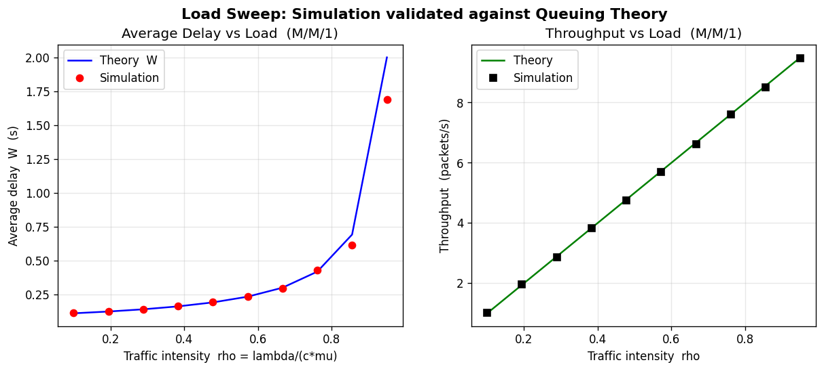
Result: simulation validated against theory
M/M/1 load sweep
Markers sit on the curve. Simulation (dots) matches theory (line) — errors < 2%.
Delay explodes as ρ → 1. The classic queuing 'knee' — throughput tracks load until saturation.

Slide 9
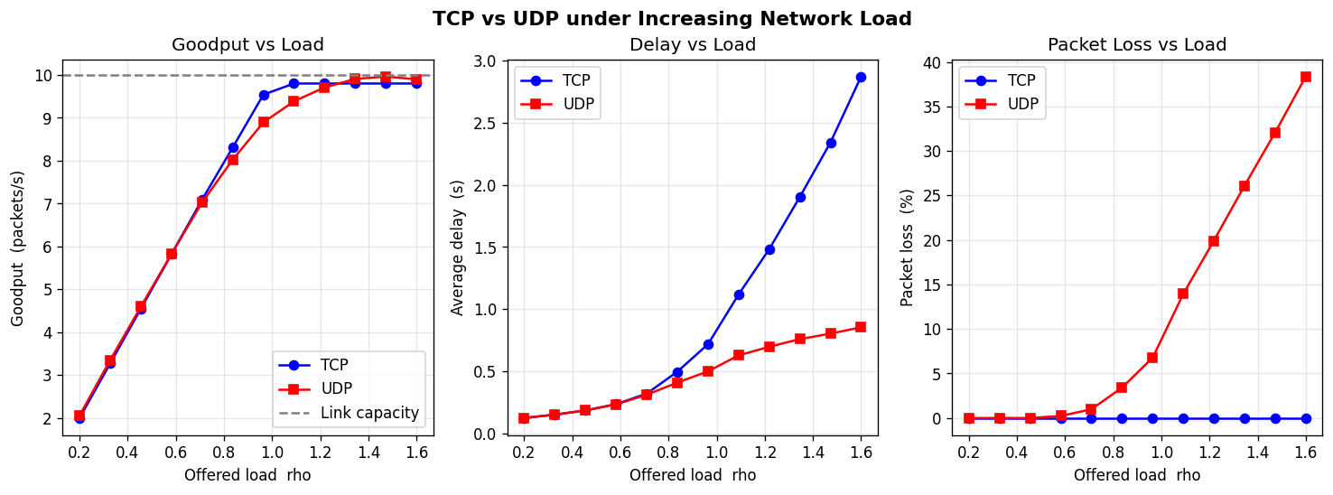
Result: TCP vs UDP under increasing load
The reliability-vs-latency trade-off
UDP — best-effort Loses up to ~38% of packets under overload, but keeps delay low.
TCP — reliable Retransmits → ≈0% loss and goodput capped at capacity, but delay grows sharply.

Slide 10
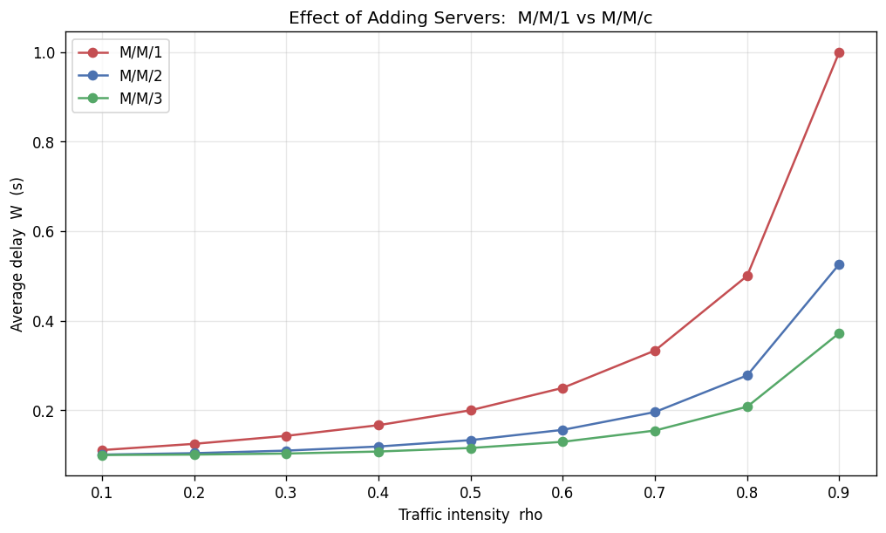
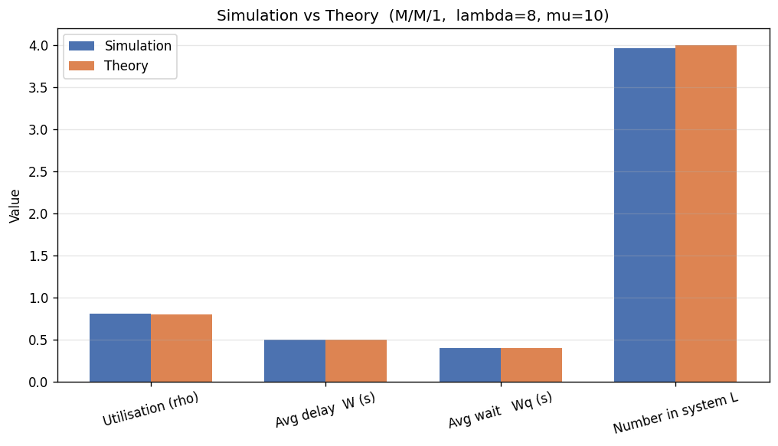
Result: more servers, lower delay
M/M/1 vs M/M/c · simulation vs theory
Adding servers keeps delay far lower at the same per-server load.
Simulated and theoretical metrics agree bar-for-bar.
Takeaway: the best configuration for a given load is the one that keeps ρ comfortably below 1 — often by adding a server rather than a faster one.

Slide 11
Tools & libraries
Built entirely in the Python scientific stack
Python 3 core language
SimPy discrete-event sim
NumPy numerical arrays
SciPy queuing formulas
P
S
N
S
Matplotlib graphs & charts
Pandas tabulate results
Streamlit interactive web app
VS Code development
M
P
S
V
Deployed & shareable: source on GitHub · one-click Google Colab notebook · live web app on Streamlit Community Cloud.

Slide 12
Expected outcomes
What this project delivers
A working simulation of M/M/1 and M/M/c queues validated against theory.
✓
Comparative analysis of throughput, delay and loss under varying loads.
✓
A clear comparison of TCP vs UDP behaviour under congestion.
✓
Identification of the best queue configuration for a given load.
✓
Visualisation of results through graphs and comparison charts.
✓
Deeper understanding of network optimisation via queuing analysis.
✓

Slide 13
Conclusion
Queuing theory + discrete-event simulation gives an intuitive, validated view of network performance.
1
Validated
2
Scalable
3
Insightful
Simulation reproduces queuing theory to within ~1–2%.
Adding servers (M/M/c) sharply reduces delay at the same load.
TCP trades higher delay for ≈0 loss; UDP keeps low delay but loses data under overload.
Key references
• Kleinrock, Queueing Systems, Vol. 1: Theory · Wiley • Raj Jain, The Art of Computer Systems Performance Analysis · Wiley • Kurose & Ross, Computer Networking: A Top-Down Approach · Pearson
Explore the project
Live web app network-performance-analyzer .streamlit.app GitHub: DEVANGDIXIT04/network-performance-analyzer · + Google Colab
Abhijeet Kumar (22803029) · Viyom Shukla (22803030) · Devang Dixit (22803031) | JIIT Sector 62 · Performance Engineering Lab

