Slide 1


TRACK - UAV
Fault Detection and Preventive Maintenance of Drones
EQUIPE – 14
ABOU JAOUDE Alexis
RAMAMOORTHY Devaraj
PRABAKARAN Rubesh
BEREZIUC Denis
GUERANDEL Louis

Slide 2
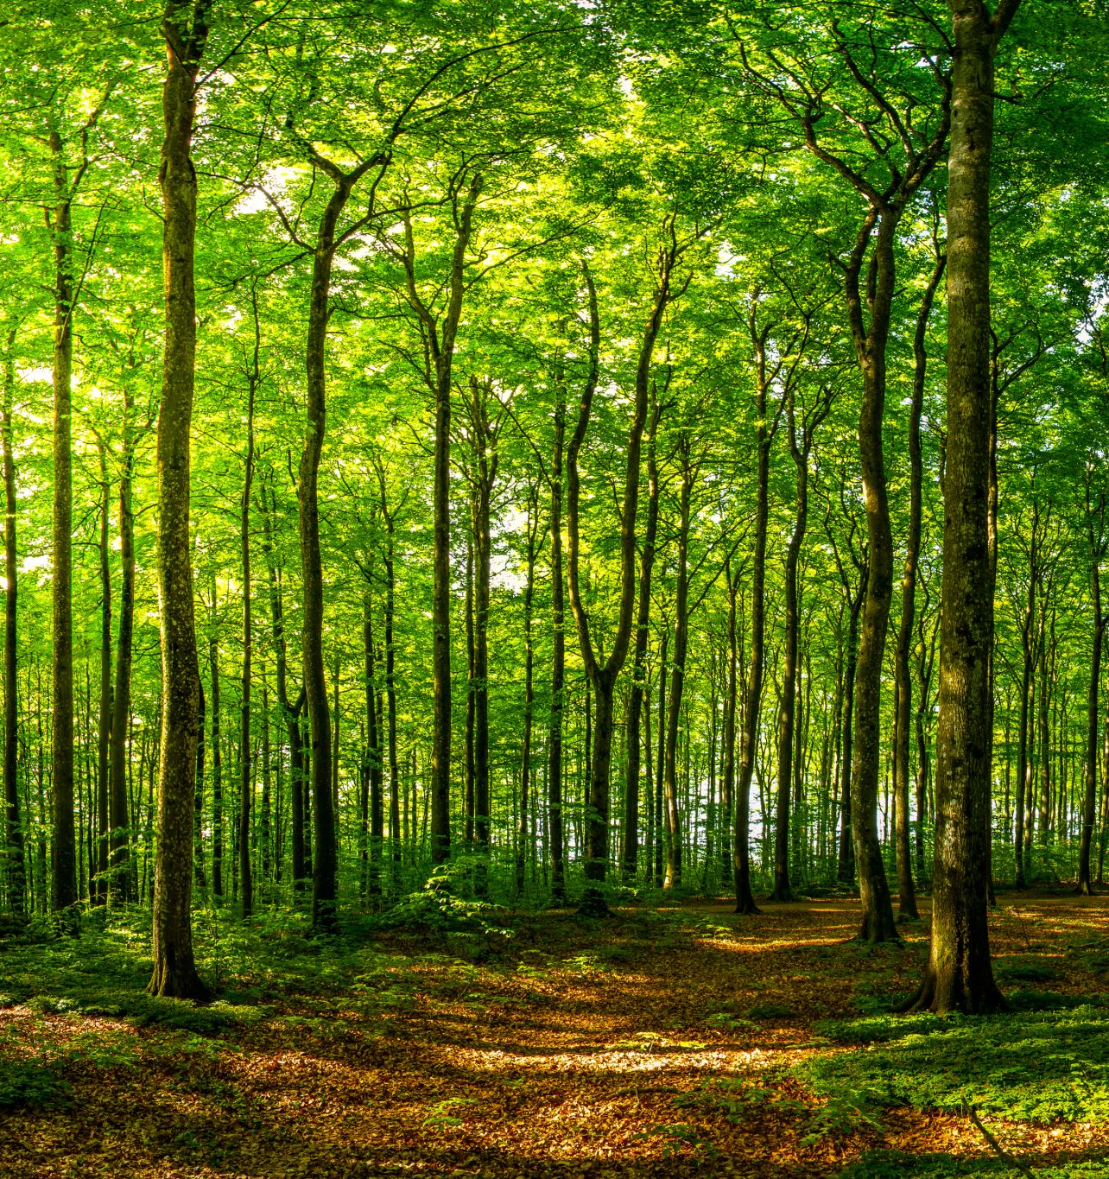
AGENDA
Introduction
Objective
Dataset Summary
Data Pre-processing
Feature Engineering
Model Prediction Report –
Random Forest Classifier

Slide 3
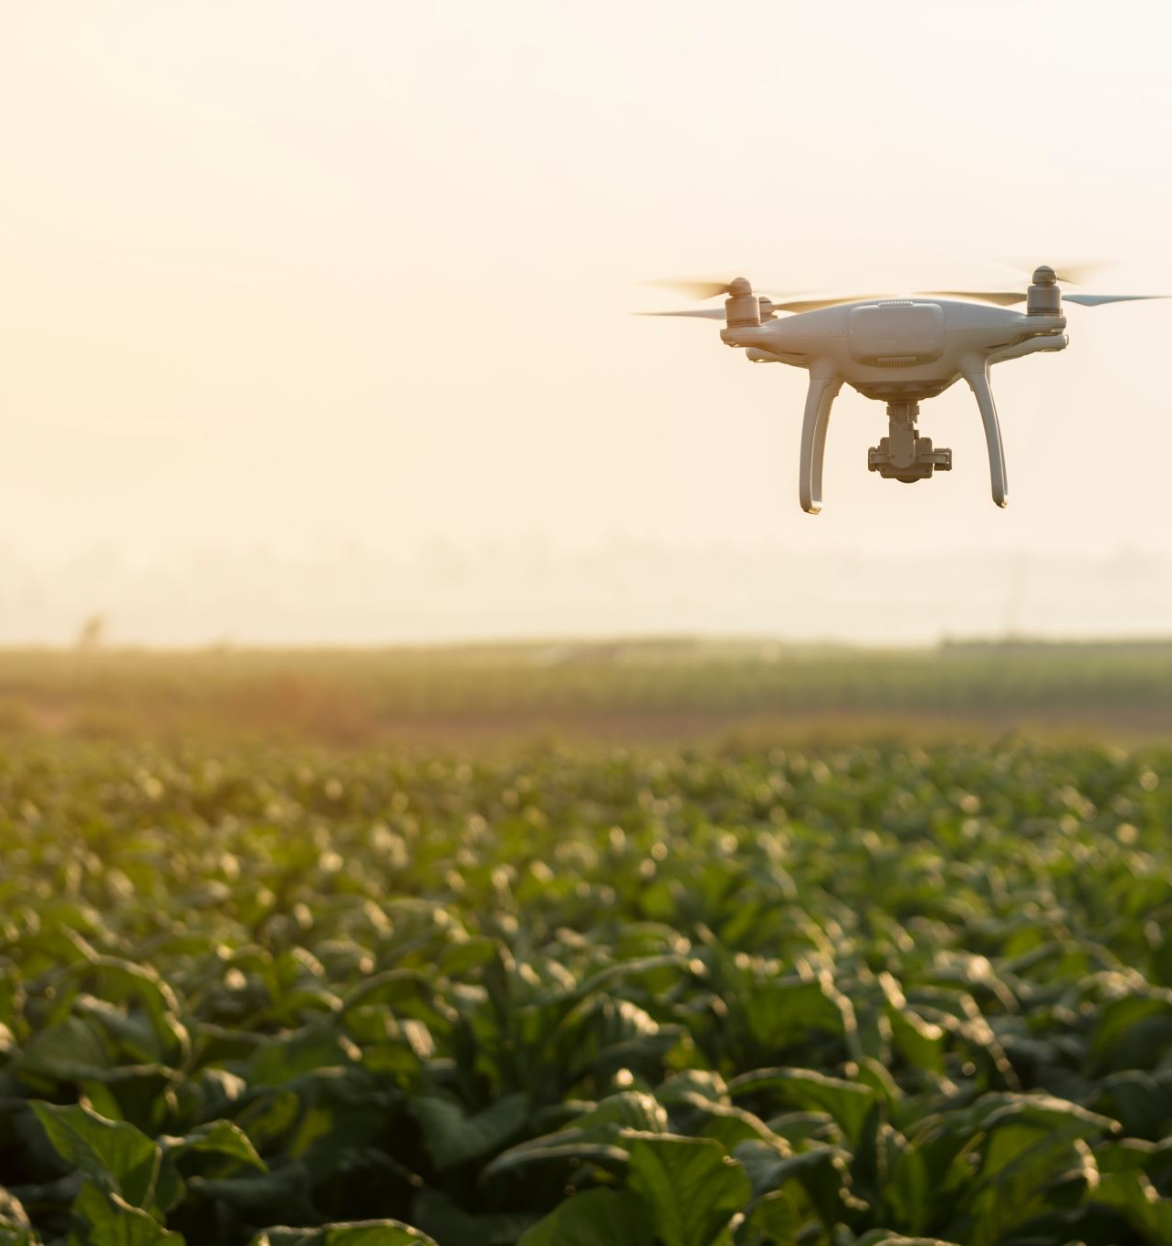
INTRODUCTION
📦 Drones are used in logistics, surveillance, inspection, and rescue.
⚠️ Growing usage raises concerns about reliability and safety.
💥 Failures can cause equipment loss, service disruption, or harm.
🛠️ Preventive maintenance is key to avoiding breakdowns.
🔍 Early fault detection helps intervene before incidents occur

Slide 4
OBJECTIVE
🔍 Fault Detection: Check if drone is functioning normally or has faults
🧩 Fault Origin: Pinpoint faulty subsystem (e.g., motor, propeller)
🚨 Severity Assessment: Rate fault criticality to guide maintenance priority

Slide 5
DATASET SUMMARY
📁 Format: MATLAB files, Python-compatible via scipy.io.loadmat
🔗 Source: DronePropA – Motion Trajectories Dataset (Defective Propellers)
📦 Volume: 130 files across 4 fault categories (partial use sufficient)
🧪 Data Quality: Real operational drone data (healthy + 4 fault types)
🛠️ Setup: Indoor tests with sensor data from drone & controller
🏷️ File Naming: Indicates drone state (e.g., F0 = no fault, t2 = trajectory 2)

Slide 6

DATA PRE – PROCESSING
Loaded and merged MATLAB .mat files (commander_data, qdrone_data, stabilizer_data)
Aligned all sensor data using the Time index
Cleaned missing or noisy values using interpolation and smoothing filters
Encoded health status → 0: Healthy, 1: Faulty
Normalized numerical features using StandardScaler and MinMaxScaler

Slide 7
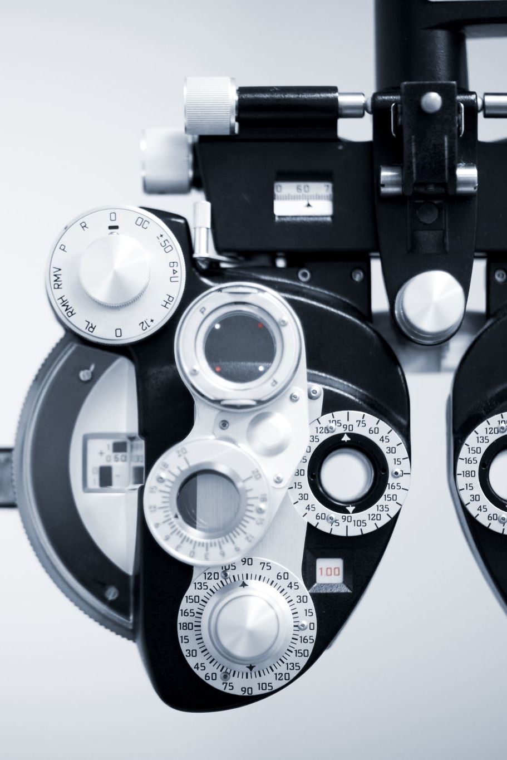
FEATURE ENGINEERING
Positional & Yaw Errors → deviation from reference trajectory
Speed & Acceleration Magnitudes → motion stability indicators
Motor Asymmetry Index → imbalance between motor outputs
Thrust Smoothness → control signal stability measure
Angular Velocity & Acceleration → dynamic response of the drone

Slide 8
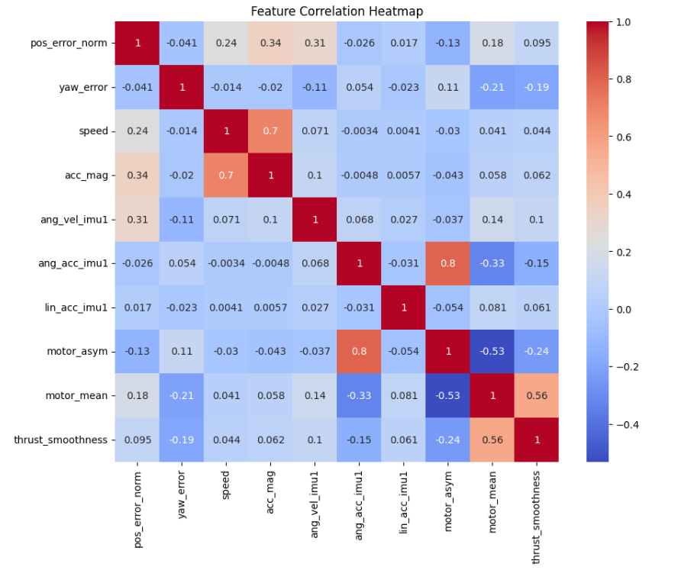
FEATURE CORRELATION

Slide 9
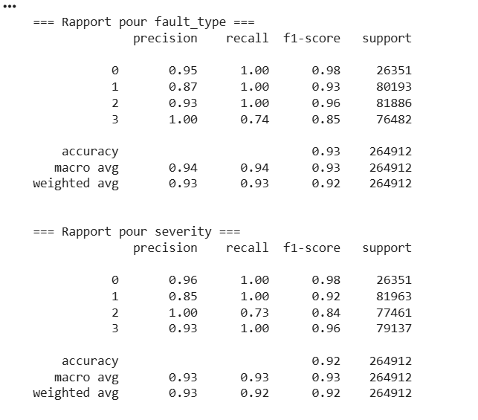
MODEL PREDICTION REPORT –
RANDOM FOREST CLASSIFIER

Slide 10
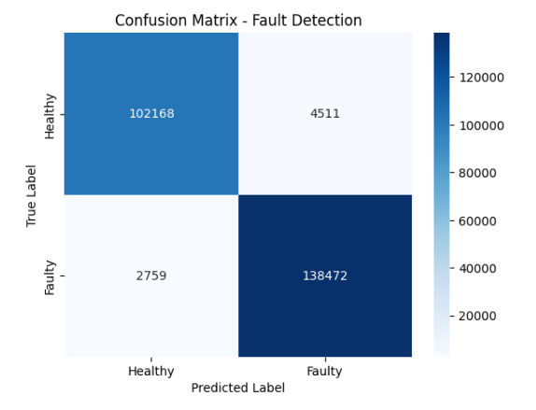
CONFUSION MATRIX

Slide 11

THANK YOU

