Slide 1
IFRAME,TABLE, MARQUEE

Slide 2
IFRAMES
An HTML iframe is used to display a web page within a web page.
The HTML <iframe> tag specifies an inline frame.
An inline frame is used to embed another document within the current HTML document
Syntax
<iframe src="url" title="description"></iframe>

Slide 3
Set Width and Height of iframe
To set the width and height of iframe by using "width" and "height" attributes.
By default, the attributes values are specified in pixels but you can also set them in percent. i.e. 50%, 60% etc.
Eg: <iframe src="https://www.facebook.com/" style="height:300px;width:400px"></iframe>

Slide 4
Embed YouTube video using iframe
Goto YouTube video which you want to embed.
Click on SHARE ➦ under the video.
Click on Embed <> option.
Copy HTML code.
Paste the code in your HTML file
Change height, width, and other properties (as per requirement).

Slide 5
Embed Google map in HTML
Open Google Maps.
Search your location.
Click Share Icon
Click Embed map.
Copy the text in the box. Paste it into the HTML of your website or blog.

Slide 6
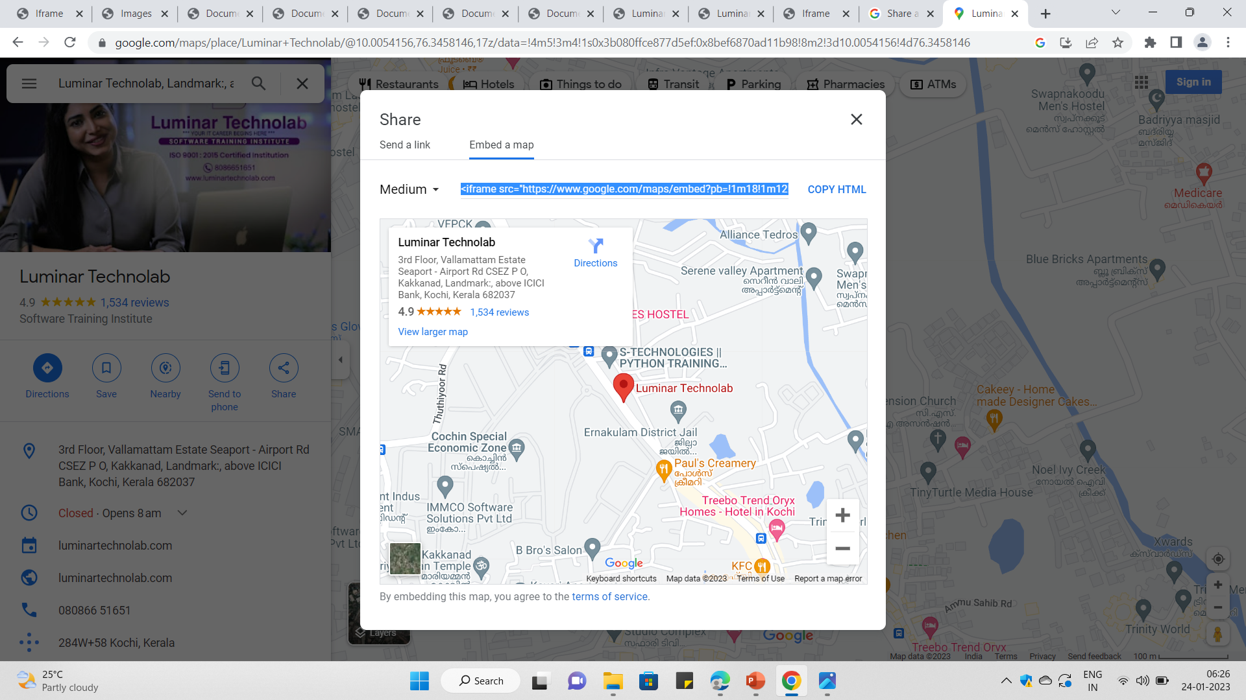











Slide 7
Iframes Tag Attribute
Src: This attribute is used to insert a file that needs to be included in the frame. URL specifies the target webpage to be loaded within an iframe.
Name: Name is an attribute used to give some identification name to the frame. It’s most useful where you are creating one link to open another webpage.
allowfullscreen: This attribute allows you to display your frame in the full-width format. So we have to set the value true to happen this function.
Frameborder: This is a helpful attribute that allows you to show a border or not to show the border to the frame. Value 1 is to show border & 0 not to show border to the frame.

Slide 8
Iframes Tag Attribute
Marginwidth: Allows you to define space between the left & right sides of the frame
Marginheight: This allows you to define space between the top & bottom of the frame.
Scrolling: These attributes control whether the scrollbar will show or not to the frame. The values included are ‘yes’, ‘ no,’ or ‘auto.’
Height: It is used to define the height of the frame. Whether in % or pixels
Width: It is used to define the width of the frame. Wether in % or pixels
Longdesc: With the help of this attribute, you can link another page with a lengthy description of the contents of your frame.

Slide 9
TABLE
The table is one of the most useful constructs.
Tables are all over the web application.
The main use of the table is that they are used to structure the pieces of information and structure the information on the web page.
An HTML table is a table-based page layout.
.

Slide 10
Table tags
The <table> tag is used to create a table.
In HTML, a table is considered as a group of rows containing each group of cells.
There can be many columns in a row.
HTML tables should be used for tabular data only, but they are also used for creating layout web pages.
If we build HTML tables without any styles or attributes in the browser, they will be displayed without any border.
Table tag : <TABLE> </TABLE>
The content which we write between these tags will be displayed within the table.

Slide 11
1. <thead> Tag
The <thead> defines a set of rows defining the head of the columns of the table.
Syntax:
<thead></thead>

Slide 12
2. <tbody> Tag
The <tbody> tag is used to group the body content in the HTML table.
Tables can contain more than one body; in some tables, in the other case, the table can contain only one body; in those cases, the <tbody> can be removed.
Tables with one body will have an implicit body.
Syntax: <tbody> </tbody>

Slide 13
3. <tfoot> Tag
The <tfoot> tag contains rows that represent a footer or summary.
Syntax:
<tfoot> </tfoot>

Slide 14
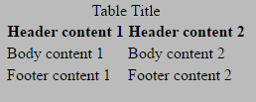
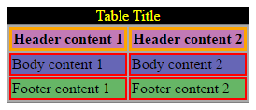

Slide 15
4. <tr> Tag
The <tr> tag is used to define a row in the HTML table.
Starts the row with the beginning by <TR> row tag and then build the row by creating each cell, and when finish all the cells for a row, then close the row with the ending row tag </TR>.
Row tag : <TR> </TR>

Slide 16
6. <th> Tag
The <th> tag is used to define the header cell in an HTML table.
The header cell in the table is used to provide information for the remaining cells of the column.
Header tag : <TH> </TH>

Slide 17
5. <td> Tag
The <td> tag is used to define the data for the cell in the HTML table.
We will create each cell with the beginning cell tag <TD> and then add the content or data to the cell and then close the cell with the ending cell tag </TD>.
Cell tag : <TD> </TD>

Slide 18
7. <bgcolor> Tag
The <bgcolor> tag is used to specify the background color of the table.
Syntax: <table bgcolor = "color_name">
For the color name, we can directly provide the color name for the background.
For example <table bgcolor =”Red”>

Slide 19
8. <caption> Tag
The <caption> tag is used to provide the caption to the table.
It is placed or used immediately after the <table> tag.
By default, the table caption will be center-aligned above the table.
Caption tag : <caption> </caption>

Slide 20
9. Cell Spanning
Spanning is nothing but combining two or more adjacent cells in the table.
It consists of col span and row span.
Col span: The col span attribute specifies the number of columns a table cell should span.
<td col span = “number”>
It always takes an integer value.
Row span: The row span attribute specifies the number of rows a table cell should span.
<td row span = “number”>
It always takes an integer value.

Slide 21
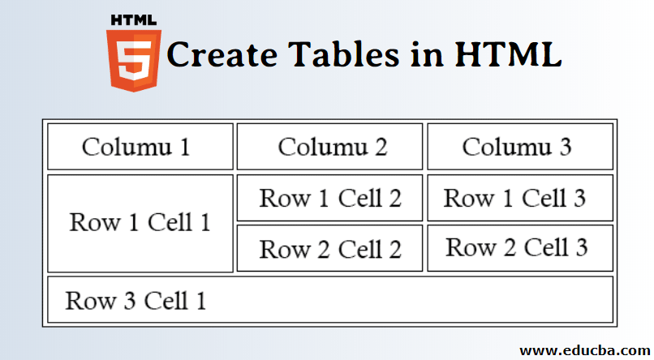

Slide 22
MARQUEE
An HTML marquee is a scrolling piece of text displayed either horizontally across or vertically down your webpage depending on the settings. This is created by using HTML <marquees> tag.
<marquee attribute_name = "attribute_value"....more attributes> One or more lines or text message or image
</marquee>

Slide 23
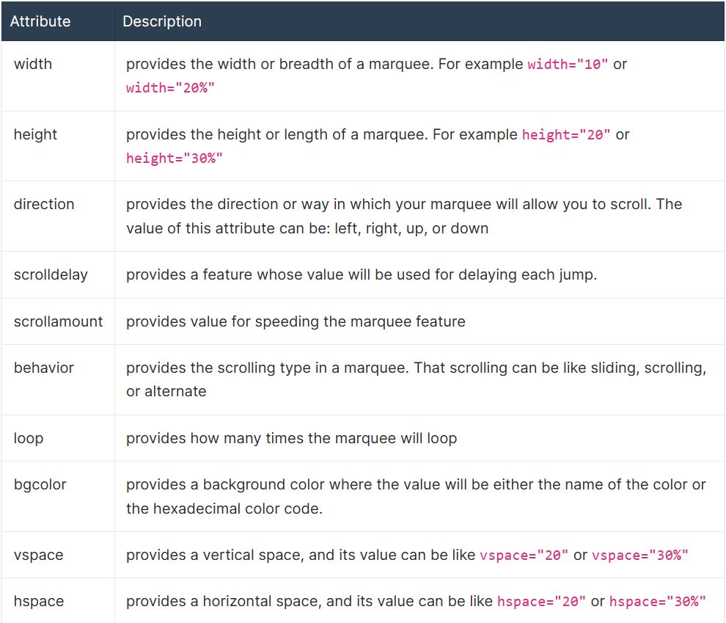

Slide 24
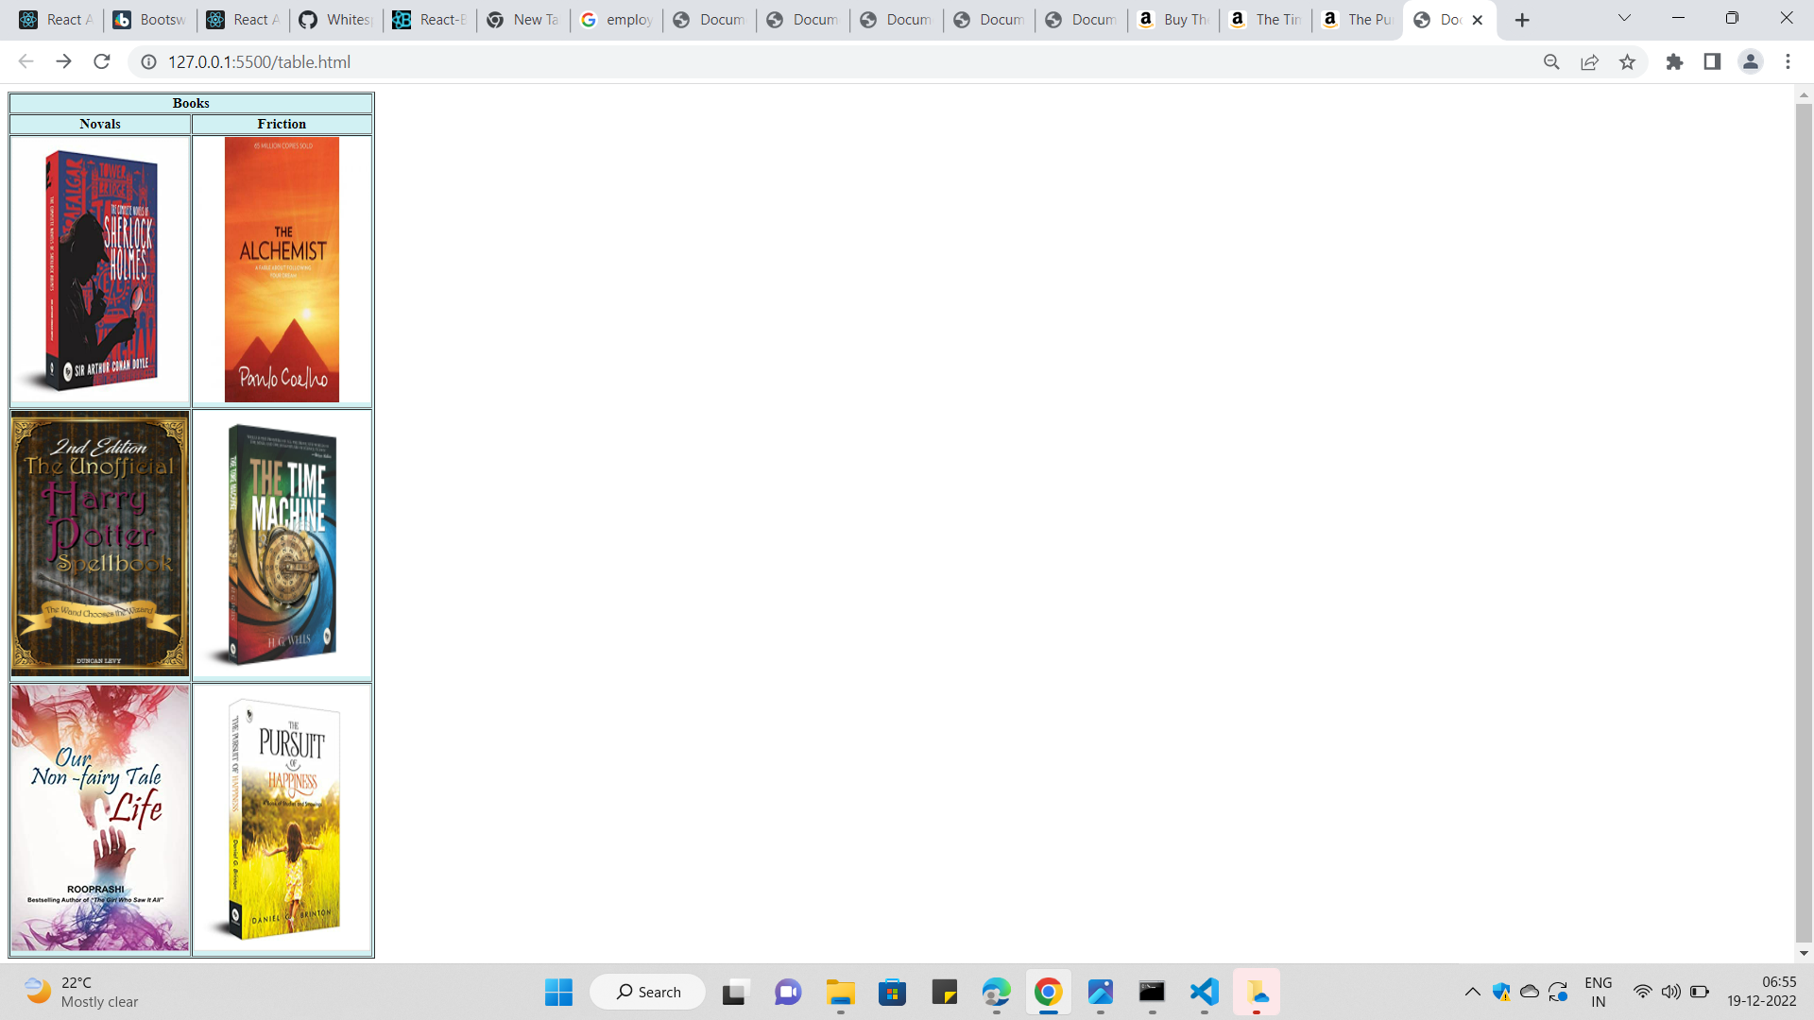
TASK 1

Slide 25
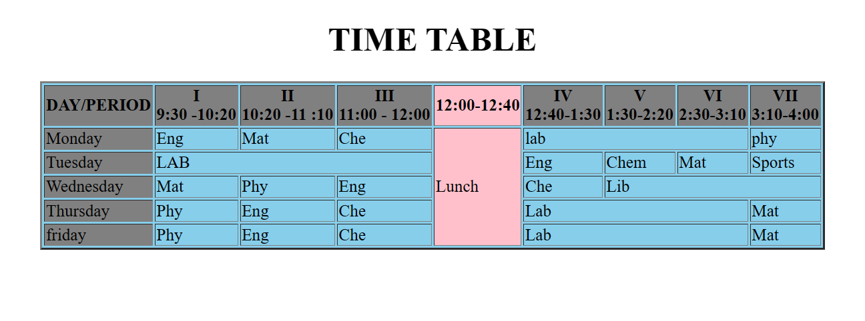
TASK 2

