Slide 1
Acme Corporation Quarterly Report

Slide 2
Agenda
Company Overview
Q1 Financial Results
Key Achievements
Challenges and Opportunities
Goals for Q2

Slide 3
Company Overview

Slide 4
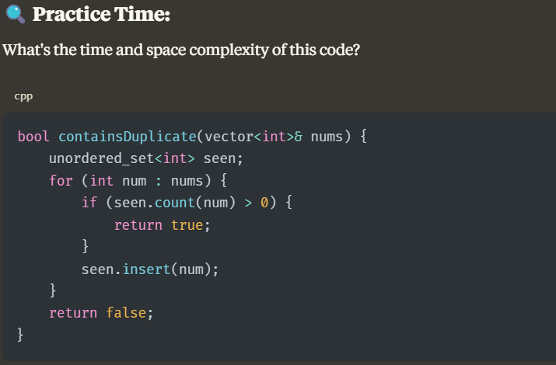
About Acme Corporation
Founded in 2010
Headquarters in Silicon Valley
500+ employees worldwide
Industry leader in innovation

Slide 5
Q1 Financial Results

Slide 6
Q1 Financial Highlights

Slide 7
Detailed Financial Breakdown
Category | Q1 2024 | Q1 2025 | Change
Revenue | $4.2M | $5.5M | +30.9%
Expenses | $3.1M | $3.4M | +9.7%
Profit | $1.1M | $2.1M | +90.9%
Margin | 26.2% | 38.2% | +12.0%

Slide 8
Key Achievements

Slide 9
Q1 2025 Key Achievements
New Product Launch
Acme Pro XL
Global Expansion
Opened 3 New Offices
Customer Growth
+25% New Customers

Slide 10
Challenges and Opportunities

Slide 11
Looking Forward
{'type': 'text_box', 'text': 'Challenges', 'font': 'Montserrat', 'size': 24, 'color': '[0, 112, 192]', 'bold': True}
{'type': 'text_box', 'text': '• Supply chain disruptions\n• Increasing competition\n• Talent acquisition\n• Regulatory changes', 'font': 'Roboto', 'size': 18}
{'type': 'text_box', 'text': 'Opportunities', 'font': 'Montserrat', 'size': 24, 'color': '[255, 192, 0]', 'bold': True}
{'type': 'text_box', 'text': '• Emerging markets\n• Strategic partnerships\n• Product innovation\n• Digital transformation', 'font': 'Roboto', 'size': 18}

Slide 12
Goals for Q2

Slide 13
Technology Roadmap
// Q2 Development Roadmap function implementQ2Features() { const features = [ "AI-powered analytics", "Mobile app redesign", "Cloud infrastructure migration", "API performance optimization" ]; const timeline = { April: ["Planning", "Resource allocation"], May: ["Development sprints", "Alpha testing"], June: ["Beta release", "Customer feedback"] }; return { features, timeline }; }

Slide 14
Thank You!
Contact: John Smith | john.smith@acme.com

