Slide 1


A
Presentation
On
“Ju-mess”
SUBMITTED TO:
Mr. Ravi Shankar Sharma
SUBMITTED BY:
Dexter
Shubham Dhanuka

Slide 2
User App

Slide 3
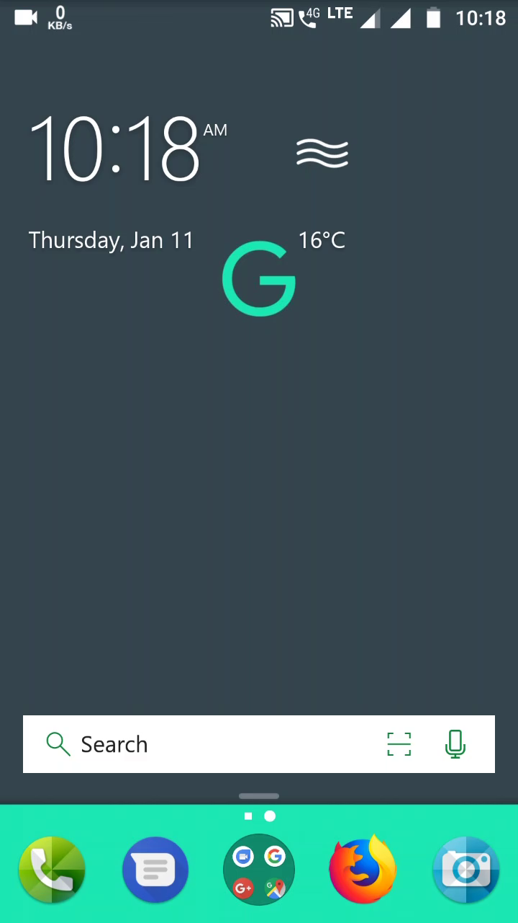

Slide 4
Management App

Slide 5
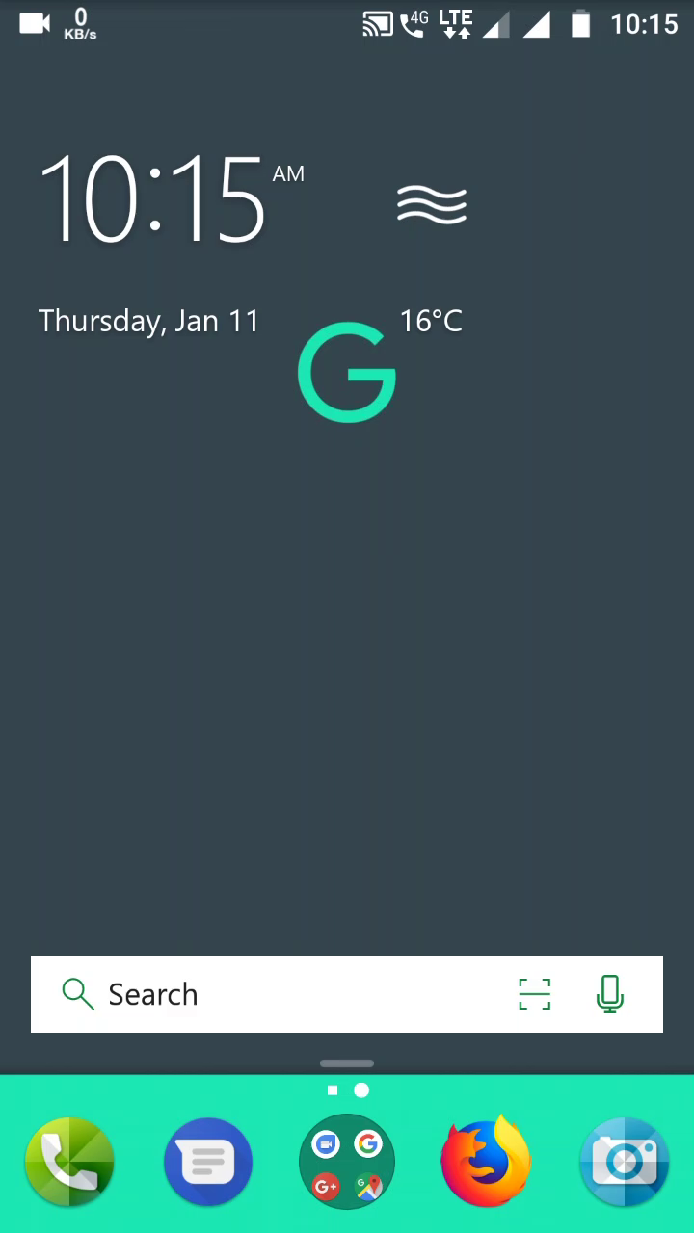

Slide 6

Problem Statement
Workflow of mess
People are not informed about the current dishes in the meal
No information is given to mess staff about total no of meal holders.
Lot of food is wasted.
Difficulty in identifying no of meal eaters.

Slide 7
Solution
App is designed to lubricate the work flow of mess.
The app is designed to list food menu 2 hours before meal time.
It provides convenience of information.
It is mainly purposed to provide dish feedback on a single platform
It helps mess team to let them know how many students are interested to come or go outside.

Slide 8
Objective of the project
Reducing the efforts of both student and faculty at JU Mess.
To ensure good quality food
To improve taste and hygiene of food.

Slide 9
Users of the project
Students
Teachers
Mess Staff
Parents
Mess Management

Slide 10
Main components
Feedback
Dishes
Schedule
Overall Rating
Updates
Today’s Meal

Slide 11
Tools and Technologies
Java
Android Studio
XML
Firebase

Slide 12
Key Learning
I had read and gathered relevant information from following websites:
Help.firebase.com
Help.androidstudio.com
From Youtube Tutorials
From Udacity tutorials

