Slide 1
Data Analytics Project
Desai Devkumar Chetanbhai

Slide 2
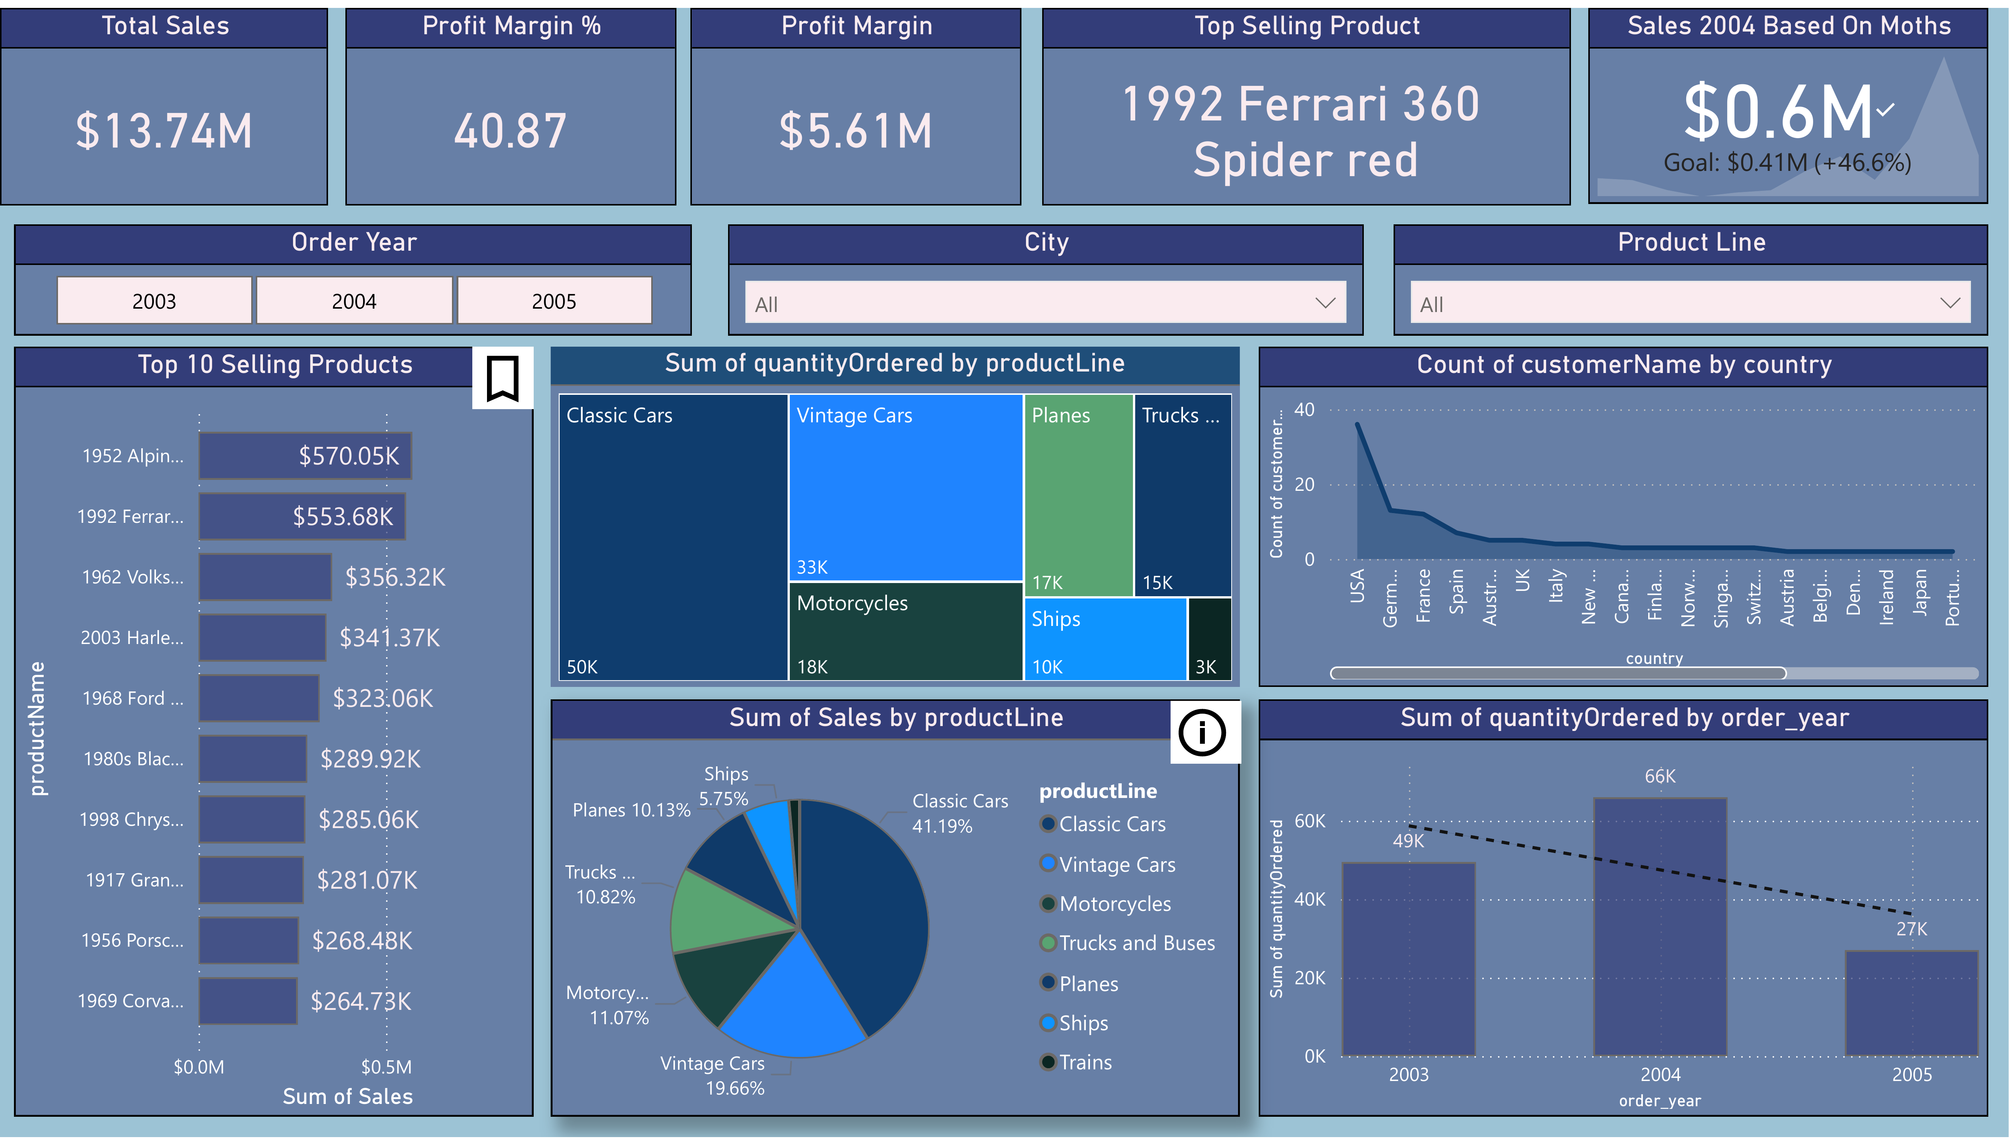
Dashboard View 1
This slide represents one of the pages from the Data Analytics Dashboard created in Power BI.

Slide 3
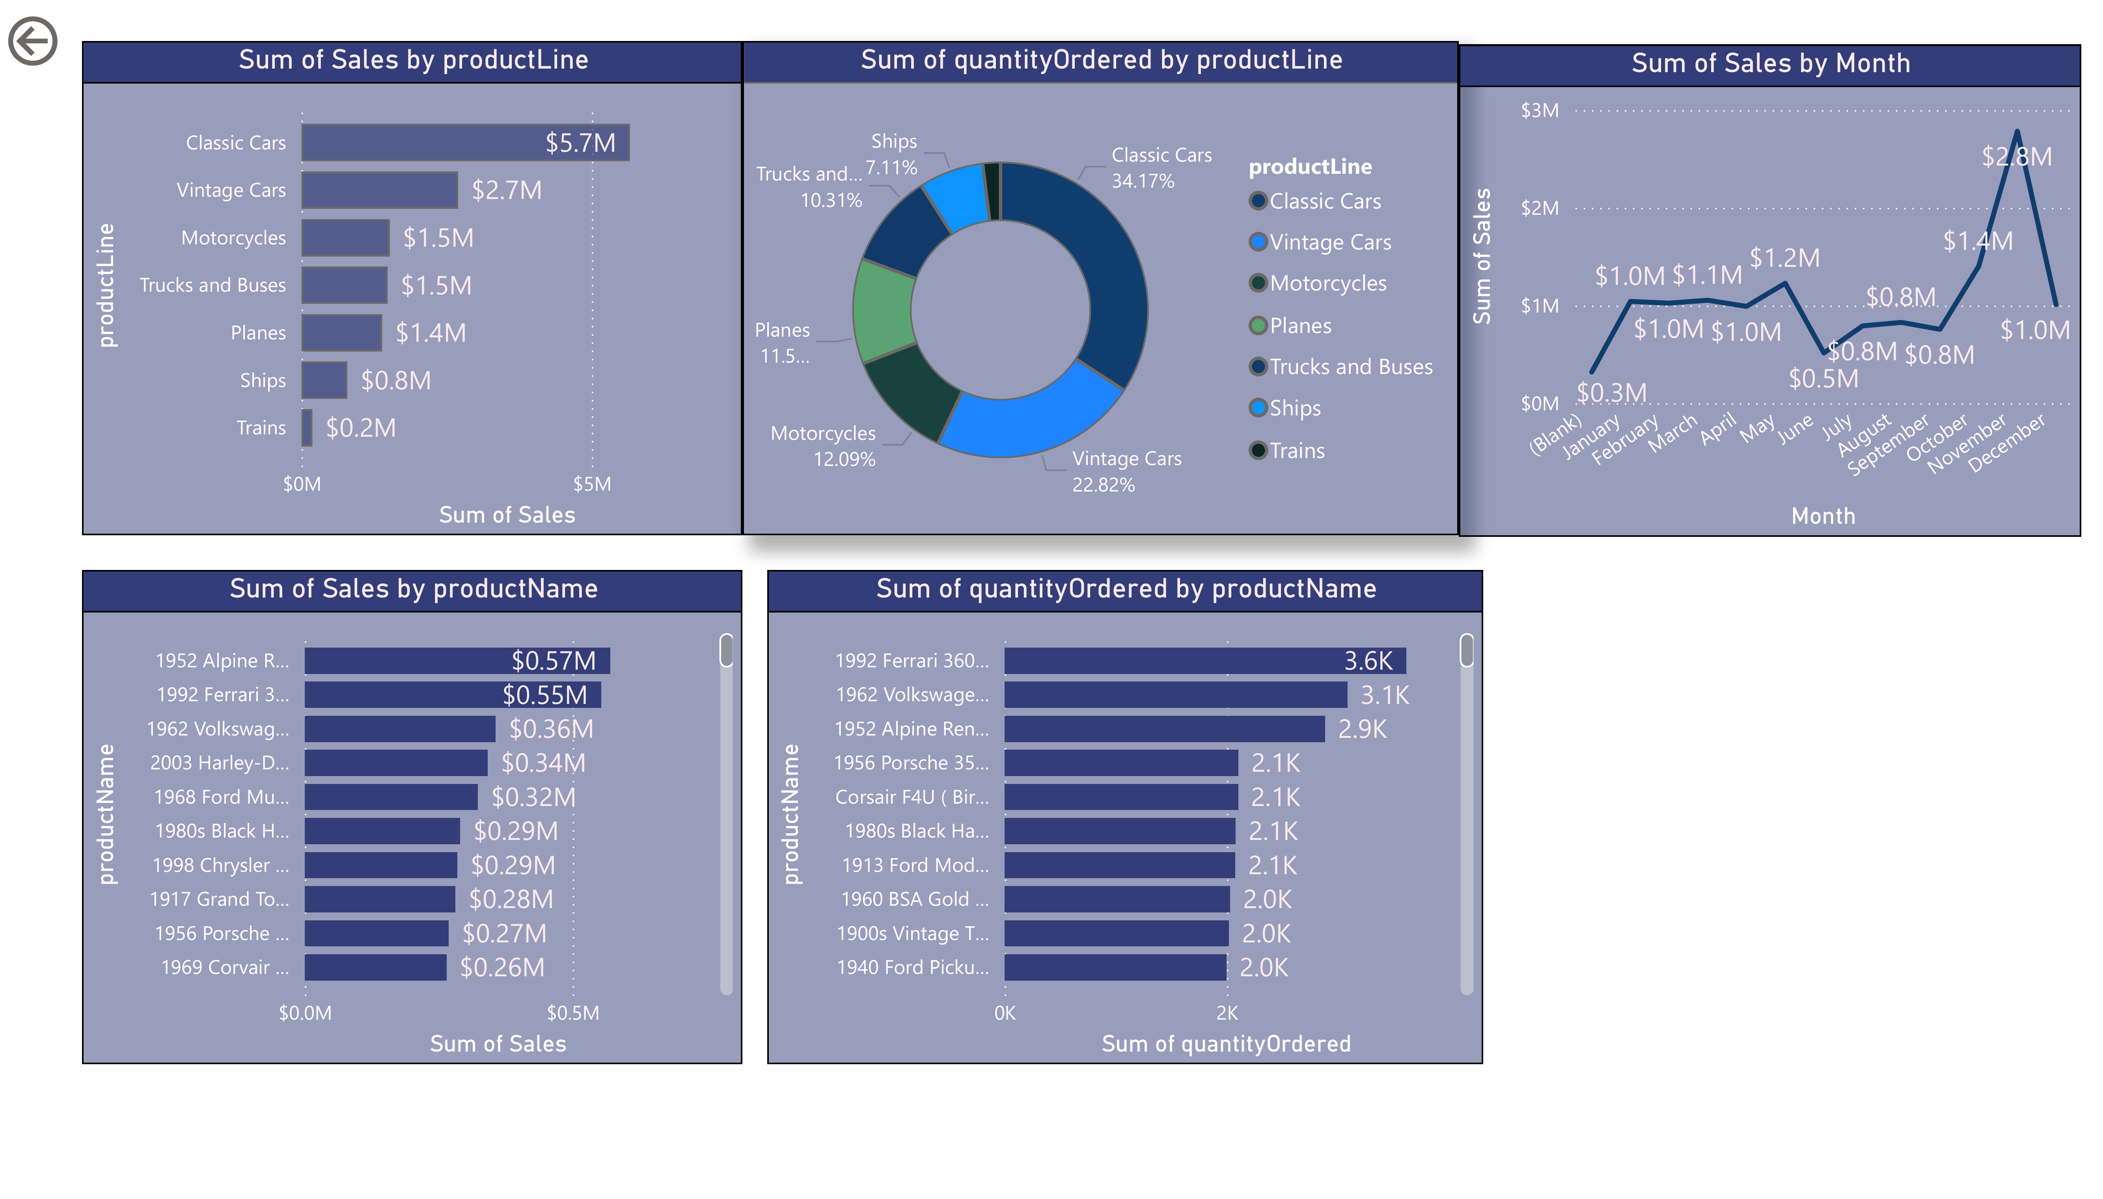
Dashboard View 2
This slide represents one of the pages from the Data Analytics Dashboard created in Power BI.

Slide 4
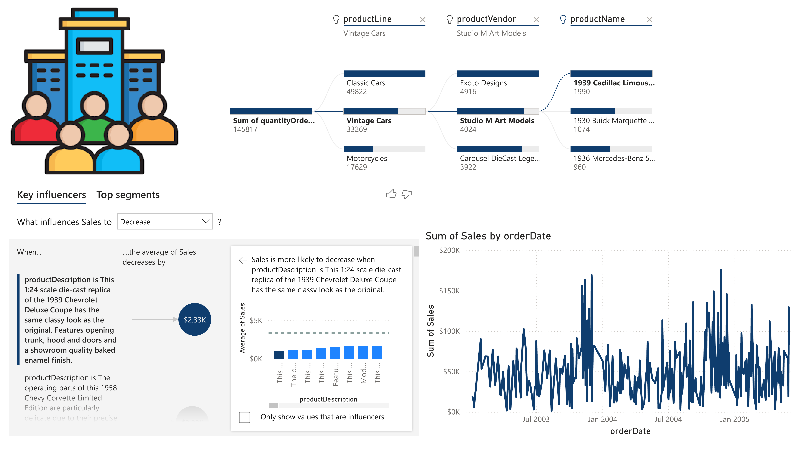
Dashboard View 3

Slide 5
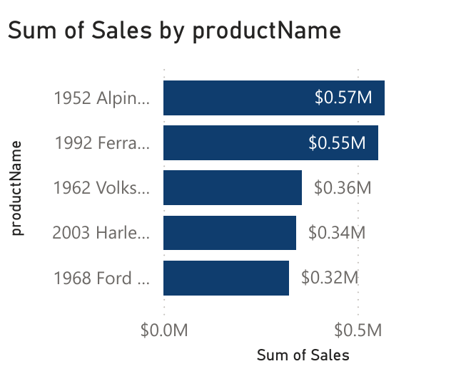
Dashboard View 4

Slide 6
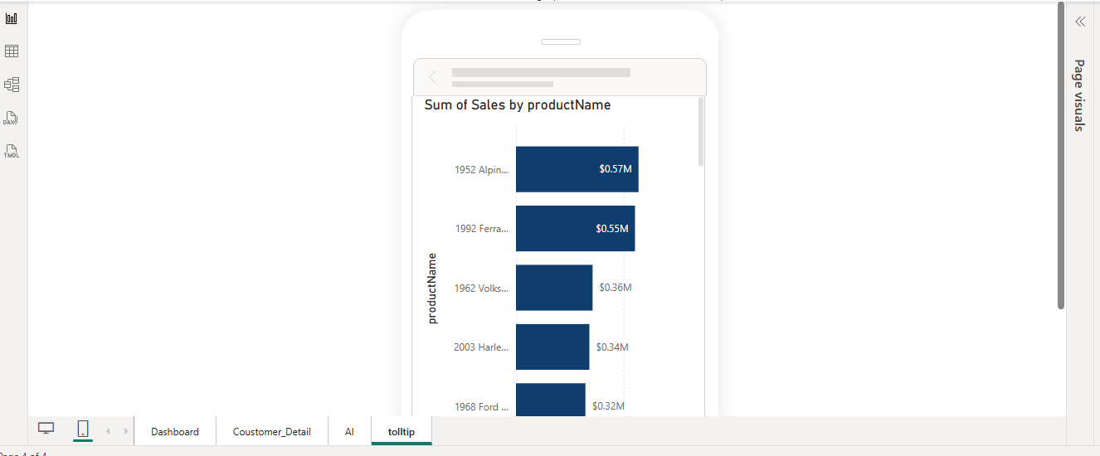
Tooltip View

Slide 7
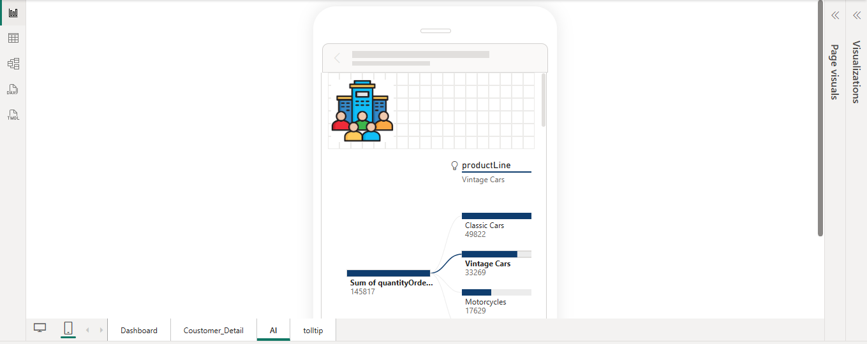
AI Insights View

Slide 8
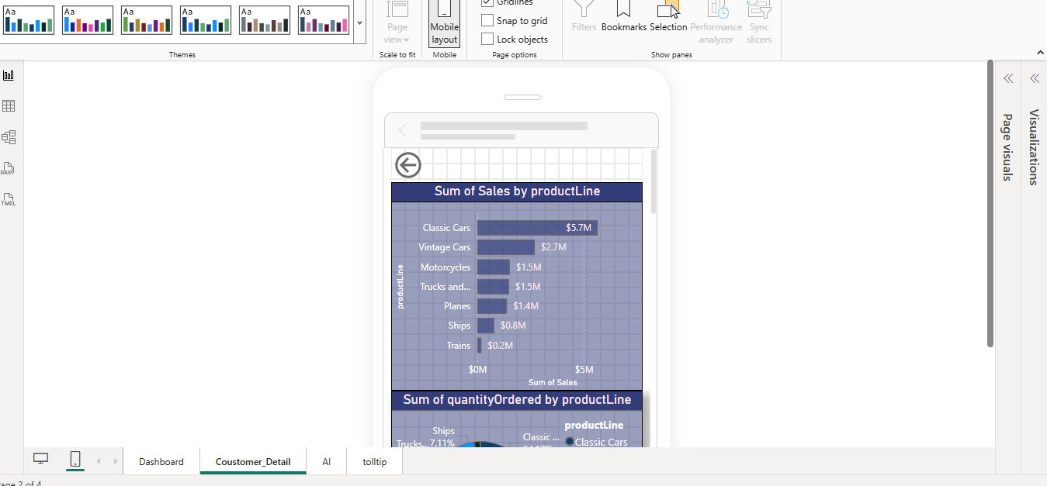
Customer Detail View

