Slide 1
Compario
Compare smarter. Buy better.

Slide 2
The Problem
Why online shopping is broken today.
Fragmented Pricing: Users must manually open multiple apps to find the best deal.
Misleading Discounts: Sellers artificially inflate prices before sales to show fake discounts.
Timing the Market: Buyers don't know if the current price is a 'good' price.

Slide 3
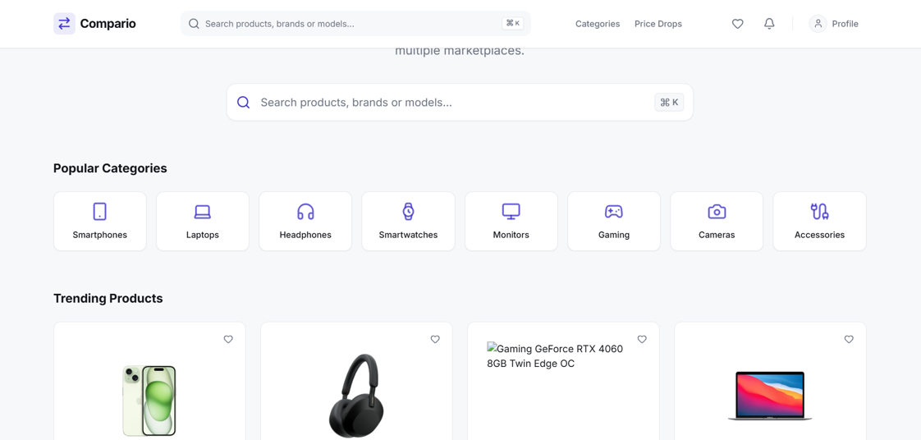
Platform Interface
Clean, premium, and data-rich user experience.

Slide 4
System Architecture
High-level data flow and processing pipeline.
Amazon API
Flipkart Affiliate
Third-Party Feeds
Marketplace Adapters
Product Normalization
MongoDB
Cron Jobs / Workers
Price Data Processing
Node.js + Express API
React + Vite
Compario UI
Core Technologies:
React
TypeScript
Tailwind CSS
Node.js
Recharts
Framer Motion

Slide 5
The Compario Solution
How we empower the modern shopper.
Centralized Dashboard: One search bar to rule them all—fetching data from verified sellers.
Price Transparency: We expose the '90-Day Average Price' and 'Historical Low'.
Smart Alerts: Users are notified via Email or Browser when their target price is hit.

Slide 6
Compario
Compare smarter. Buy better.
Any Questions?

