Slide 1
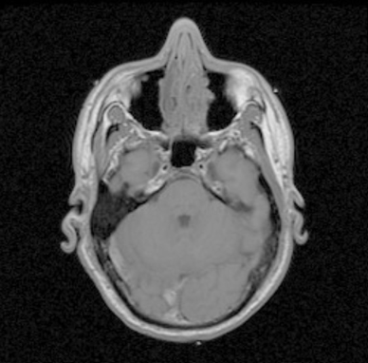
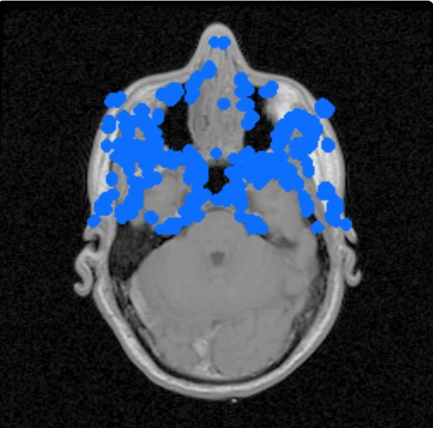

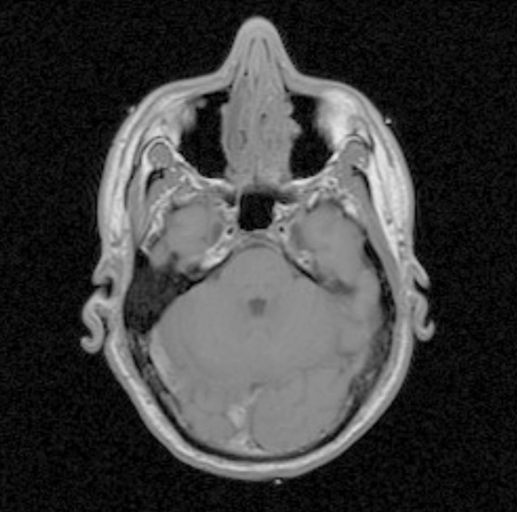
Name
Age
Date
…..
Cryptographic Hash Function SHA-1
Hospital Center
Patient’s Data
110100101000110
N Bits
Binary signature
Concatenation
Coding with reedmuller
N pixels detected and reset their LSBs
Harris corner detector
Insertion
Original image
Key
Watermarked image

Slide 2
Harris corner detector
pixels detected and reset their LSBs
Key
Watermarked image
Extraction
Message decoded, verified and possibly corrected
Decoding
Verification
Correction
Signature of hospital center
Patient Data
Comparison
decision
Name
Age
Date
…..
Signature database
Yes
No
File patient accepted

