Slide 1

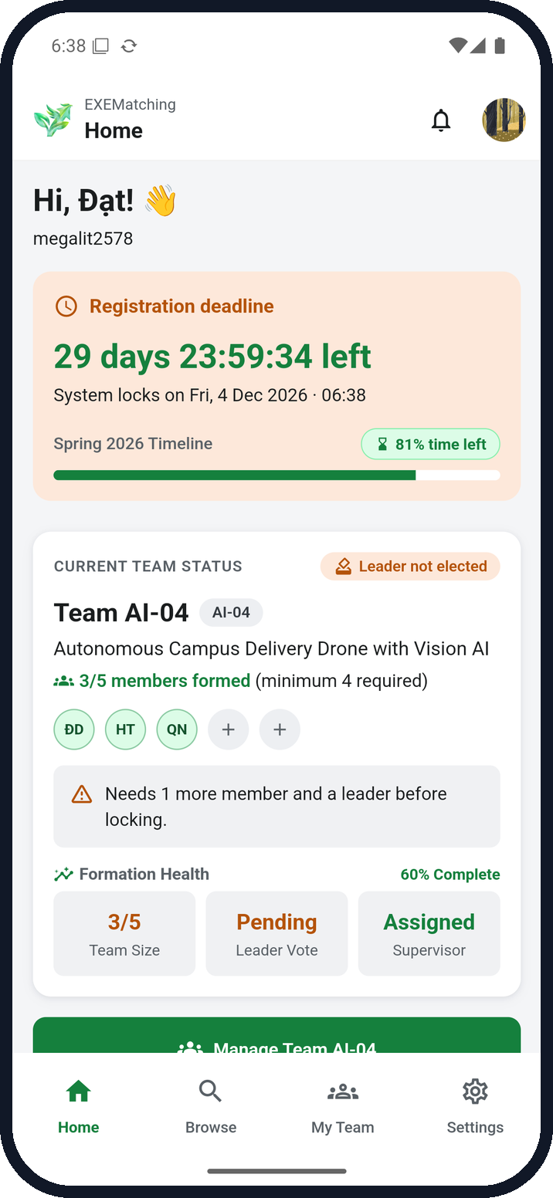
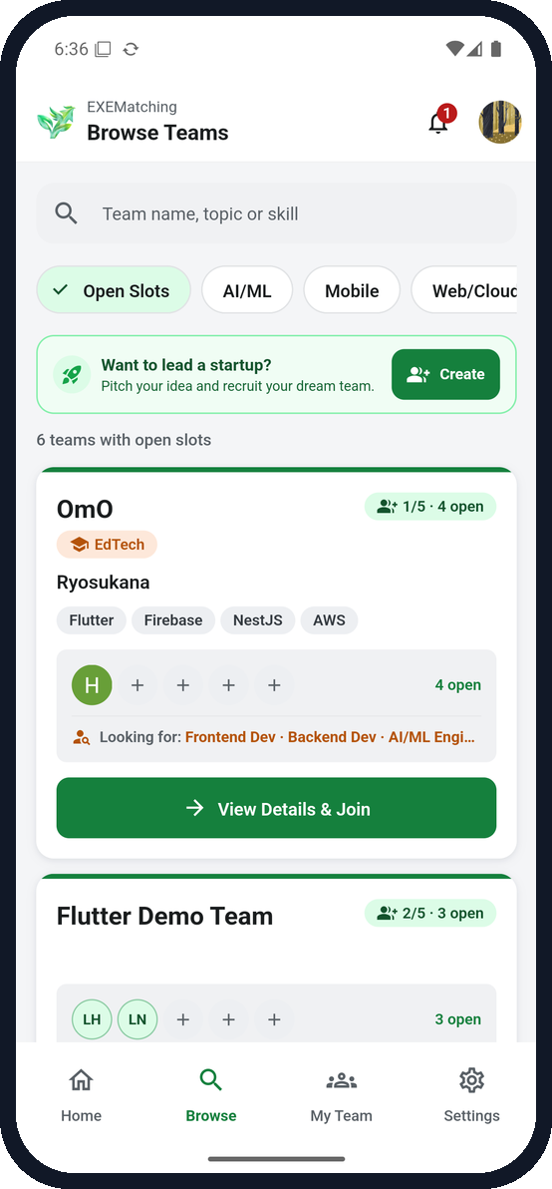
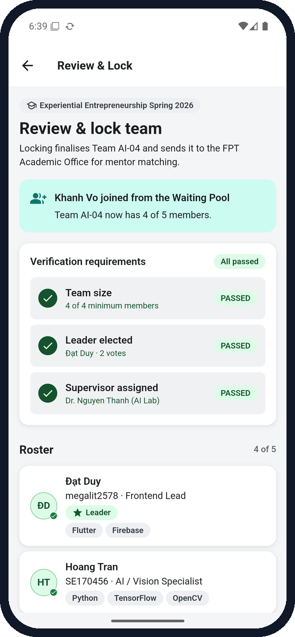
EXEMatching
PRM393 · MOBILE PROGRAMMING · LAB 3
Find your capstone team.
Elect a leader.
Lock the roster.
A cloud-enabled Flutter app on Firebase, tested end to end
on a real emulator by Google ARTEMIS.
Flutter · MVVM
7 Firebase services
13 E2E cases × 3 runs
Gemini code review
Team DEVORGANIZE222 · Firebase project prm393-lab-3-exematching

Slide 2









LAB 2 RECAP
Who we built it for
THREE PAINS, THREE FLOWS
Minh Lê
Finding teammates with the right skills
Final-year Software Engineering student
Browse open teams by topic, skill and open slot, and join one in two taps.
Persona · Lab 2
Choosing a leader without peer pressure
Votes stay hidden until you vote; a majority elects the leader.
I have two weeks to register a capstone team. I don't know who has the skills we need, nobody wants to say who should lead, and if one person drops out we can't lock.
Recovering when a member drops out
A team below 4 members can invite students from the Waiting Pool, then lock.
GOALS
Teammates with matching skills
A fair leader vote
Success = a locked team of 4–5 members with an elected leader, before the deadline.
Locked before the deadline
EXEMatching · PRM393 Lab 3 · DEVORGANIZE222
02 / 17

Slide 3
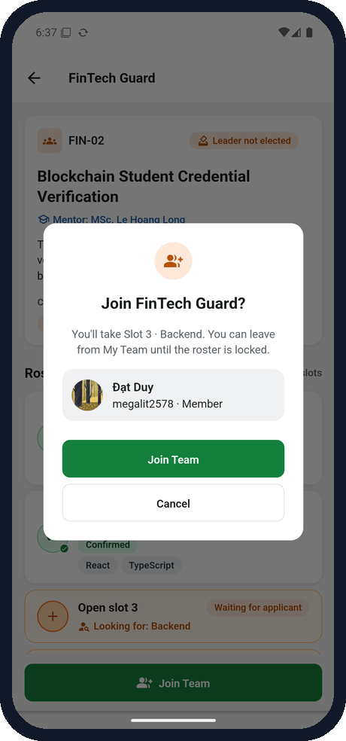
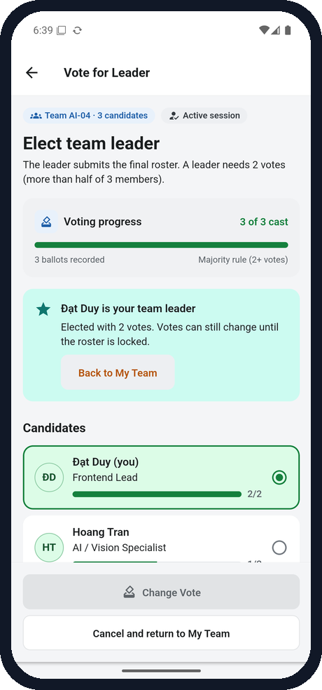
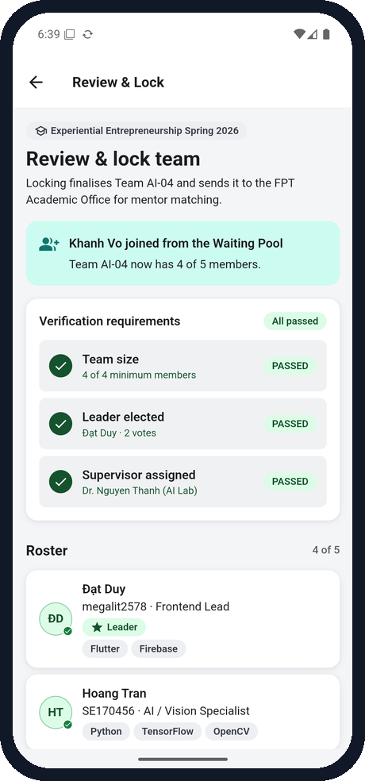
THE 3 CRITICAL FLOWS
From browsing to a locked roster
1
Discover & join
2
Elect a leader
3
Lock the roster
Home → Browse → Team detail → Join
My Team → Vote → majority wins
Review & Lock → Waiting Pool → Lock
Alt: team fills first · no results · offline
Alt: tallies hidden until you vote · change vote
Alt: fewer than 4 members blocks the lock
EXEMatching · PRM393 Lab 3 · DEVORGANIZE222
03 / 17

Slide 4
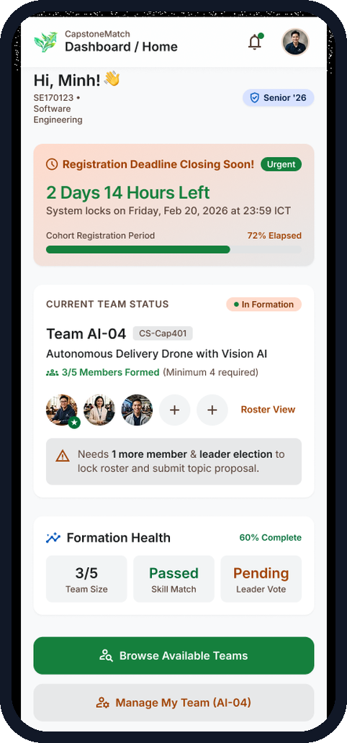
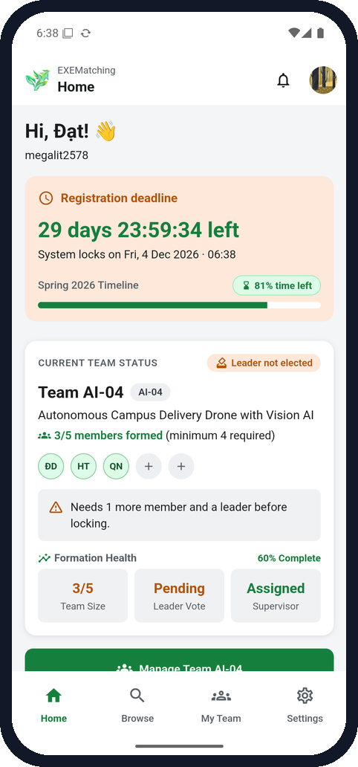
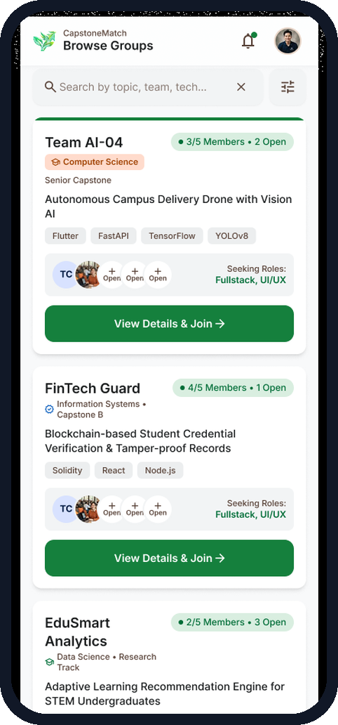
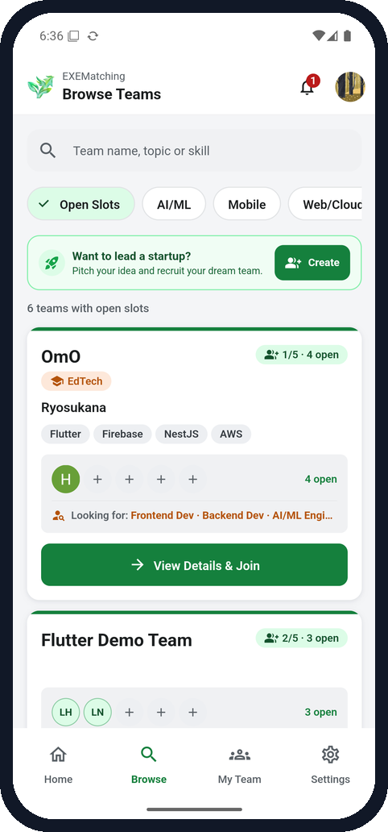
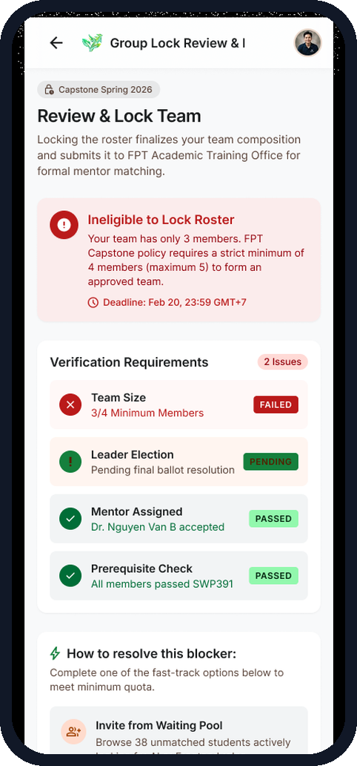
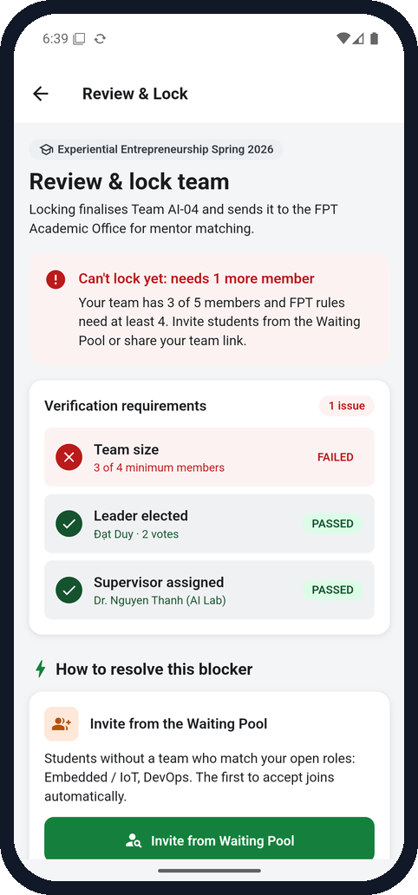

DESIGN TRACEABILITY
Figma frames, built in Flutter
Figma
App
Figma
App
Figma
App
SCR_02 · Home
SCR_03 · Browse
SCR_07 · Review & Lock
Deliberate deviations
DV-01 “Team” everywhere
DV-04 Direct join
DV-08 Bell + Settings tab
DV-09/10 WCAG AA contrast
DV-14 Icon + label, not colour only
16 in docs/design-traceability.md
EXEMatching · PRM393 Lab 3 · DEVORGANIZE222
04 / 17

Slide 5






ARCHITECTURE
MVVM with one-way dependencies
Screens & widgets
Every screen renders one ViewState<T>
lib/screens · lib/widgets
Declarative UI only: no Firebase SDK, no business rules
Loading
Empty + action
Failure + retry
Data
ViewModels
0
lib/viewmodels
Counted from the source when this deck is generated.
ChangeNotifier owning ViewState<T>, validation and analytics calls
Firebase imports in
lib/screens + lib/widgets
Service interfaces
lib/services
One composition root
Contracts the view-models depend on; local fakes for tests
lib/app/providers.dart wires the Firebase services into the view-models with Provider.
Firebase implementations
lib/firebase
Auth, Firestore, Storage, FCM, Analytics, Crashlytics, Remote Config
EXEMatching · PRM393 Lab 3 · DEVORGANIZE222
05 / 17

Slide 6









CLOUD BACKEND
7 Firebase services, each with console proof
VERIFIED
VERIFIED
VERIFIED
VERIFIED
Authentication
Firestore
Storage
Cloud Messaging
Google Sign-In, limited to the class roster
Teams, votes and the Waiting Pool in transactions
Team PDF uploaded to reports/{uid}/
Invites and updates in all 3 app states
Users tab · roster rejection (TC-01)
Team documents · deployed rules
Uploaded PDFs · owner-only rules
Foreground · background · terminated
VERIFIED
VERIFIED
VERIFIED
Security rules
Analytics
Crashlytics
Remote Config
Firestore and Storage rules, deployed and screenshotted from the console.
10 events, IDs and counts only
Crashes and non-fatals with user ID and keys
Registration and pool switches, live
DebugView · Logcat per E2E run
Test crash + non-fatal, Nov 4
Published, seen live, reverted
VERIFIED means the console or device screenshots are in evidence/ when this deck is generated.
EXEMatching · PRM393 Lab 3 · DEVORGANIZE222
06 / 17

Slide 7
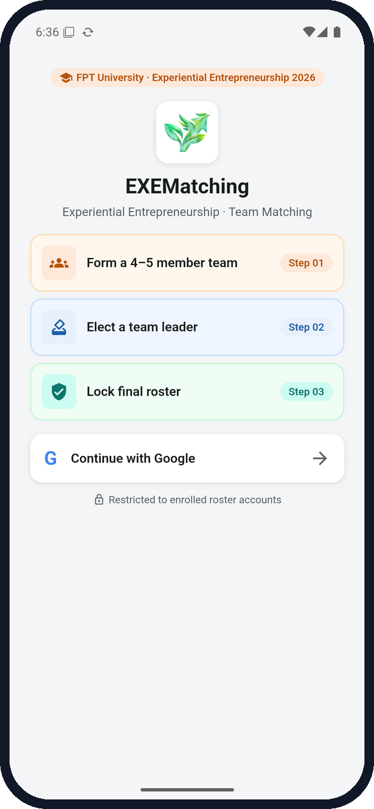
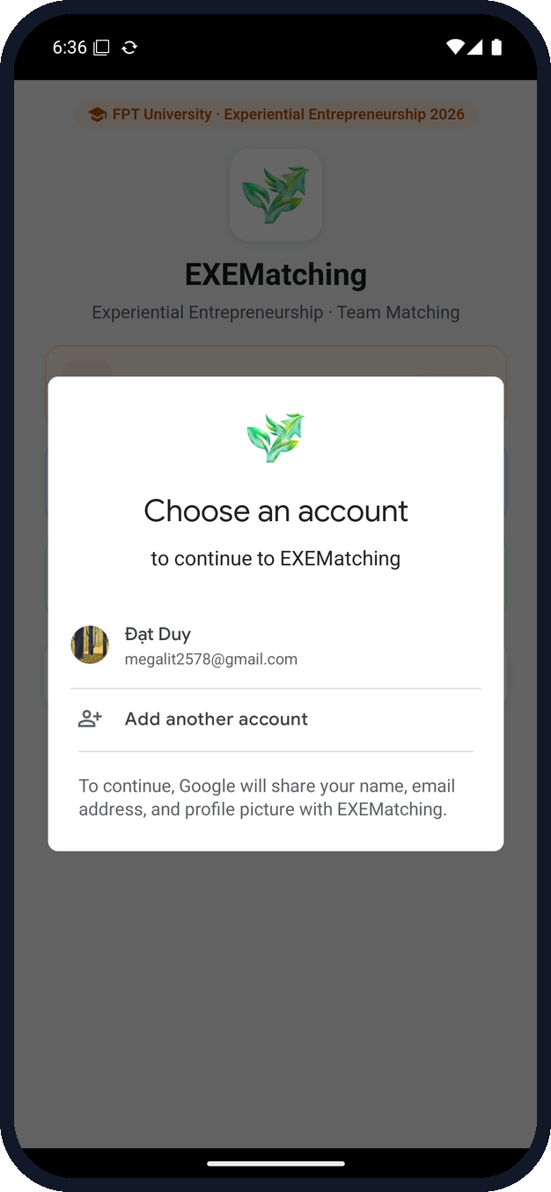
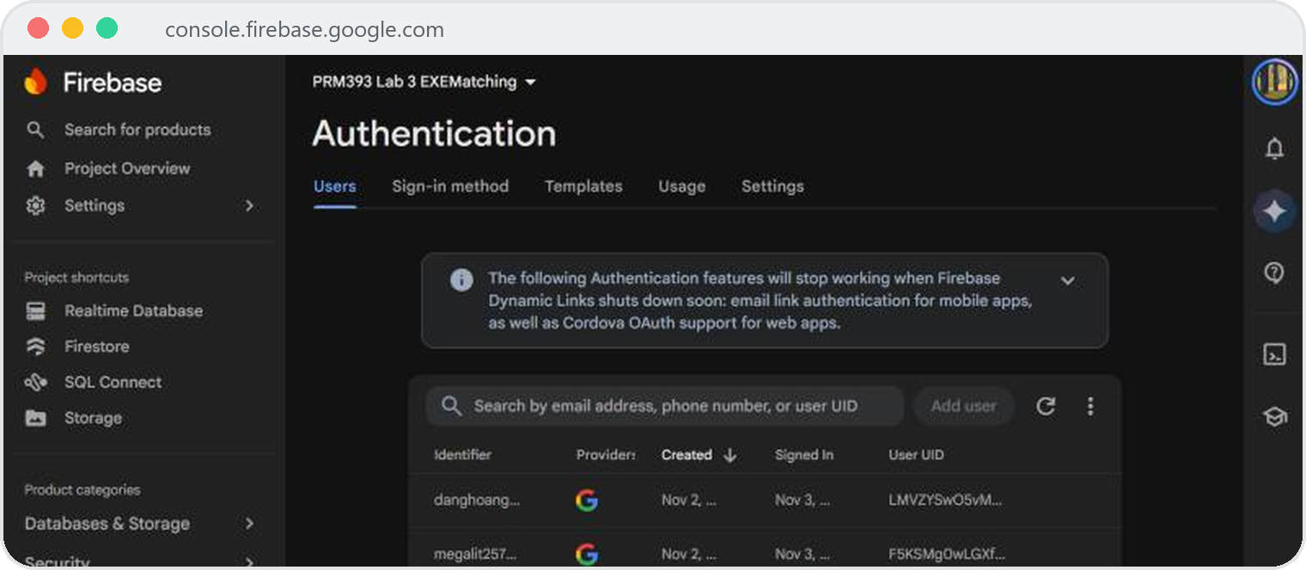



CLOUD SERVICE 1 · AUTHENTICATION
Google Sign-In, roster only
Authentication → Users: Google-provider accounts with their UIDs
Google credential → FirebaseAuth
authStateChanges() drives routing; sign-out clears Google and Firebase.
Roster check in app and rules
allowedEmails/{email} must be enabled; rules check isRosterMember().
Not on the roster? Rejected
E2E TC-01 passed 3/3 runs.
EXEMatching · PRM393 Lab 3 · DEVORGANIZE222
07 / 17

Slide 8
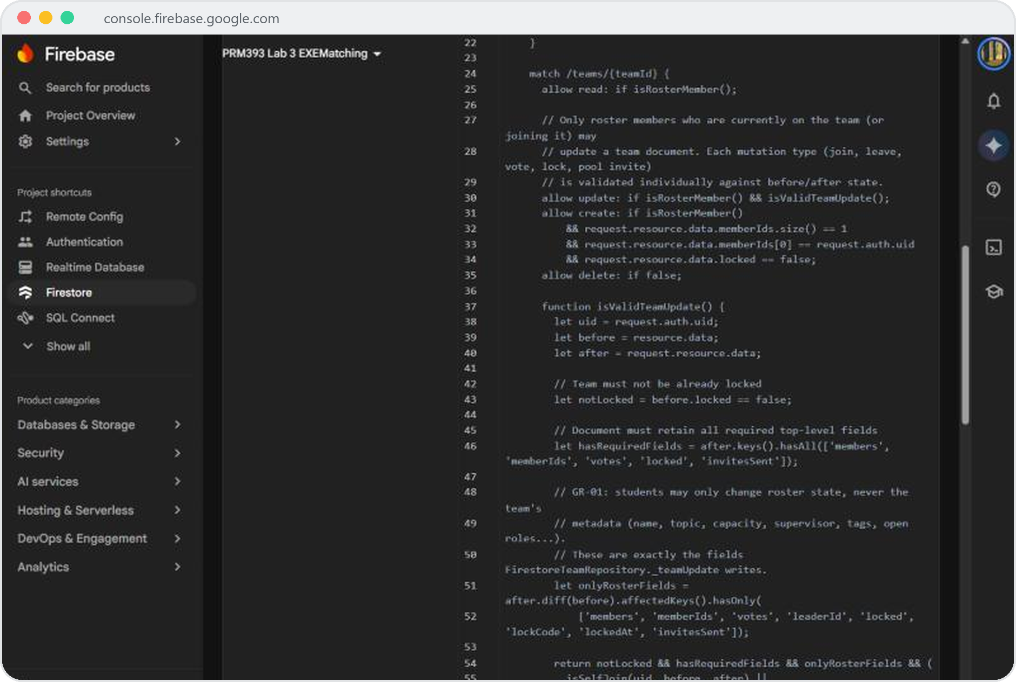



CLOUD SERVICE 2 · CLOUD FIRESTORE
Transactions and tight security rules
5
8
mutations run in
runTransaction
fields a student
may change
Join, leave, vote, lock, invite
Each re-reads the team inside the transaction, so two students can't take the last slot.
affectedKeys().hasOnly([...])
Topic, capacity and supervisor can't be edited by a client.
Waiting Pool privacy
Leaders read only unassigned candidates; assigned records stay private.
Deployed rules: a student may change only roster fields (GR-01)
EXEMatching · PRM393 Lab 3 · DEVORGANIZE222
08 / 17

Slide 9
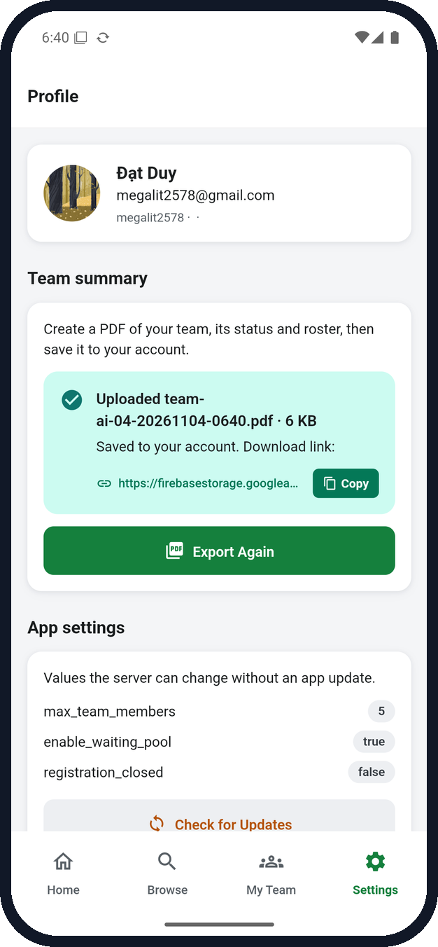
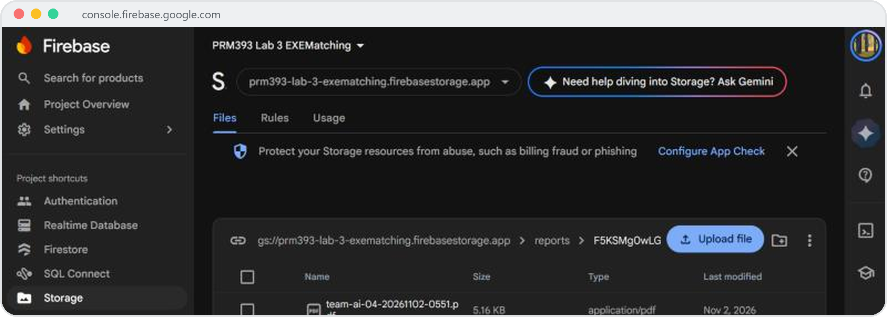



CLOUD SERVICE 3 · CLOUD STORAGE
Team PDF, private to its owner
Storage → reports/{uid}/: PDFs uploaded by the app (E2E TC-13)
firebase/storage.rules
match /reports/{userId}/{allPaths=**} {
allow read, write: if request.auth != null
&& request.auth.uid == userId;
}
PDF built on the device
Upload progress 0 → 100 %
Download link shown
Export & Upload
EXEMatching · PRM393 Lab 3 · DEVORGANIZE222
09 / 17

Slide 10
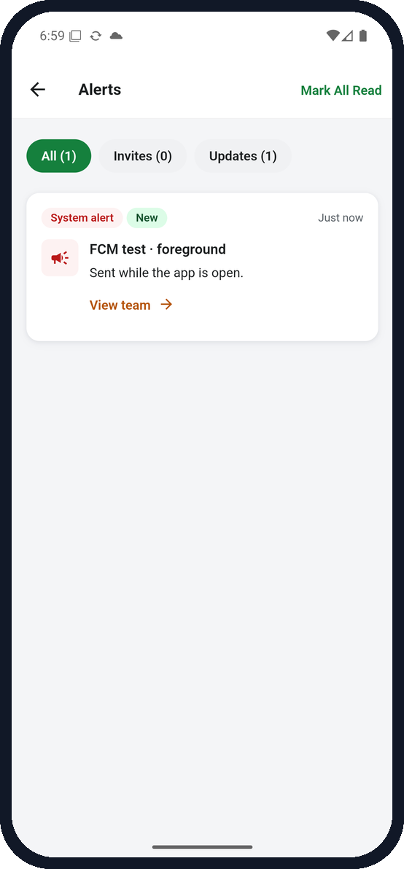
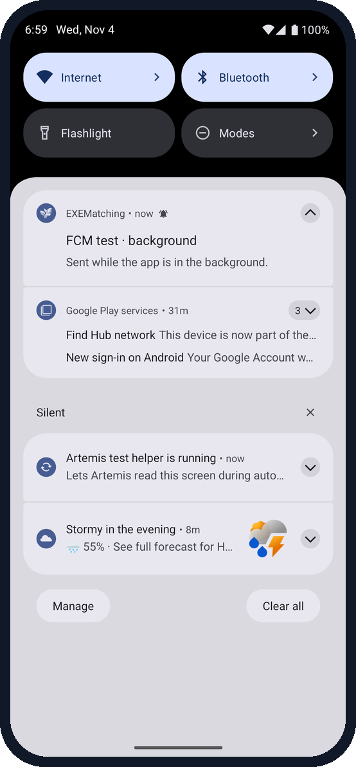
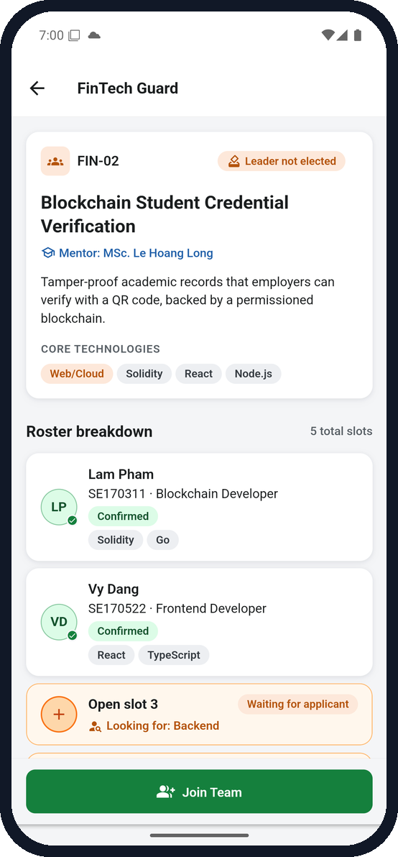

CLOUD SERVICE 4 · CLOUD MESSAGING
One test message, three app states
Foreground
Background
Terminated
onMessage stores it; it appears in Alerts at once
Android shows it; a tap runs onMessageOpenedApp
Process killed; a tap cold-starts the app into the team
EXEMatching · PRM393 Lab 3 · DEVORGANIZE222
10 / 17

Slide 11
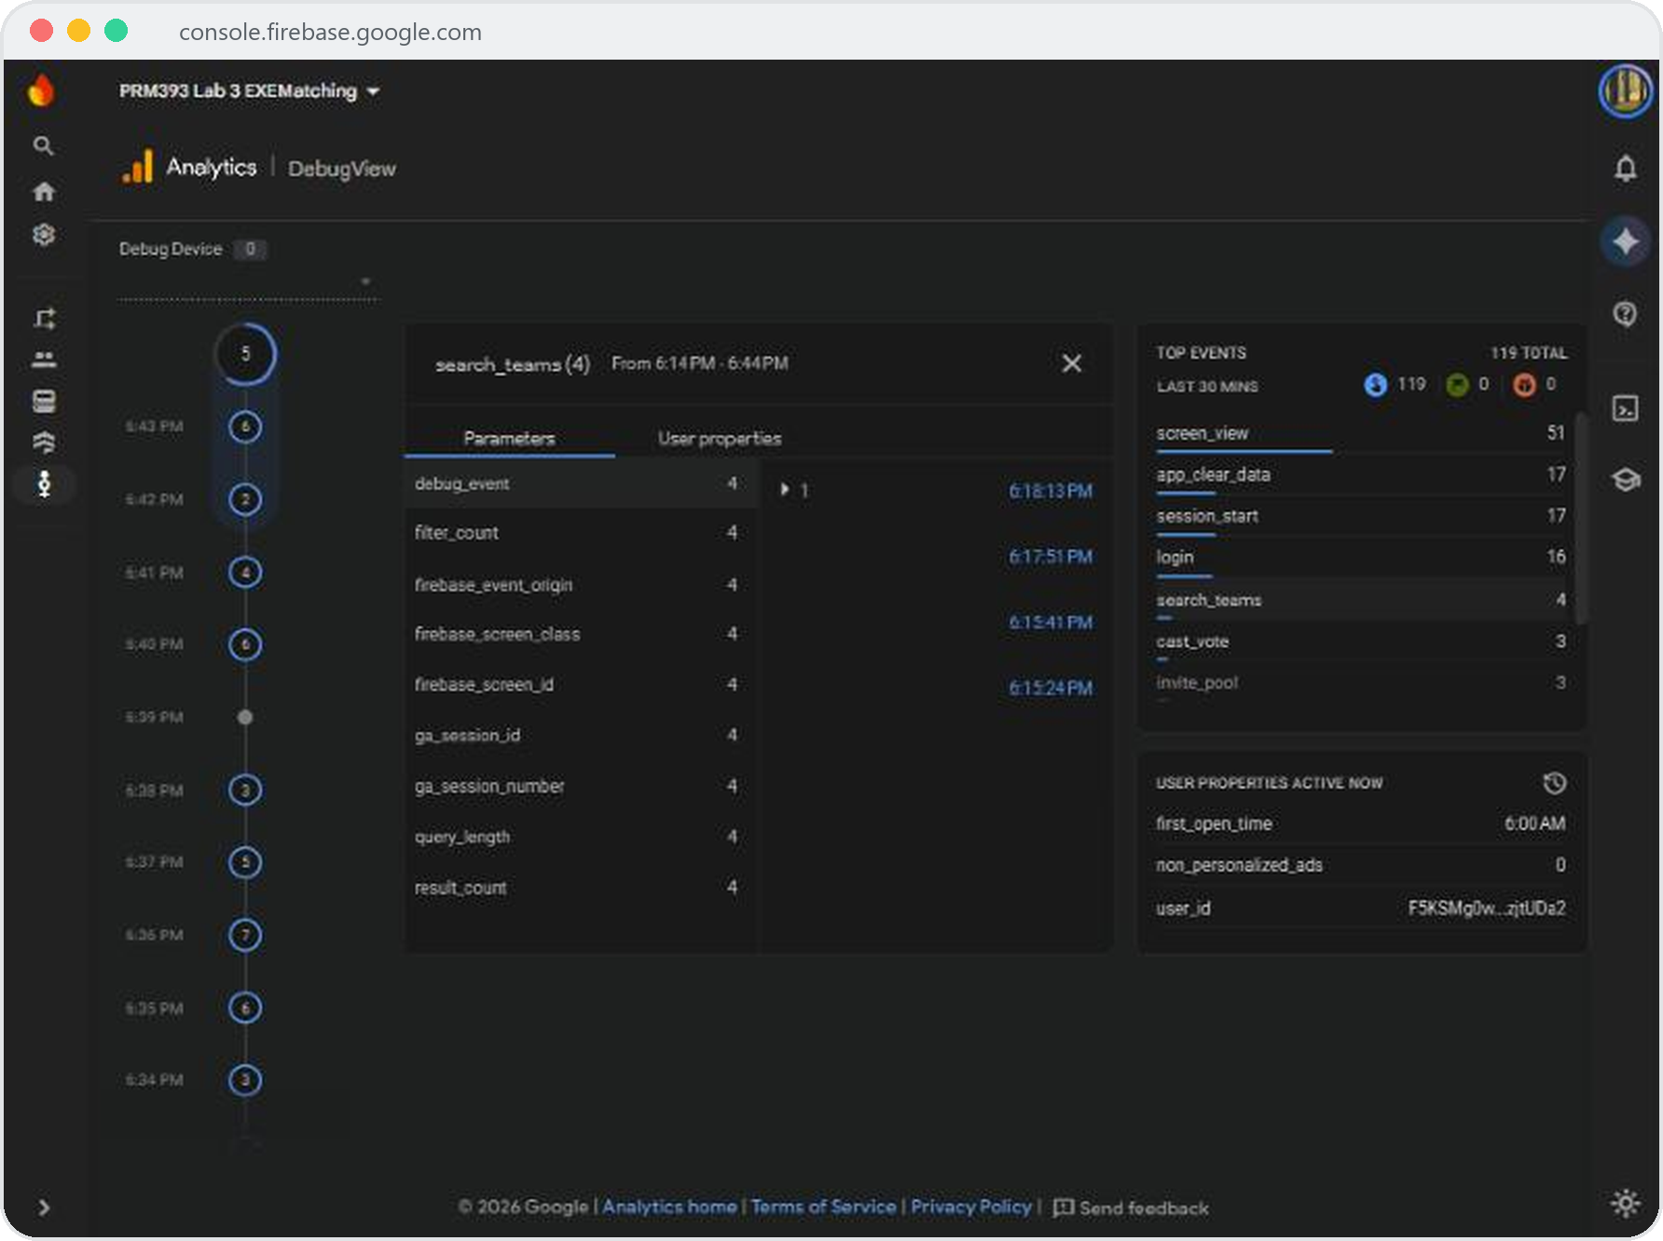





CLOUD SERVICE 5 · GOOGLE ANALYTICS
10 events, no personal data
Recommended events
login
logout
search_teams
view_team
Domain events
create_team
join_team
cast_vote
invite_pool
lock_roster
export_report
IDs and counts only
search_teams sends query_length, never the search text; no email or name.
User ID after sign-in
setUserId(uid) links events to the account, not to a name.
Checked twice
DebugView screenshots, and every E2E run saves the events it caused from Logcat.
DebugView: search_teams with query_length, result_count and filter_count
EXEMatching · PRM393 Lab 3 · DEVORGANIZE222
11 / 17

Slide 12
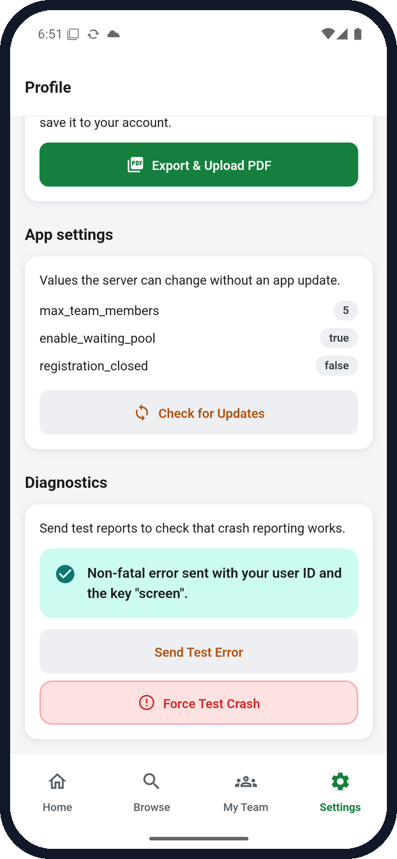
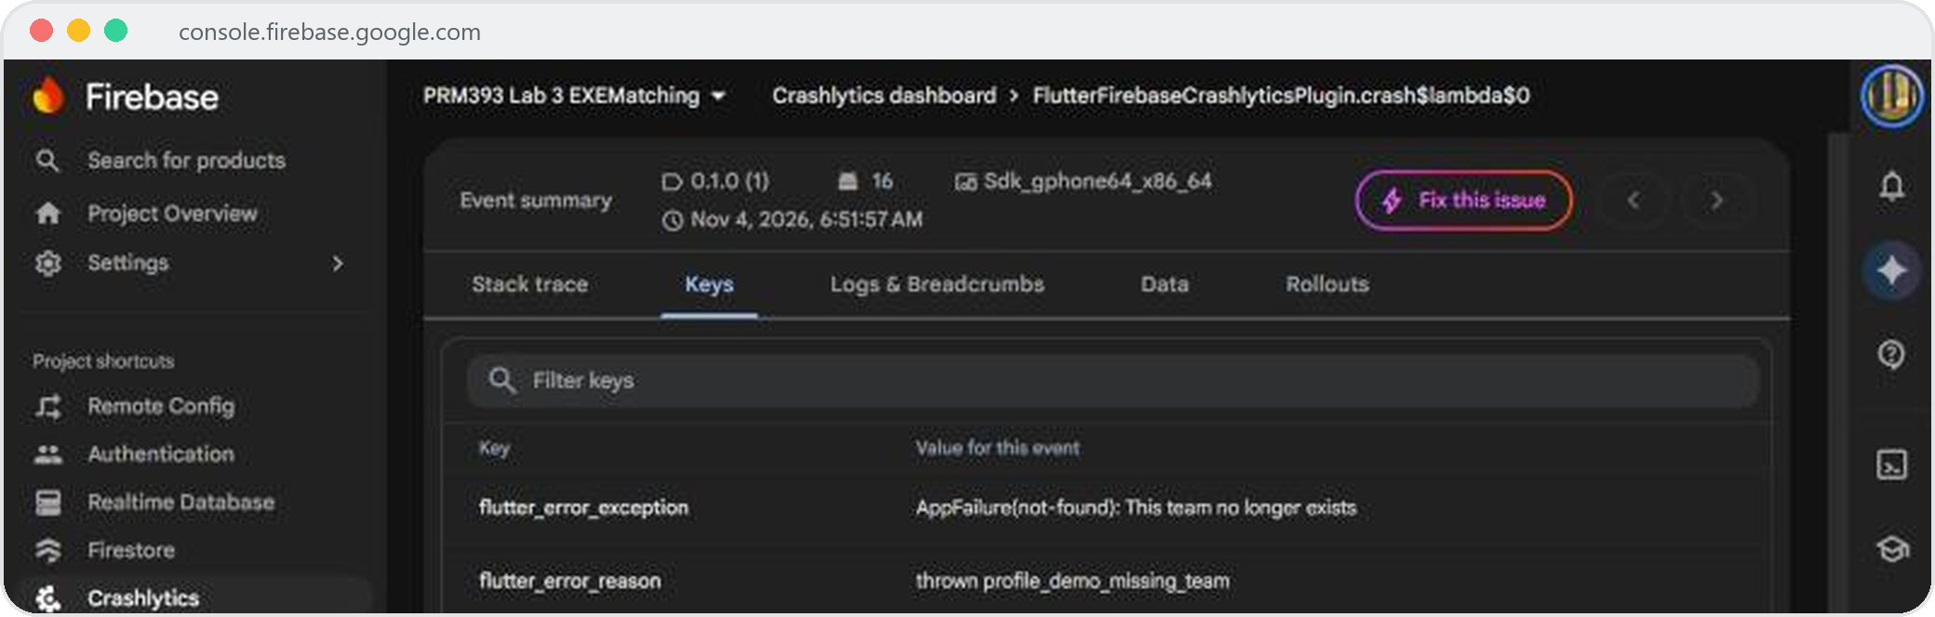
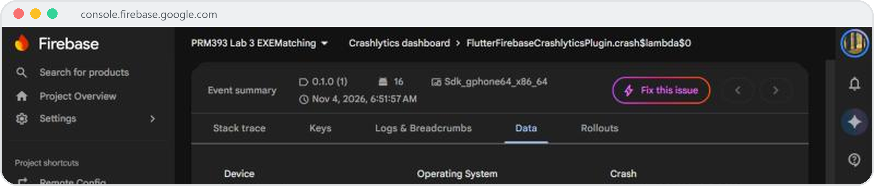



CLOUD SERVICE 6 · CRASHLYTICS
Crashes and handled errors, with context
Test crash of Nov 4, 06:51:57 · Keys: screen = profile
Same event · Data: the user ID is the Firebase Auth UID
Send Test Error
FlutterError.onError → fatal
recordError → non-fatal
keys: screen · student_cohort · team_id
EXEMatching · PRM393 Lab 3 · DEVORGANIZE222
12 / 17

Slide 13
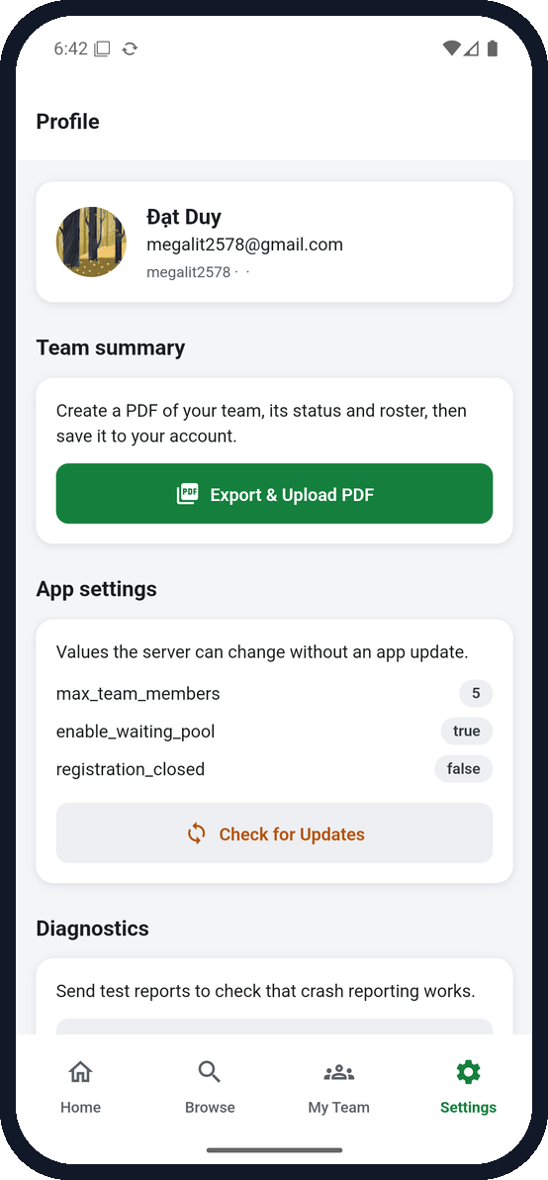

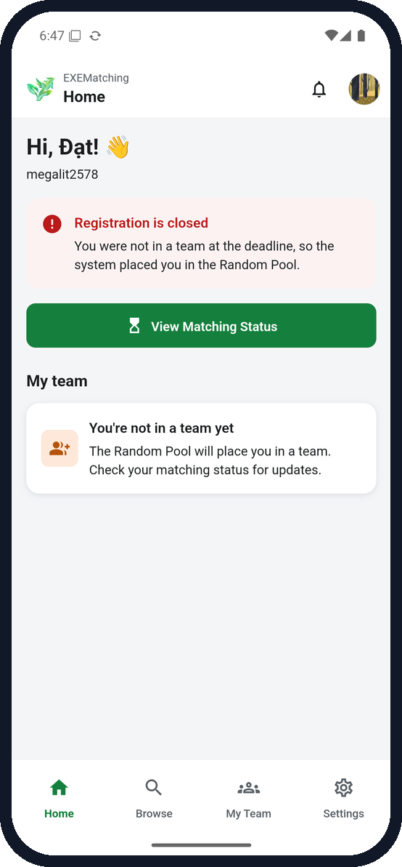
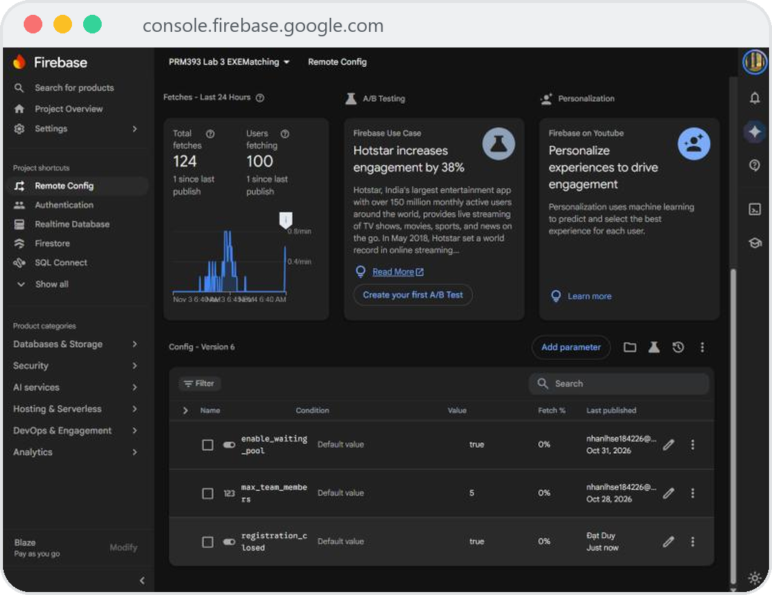

CLOUD SERVICE 7 · REMOTE CONFIG
Close registration without an app update
registration_closed = true, published
Before · false
After · true
Home: closed
onConfigUpdated activates the new value and the view-models rebuild: the open app changed within a minute, with no restart or reinstall. The parameter was deleted again afterwards.
EXEMatching · PRM393 Lab 3 · DEVORGANIZE222
13 / 17

Slide 14




QUALITY · GOOGLE ARTEMIS
13 cases × 3 runs on a real emulator
24
Test case
Run 1 · 2 · 3
runs passed in the final run
(e2e_test/evidence/junit.xml)
/ 39
TC-01
Account not on roster
TC-02
Sign in with roster account
Every attempt, as recorded
TC-03
Search & filter
Attempt 1
6/39
TC-04
Empty state + clear filters
Attempt 2
23/39
TC-05
Offline error + retry
Final run
24/39
TC-06
Join a team with an open slot
The agent's SUCCESS is not trusted
TC-07
Team fills before confirming
Each run is checked against the accessibility tree, Logcat and Firestore.
TC-08
Tallies hidden until voting
Failed runs are explained
TC-09
Vote elects the leader
Bugs found, harness fixes and Gemini free-tier 429s, per trace ID: docs/test-plan.md §3.
TC-10
Lock blocked → pool recovery
TC-11
Share link → Android share sheet
TC-12
Decline invite + Undo
TC-13
Export & upload team PDF
EXEMatching · PRM393 Lab 3 · DEVORGANIZE222
14 / 17

Slide 15






AI-ASSISTED CODE REVIEW
Gemini reviews the PR, people decide
Pull request
gemini_review.py · one API request
gemini-3.5-flash-lite
Inline review comments
GR-01
isSelfJoin only checked the roster size, so a client could also rewrite topic, capacity or supervisor.
ACCEPTED
Security · High
Fixed for all 5 team mutations · c9543a3
GR-02
Querying the Waiting Pool outside the transaction could let two teams pick the same student.
REJECTED
Concurrency · Med
The client SDK can't query in a transaction; the candidate is re-read inside it
GR-03
A missing Firebase CLI login raised a bare KeyError in the E2E backend.
ACCEPTED
Reliability · Med
Actionable message · ee6ec78
GR-04
The Remote Config start-up catch dropped the error message.
ACCEPTED
Reliability · Low
Logged, defaults kept · d6926d1
GR-05
Slicing the error body to 2000 chars might split a UTF-8 character.
REJECTED
Reliability · Med
False positive: decoded before slicing
EXEMatching · PRM393 Lab 3 · DEVORGANIZE222
15 / 17

Slide 16










WHAT TESTING TAUGHT US
Real bugs, found on a real device
Bugs the runs exposed, all fixed
Lessons
Invite from Waiting Pool always failed
An agent's “success” is not evidence
Rules hid unassigned pool records from leaders (PERMISSION_DENIED).
TC-12 reported the invite restored while the screen showed none.
Typing did nothing for TalkBack and ARTEMIS
Only recorded runs count
Trace IDs, screenshots and Firestore checks, never a typed-in 39/39.
A Semantics wrapper created a second, non-editable text field.
Test rules with the real flows
Voting showed a false error
A correct-looking rule broke Flow 3 until the app ran against it.
cast_vote sent a bool parameter that Analytics rejects.
Undo after declining never appeared
The card was disposed before the snackbar showed.
ARTEMIS Pro exploratory session: not run yet (docs/test-plan.md §4).
EXEMatching · PRM393 Lab 3 · DEVORGANIZE222
16 / 17

Slide 17
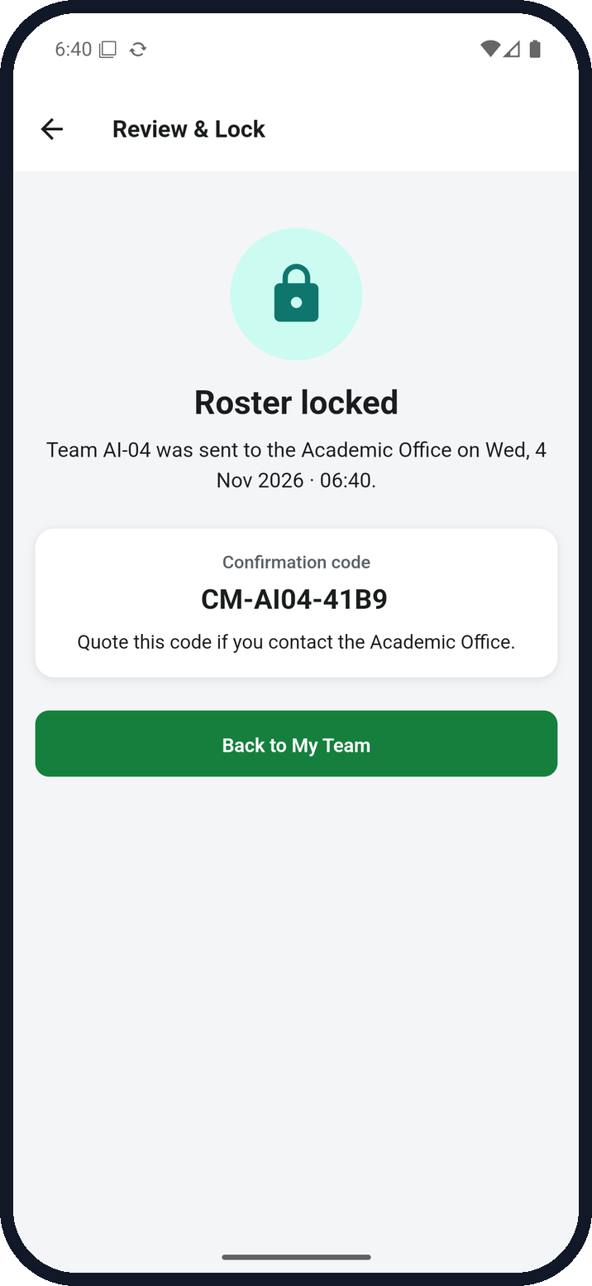
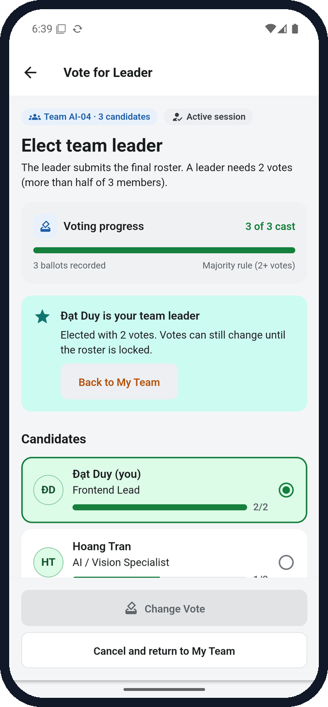



THANK YOU
Questions?
github.com/DEVORGANIZE222/Lab3_Cloud-Enabled_Mobile_App
docs/test-plan.md · evidence/ · report/Lab03_DEVORGANIZE222.pdf
Firebase project prm393-lab-3-exematching
Team DEVORGANIZE222 · PRM393 Mobile Programming · FPT University

