Slide 1
FIELD NAME | DATA TYPE | FIELD SIZE | CONSTRAINTS | DESCRIPTION
user_id | Integer | 1 to 8 | Primary key | The primary key (auto increment)
username | varchar | 50 | Not null | Stores username
password | BLOB | 0 to 2 GB | Not null | Stores password
email | varchar | 100 | Not null | Stores the email of the user
role | varchar | 20 | Not null | Stores the role of the user
phone | varchar | 15 | null | Stores the phone of the user
created_at | datetime | 8 bytes (INTEGER) | Not null | Stores the date and time the user’s account was created

Slide 2
FIELD NAME | DATA TYPES | FIELD SIZE | CONSTRAINTS | DESCRIPTION
space_id | integer | 1 to 8 | Primary key | The primary key (auto increment)
name | varchar | 100 | Not null | Stores the Name of the space
description | text | 255 | Not null | Stores the description for the specific space
price | decimal | 255 | Not null | Stores the price of the space
status | varchar | 20 | Not null | Stores the status of the space
dimensions | varchar | 255 | Not null | Stores the dimensions of the space
location | varchar | 255 | Not null | Store the location of the space
model_path | varchar | 255 | Not null | Store the path of the model
created_at | datetime | 255 | Not null | The created at in system

Slide 3
FIELD NAME | DATA TYPES | FIELD SIZE | CONSTRAINTS | DESCRIPTION
tenant_id | integer | 1 to 8 | Primary key | The primary key tenant id (auto increment)
lease_start_date | date | 8 bytes (INTEGER) | Not null | Stores the start date of the lease
lease_end_date | date | 8 bytes (INTEGER) | Not null | Stores in the end date of the lease
monthly_rent | decimal | 8 bytes | Not null | Stores the monthly rent of the tenants
payment_status | varchar | 10 | Not null | The payment status of the tenant
Rental_space_id | integer | 1 to 8 | Foreign key | The foreign key from myApp_rentals_space referencencing space_id
user_id | integer | 1 to 8 | Not null | The foreign key from myApp_user referencencing user_id

Slide 4
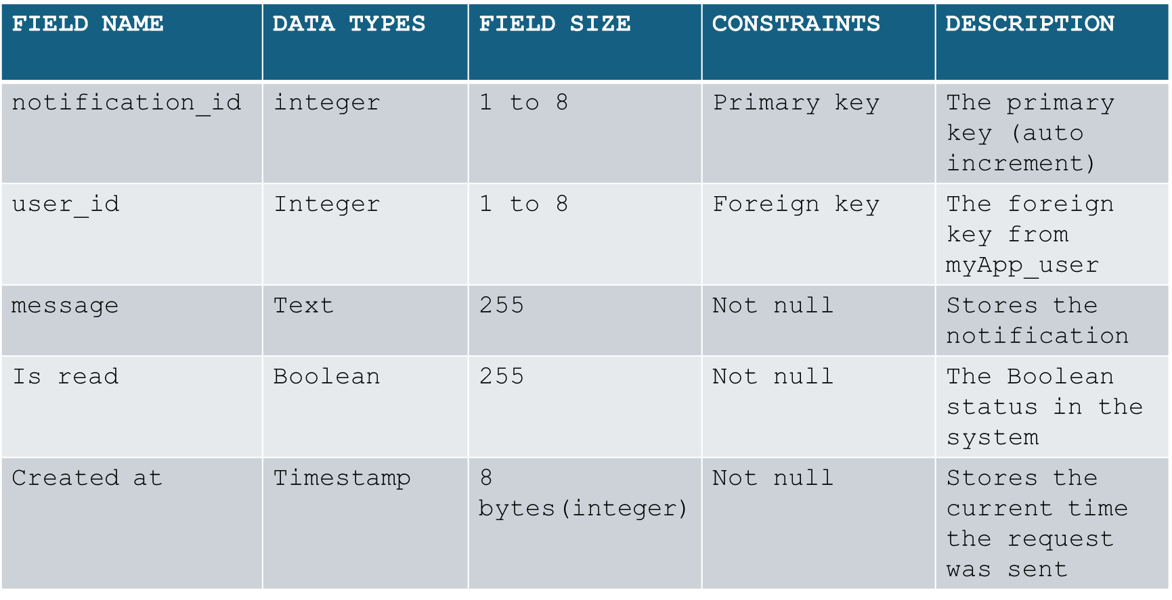

Slide 5
FIELD NAME | DATA TYPES | FIELD SIZE | CONSTRAINTS | DESCRIPTION
payment_id | integer | 1 to 8 | Primary key | The primary key (Auto increment)
amount_paid | decimal | 8 bytes | Not Null | Stores the amount paid by the tenant
payment_date | datetime | 8 bytes (INTEGER) | Not Null | Stores the date when the tenant paid
payment_method | varchar | 50 | Not null | Stores the payment method
invoice_number | varchar | 100 | Not null | Stores the invoice number
tenant_id | integer | 1 to 8 | Foreign key | The foreign key from myApp_tenant referencing tenant_id

Slide 6
Table model
FIELD NAME | DATA TYPES | FIELD SIZE | CONSTRAINTS | DESCRIPTION
model_id | integer | 1 to 8 | Primary key | The primary key (auto increment)
rental Space id | integer | 1 to 8 | Foreign key | The foreign key from myApp_rental_spaces table referencing space_id
file_path | varchar | 100 | Not null | The file path of the model of spaces
uploaded_by_id | integer | 1 to 8 | Foreign key | The foreign key from myApp_user referencing user_id
uploaded_at | datetime | 255 | Foreign key | The date and time the model was added

Slide 7
FIED NAME | DATA TYPES | FIELD SIZE | CONSTRAINTS | DESCRIPTION
request_id | integer | 1 to 8 | Primary key | The primary key (auto increment)
tenant_id | integer | 1 to 8 | Foreign key | The foreign key from myApp_tenant
space_id | integer | 1 to 8 | Foreign key | The foreign key from myApp_rentalspaces
description | Text | 255 | Not null | Stores the request description
status | varchar | 20 | Not null | Stores the request status in system
Created at | Datetime | 8 bytes | Not null | Stores the date and time of the request was sent

Slide 8
Notification table
FIELD NAME | DATA TYPES | FIELD SIZE | CONSTRAINTS | DESCRIPTION
notification_id | integer | 1 to 8 | Primary key | The primary key (auto increment)
user_id | Integer | 1 to 8 | Foreign key | The foreign key from myApp_user
message | Text | 255 | Not null | Stores the notification
Is read | Boolean | 255 | Not null | The Boolean status in the system
Created at | Timestamp | 8 bytes(integer) | Not null | Stores the current time the request was sent

Slide 9
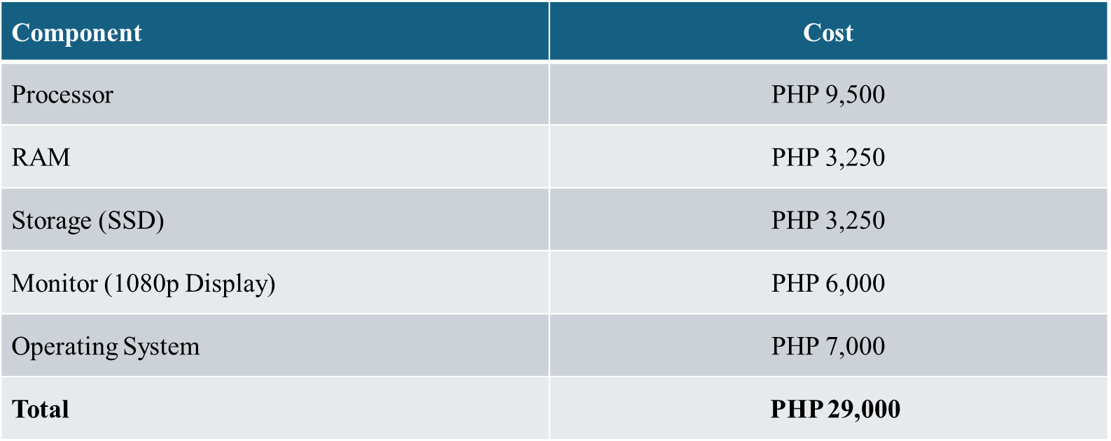
Component | Cost
Processor | PHP 9,500
RAM | PHP 3,250
Storage (SSD) | PHP 3,250
Monitor (1080p Display) | PHP 6,000
Operating System | PHP 7,000
Total | PHP 29,000

