Slide 1

Sorting Algorithms and Their Efficiency
Chapter 11
Drew Guarnera

Slide 2



Sorting Algorithm Classifications
Internal
External
Sorting is done entirely in memory (RAM)
Sorting is split between memory and non-volatile storage (Hard Drive, or Flash Memory)

Slide 3
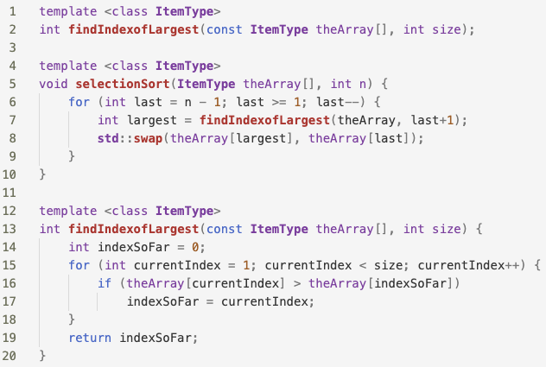
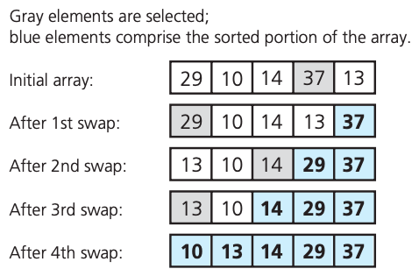
Selection Sort
Selection Sort
select max
unsorted
sorted

Slide 4
Selection Sort
Selection Sort Analysis
(n-1)+(n-2)+(n-3)+…+1 = n(n-1)/2
Best Case: O(n²)
Worst Case: O(n²)
Could be a good choice when:
n is small
moving data is costly while comparisons are not

Slide 5
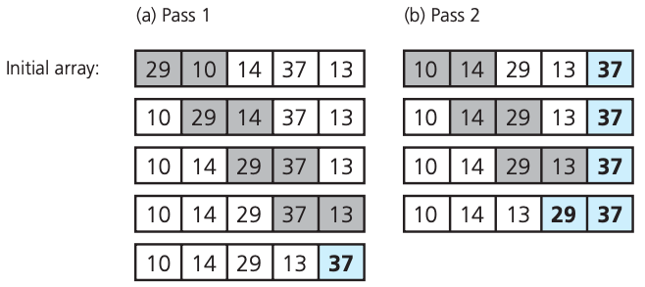
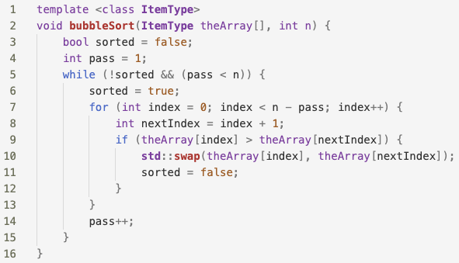
Selection Sort
Bubble Sort
swapping will bubble larger items to the end
unsorted
sorted

Slide 6
Selection Sort
Bubble Sort Analysis
(n-1)+(n-2)+(n-3)+…+1 = n(n-1)/2
Best Case: O(n)
Worst Case: O(n²)
Could be a good choice when:
n is small

Slide 7
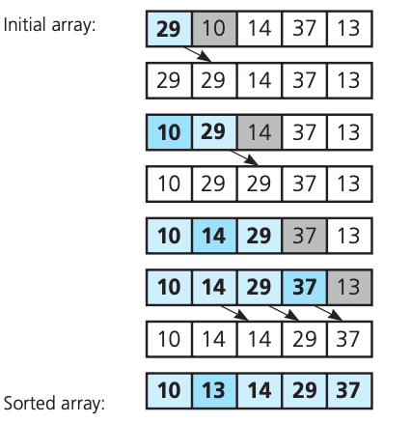
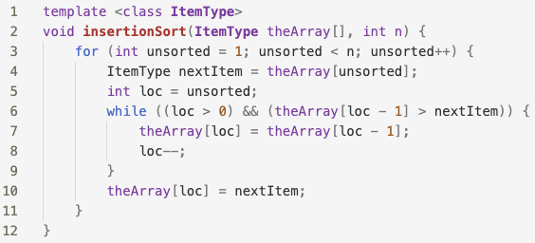
Selection Sort
Insertion Sort
insert next into sorted list
sorted
unsorted

Slide 8
Selection Sort
Insertion Sort Analysis
(n-1)+(n-2)+(n-3)+…+1 = n(n-1)/2
Best Case: O(n)
Worst Case: O(n²)
Could be a good choice when:
n is small

Slide 9
Sorting Runtimes
Algorithm Name | Best Case | Worst Case
Selection Sort select the largest element, swap it with the last element of the unsorted array | O(n²) | O(n²)
Bubble Sort swap adjacent elements if they are out of order | O(n) | O(n²)
Insertion Sort insert each element into its correct position in a sorted array | O(n) | O(n²)

Slide 10
Next Time
Can we do better?
Yes!
Faster sorting with:
Merge Sort
Quick Sort
Radix Sort

