Slide 1

Databricks
setup

Slide 2
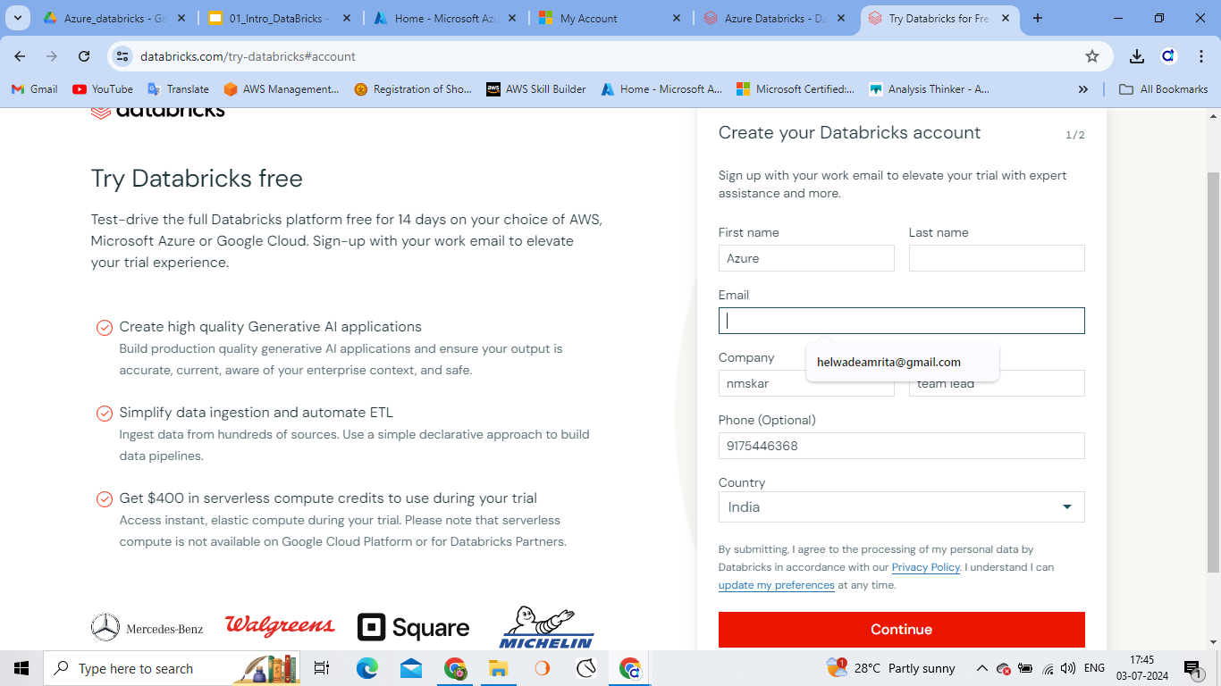
Databricks signup
Data bricks sign up page

Slide 3
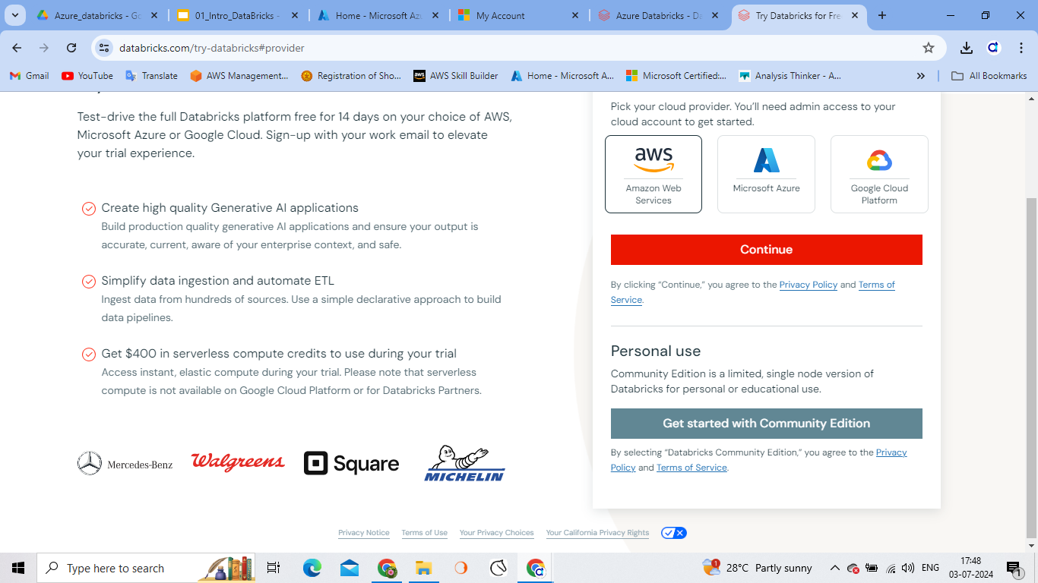
Databricks signup
Select community edition for free usage.
Or select Microsoft azure to connect specific project

Slide 4
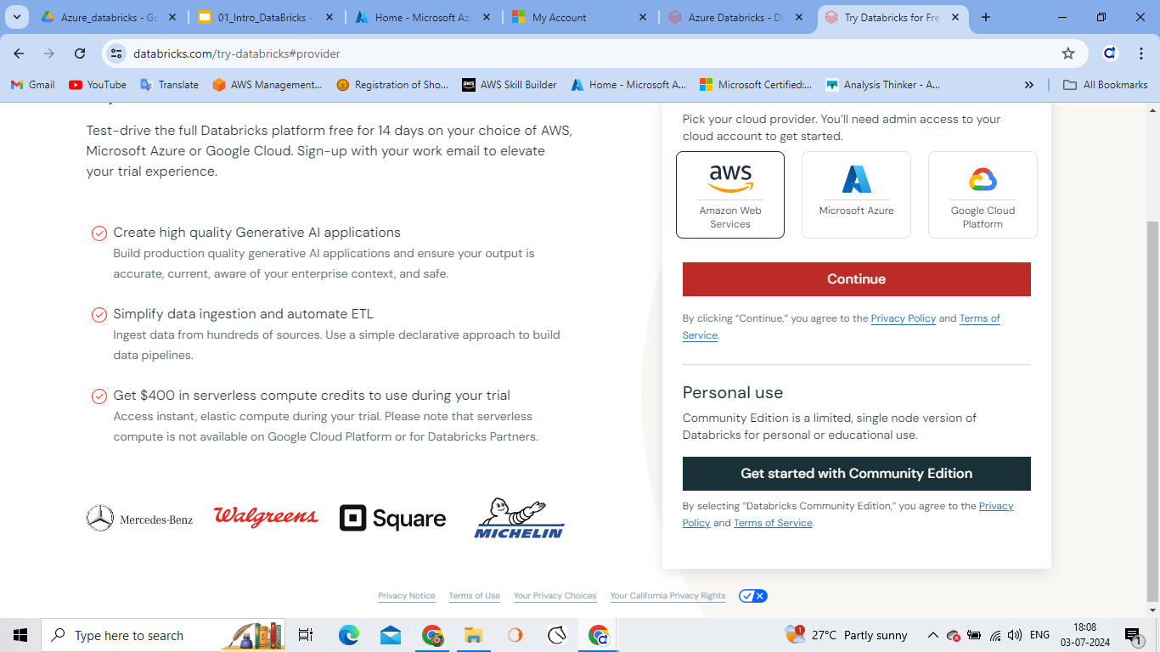
Databricks signup
Data bricks sign up page

Slide 5
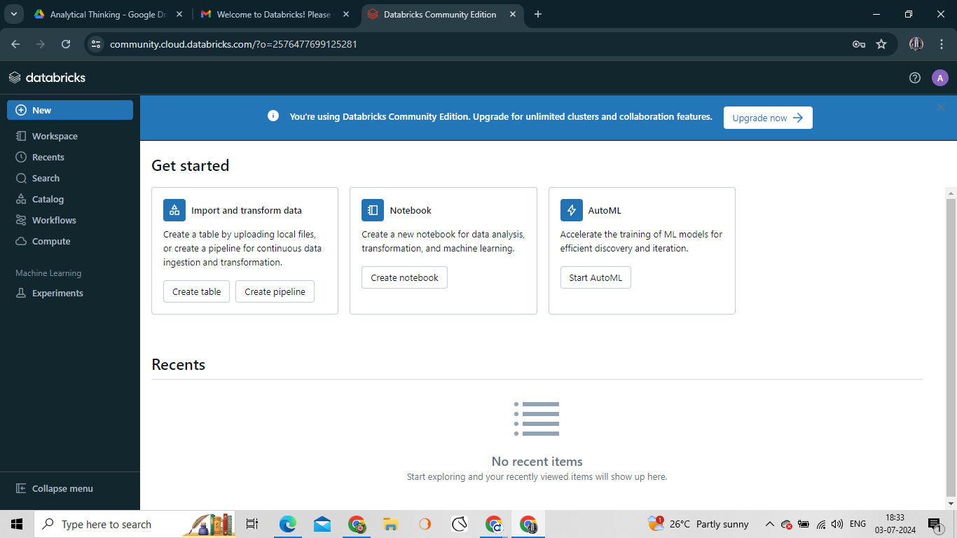

Slide 6
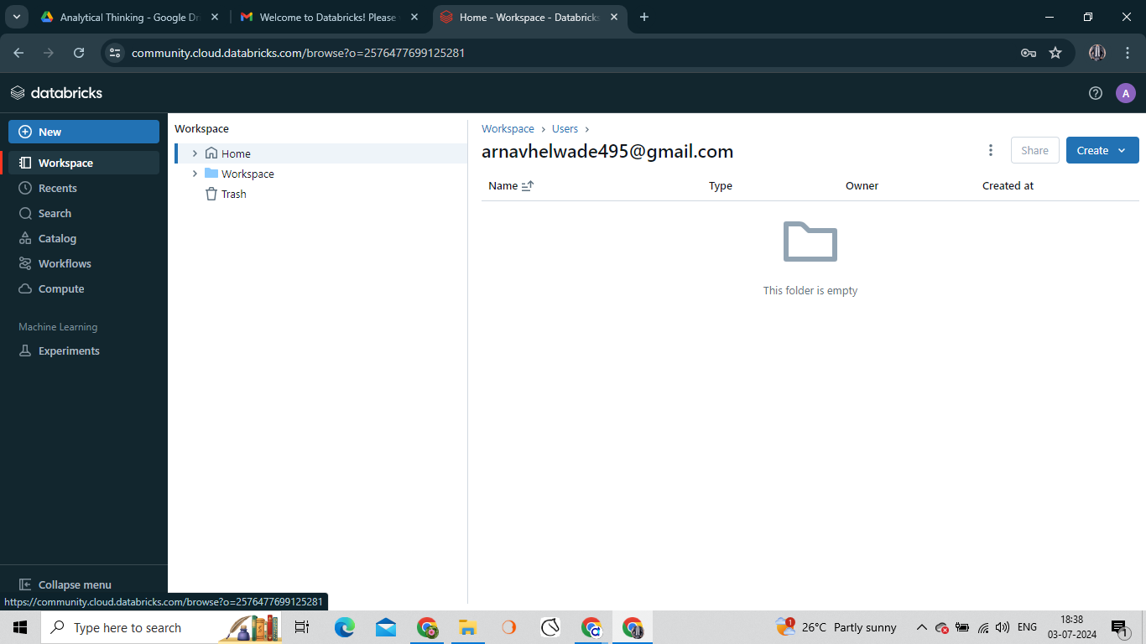
Right click and select import and browse the notebook.dbc file

Slide 7
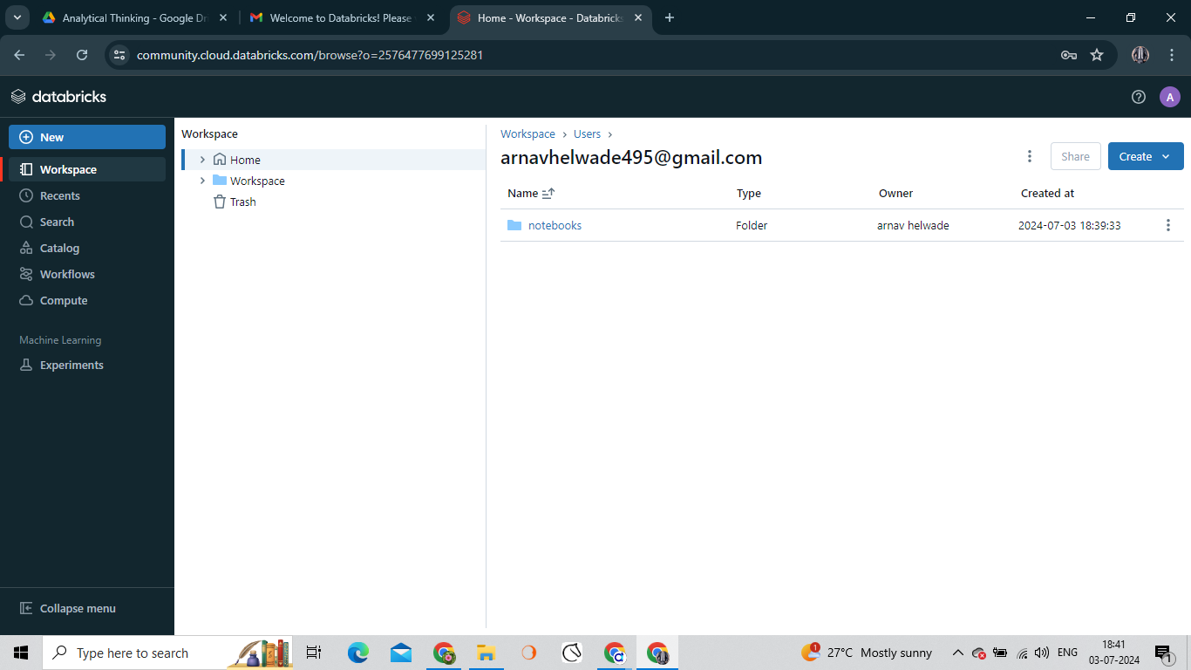

Slide 8

CICD upload
Create a folder first
Inside the folder click on 3 dots and select import
Same process for rest of the folders

Slide 9
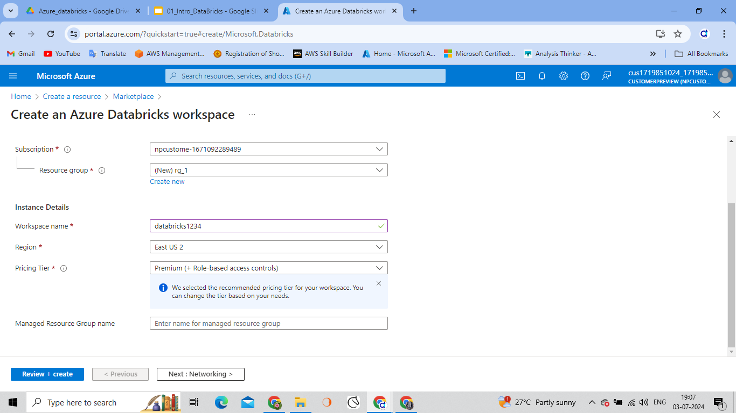

Slide 10
Creating resource for datacricks
Create a azure databrick service
Select the appropriate values
To create a unity catalog we need to have a premium workspace
Managed Resource Group name : it is used while creating the clusters it is used to create compute and virtual machine

Slide 11
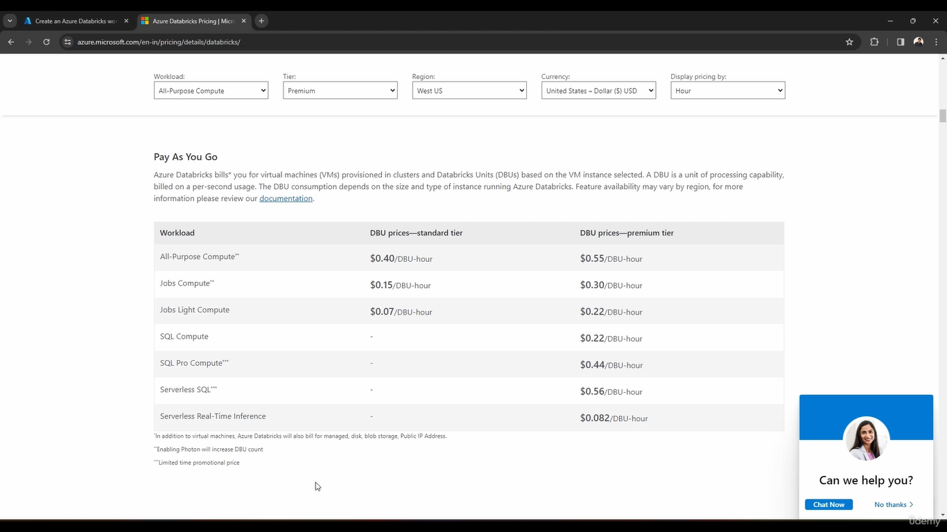

Slide 12
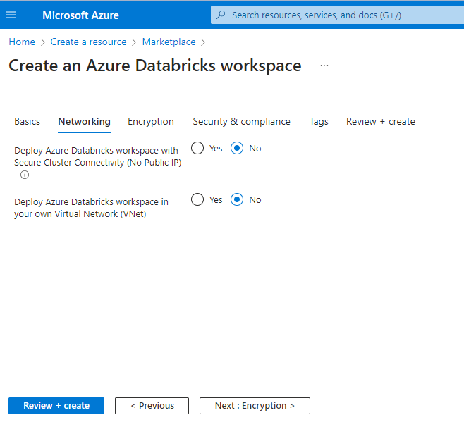
Networking
Select yes if need to set up the Virtual net in case of real time
Click on review +create to create service

Slide 13
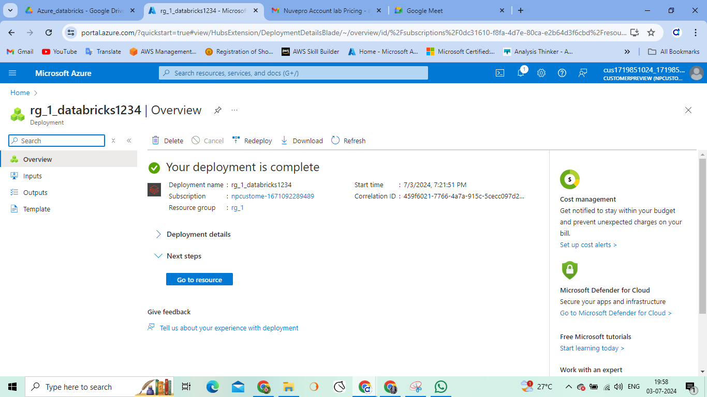

Slide 14
Creating Azure Data lake storage service

Slide 15
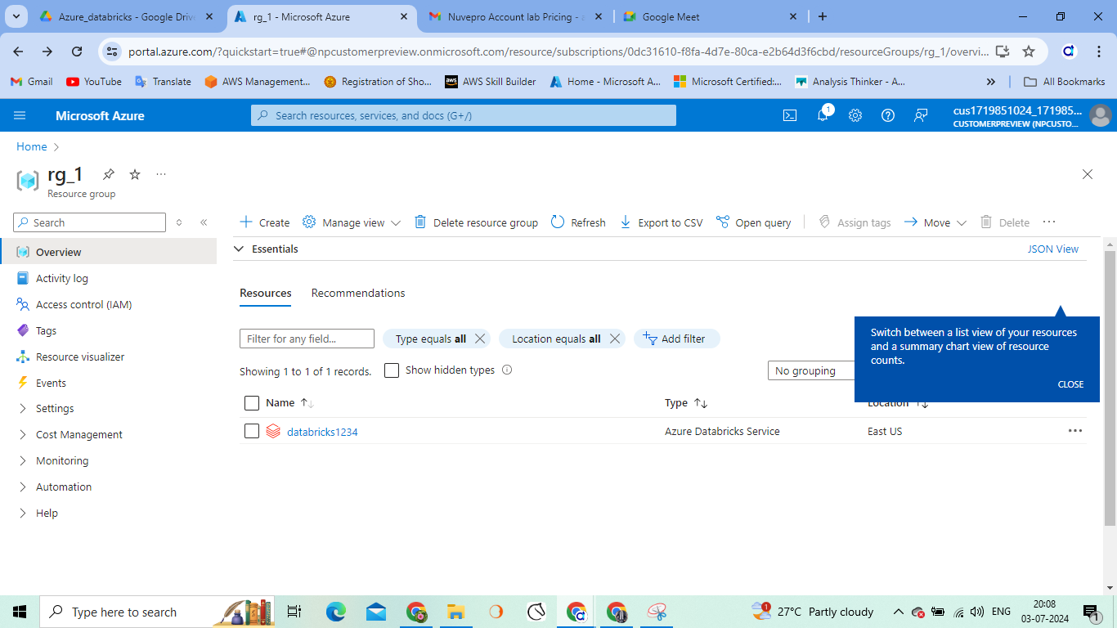

Slide 16
Steps
rg_1 resource group is having one databricks instance i.e. databricks1234
Create a storage account here.
Select LRS as a Redundancy
Performance as Standanrd
Go to Advance tab and tick on Enable hierarchical namespace . This is creating the azure datalake storage otherwise it will be the normal blob storage.
Rest of the parameters are same and click on review.

Slide 17
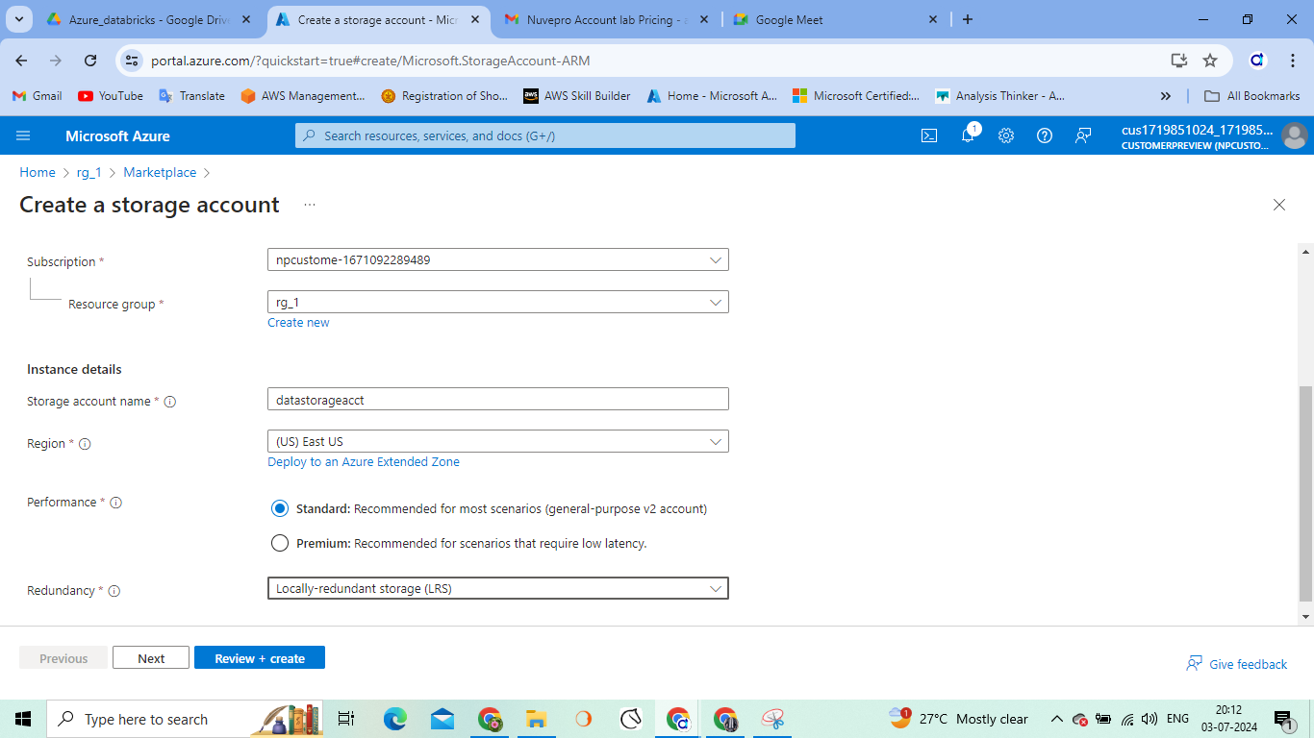

Slide 18
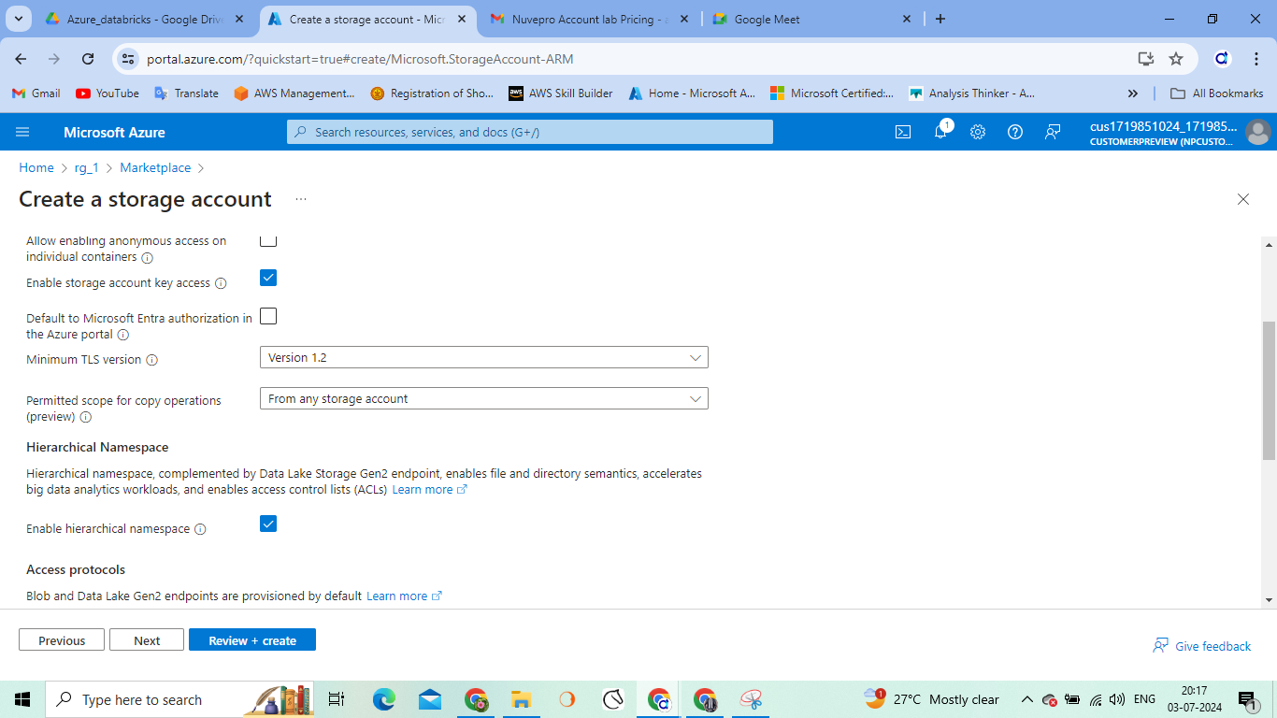

Slide 19
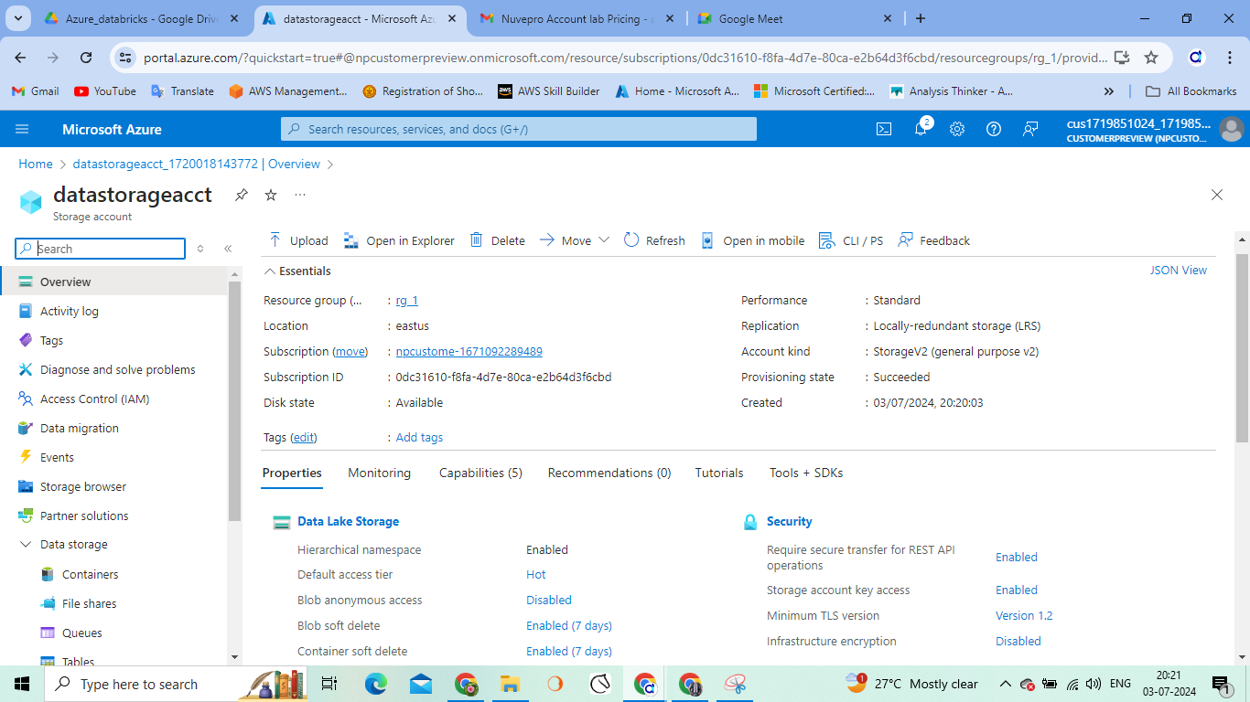

Slide 20
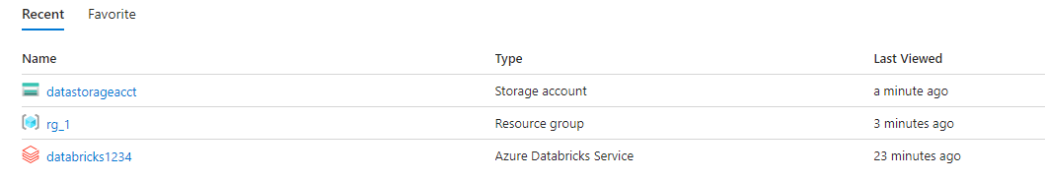
Two services
Databricks
Azure data lake

Slide 21
ERROR
While creating the compute you may come across the error like azure quota exceeded exemption
Here are some settings you need to change.
Search for Quota in azure portal
Go to My quotas
Check the region e.g. in my case region selected in resource group is west India
In the search bar search for Standard DDSv4 / 5 family and adjust the limit to either 5

Slide 22
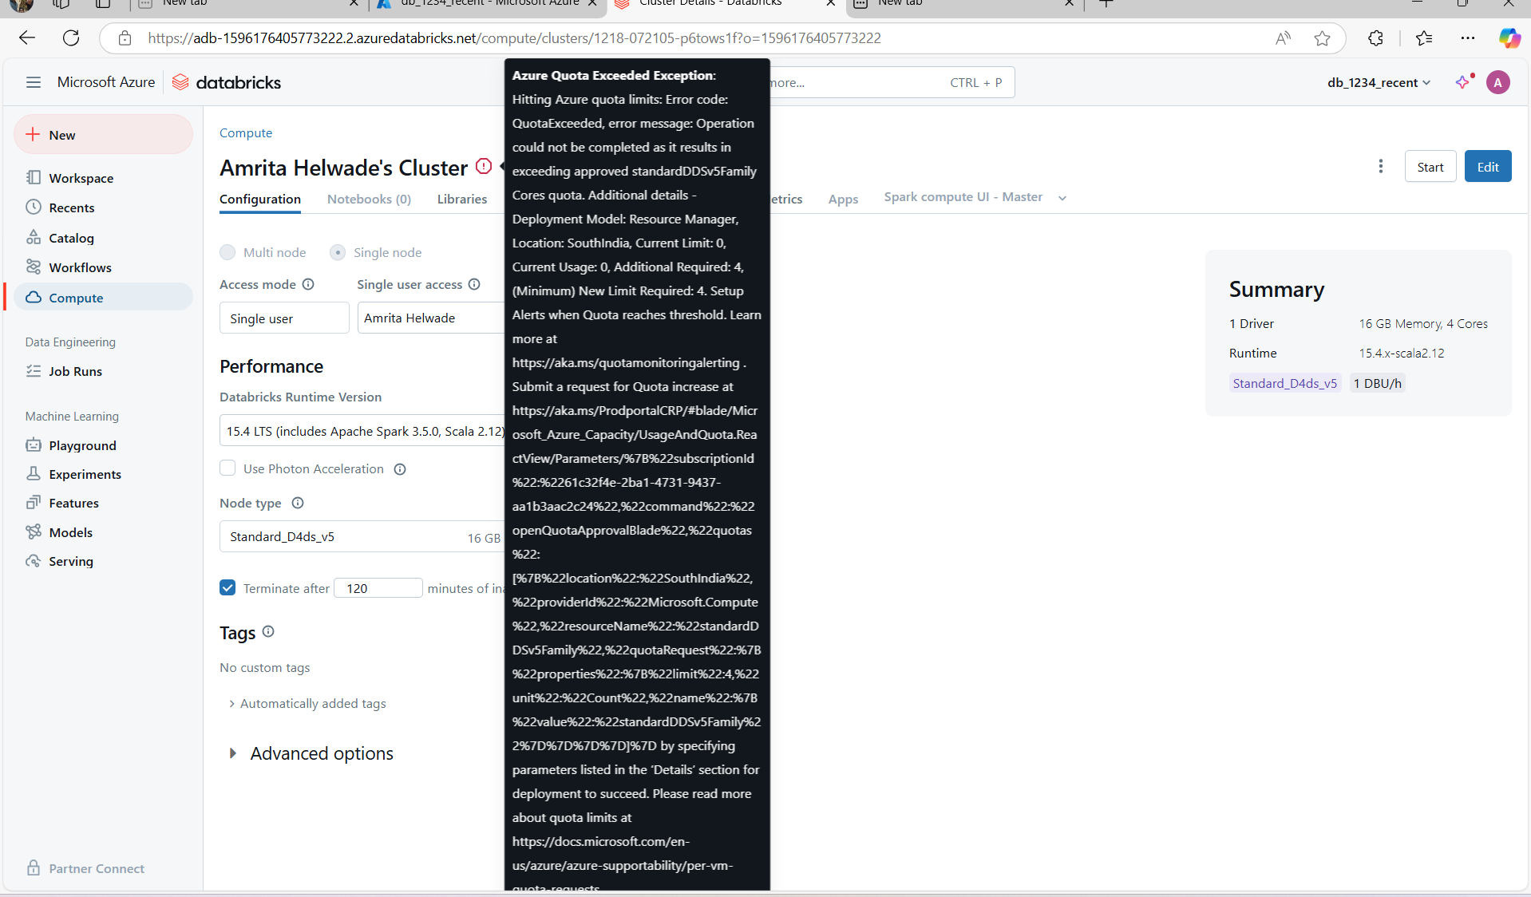

Slide 23
