Slide 1

Databricks

Slide 2
Audience
No experience needed for Azure Databricks , we will start from Scratch
An Azure account for hands-on practical
Basic knowledge on Python and SQL
Basic knowledge on Azure Cloud Environment

Slide 3
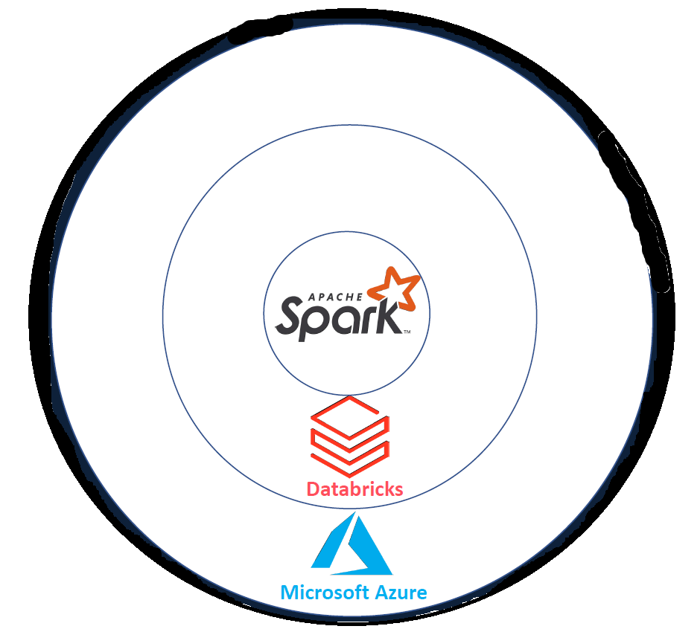
What is Databricks
Core of the Databricks is Apache spark used for developing big data projects
Databricks developed by Apache spark for providing necessary managerial layer.
Microsoft helps to make available Databricks services.
Collection of three services makes together Azure Databricks

Slide 4
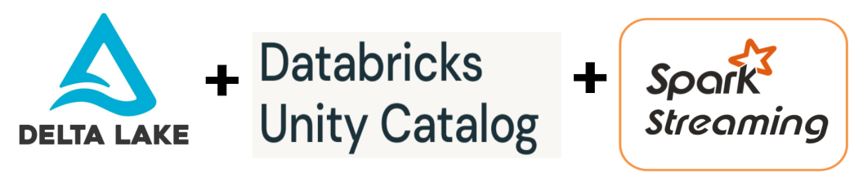
Continuous Integration + Continuous Deployment

Slide 5
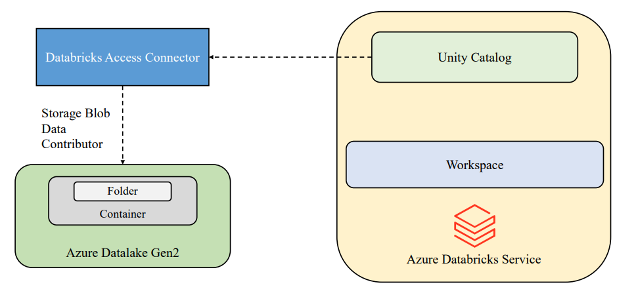

Slide 6
Data Processing in early days
Any big data technology uses the model called distributed computing
Instead of having single processing system we may have distributed storage and distributed approach.
Initially data analytics used to happen on single supercomputer, which manages entire workflow
When data limits are reached we need to add storage and compute. This is called vertical scaling.

Slide 7
Horizontal scaling
Computers are added in horizontally and work parallelly to execute the task.
When limits for the set of computers for reached we just need to add another one. This approach is called horizontal scaling
This group of computers share and work parellel promote faster completion of the task is called clusters
As each computer will have the operating system to coordinate this group of computers together. There will be an OS which is call operation cluster manager

Slide 8
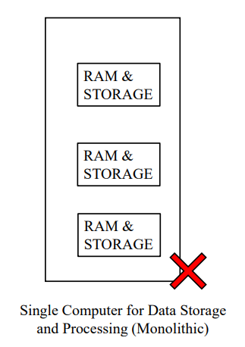
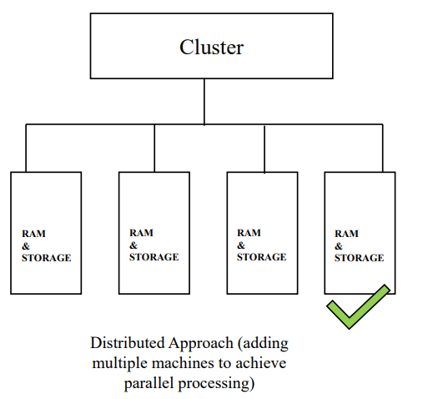
Big data approach

Slide 9
Traditional Hadoop mapreduce processing
Storage HDFS disc
  HDFS read
Iteration 1 - Process data
  HDFS write
Storage HDFS disc
  HDFS read
Iteration 1 - Process data
  HDFS write
Storage HDFS disc

Slide 10
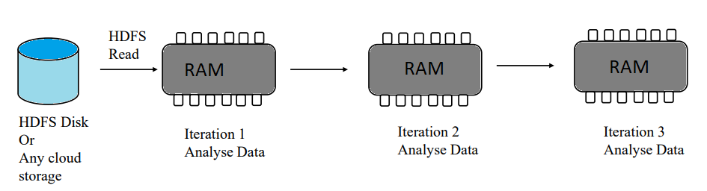
Emergence of spark

Slide 11
Apache spark
Apache Spark is a lightning-fast unified analytics engine for big
data processing and machine learning
Open source
Simple and easy to use API’s
In memory processing engine
Distributed computing Platform
Unified engine which supports SQL, Streaming, ML and graph processing

Slide 12
Apache spark
Apache spark is an open source in-memory application framework for distributed data processing and iterative analysis on massive data volumes
In simple terms, Spark is a
Compute Engine
Unified data processing System

Slide 13
Azure
Unified azure portal+ unified billing
Azure Active directory
Azure DevOps
Azure Data Factory
Azure ML
Power BI
Messaging Services
Data Services
SPARK
cluster
SQL analytics
Data lake
MLflow
Workspace and notebooks
Databases / tables
Optimized spark
Administration controls
Databricks

Slide 14
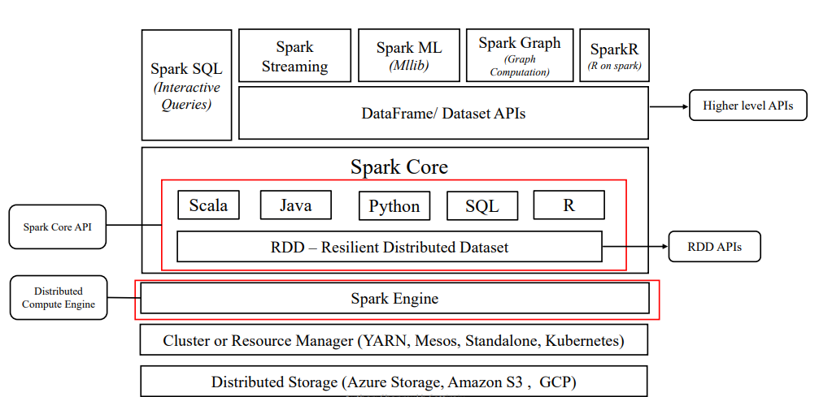
Apache Spark Ecosystem

Slide 15
What is Databricks
Unified Interface
Open analytics platform
Compute Management
Notebooks
Integrates with Cloud Storages
MLFlow modeling
Git
SQL Warehouses

Slide 16
How Databricks Work with Azure?
Unified billing
Integration with Data services
Azure Entra ID (previously Azure Active Directory
Azure Data Factory
Power BI
Azure DevOps

Slide 17
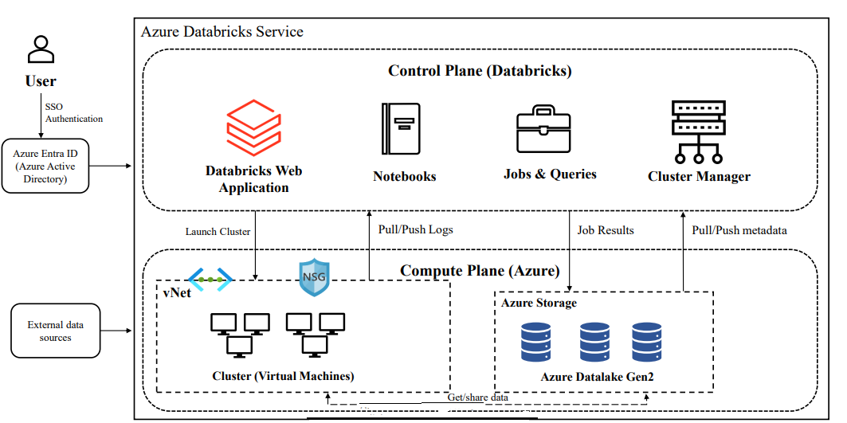
Azure Databricks Architecture

Slide 18
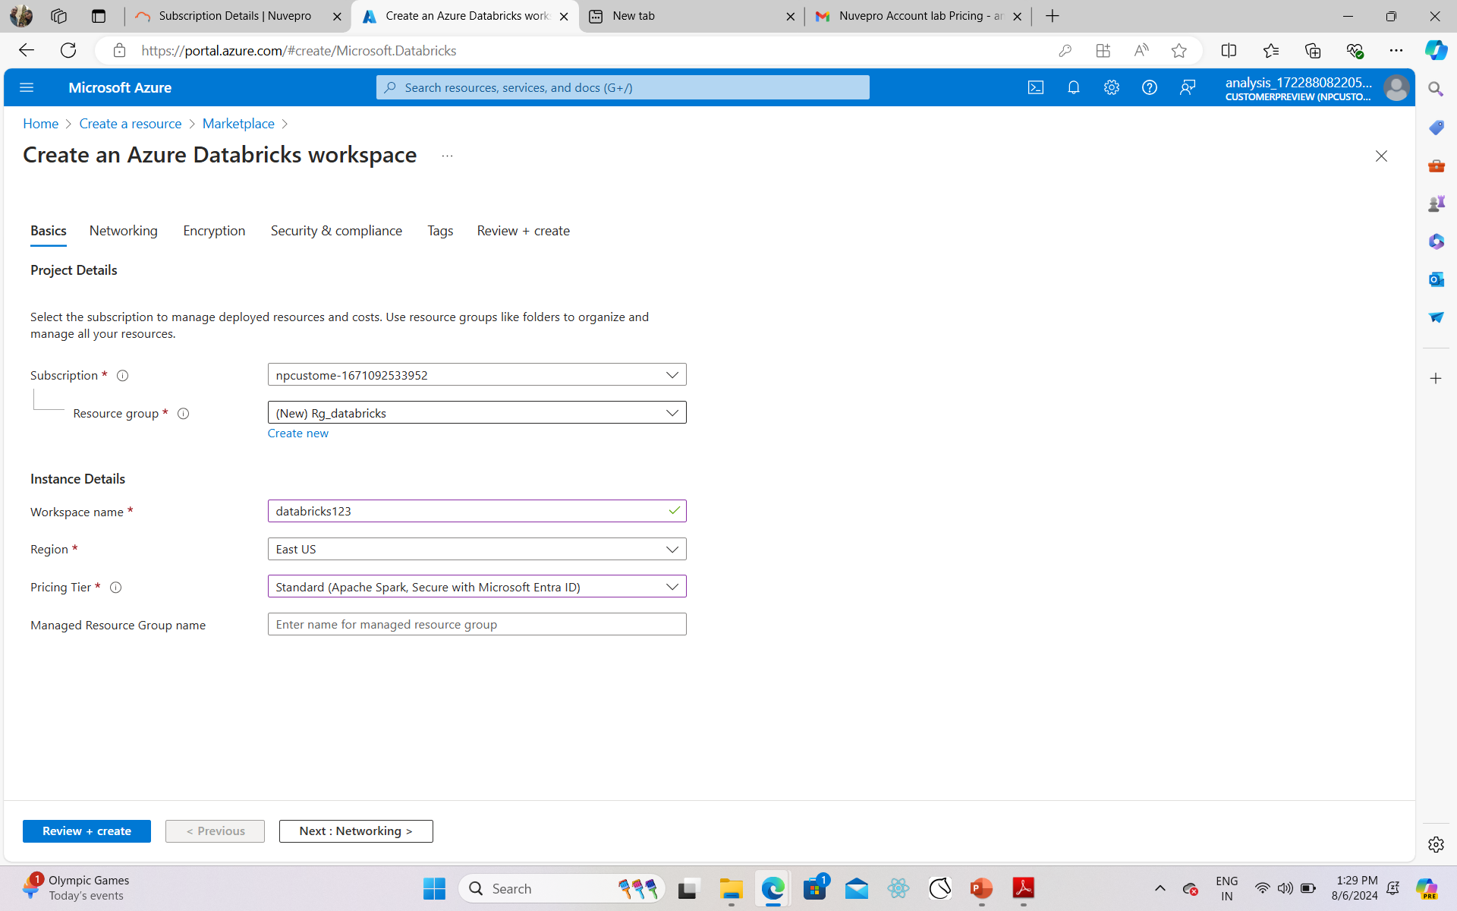

Slide 19
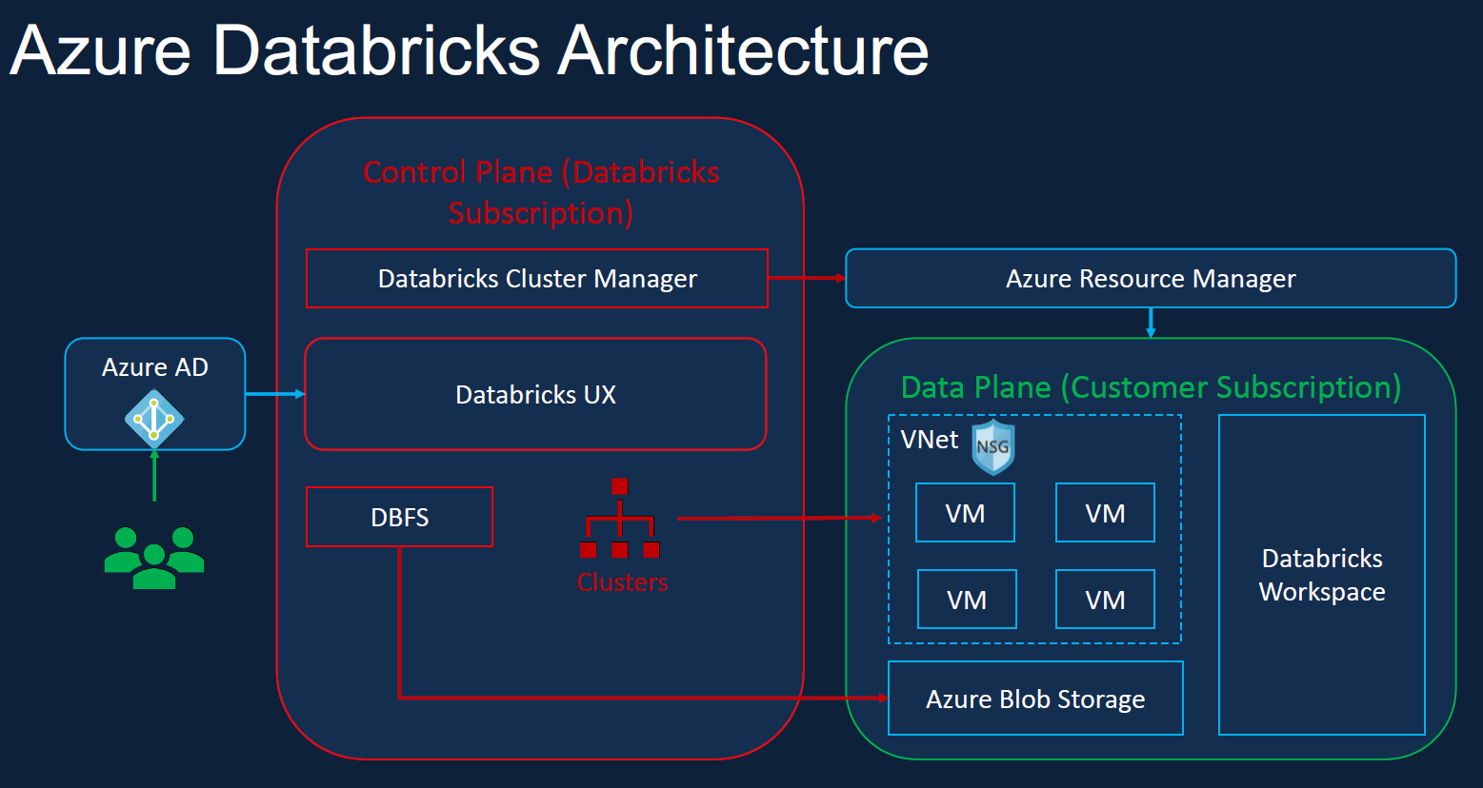

Slide 20
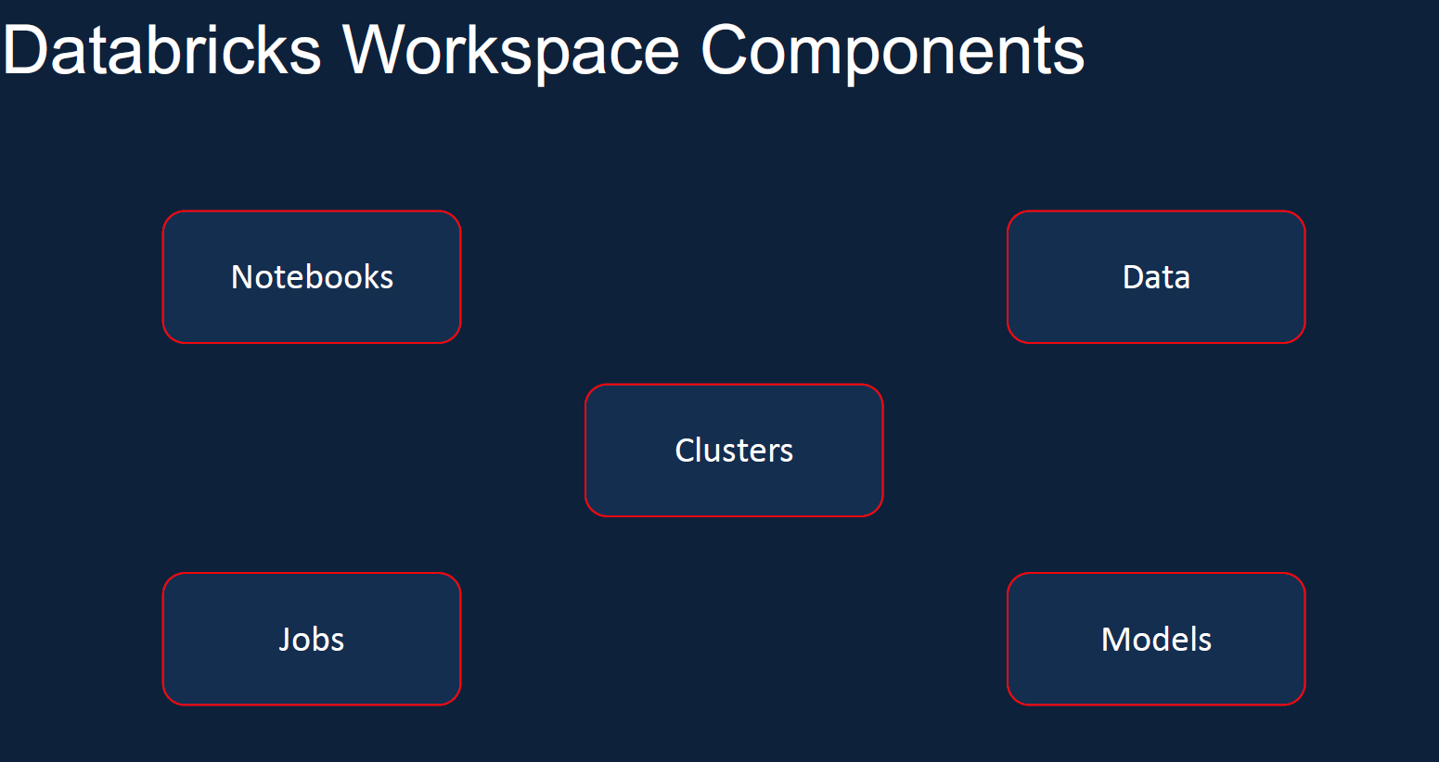

Slide 21
Clusters

Slide 22
Step by step working on clusters:
Cluster types
Cluster configuration
Creating a cluster
Cost Control
Cluster Pools
Cluster Policy
What is Databricks cluster
Pricing

Slide 23
Azure Databricks Compute?
Cluster is a set of computation resources and configurations to run your workloads
Workloads can be:
  Set of commands in a notebook
  A job that you run as a automated workflow
Cluster types:
  All purpose Cluster :- To execute set of commands in a notebook
  Job Cluster :- To execute a job that you run as a automated workflow

Slide 24
Cluster Type 1
All purpose Cluster :
To interactively run the commands in your notebook
Created manually
Multiple users can share such clusters to do collaborative interactive analysis.
You can terminate, restart, attach , detach these clusters to multiple notebooks
You can choose
Multi-node cluster = Driver node and executor nodes will be on separate machine
Single node cluster = Only there will be a single driver node with single machine

Slide 25
Cluster Type 2
Job Cluster
To run a job that you run as a automated workflow
It runs a new job cluster and terminates the cluster automatically when the job is complete.
You cannot restart a job cluster
Can not create job compute manually unless job definition is define

Slide 26
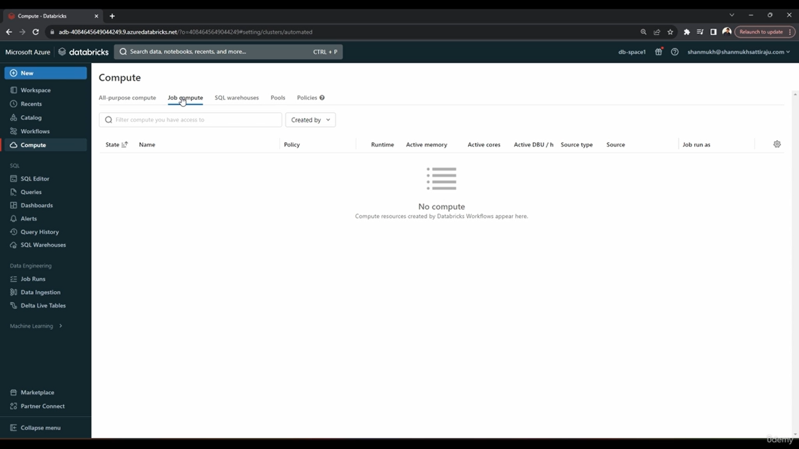
Create a cluster

Slide 27
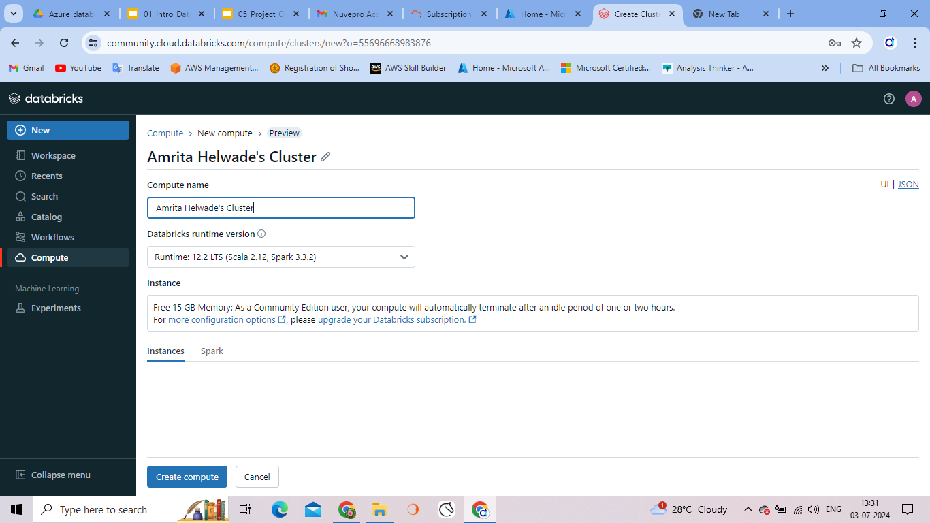

Slide 28
To create a new cluster
The policy
The access mode, which controls the security features used when interacting with data
The runtime version •
The cluster worker and driver node type

Slide 29
Nodes
Single node: Only one node. i.e. Driver node and no Worker node. Supports spark workloads. Not horizontally scalable. So not suitable for large ETL workloads. Mainly used for light weight ML and analysis workloads which not required any distributed compute capacity.
Multi node: One drive node and one worker node. When we run Spark job against a multi node cluster, the driver node will distribute the task to run on the worker node in parallel and returns the result. They give us ability horizontal scale the cluster depends on the workload. These are the default types of cluster used for spark jobs and suitable for large workloads

Slide 30
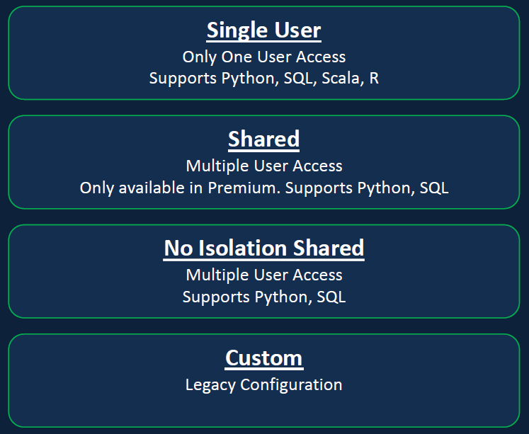
Access mode

Slide 31
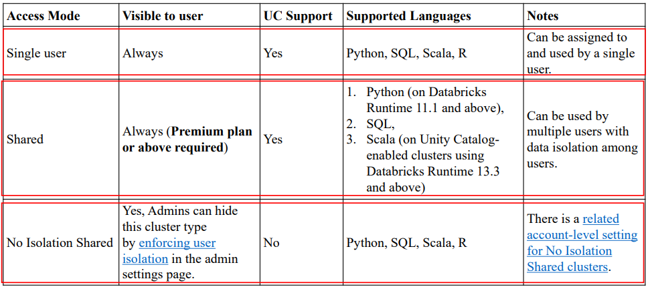
Cluster Access modes

Slide 32
Databricks Runtime
Databricks Runtime
Optimized version of apache spark library. Scala, java, ubuntu, GPU, spark, deltalake, Python, R Ubuntu
Databricks runtime ML
ML libraries like PyTorch, Keras, Tensorflow, Xgboost etc
Databrick runtime Light
Runtime options for only jobs not requiring advance features
Photon runtime
Everything from Databricks runtime, Photon engine

Slide 33
Cluster Runtime version:
Databricks Runtime is the set of core components that run on your clusters.
So which version to use?
For all purpose compute:
Databricks recommends using the latest Databricks Runtime version.
Using the most current version will ensure you have the latest optimizations and most up-to-date compatibility between your code and preloaded packages.

Slide 34
Cluster Runtime version:
For Job compute:
  As these will be operational workloads, consider using the Long Term Support (LTS) Databricks Runtime version.
  Using the LTS version will ensure you don’t run into compatibility issues and can thoroughly test your workload before upgrading.
For ML Workloads: For advanced machine learning use cases, consider the specialized ML Runtime version

Slide 35
Cluster policies ( in Unity Catalog)
Policies are a set of rules configured by admins
These are used to limit the configuration options available to users when they create a cluster
Policies have access control lists that regulate which users and groups have access to the policies.
Any user with unrestricted policy can create any type of cluster

Slide 36
Use photon acceleration
Photon acceleration is the engine give by databricks if you want to have your workload in much better performance
This is going to enhance the DBU/h
When we create a clusters, here it is group of virtual machines
Spark supports worker and driver mode
Worker type: asking for the type of configuration needed for virtual machine. Dropdown provides the configuration for worker/executor.
Driver type: is different types of configuration.

Slide 37
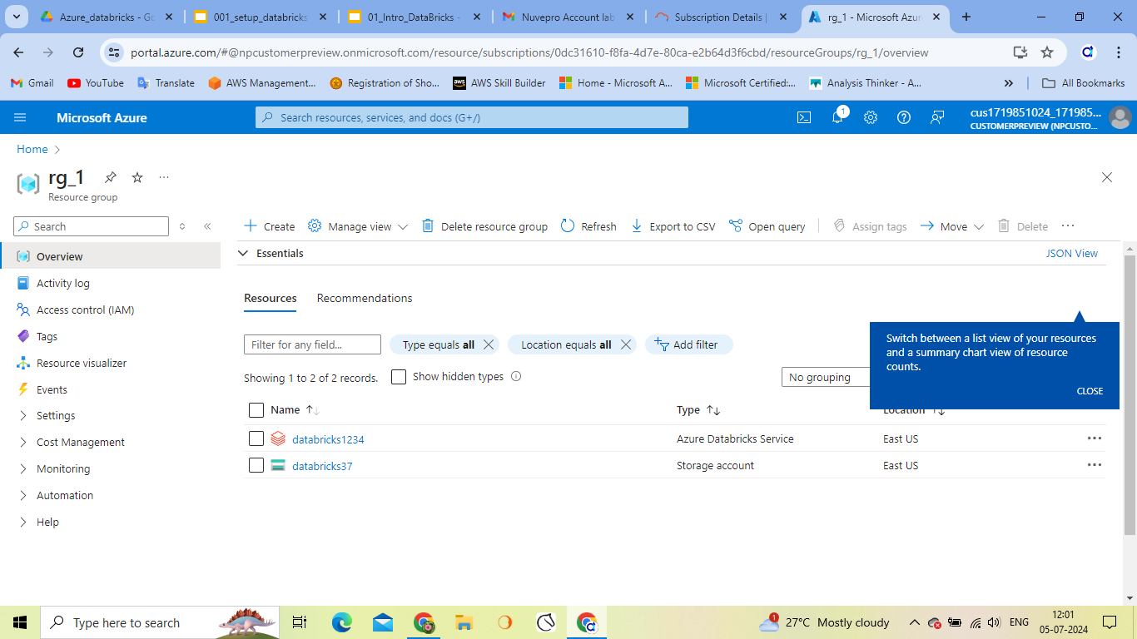
Practical

Slide 38
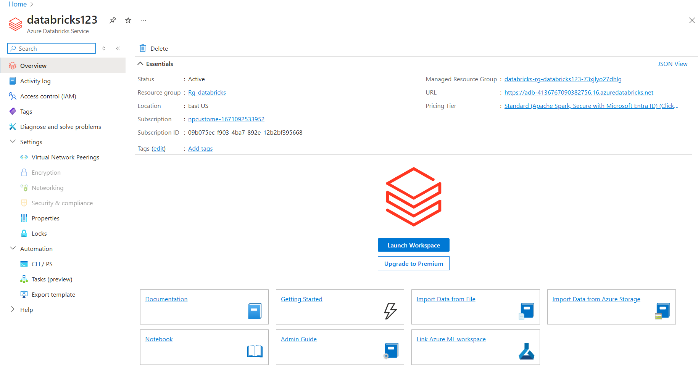

Slide 39
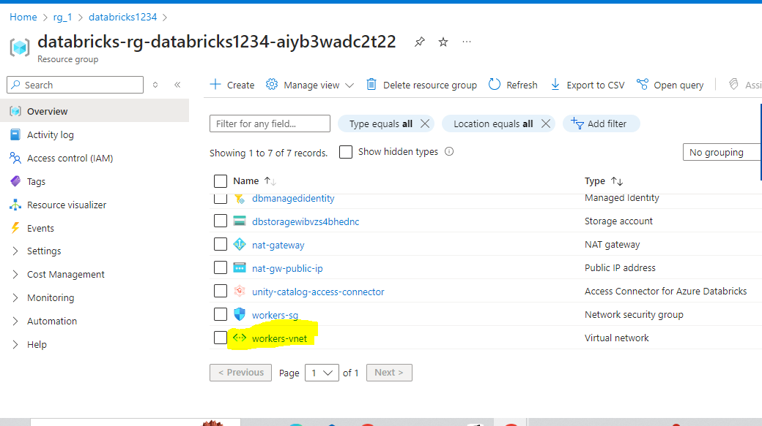
Find the v-net and network security
Click on the manages resource group. Worker-vnet is the virtual network here.
Virtual machine can be seen when we create the compute

Slide 40
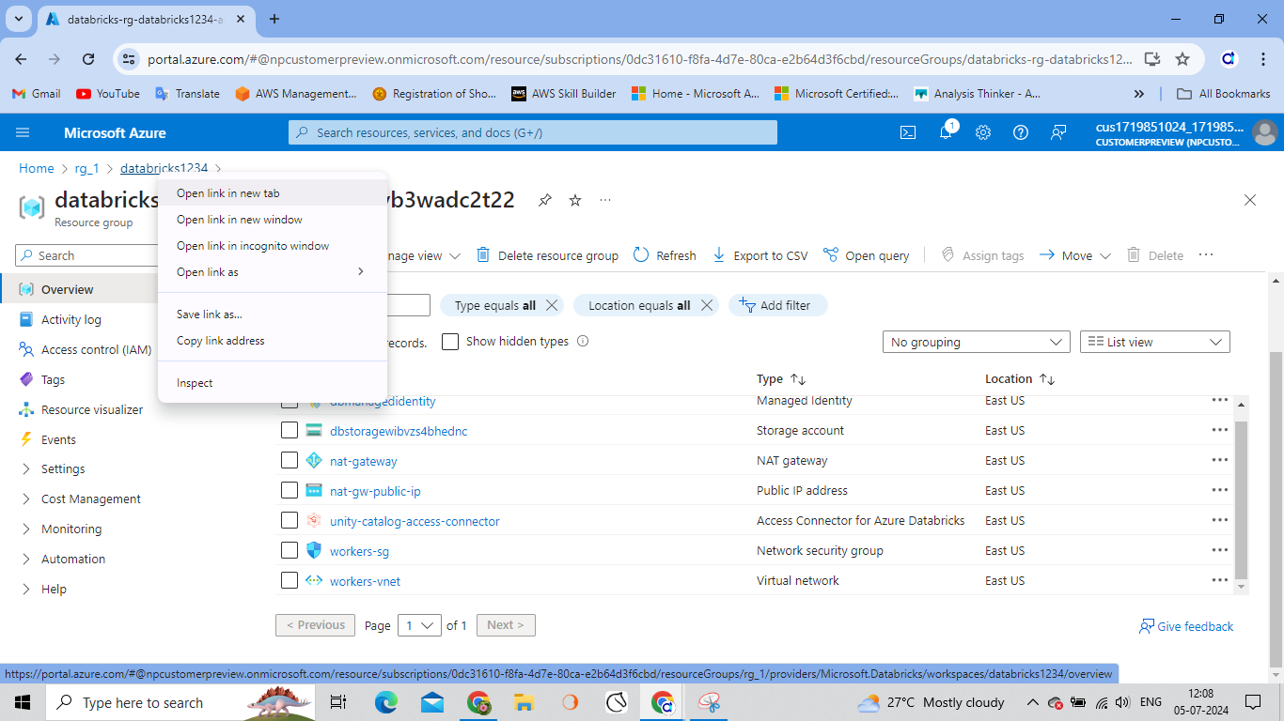
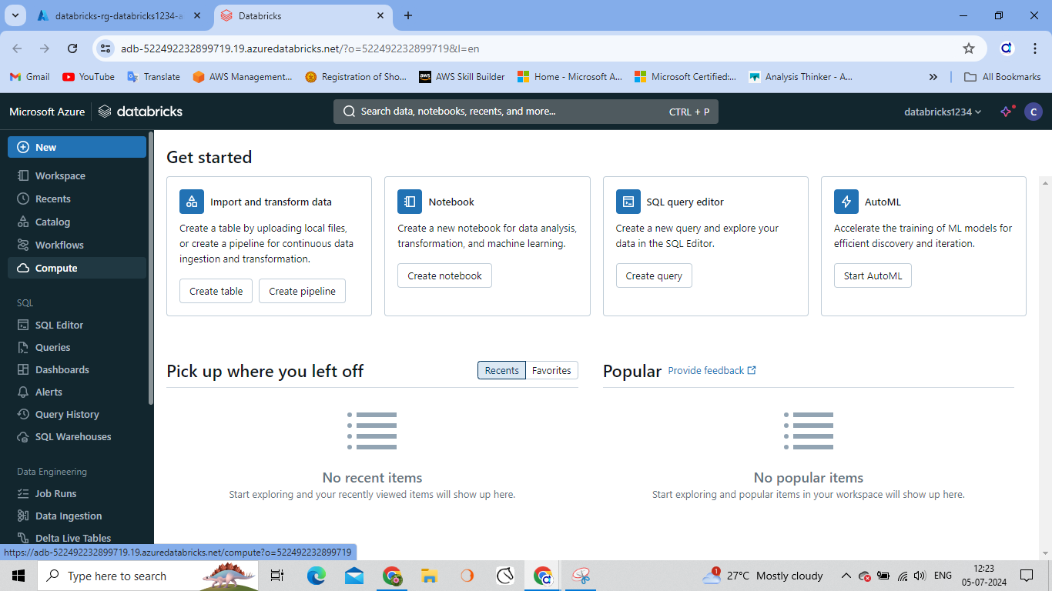
Cluster creation
Launch a new workspace for databricks
In order to create some clusters click on compute and create a single node cluster

Slide 41
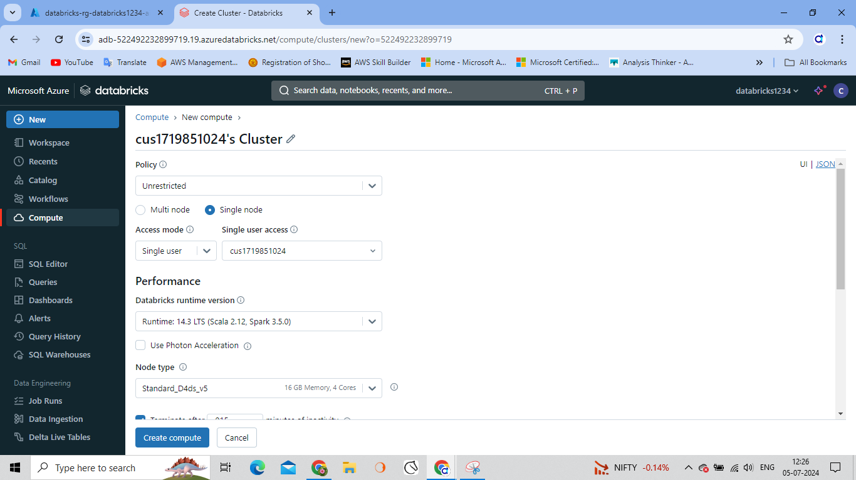
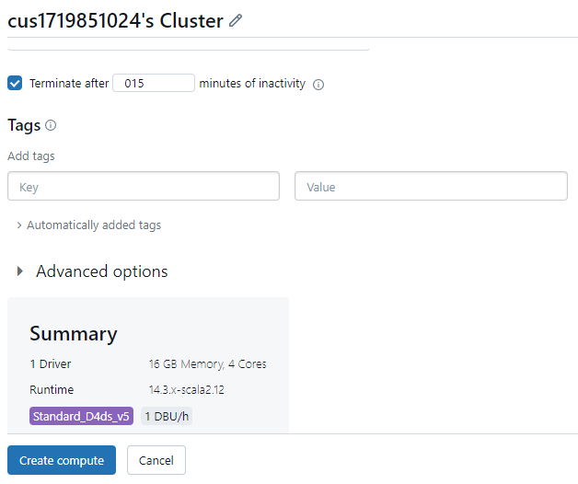
Create compute

Slide 42
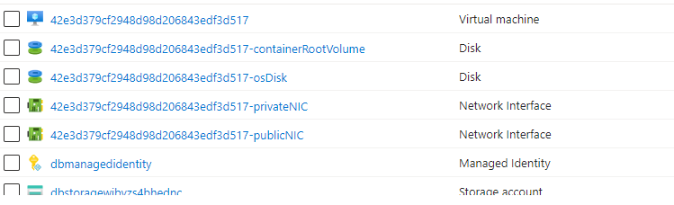
What happens in Azure resource?
After refresh you can see new storage disk, VM, network interface, Public IP address are added. These are created when we initiated the cluster
These are group of computers generated when we select the single node cluster.
Cluster will be charges when we run the cluster based on all services allotted to it.
Always terminate the cluster when notebook execution is done

Slide 43
Cluster pools ( in Unity Catalog)
Speed Up Your Data Pipeline with Databricks Pools

Slide 44
Pricing of Databricks
Workload (All purpose, jobs, SQL, Photon)
Tier (Premium/standard)
VM type(General Purpose/ GPU/ Optimized)
Purchase plan (pay as you go/ Pre-Purchase)
Azure Databricks Pricing | Microsoft Azure

Slide 45
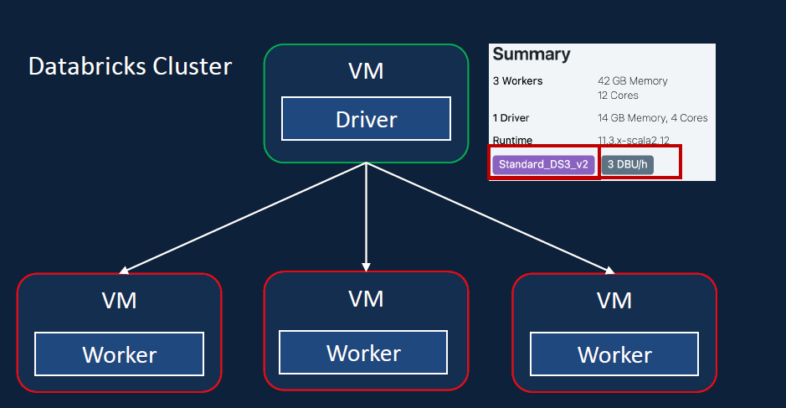
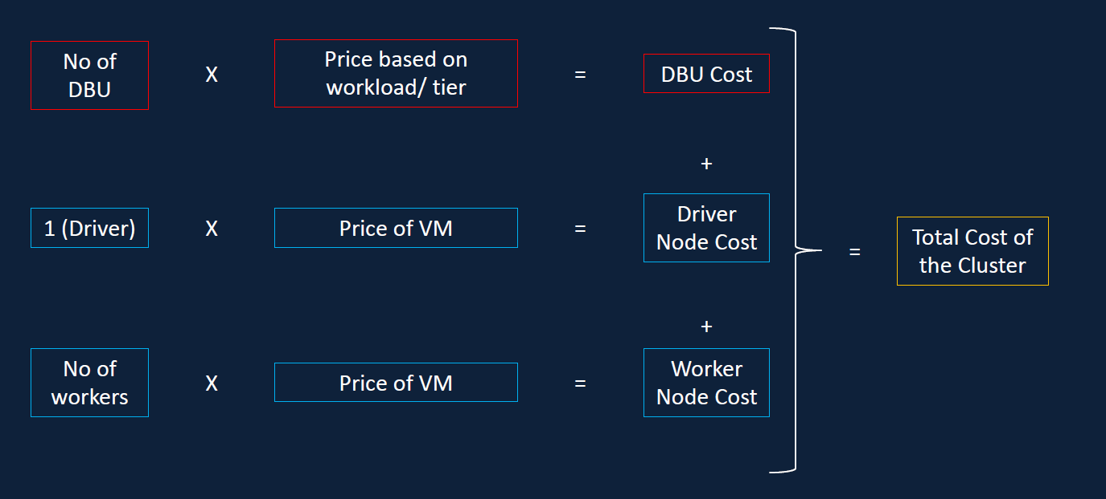
Example

Slide 46
Thank You

