Slide 1
Databricks Notebook

Slide 2
What is notebook
Creating notebook
Magic commands
Databricks Utilities
Import project solution notebook

Slide 3
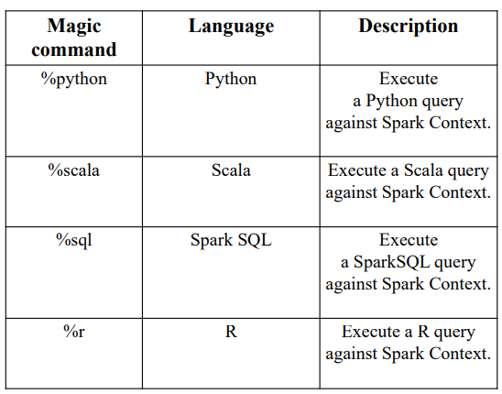
Commands
You can use multiple languages in one notebook
You need to specify language magic command at the beginning of a cell.
By default, the entire notebook will work on the language that you choose at the top

Slide 4
Use of utilities
Make easy to combine different types of task in a single notebook
Allow to combine file operations with ETL task
File system Utilities
Secrete Utilities
Widgets Utilities
Notebook workflow Utilities

Slide 5
DBUtils
Azure Databricks provides set of utilities to efficiently interact with your notebooks
Most commonly used DBUtils are:
  File System Utilities
  Widget Utilities
  Notebook Utilities

Slide 6
File System Utilities
dbutils.fs provides utilities for working with File Systems. Below are the available utilities
  cp : Copies a file or directory, possibly across FileSystems
  head : Returns up to the first 20 records
  ls : Lists the contents of a directory
  mkdirs : Creates the given directory if it does not exist, also creating any necessary parent directories
  mv :Moves a file or directory, possibly across FileSystems
  put : Writes the given String out to a file
  rm : Removes a file or directory

Slide 7
Widgets Utilities
Dbutils.Widgets Utilities helps to gets the input value using parameters. Widget types are:
combobox : Creates a combobox input widget with a given name, default value and choices
dropdown : Creates a dropdown input widget a with given name, default value and choices
get : Retrieves current value of an input widget

Slide 8
Widgets Utilities
multiselect : Creates a multi select input widget with a given name, default value and choices
remove : Removes an input widget from the notebook
removeAll : Removes all widgets in the notebook •
text : Creates a text input widget with a given name and default value

Slide 9
Notebook Utilities
Invove one notebook through others.
Exit : This method lets you exit a notebook with a value
Run : This method runs a notebook and returns its exit value

Slide 10
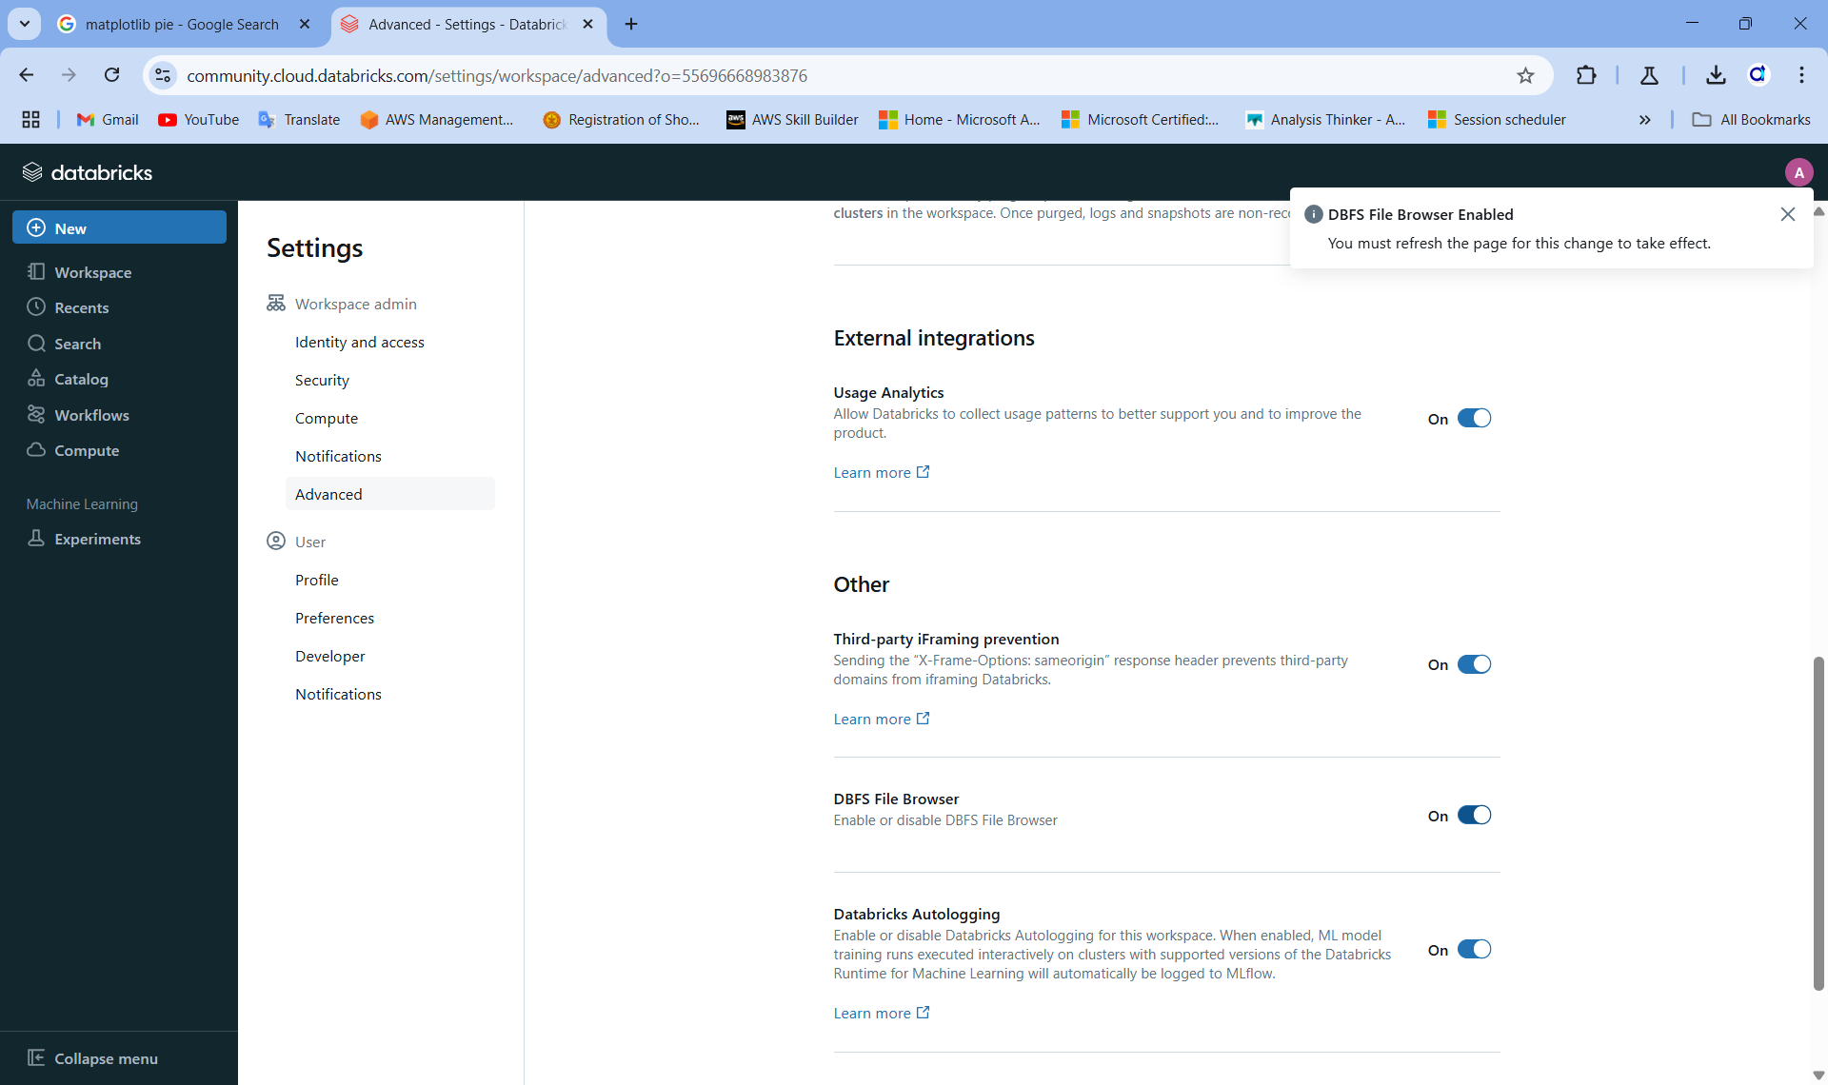
DBFS (Databricks file system)
To upload files in databricks file system go to user settings,
Go to advance -> other -> and enable DBFS file browser
Refresh the page after DBFS file Browser Enabled

Slide 11
Reference link
https://learn.microsoft.com/en-us/azure/databricks/notebooks/notebooks-code

Slide 12
Thank You

