Slide 1
DBFS
Databrick file system

Slide 2
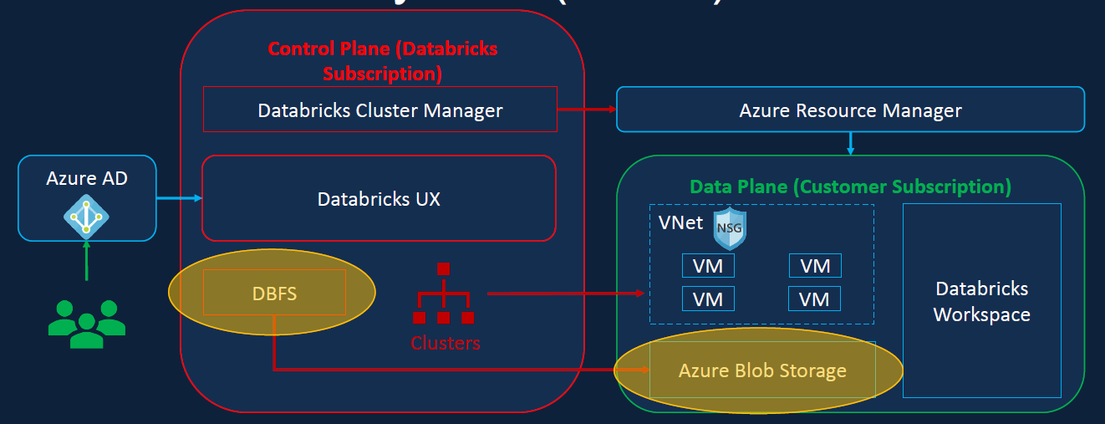
DBFS
Databrick file system: is a distributed file system mounted on the databricks workspace.
DBFS root is the default storage for databricks workspace created during workspace deployment.

Slide 3
Root
Backed by the default Azure blob storage
Can be accessed via web UI
Query results are stored here
Default storage location for managed tables
Default storage location but not recommended for user data.

Slide 4
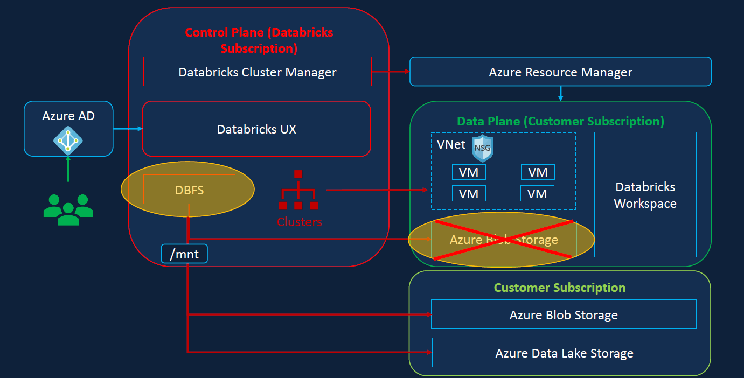
Databricks mount
Benefits:
Access data without requiring credentials
Access files using file semantics rather than storage URLs (e.g. /mnt/storage1)
Stores files to object storage (e.g. Azure Blob), so you get all the benefits from Azure
Recommended solution for access Azure Storage until the introduction
of Unity Catalog (Generally Available from end of 2022)
Databricks notebook
DBFS
Azure datalake gen2

Slide 5
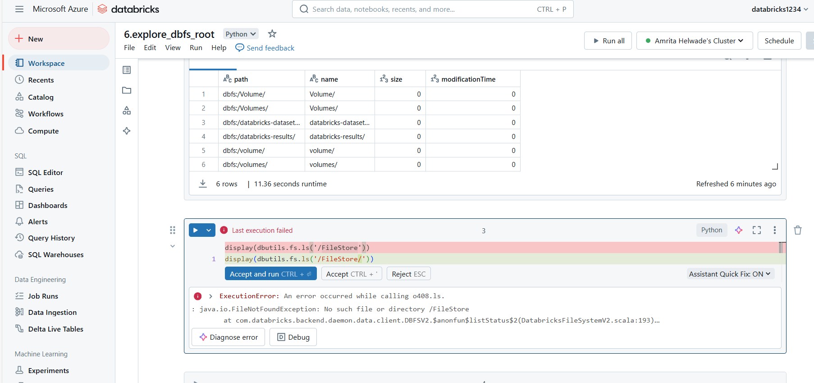
Connecting with DBFS
To resolve this, make DBFS file browser enabled
Refresh and check if changes are done
Go to compute and click on browse DBFS
Which is holding FileStore folder.
Click on Upload to upload files here.

Slide 6
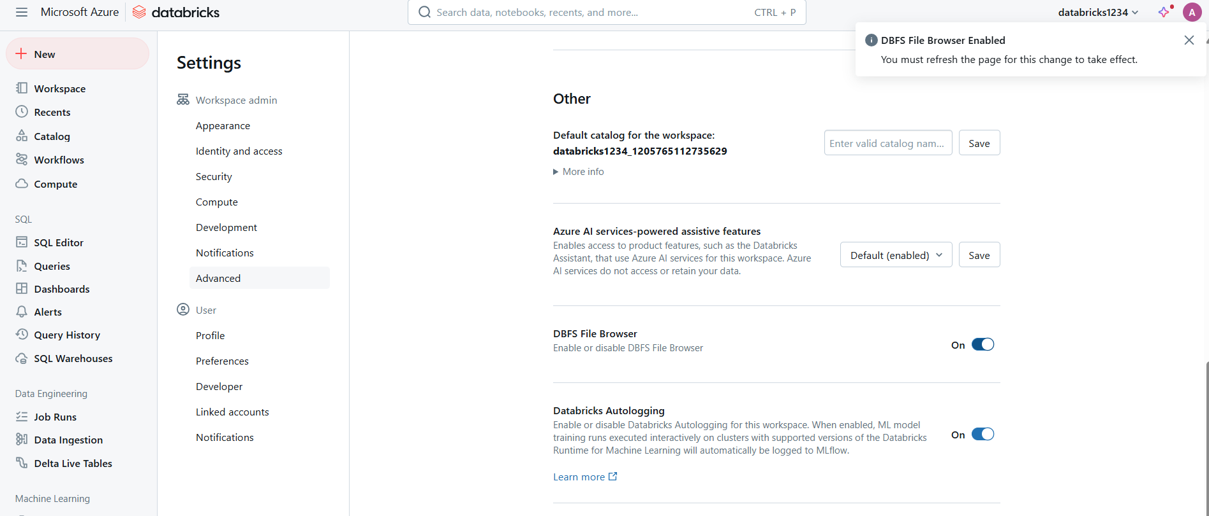
Change the setting step1

Slide 7
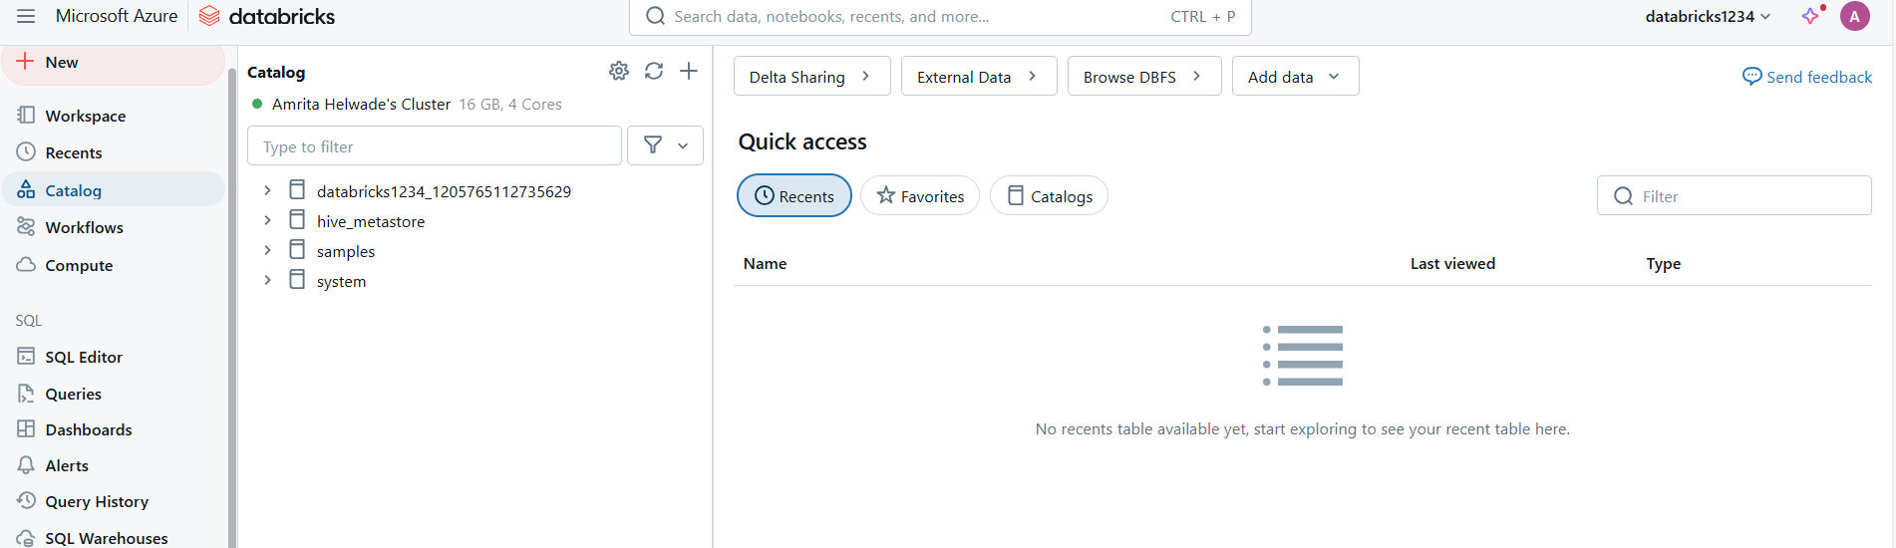
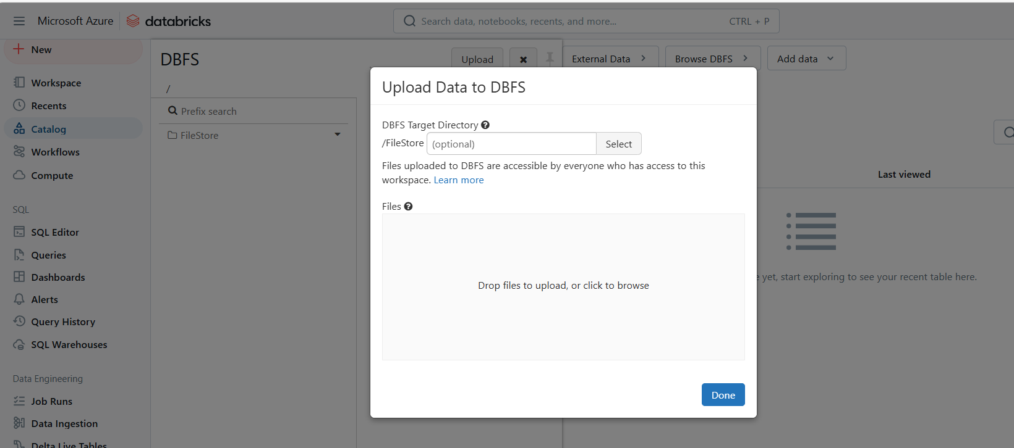
Step 2

Slide 8
step3
Go to the notebook and check for execution of following code
  display(dbutils.fs.ls('/FileStore'))
  display(spark.read.csv('dbfs:/FileStore/circuits.csv'))
  display(spark.read.csv('/FileStore/circuits.csv’))
Drawback:
  This folder is available for all who are having access to this workspace. And customer data can not be kept here.
  This folder and storage will be dropped when we delete the workspace.

Slide 9
Solution for drawback-Mount
Customer data can be stored in lake gen2. Even after deletion of the workspace customer data can be kept untouched.
To deal with this we can connect to lake gen2 using ABFS protocol which we done in previous section. But this is tedious in case of URLs and need credentials to authenticate to storage acct before accessing the data.
To make better databricks allows us to mount these storage account to DBFS. We specify the credential when it is mounted and once it is mounted everyone has access to the workspace without providing credentials.
Acces file using file semantics rather than storage URL(e.g. mnt/folder)

Slide 10
Databricks mounts
Databricks notebook
DBFS (/mnt/storage)
Service principal
Azure datalake gen 2
Create mount using credentials
Provide required access

