Slide 1
Spark streaming Structure

Slide 2
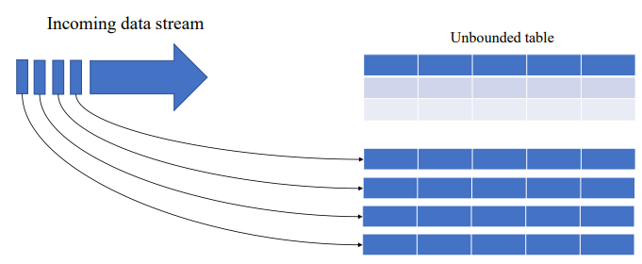
Spark structured streaming

Slide 3
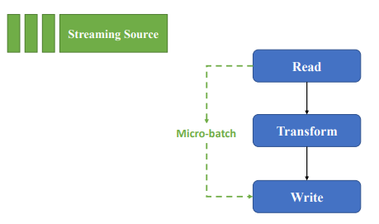
Spark structured streaming flow

Slide 4
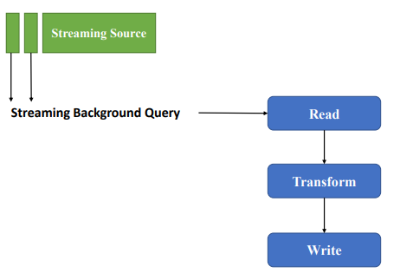
Spark structured streaming flow

Slide 5
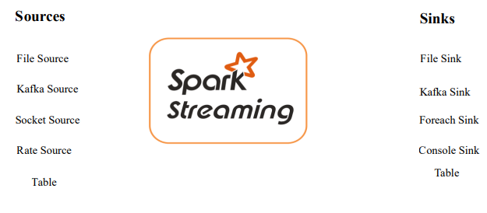
Supported sources and Slinks

Slide 6
StreamWriter
<StreamingDataframe>.writeStream .option('checkpointLocation’,) .outputMode('append’) .toTable(‘’) Checkpoint
To develop fault-tolerant and resilient Spark applications.
It maintains intermediate state on fault-tolerant compatible file systems like HDFS, ADLS and S3 storage systems to recover from failures.
Must be unique to each stream

Slide 7
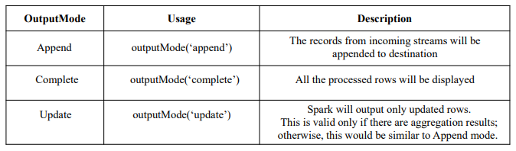
outputModes

Slide 8
Triggers
Triggers | Usage | Description
Unspecified (default) |  | will trigger the microbatch for every 500 ms or half a second
processingTime (Fixed Interval) | . trigger(processingTime='2 minutes') | You can set processing time or time interval for each execution .
availableNow (OneTime) | .trigger(availableNow = True) | consumes all available records from previous execution as an incremental batch
Continuous (experimental) | .trigger(continuous = ‘1 second’) | For ~1ms latency

Slide 9
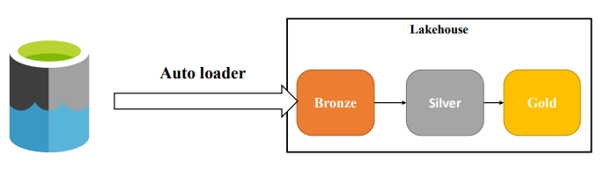
Autoloader

Slide 10
Autoloader
Autoloader is an optimized data ingestion tool that incrementally and efficiently processes new data files as they arrive in the cloud storage built into the Databricks Lakehouse.
Auto Loader incrementally and efficiently processes new data files as they arrive in cloud storage without any additional setup.
Auto Loader can load data files from Cloud Storages without being vendor specific (AWS S3 , Azure ADLS , Google Cloud Storage, DBFS).

Slide 11
Autoloader
Auto Loader can ingest JSON, CSV, PARQUET, AVRO, ORC, TEXT, and BINARYFILE file formats
This Auto loader is beneficial when you are ingesting data into your lakehouse particularly into bronze layer as a streaming query.

Slide 12
Implementing Autoloader
df_str = (spark.readStream
.format("cloudFiles") ## This will tell the spark to use AutoLoader.
.option("cloudFiles.format","csv") ## Tells Autoloader to expect csv files
.option('header','true')
.schema(schema)
.load(f'{source_dir}') )

Slide 13
Schema evolution
Schema evolution is the process of managing changes in data schema as it evolves over time, often due to updates in software or changing business requirements, which can cause schema drift
Ways to handle schema changes
  Fail the stream
  Manually change the existing schema
  Evolve automatically with change in schema

Slide 14
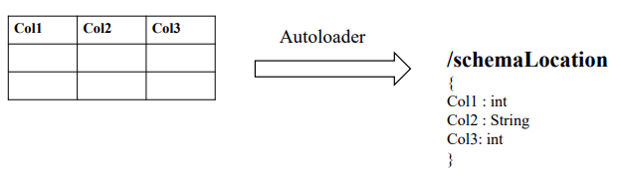
Schema validation

Slide 15
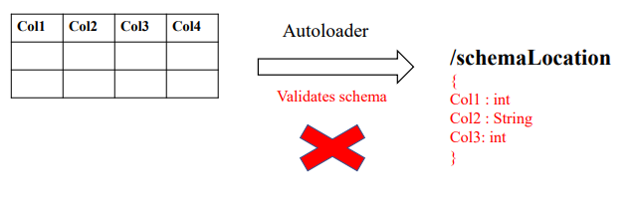
Schema validation

Slide 16
Schema evolution
addNewColumns = Stream fails. New columns are added to the schema. Existing columns do not evolve data types.
failOnNewColumns = Stream fails. Stream does not restart unless the provided schema is updated, or the offending data file is removed
rescue = Schema is never evolved and stream does not fail due to schema changes. All new columns are recorded in the rescued data column.
none = ignore any new columns (Does not evolve the schema, new columns are ignored, and data is not rescued unless the rescuedDataColumn option is set. Stream does not fail due to schema changes.)

Slide 17
Thank
You

