Slide 1
Project Overview

Slide 2
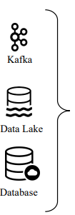
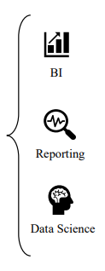
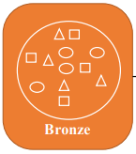
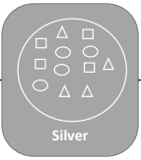
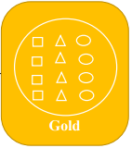
Medallion Architecture

Slide 3











Project architecture
PowerBI/ML/DA project
Azure data lake storage gen2

Slide 4

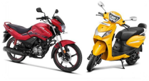
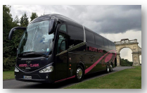
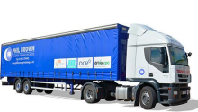
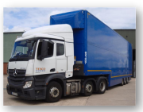
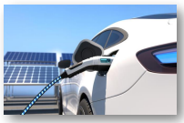
Raw Traffic count dataset
Pedal cycle
Two wheeler
Buses
LGV ( large goods vehicle)
HGV (heavy goods vehicle)
Electric vehicle

Slide 5
Data dictionary
Vehicle flow point | Travel info of vehicle |  | Count of types of vehicle
Record id | hour | latitude | Pedal cycle | LGV
Count point id | Region id | longitude | Two wheeler | HGV
Direction of travel | Region name | Road category ID | Car and taxi | EV car
Year | Local authority name | Start junction road name | Buses and coaches | EV bikes
Count data | Road name | End junction road name

Slide 6
Data dictionary in detail
Record ID = Uniquely identifies a record
Count point id = A unique reference for the road link
Direction of travel = Direction of travel
Year = Year it happened
Count date = The date when the actual count took place
hour = Hour 7 represents from 7am to 8am, and 17 tells from 5pm to 6pm.
Region id = Website region identifier
Region name = The name of the Region that travel took place
Local authority name = Local authority that region

Slide 7
Data dictionary in detail
Cars and taxis = Counts of Cars and taxis
Buses and coaches = Counts of Buses and coaches
LGV Type = Counts of LGV Type
HGV Type = Counts of HGV Type
EV Car = Counts of EV Car
EV Bike = Counts of EV Bik

Slide 8
Project Setup

Slide 9
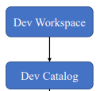

Expected
setup
Row_traffic row_roads
Silver_traffic Silver_roads
Gold_traffic gold_roads

Slide 10



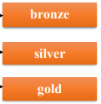

Containers
folders

Slide 11
External Locations
We are going to create five external locations as mentioned below:
Landing
Checkpoints
Bronze
Silver
Gold

Slide 12
Thank
You

