Slide 1
Ingestion Bronze

Slide 2
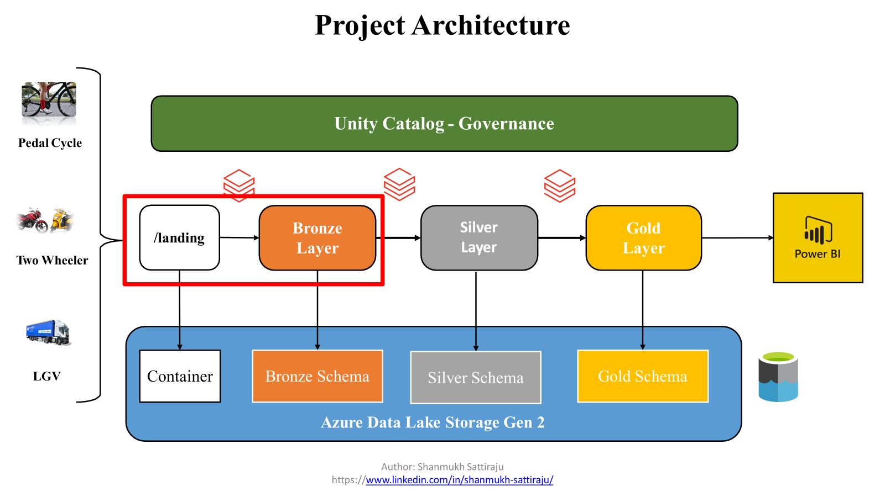
Project Architecture

Slide 3




Ingesting data to Bronze Layer
Schema: bronze
Tables:
1. raw_traffic
2. raw_roads
Bronze

Slide 4
Basic requirement
Ingest all files into the data lake
Ingested data must have schema applied
Ingested data must have audit columns
Ingested data must be stored in columnar format
Must be able to analyze the ingested data via SQL
Ingestion logic must be able to handle incremental load

Slide 5
CSV

Slide 10
json

Slide 13
Multiple files

Slide 19
Thank
You

