Slide 1
Silver Layer Transformation

Slide 2

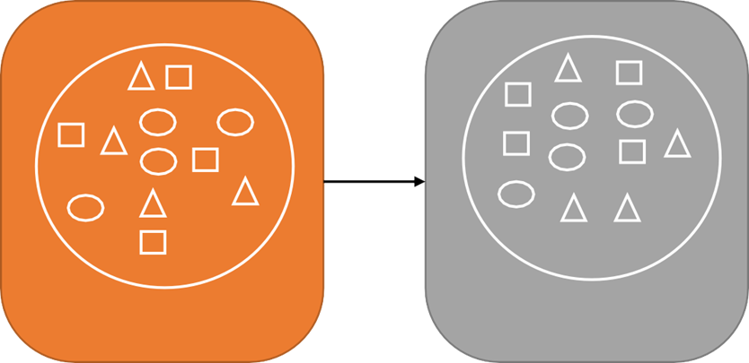

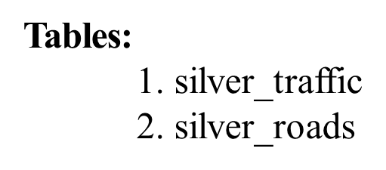
Transforming data in silver layer
Bronze
Bronze
Silver

Slide 3
Transforming raw traffic dataset

Slide 4
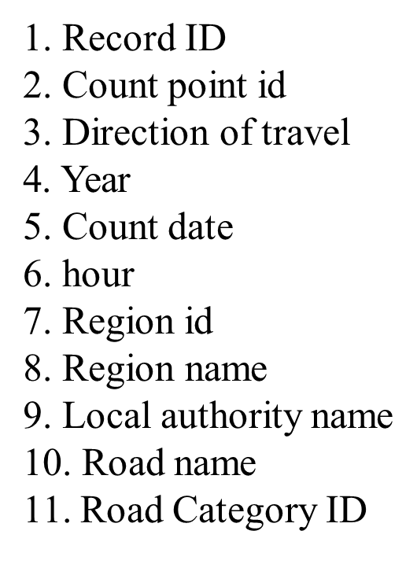
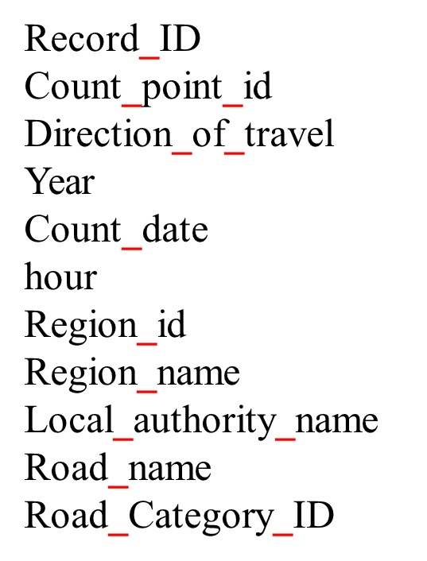
Renaming Columns

Slide 5
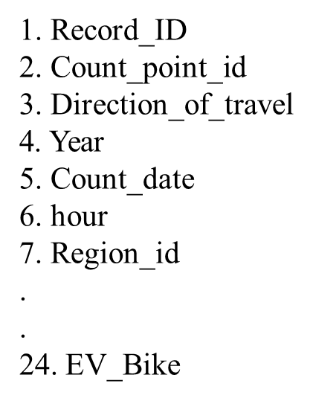
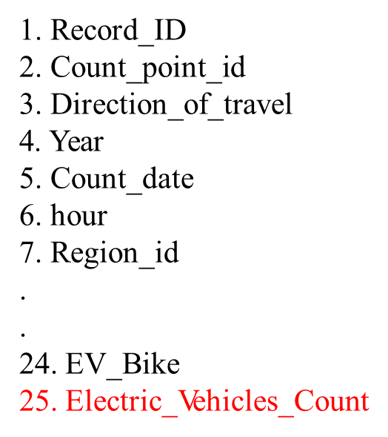
Creating Electric_Vehicles_Count

Slide 6
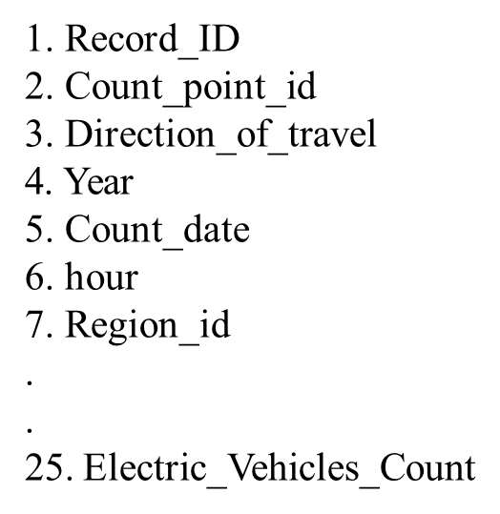
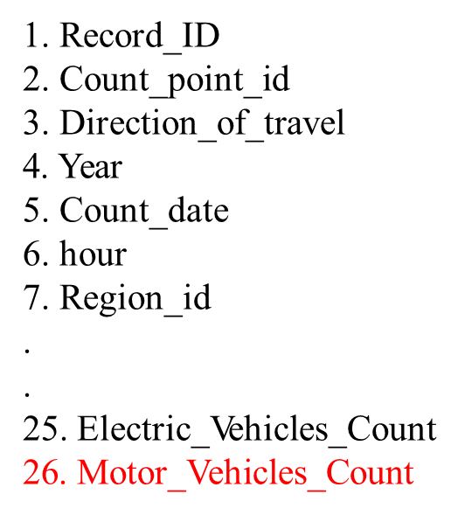
Creating Motor_Vehicles_Count

Slide 8
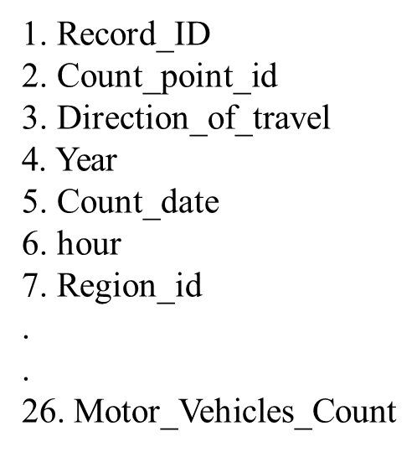
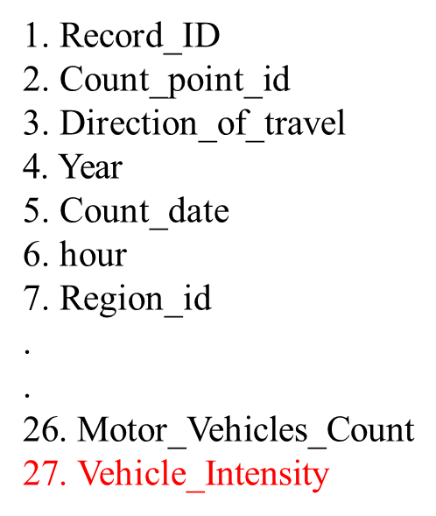
Creating Vehicle_Intensity

Slide 9
Thank
You

