Slide 1
Loading to Gold Layer

Slide 2

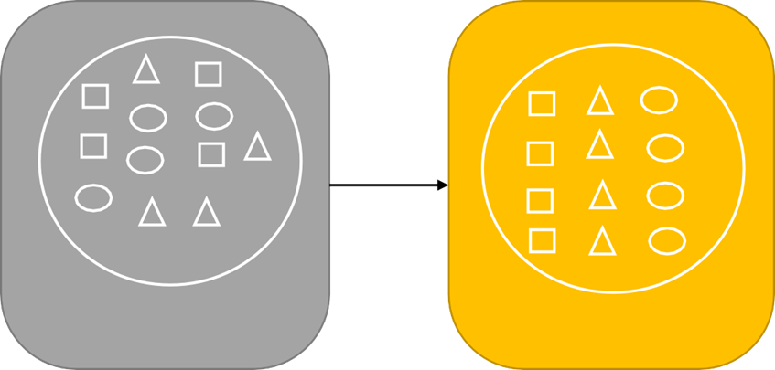

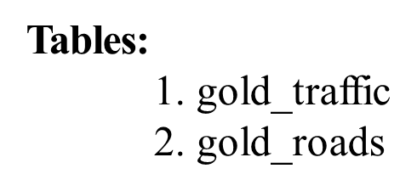
Loading data to Gold Layer
Silver
Gold

Slide 3
Thank
You

