Slide 1
Delta Live Tables

Slide 2



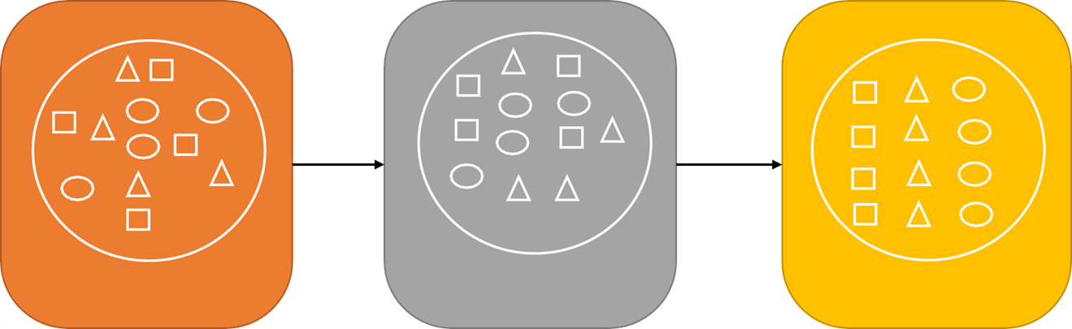




Delta Live Tables (DLT) Origin
BI
Reporting
Bronze
Silver
Gold
Data Science

Slide 3
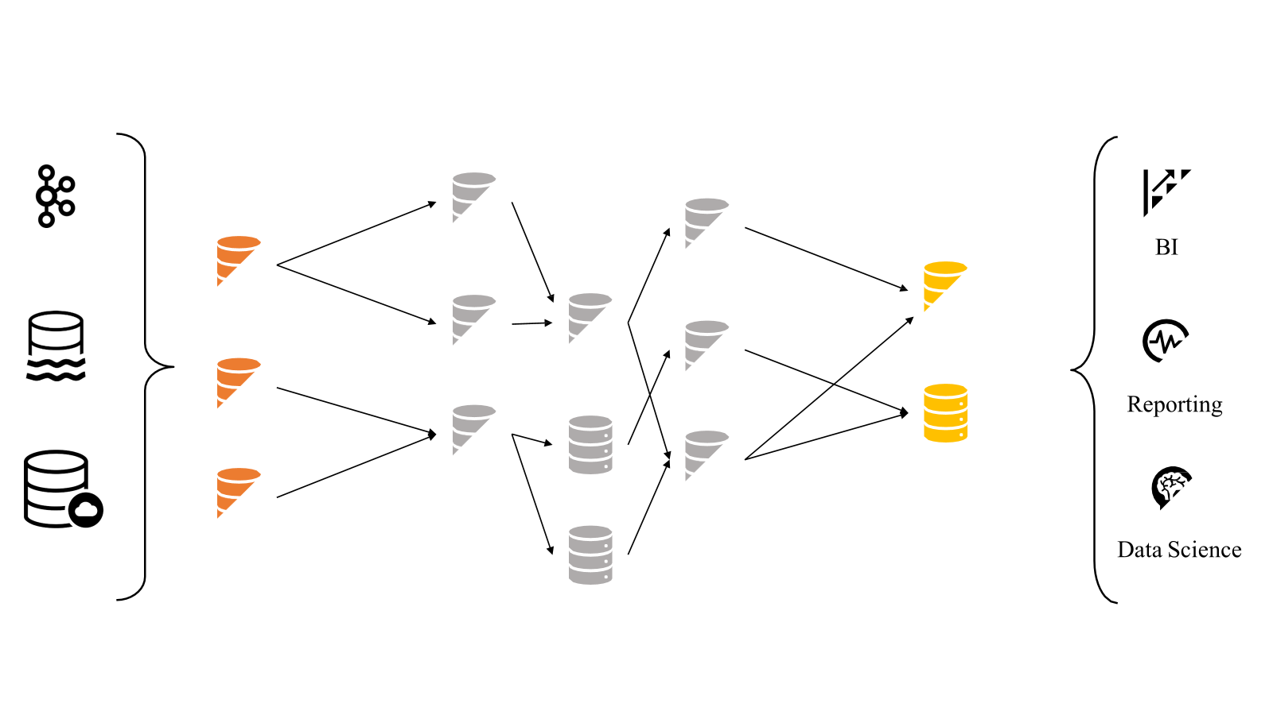
Medallion/Lakehouse Architecture Tables

Slide 4
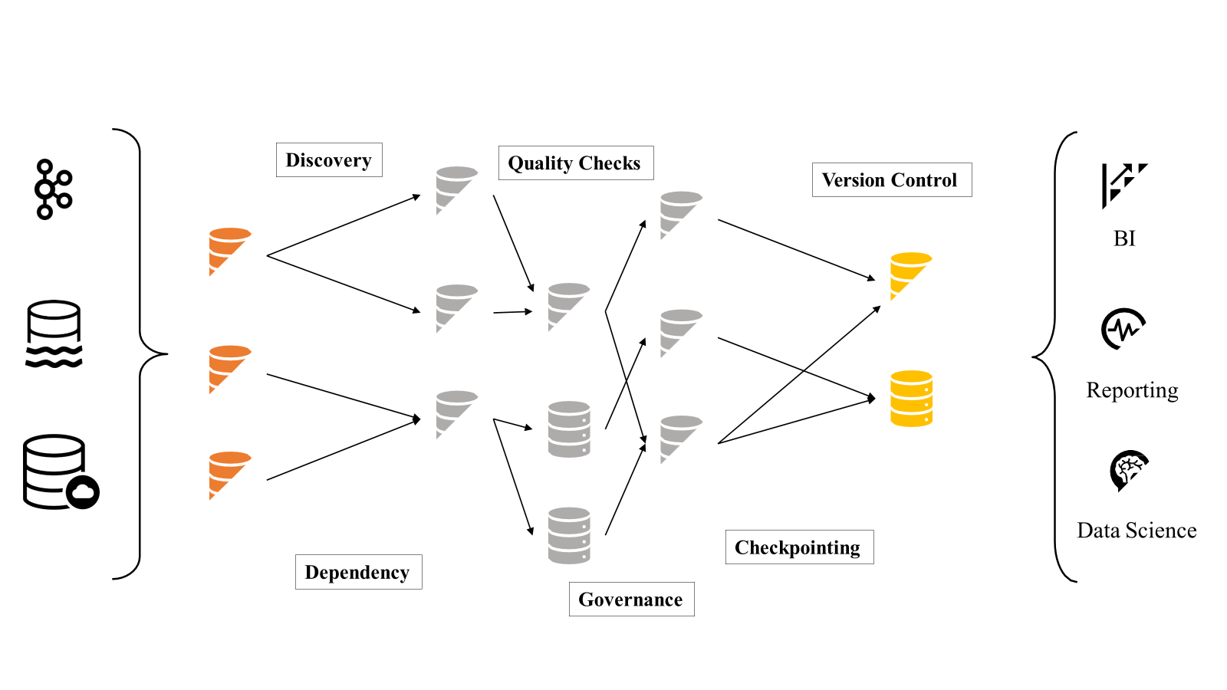
Considerations in Lakehouse Architecture

Slide 5
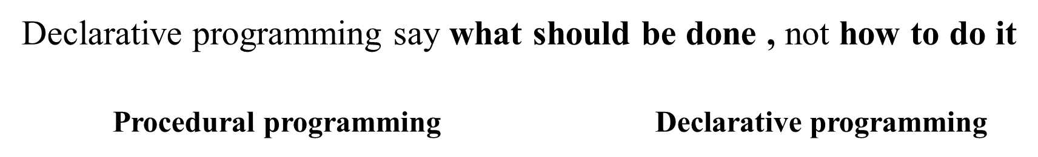

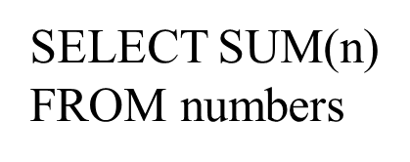
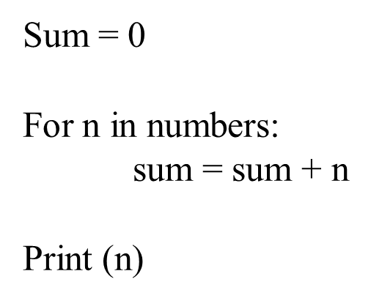
Declarative programming

Slide 6
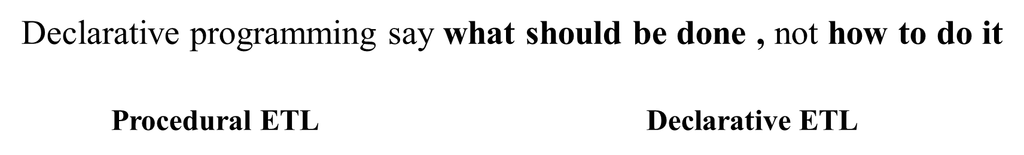
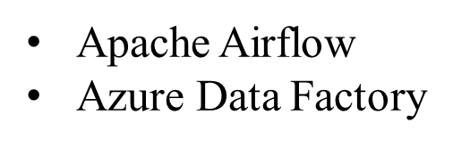

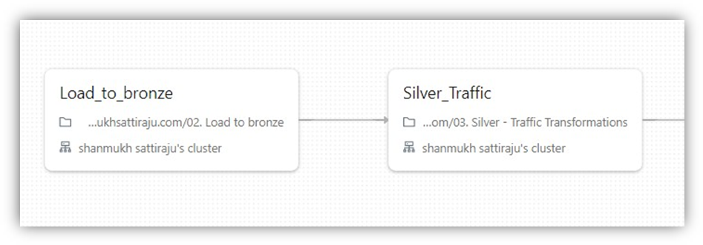
Declarative ETL with DLT

Slide 7
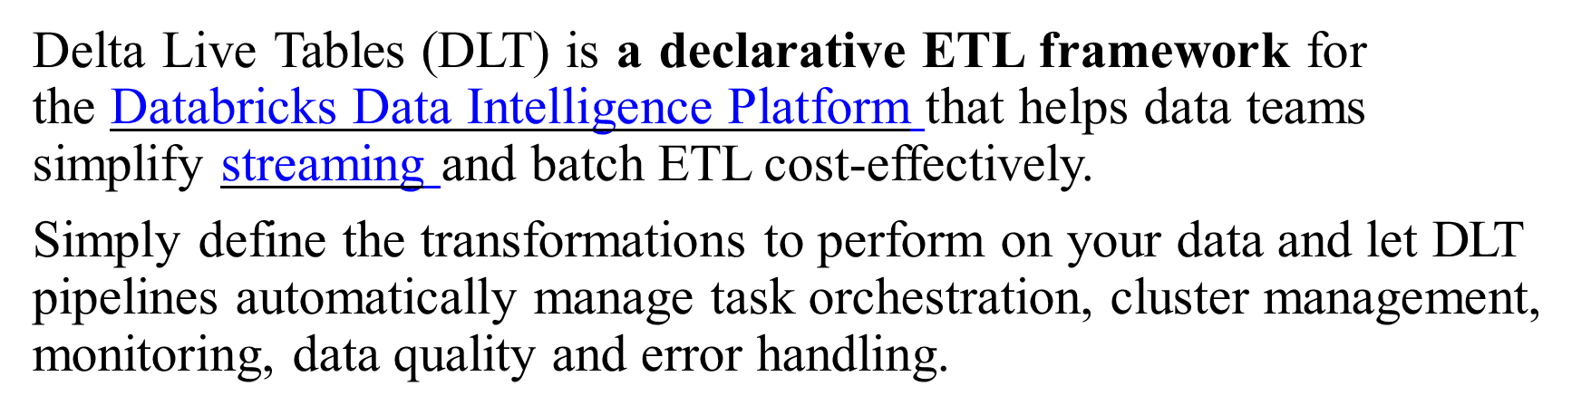
Delta Live Tables (DLT)

Slide 8
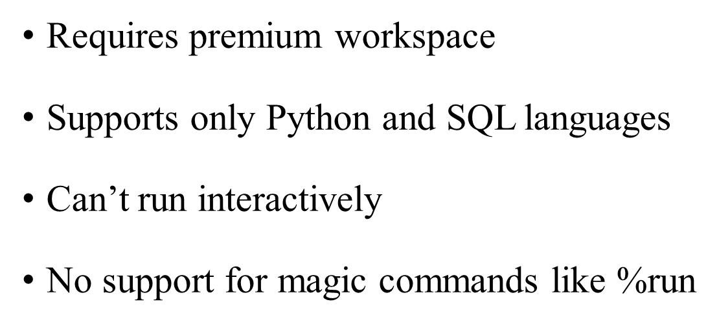
Delta Live Table Execution

Slide 9
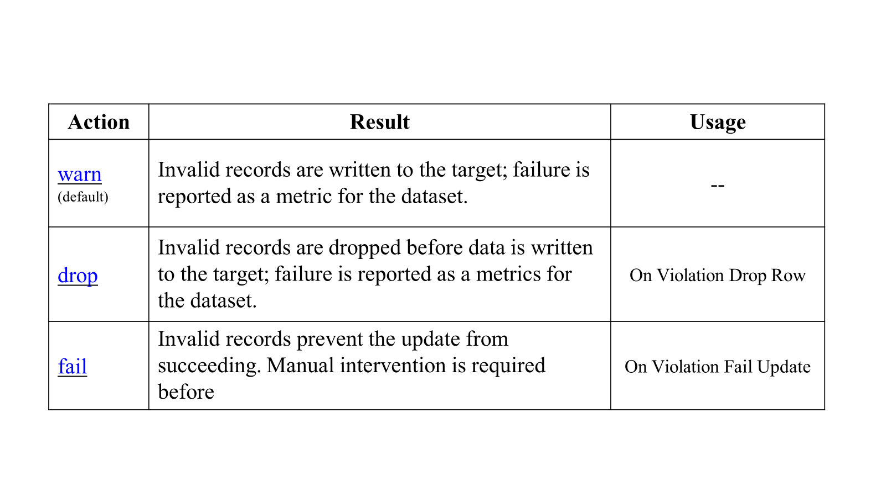
Expectations in DLT pipeline

Slide 10
Thank
You

