Slide 1
Continuous Integration & Continuous Deployment

Slide 2
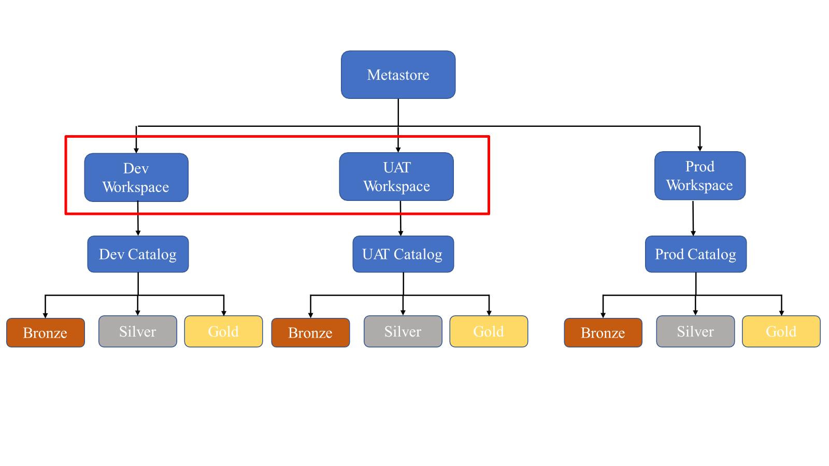
Expected Setup

Slide 3
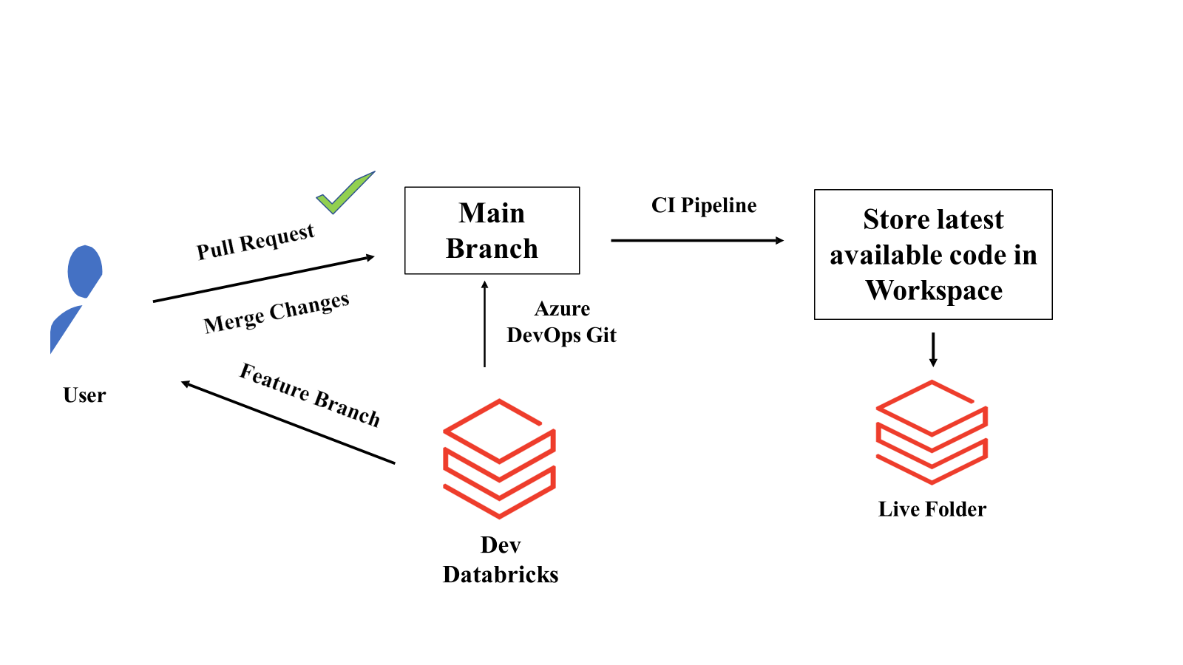
Continuous Integration

Slide 4
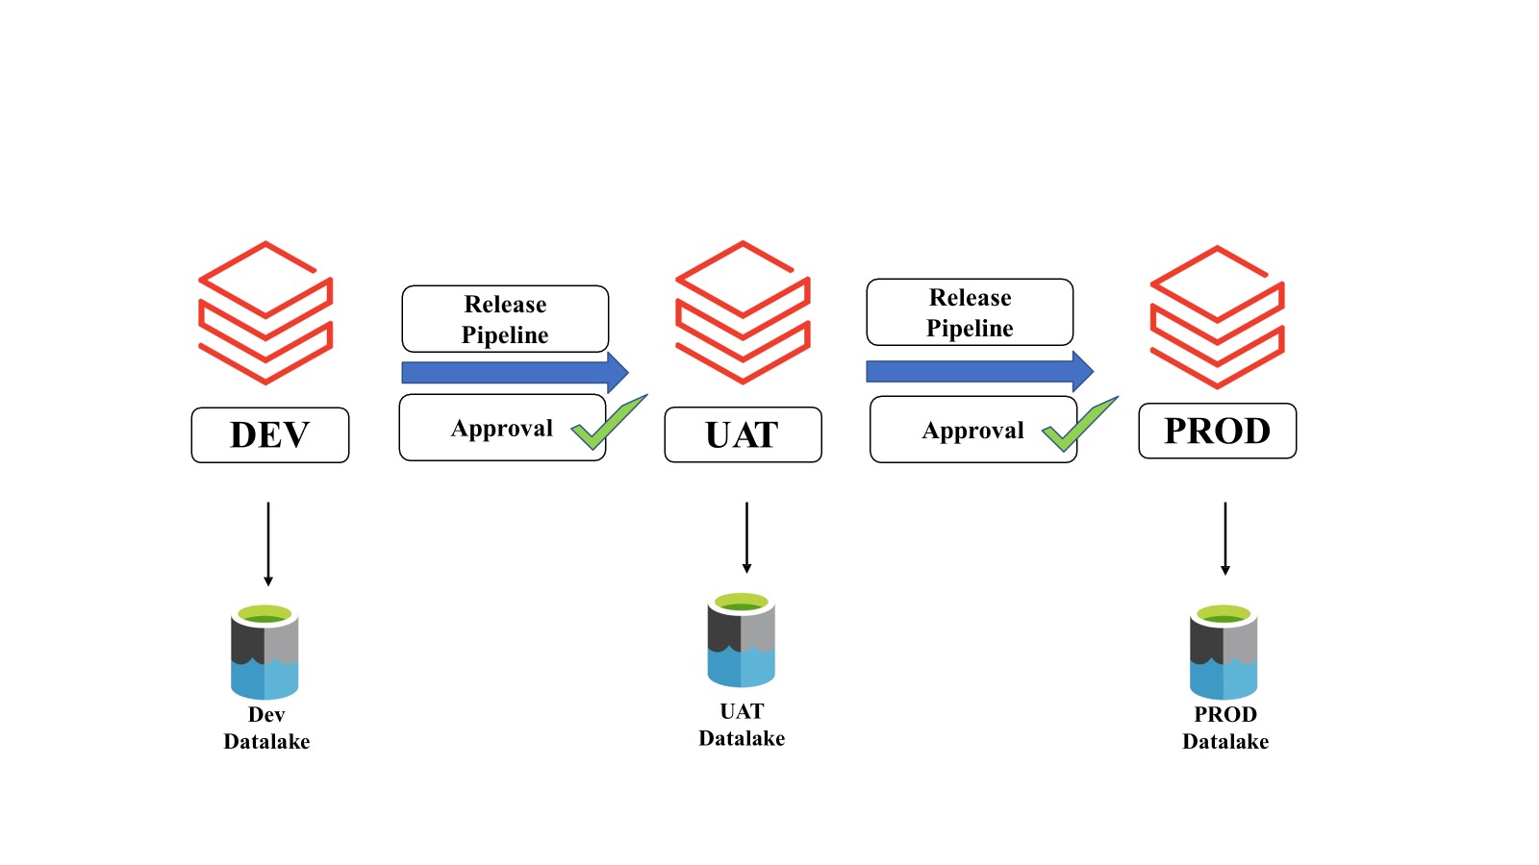
Continuous Deployment

Slide 5
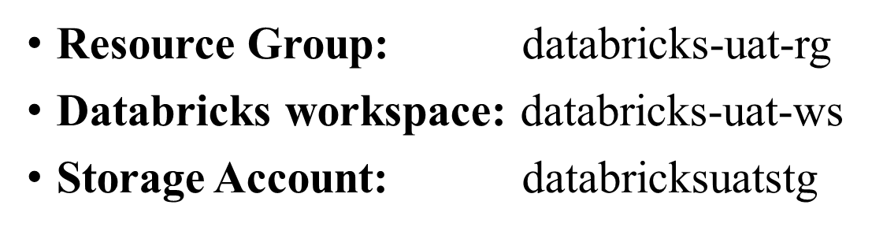
Creating UAT resources in Azure

Slide 6
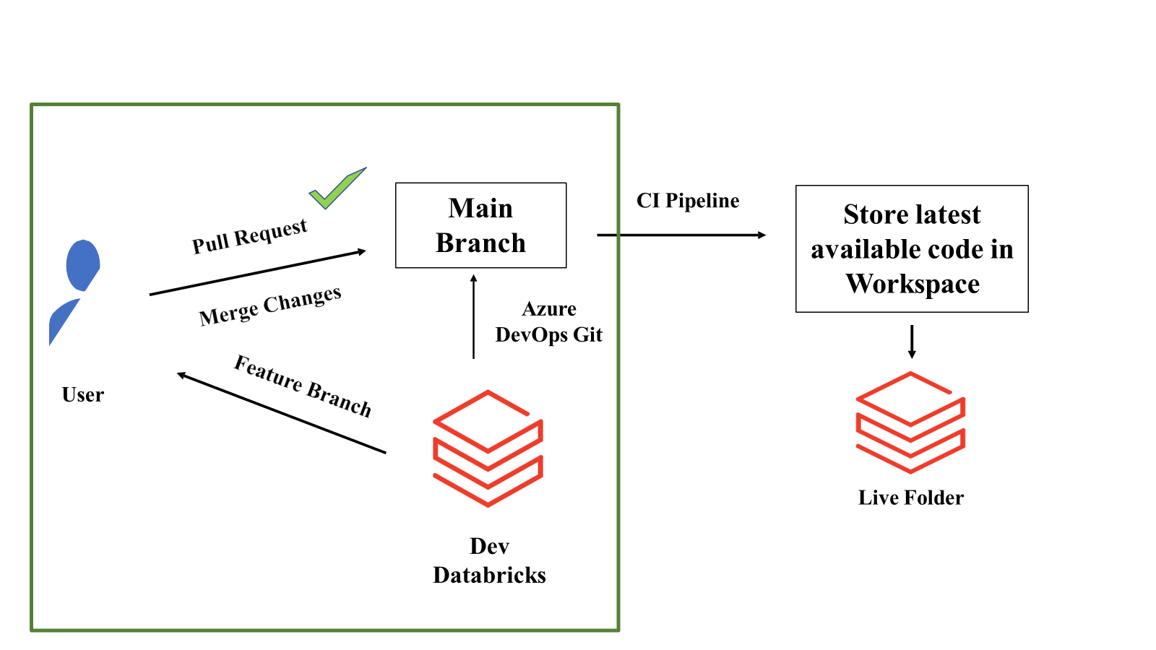
Continuous Integration

Slide 7
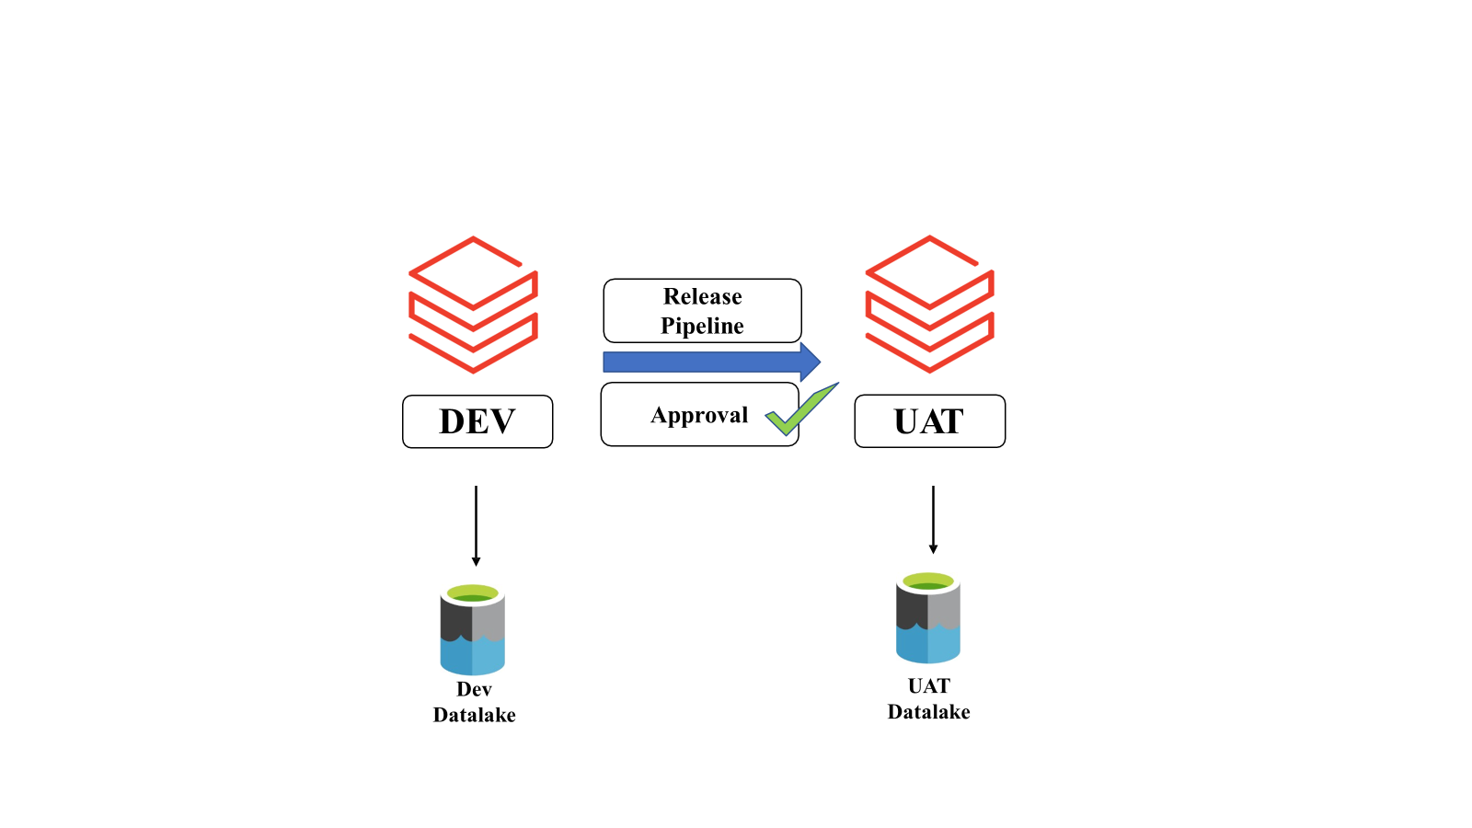
Continuous Deployment

Slide 8
Practical
Resource group : my_project_rg
Storage account : staactgen2
Databricks workspace : databricks1234

Slide 13
Thank
You

