Slide 1
AZURE –ML Studio
By
Amrita Helwade

Slide 2
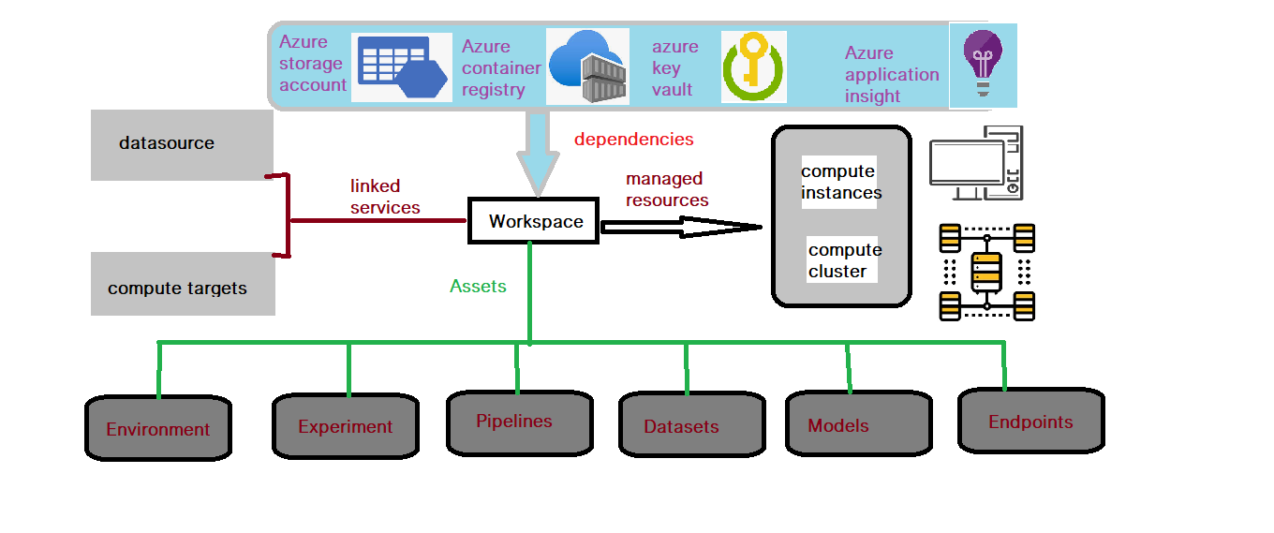
Azure ML architecture

Slide 3
Azure datastore
Azure ML workspace
Blob
Files
Data Lake
Azure SQL
Postgre
MySQL
Databrick

Slide 4
Azure ML workspace
Notebook script
Automated ML
Designer
Experiment

Slide 5
Work flow of Azure ML
Get the Data
Prepare the Data
Feature selection
Choose and apply learning algorithm
Train and evaluate the model

Slide 6
Get the data
Enter the data manually
Import the data
Prepare the data
add columns
clean missing data
Feature selection
Principal component Analysis
Filter based feature selection
Unpack Zipped dataset
Fisher linear discriminant analysis
Permutation feature impoetance

Slide 7
Choose and apply ML algorithm
Clustesr
Regression
Train and evaluate the model
Train the model
Score the model
Evaluate the model
classification

Slide 8
AZURE ML Data Manipulation
Add columns
Add rows
Apply SQL transformation
Remove duplicate row
Select columns in dataset
Edit metadata
Clean missing data

