Slide 1
CS 790Q
Biometrics
Face Recognition Using Dimensionality Reduction
PCA and LDA
M. Turk, A. Pentland, "Eigenfaces for Recognition", Journal of Cognitive Neuroscience, 3(1), pp. 71-86, 1991.
D. Swets, J. Weng, "Using Discriminant Eigenfeatures for Image Retrieval", IEEE Transactions on Pattern Analysis and Machine Intelligence, 18(8), pp. 831-836, 1996.
  A. Martinez, A. Kak, "PCA versus LDA", IEEE Transactions on Pattern Analysis and Machine Intelligence, vol. 23, no. 2, pp. 228-233, 2001.
Notes:
Good afternoon and thank you everyone for coming.
My talk today will describe the research I performed at the IRIS at USC, the object of this work being to build a computational framework that addresses the problem of motion analysis and interpretation.

Slide 2
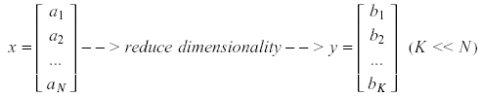
Principal Component Analysis (PCA)
Pattern recognition in high-dimensional spaces
  Problems arise when performing recognition in a high-dimensional space (curse of dimensionality).
  Significant improvements can be achieved by first mapping the data into a lower-dimensional sub-space.
  The goal of PCA is to reduce the dimensionality of the data while retaining as much as possible of the variation present in the original dataset.

Slide 3
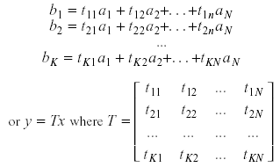
Principal Component Analysis (PCA)
Dimensionality reduction
  PCA allows us to compute a linear transformation that maps data from a high dimensional space to a lower dimensional sub-space.

Slide 4


Principal Component Analysis (PCA)
Lower dimensionality basis
  Approximate vectors by finding a basis in an appropriate lower dimensional space.
    (1) Higher-dimensional space representation:
    (2) Lower-dimensional space representation:

Slide 5
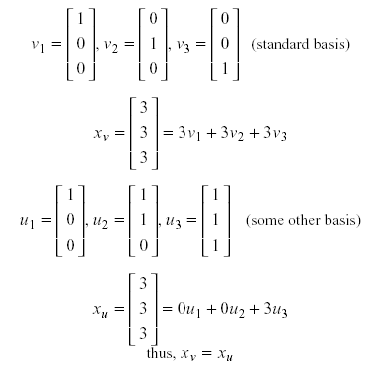
Principal Component Analysis (PCA)
Example

Slide 6

Principal Component Analysis (PCA)
Information loss
  Dimensionality reduction implies information loss !!
  Want to preserve as much information as possible, that is:
How to determine the best lower dimensional sub-space?

Slide 7
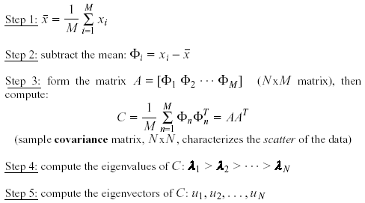
Principal Component Analysis (PCA)
Methodology
  Suppose x₁, x₂, ..., x_{M} are N x 1 vectors

Slide 8
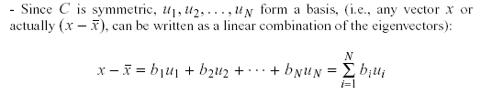
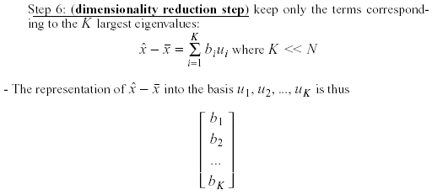
Principal Component Analysis (PCA)
Methodology – cont.

Slide 9
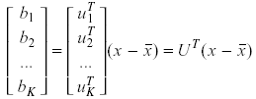
Principal Component Analysis (PCA)
Linear transformation implied by PCA
  The linear transformation R^{N} → R^{K} that performs the dimensionality reduction is:

Slide 10
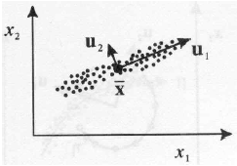
Principal Component Analysis (PCA)
Geometric interpretation
  PCA projects the data along the directions where the data varies the most.
  These directions are determined by the eigenvectors of the covariance matrix corresponding to the largest eigenvalues.
  The magnitude of the eigenvalues corresponds to the variance of the data along the eigenvector directions.

Slide 11

Principal Component Analysis (PCA)
How to choose the principal components?
  To choose K, use the following criterion:

Slide 12


Principal Component Analysis (PCA)
What is the error due to dimensionality reduction?
  We saw above that an original vector x can be reconstructed using its principal components:
  It can be shown that the low-dimensional basis based on principal components minimizes the reconstruction error:
  It can be shown that the error is equal to:

Slide 13

Principal Component Analysis (PCA)
Standardization
  The principal components are dependent on the units used to measure the original variables as well as on the range of values they assume.
  We should always standardize the data prior to using PCA.
  A common standardization method is to transform all the data to have zero mean and unit standard deviation:

Slide 14
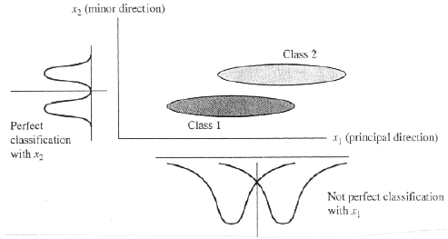
Principal Component Analysis (PCA)
PCA and classification
  PCA is not always an optimal dimensionality-reduction procedure for classification purposes:

Slide 15
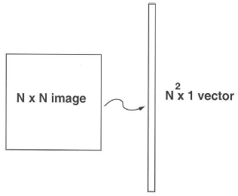
Principal Component Analysis (PCA)
Case Study: Eigenfaces for Face Detection/Recognition
  M. Turk, A. Pentland, "Eigenfaces for Recognition", Journal of Cognitive Neuroscience, vol. 3, no. 1, pp. 71-86, 1991.
Face Recognition
  The simplest approach is to think of it as a template matching problem
  Problems arise when performing recognition in a high-dimensional space.
  Significant improvements can be achieved by first mapping the data into a lower dimensionality space.
  How to find this lower-dimensional space?

Slide 16
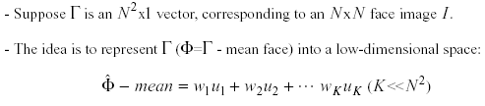
Principal Component Analysis (PCA)
Main idea behind eigenfaces

Slide 17
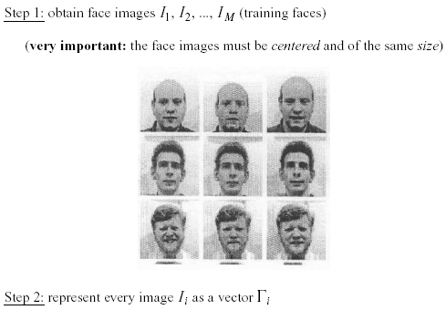
Principal Component Analysis (PCA)
Computation of the eigenfaces

Slide 18
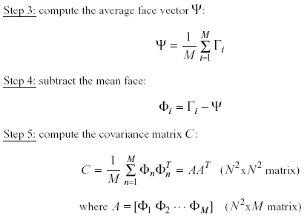
Principal Component Analysis (PCA)
Computation of the eigenfaces – cont.

Slide 19
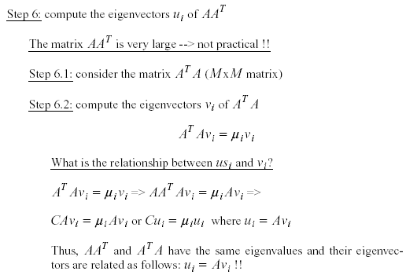
Principal Component Analysis (PCA)
Computation of the eigenfaces – cont.

Slide 20
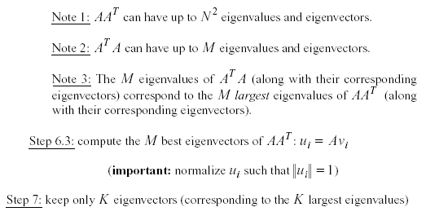
Principal Component Analysis (PCA)
Computation of the eigenfaces – cont.

Slide 21
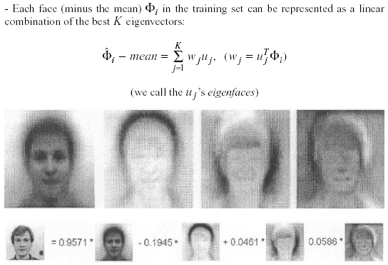
Principal Component Analysis (PCA)
Representing faces onto this basis

Slide 22
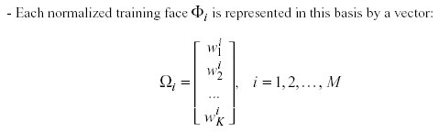
Principal Component Analysis (PCA)
Representing faces onto this basis – cont.

Slide 23
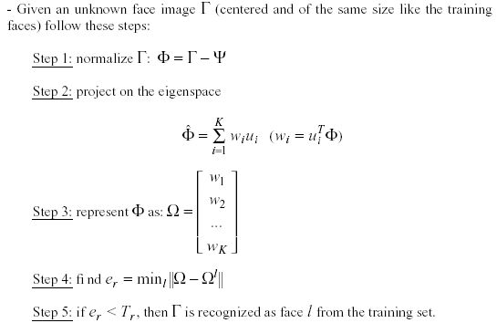
Principal Component Analysis (PCA)
Face Recognition Using Eigenfaces

Slide 24

Principal Component Analysis (PCA)
Face Recognition Using Eigenfaces – cont.
  The distance e_{r} is called distance within the face space (difs)
  Comment: we can use the common Euclidean distance to compute e_{r}, however, it has been reported that the Mahalanobis distance performs better:

Slide 25
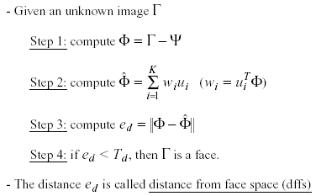
Principal Component Analysis (PCA)
Face Detection Using Eigenfaces

Slide 26
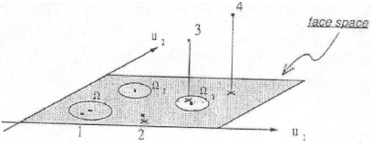
Principal Component Analysis (PCA)
Face Detection Using Eigenfaces – cont.

Slide 27
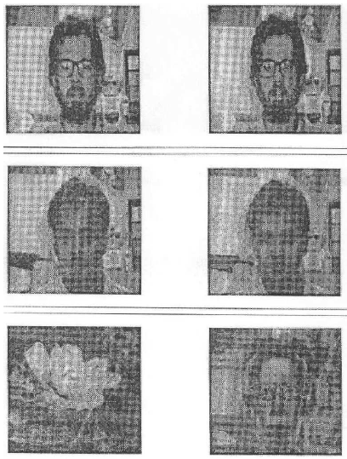
Principal Component Analysis (PCA)
Reconstruction of faces and non-faces

Slide 28
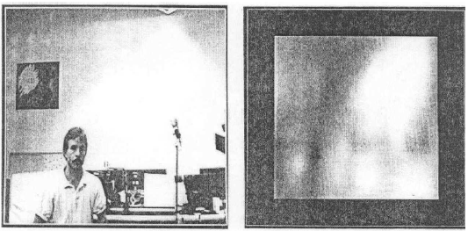
Principal Component Analysis (PCA)
Time requirements
  About 400 ms (Lisp, Sun4, 128x128 images)
Applications
  Face detection, tracking, and recognition

Slide 29
Principal Component Analysis (PCA)
Problems
  Background (de-emphasize the outside of the face – e.g., by multiplying the input image by a 2D Gaussian window centered on the face)
  Lighting conditions (performance degrades with light changes)
  Scale (performance decreases quickly with changes to head size)
    multi-scale eigenspaces
    scale input image to multiple sizes
  Orientation (performance decreases but not as fast as with scale changes)
    plane rotations can be handled
    out-of-plane rotations are more difficult to handle

Slide 30
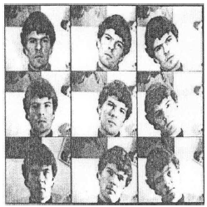
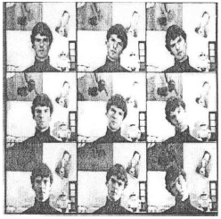
Principal Component Analysis (PCA)
Experiments
  16 subjects, 3 orientations, 3 sizes
  3 lighting conditions, 6 resolutions (512x512 ... 16x16)
  Total number of images: 2,592

Slide 31
Principal Component Analysis (PCA)
Experiment 1
  Used various sets of 16 images for training
  One image/person, taken under the same conditions
  Eigenfaces were computed offline (7 eigenfaces used)
  Classify the rest images as one of the 16 individuals
  No rejections (no threshold for difs)
  Performed a large number of experiments and averaged the results:
    96% correct averaged over light variation
    85% correct averaged over orientation variation
    64% correct averaged over size variation

Slide 32

Principal Component Analysis (PCA)
Experiment 2
  They considered rejections (by thresholding difs)
  There is a tradeoff between correct recognition and rejections.
  Adjusting the threshold to achieve 100% recognition accuracy resulted in:
    19% rejections while varying lighting
    39% rejections while varying orientation
    60% rejections while varying size
Experiment 3
  Reconstruction using partial information

Slide 33
Linear Discriminant Analysis (LDA)
Multiple classes and PCA
  Suppose there are C classes in the training data.
  PCA is based on the sample covariance which characterizes the scatter of the entire data set, irrespective of class-membership.
  The projection axes chosen by PCA might not provide good discrimination power.
What is the goal of LDA?
  Perform dimensionality reduction while preserving as much of the class discriminatory information as possible.
  Seeks to find directions along which the classes are best separated.
  Takes into consideration the scatter within-classes but also the scatter between-classes.
  More capable of distinguishing image variation due to identity from variation due to other sources such as illumination and expression.

Slide 34
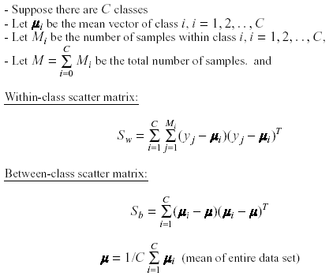
Linear Discriminant Analysis (LDA)
Methodology

Slide 35

Linear Discriminant Analysis (LDA)
Methodology – cont.
  LDA computes a transformation that maximizes the between-class scatter while minimizing the within-class scatter:
  Such a transformation should retain class separability while reducing the variation due to sources other than identity (e.g., illumination).

Slide 36
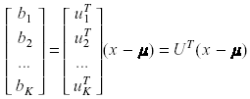
Linear Discriminant Analysis (LDA)
Linear transformation implied by LDA
  The linear transformation is given by a matrix U whose columns are the eigenvectors of S_{w}⁻¹ S_{b} (called Fisherfaces).
  The eigenvectors are solutions of the generalized eigenvector problem:

Slide 37

Linear Discriminant Analysis (LDA)
Does S_{w}⁻¹ always exist?
  If S_{w} is non-singular, we can obtain a conventional eigenvalue problem by writing:
  In practice, S_{w} is often singular since the data are image vectors with large dimensionality while the size of the data set is much smaller (M << N )

Slide 38
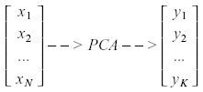
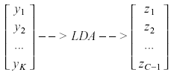
Linear Discriminant Analysis (LDA)
Does S_{w}⁻¹ always exist? – cont.
  To alleviate this problem, we can perform two projections:
    PCA is first applied to the data set to reduce its dimensionality.
    LDA is then applied to further reduce the dimensionality.

Slide 39
Linear Discriminant Analysis (LDA)
Case Study: Using Discriminant Eigenfeatures for Image Retrieval
  D. Swets, J. Weng, "Using Discriminant Eigenfeatures for Image Retrieval", IEEE Transactions on Pattern Analysis and Machine Intelligence, vol. 18, no. 8, pp. 831-836, 1996.
Content-based image retrieval
  The application being studied here is query-by-example image retrieval.
  The paper deals with the problem of selecting a good set of image features for content-based image retrieval.

Slide 40
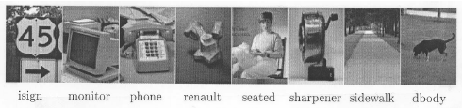
Linear Discriminant Analysis (LDA)
Assumptions
  "Well-framed" images are required as input for training and query-by-example test probes.
  Only a small variation in the size, position, and orientation of the objects in the images is allowed.

Slide 41
Linear Discriminant Analysis (LDA)
Some terminology
  Most Expressive Features (MEF): the features (projections) obtained using PCA.
  Most Discriminating Features (MDF): the features (projections) obtained using LDA.
Computational considerations
  When computing the eigenvalues/eigenvectors of S_{w}⁻¹S_{B}u_{k} = λ_{k}u_{k} numerically, the computations can be unstable since S_{w}⁻¹S_{B} is not always symmetric.
  See paper for a way to find the eigenvalues/eigenvectors in a stable way.
  Important: Dimensionality of LDA is bounded by C-1 --- this is the rank of S_{w}⁻¹S_{B}

Slide 42
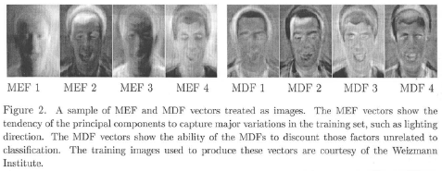
Linear Discriminant Analysis (LDA)
Factors unrelated to classification
  MEF vectors show the tendency of PCA to capture major variations in the training set such as lighting direction.
  MDF vectors discount those factors unrelated to classification.

Slide 43
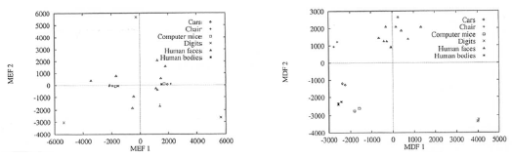
Linear Discriminant Analysis (LDA)
Clustering effect
Methodology
  Generate the set of MEFs for each image in the training set.
  Given an query image, compute its MEFs using the same procedure.
  Find the k closest neighbors for retrieval (e.g., using Euclidean distance).

Slide 44
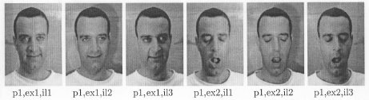
Linear Discriminant Analysis (LDA)
Experiments and results
  Face images
    A set of face images was used with 2 expressions, 3 lighting conditions.
    Testing was performed using a disjoint set of images - one image, randomly chosen, from each individual.

Slide 45
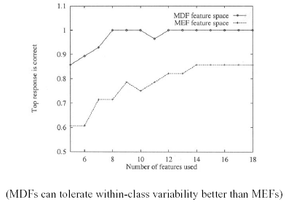
Linear Discriminant Analysis (LDA)

Slide 46
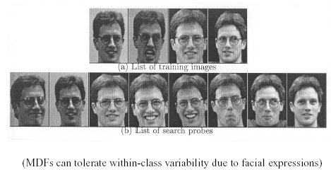
Linear Discriminant Analysis (LDA)
  correct search probes

Slide 47
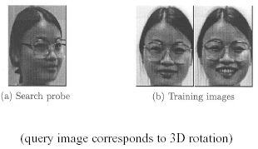
Linear Discriminant Analysis (LDA)
  failed search probe

Slide 48
Linear Discriminant Analysis (LDA)
Case Study: PCA versus LDA
  A. Martinez, A. Kak, "PCA versus LDA", IEEE Transactions on Pattern Analysis and Machine Intelligence, vol. 23, no. 2, pp. 228-233, 2001.
Is LDA always better than PCA?
  There has been a tendency in the computer vision community to prefer LDA over PCA.
  This is mainly because LDA deals directly with discrimination between classes while PCA does not pay attention to the underlying class structure.
  This paper shows that when the training set is small, PCA can outperform LDA.
  When the number of samples is large and representative for each class, LDA outperforms PCA.

Slide 49
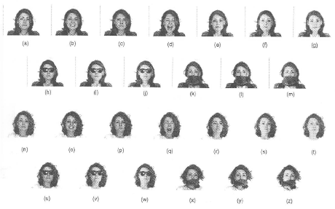
Linear Discriminant Analysis (LDA)
Is LDA always better than PCA? – cont.

Slide 50
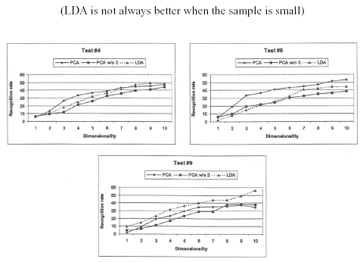
Linear Discriminant Analysis (LDA)
Is LDA always better than PCA? – cont.

Slide 51
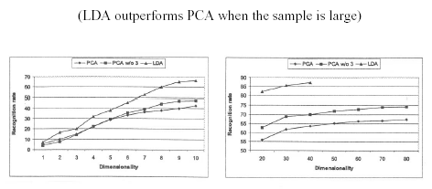
Linear Discriminant Analysis (LDA)
Is LDA always better than PCA? – cont.

Slide 52
Linear Discriminant Analysis (LDA)
Critique of LDA
  Only linearly separable classes will remain separable after applying LDA.
  It does not seem to be superior to PCA when the training data set is small.

