Slide 1
Principal Component Analysis
Amrita Nandan Helwade

Slide 2



AGENDA
PCA
BASICS
PCA
Problem 1
PCA
Problem 2

Slide 3

PCA
BASICS
Why PCA ?

Slide 4
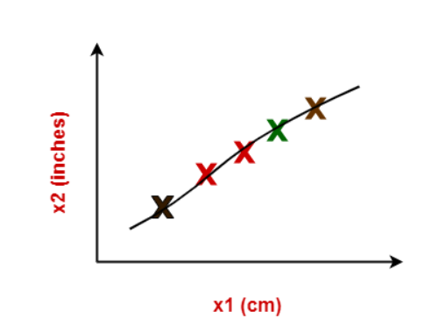
PCA
BASICS
What is PCA ?
What is Principal Component Analysis ?
Principal Component Analysis is a well-known dimension reduction technique.
It transforms the variables into a new set of variables called as principal components.
These principal components are linear combination of original variables and are orthogonal.
The first principal component accounts for most of the possible variation of original data.
The second principal component does its best to capture the variance in the data.
There can be only two principal components for a two-dimensional data set.
Why PCA?
Consider the following example-
The following graph shows two dimensions x1 and x2.
x1 represents the measurement of several objects in cm.
x2 represents the measurement of several objects in inches.
Using both these dimensions convey similar information.
Also, they introduce a lot of noise in the system.
So, it is better to use just one dimension.

Slide 5
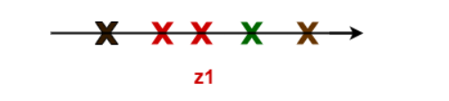
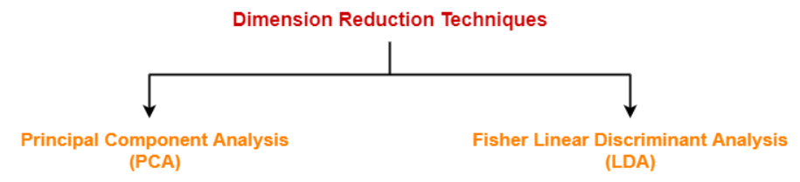
PCA
BASICS
Why PCA ?
Using dimension reduction techniques-
We convert the dimensions of data from 2 dimensions (x1 and x2) to 1 dimension (z1).
It makes the data relatively easier to explain.
Benefits PCA?
Dimension reduction offers several benefits such as-
It compresses the data and thus reduces the storage space requirements.
It reduces the time required for computation since less dimensions require less computation.
It eliminates the redundant features.
It improves the model performance.

Slide 6
PCA
How to calculate PCA ?
PROBLEM 1
Steps involved in PCA
Step-01: Get data.
Step-02: Compute the mean vector (µ).
Step-03: Subtract mean from the given data.
Step-04: Calculate the covariance matrix.
Step-05: Calculate the eigen vectors and eigen values of the covariance matrix.
Step-06: Choosing components and forming a feature vector.
Step-07: Deriving the new data set.
Practice Problems Based On Principal Component Analysis-
Lets consider data = { 2, 3, 4, 5, 6, 7 ; 1, 5, 3, 6, 7, 8 }.
Problem 1: Compute the principal component using PCA Algorithm.
OR
Consider the two dimensional patterns (2, 1), (3, 5), (4, 3), (5, 6), (6, 7), (7, 8).
Compute the principal component using PCA Algorithm.
OR
Compute the principal component of following data-
CLASS 1 X = 2 , 3 , 4
Y = 1 , 5 , 3
CLASS 2 X = 5 , 6 , 7
Y = 6 , 7 , 8

Slide 7


PCA
How to calculate PCA ?
Solution
Solution
Step-01:
Get data.
The given feature vectors are-
x1 = (2, 1)
x2 = (3, 5)
x3 = (4, 3)
x4 = (5, 6)
x5 = (6, 7)
x6 = (7, 8)
Step-02:
Calculate the mean vector (µ).
Mean vector (µ)
= ((2 + 3 + 4 + 5 + 6 + 7) / 6, (1 + 5 + 3 + 6 + 7 + 8) / 6)
= (4.5, 5)
Thus,

Slide 8


PCA
How to calculate PCA ?
Solution
Solution
Step-03:
Subtract mean vector (µ) from the given feature vectors.
x1 – µ = (2 – 4.5, 1 – 5) = (-2.5, -4)
x2 – µ = (3 – 4.5, 5 – 5) = (-1.5, 0)
x3 – µ = (4 – 4.5, 3 – 5) = (-0.5, -2)
x4 – µ = (5 – 4.5, 6 – 5) = (0.5, 1)
x5 – µ = (6 – 4.5, 7 – 5) = (1.5, 2)
x6 – µ = (7 – 4.5, 8 – 5) = (2.5, 3)
Feature vectors (xi) after subtracting mean vector (µ) are-
Step-04:
Calculate the covariance matrix.
Covariance matrix is given by-

Slide 9
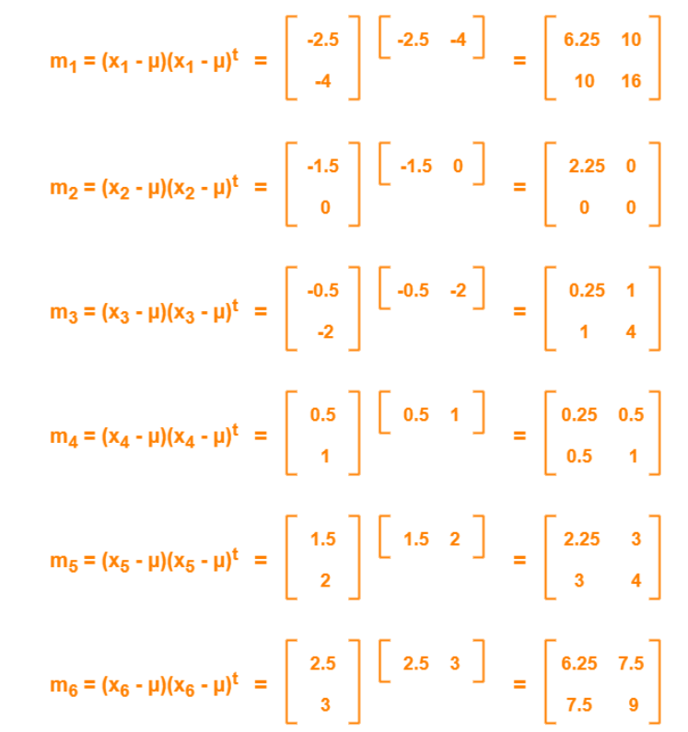
PCA
How to calculate PCA ?
NOW

Slide 11
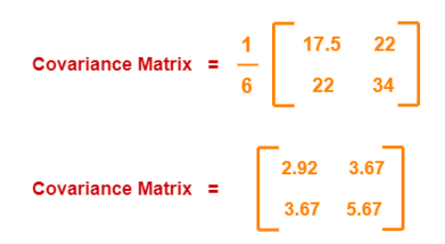
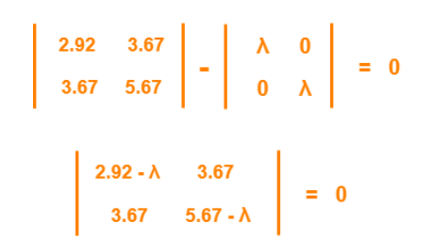
PCA
How to calculate PCA ?
Solution
Solution
Now,
Covariance matrix
= (m1 + m2 + m3 + m4 + m5 + m6) / 6
On adding the above matrices and dividing by 6, we get-
Step-04:
Calculate the eigen values and eigen vectors of the covariance matrix.
λ is an eigen value for a matrix M if it is a solution of the characteristic equation |M – λI| = 0.
So, we have-

Slide 12
PCA
How to calculate PCA ?
Solution
Solution
Step-05:
From here,
(2.92 – λ)(5.67 – λ) – (3.67 x 3.67) = 0
16.56 – 2.92λ – 5.67λ + λ2 – 13.47 = 0
λ2 – 8.59λ + 3.09 = 0
Solving this quadratic equation, we get λ = 8.22, 0.38
Thus, two eigen values are λ1 = 8.22 and λ2 = 0.38.
Clearly, the second eigen value is very small compared to the first eigen value.
So, the second eigen vector can be left out.
Eigen vector corresponding to the greatest eigen value is the principal component for the given data set.
So. we find the eigen vector corresponding to eigen value λ1.
We use the following equation to find the eigen vector-
MX = λX
where-
M = Covariance Matrix
X = Eigen vector
λ = Eigen value

Slide 13
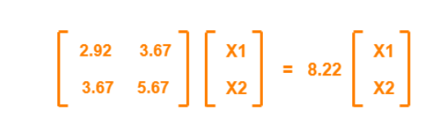

PCA
How to calculate PCA ?
Solution
Solution
Substituting the values in the above equation, we get
Solving these, we get-
2.92X1 + 3.67X2 = 8.22X1
3.67X1 + 5.67X2 = 8.22X2
On simplification, we get-
5.3X1 = 3.67X2 ………(1)
3.67X1 = 2.55X2 ………(2)
From (1) and (2), X1 = 0.69X2
From (2), the eigen vector is-

Slide 14

PCA
How to calculate PCA ?
Solution
Solution
Thus, principal component for the given data set is-

Slide 15

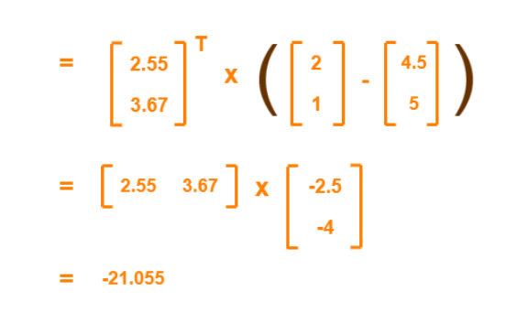
PCA
How to calculate PCA ?
PROBLEM 2
Problem No. 2
Use PCA Algorithm to transform the pattern (2, 1) onto the eigen vector in the previous question.
Feature vectors (xi) after subtracting mean vector (µ) are-
Solution
The given feature vector is (2, 1).
The feature vector gets transformed to
= Transpose of Eigen vector x (Feature Vector – Mean Vector)

