Slide 1
Intro-2

Slide 2
Create the free account and tenant settings
Go to settings
Nevigate to admin portal
Untick Microsoft default connection
Click on the enable button

Slide 3
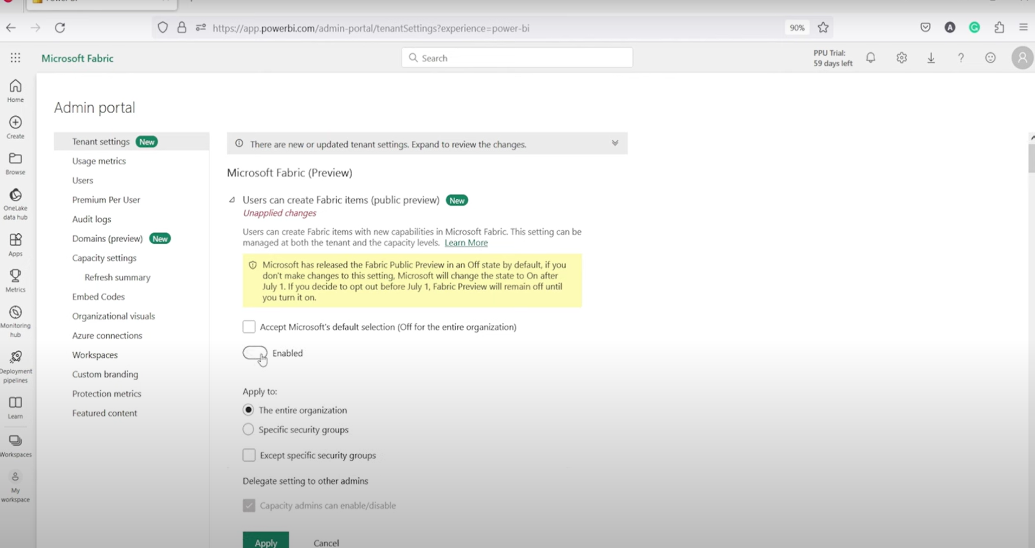

Slide 4
Key highlights
One copy
One lake
Unified integrated environment
One security
One compute

Slide 5
One lake
Microsoft fabric’s foundation lies in the data lake, which is also known as OneLake.
One lake is the integral part of Microsoft fabric service, providing a centralized location to store all organizational data, ensuring seamless operation across various experiences.
OneLake is similar to OneDrive is automatically included with evry Microsoft Fabric tenant. It serves as the single repository for all analytics data, catering to entire organization.
This logical data lake, OneLake, is build on top of ADLS Gen2 , offering a unified Software as a Service experience for professional and citizen developer.
One lake is available in delta parquet format

Slide 6
Microsoft fabric provides the integrated platform.
Various tools like data frame, data factory etc remains the same but the entire data is going to stay on OneLake via LakeHouse and
All the engines have been modified and optimized the data parquet files
For example: Data is available from data flow -> data pipeline and land it on the lake house immediately data is available to the end user via Power BI
Lake house is the SQL end point used to query the data. Ware house is available for read and write the SQL

Slide 7
LakeHouse
Microsoft Fabric LakeHouse is cutting-edge data architecture platform designed to effectively store manage and analyze both structured and unstructured data within a unified storage system
By seamlessly integrating structured and unstructured data, the lakehouse enables organizations to derive valuable insights from their data assets in a single, consolidated location
Lakehouse simplifies data access through the automatic generation of read-only SQL endpoint and default dataset upon creation
This SQL endpoint provides user with convenient access to the data for analysis and querying purposes

Slide 8
Components of Fabric
Data Engineering
Data Factory
Data Science
Data Warehouse
Real-Times Analytics
PowerBI

Slide 9
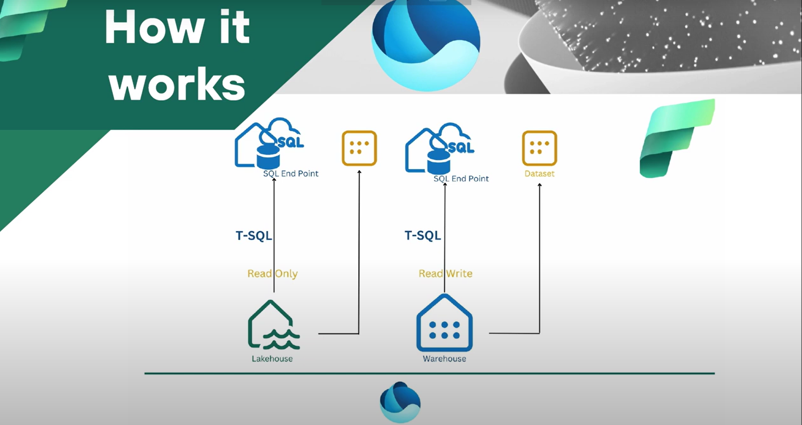

Slide 10
Users (Customers)
Who should use it?
Green Field
Azure Synapse
Azure –Lake /SQL
Power BI
On other cloud

Slide 11
When to use?
Plan to start data analytics/Data Science project
Plan to upgrade/enhance data analytics/Data Science project
Plan to migrate from inhouse to cloud or cloud to cloud

Slide 12
Useful links
fabric terminology
license documentation

Slide 13
LAKEHOUSE AND WAREHOUSE CREATION

Slide 14
Steps
Click on the workspace
Generate the lakehouse pass the proper name to create a new lakehouse
Here we are selecting the compute and inside the same we are creating all services
This process will generate dataset, SQL endpoint along with the lakehouse
Create the warehouse
Go back to workspace

Slide 15
GLIMPSE
The foundation of Microsoft Fabric is a lakehouse, which is built on top of the OneLake scalable storage layer and uses Apache Spark and SQL compute engines for big data processing. A lakehouse is a unified platform that combines:
The flexible and scalable storage of a data lake
The ability to query and analyze data of a data warehouse

Slide 16
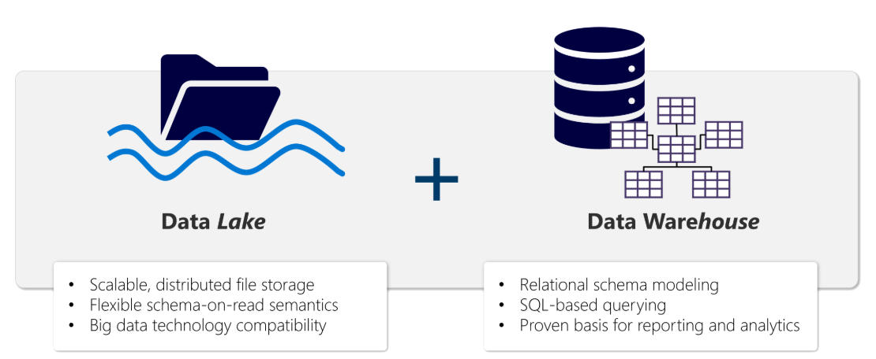
Glimpse
A lakehouse presents as a database and is built on top of a data lake using Delta format tables. Lakehouses combine the SQL-based analytical capabilities of a relational data warehouse and the flexibility and scalability of a data lake. Lakehouses store all data formats and can be used with various analytics tools and programming languages. As cloud-based solutions, lakehouses can scale automatically and provide high availability and disaster recovery.

Slide 17
Benefits
Lakehouses use Spark and SQL engines to process large-scale data and support machine learning or predictive modeling analytics.
Lakehouse data is organized in a schema-on-read format, which means you define the schema as needed rather than having a predefined schema.
Lakehouses support ACID (Atomicity, Consistency, Isolation, Durability) transactions through Delta Lake formatted tables for data consistency and integrity.
Lakehouses are a single location for data engineers, data scientists, and data analysts to access and use data.

Slide 18
Use
You can use your lakehouse for many reasons, including:
Analyze using SQL.
Train machine learning models.
Perform analytics on real-time data.
Develop reports in Power BI.

Slide 19
Create and explore lakehouse
When you create a new lakehouse, you have three different data items automatically created in your workspace.
The lakehouse contains shortcuts, folders, files, and tables.
The Semantic model (default) provides an easy data source for Power BI report developers.
The SQL analytics endpoint allows read-only access to query data with SQL.

Slide 20
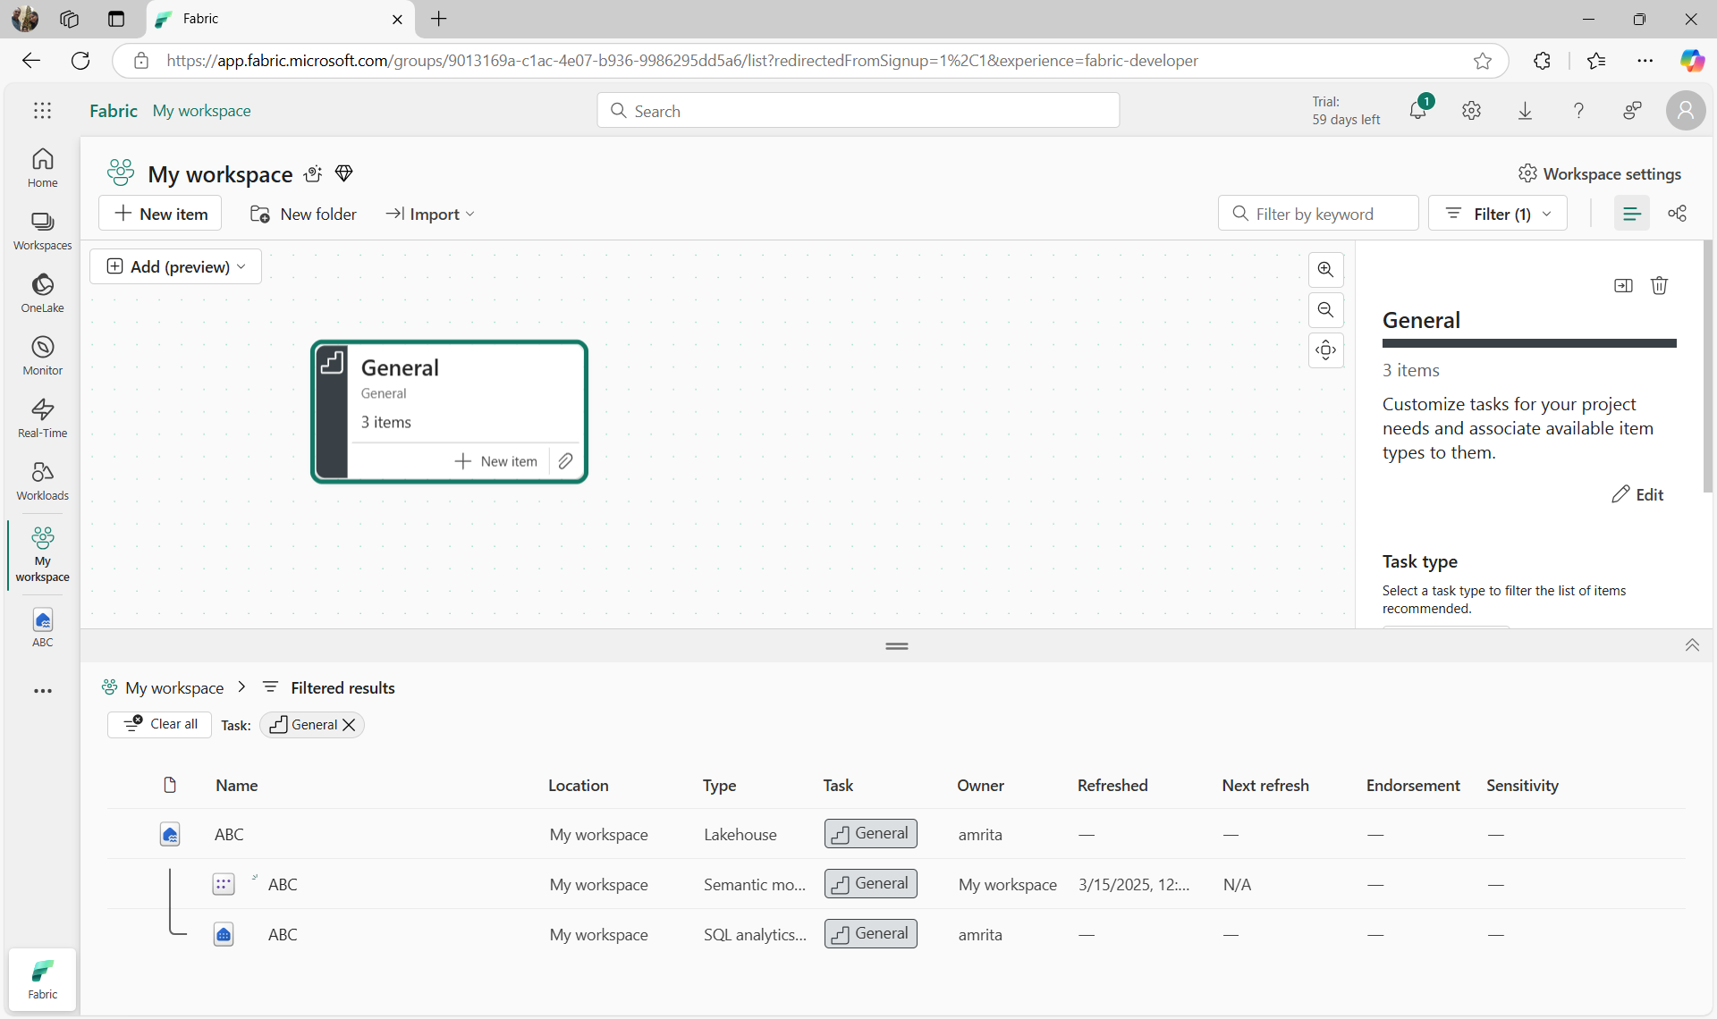

Slide 21
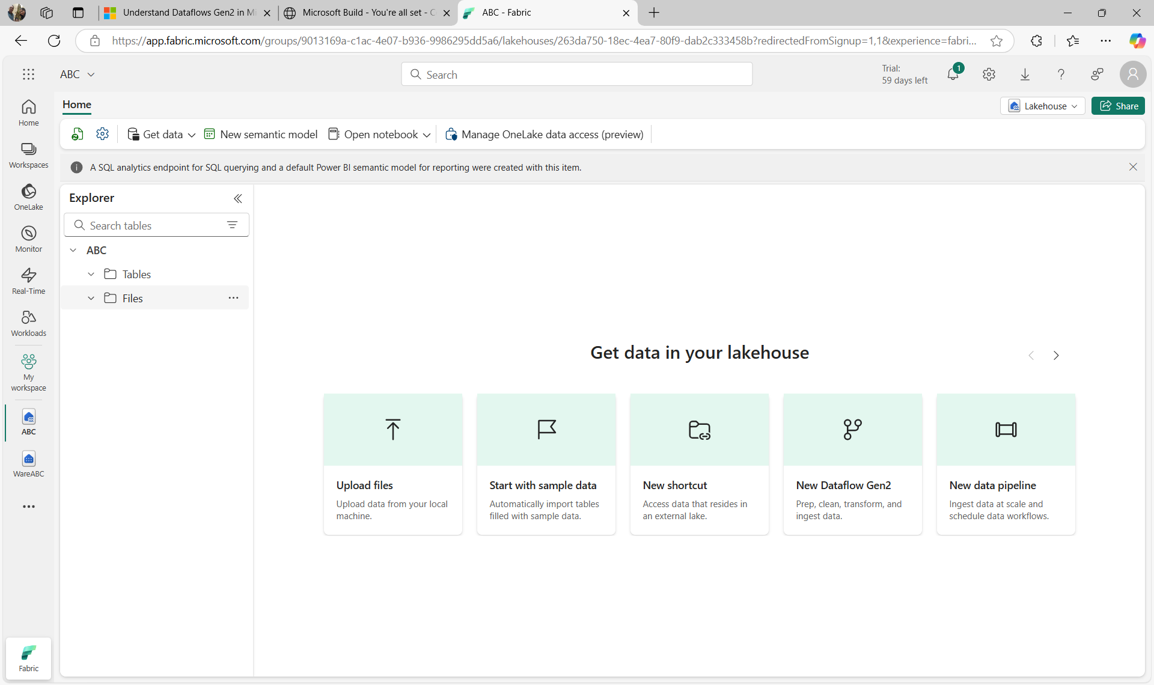

Slide 22
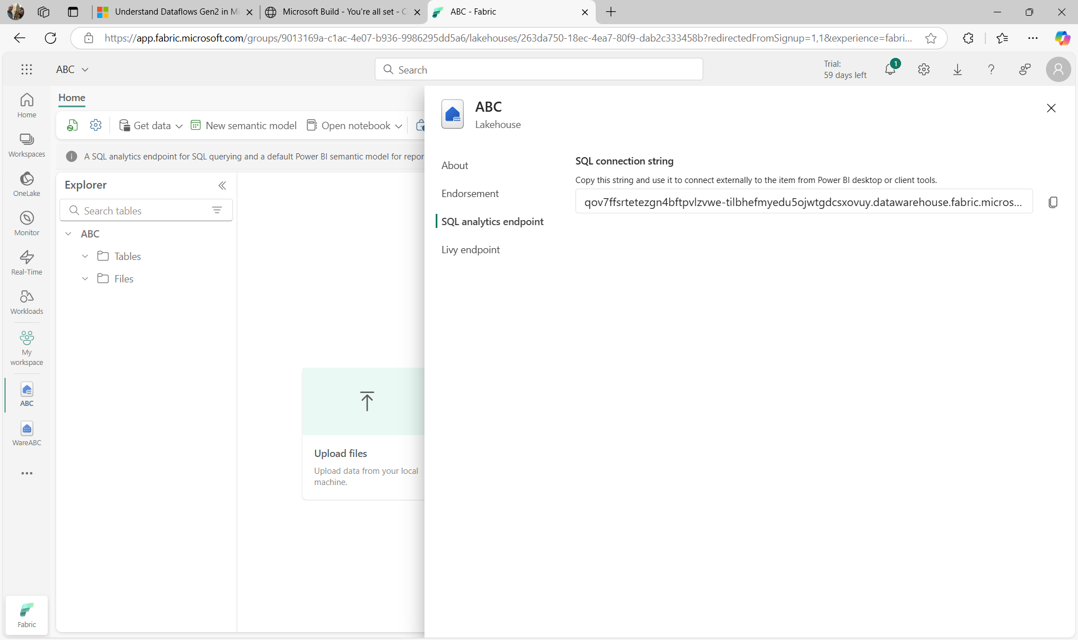

Slide 23
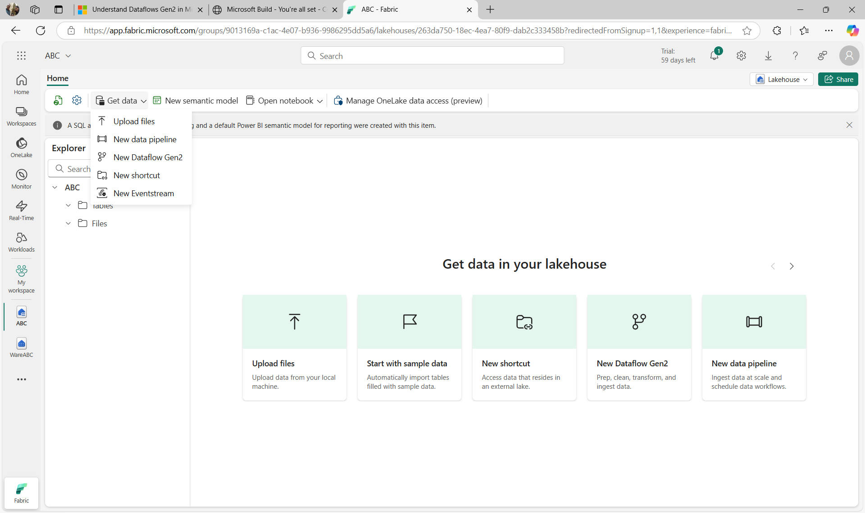

Slide 24
Ingest data
Ingesting data into your lakehouse is the first step in your ETL process. Use any of the following methods to bring data into your lakehouse.
Upload: Upload local files.
Dataflows Gen2: Import and transform data using Power Query.
Notebooks: Use Apache Spark to ingest, transform, and load data.
Data Factory pipelines: Use the Copy data activity.
This data can then be loaded directly into files or tables. Consider your data loading pattern when ingesting data to determine if you should load all raw data as files before processing or use staging tables.

Slide 25
Ingest data
Spark job definitions can also be used to submit batch/streaming jobs to Spark clusters. By uploading the binary files from the compilation output of different languages (for example, .jar from Java), you can apply different transformation logic to the data hosted on a lakehouse. Besides the binary file, you can further customize the behavior of the job by uploading more libraries and command line arguments.

Slide 26
Transform and load data
Most data requires transformations before loading into tables. You might ingest raw data directly into a lakehouse and then further transform and load into tables. Regardless of your ETL design, you can transform and load data simply using the same tools to ingest data. Transformed data can then be loaded as a file or a Delta table.
Notebooks are favored by data engineers familiar with different programming languages including PySpark, SQL, and Scala.
Dataflows Gen2 are excellent for developers familiar with Power BI or Excel since they use the PowerQuery interface.
Pipelines provide a visual interface to perform and orchestrate ETL processes. Pipelines can be as simple or as complex as you need.

Slide 27
Analyze and Visualize
After data is ingested, transformed, and loaded, it's ready for others to use. Fabric items provide the flexibility needed for every organization so you can use the tools that work for you.
Data scientists can use notebooks or Data wrangler to explore and train machine learning models for AI.
Report developers can use the semantic model to create Power BI reports.
Analysts can use the SQL analytics endpoint to query, filter, aggregate, and otherwise explore data in lakehouse tables.
By combining the data visualization capabilities of Power BI with the centralized storage and tabular schema of a data lakehouse, you can implement an end-to-end analytics solution on a single platform.

Slide 28
Warehouse
Introduction
Warehouse fundamentals
Process

Slide 29
Introduction
Relational data warehouses are at the center of most enterprise business intelligence (BI) solutions. While the specific details may vary across data warehouse implementations, a common pattern based on a denormalized, multidimensional schema has emerged as the standard design for a relational data warehouse.
Microsoft Fabric's data warehouse is a modern version of the traditional data warehouse. It centralizes and organizes data from different departments, systems, and databases into a single, unified view for analysis and reporting purposes. Fabric's data warehouse provides full SQL semantics, including the ability to insert, update, and delete data in the tables. Fabric's data warehouse is unique because it's built on the Lakehouse, which is stored in Delta format and can be queried using SQL. It's designed for use by the whole data team, not just data engineers.
Fabric's data warehouse experience is designed to address these challenges. Fabric enables data engineers, analysts, and data scientists to work together to create and query a data warehouse that is optimized for their specific needs.
In this module, you'll learn about data warehouses in Fabric, create a data warehouse, load, query, and visualize data.

Slide 30
Fundamentals
The process of building a modern data warehouse typically consists of:
Data ingestion - moving data from source systems into a data warehouse.
Data storage - storing the data in a format that is optimized for analytics.
Data processing - transforming the data into a format that is ready for consumption by analytical tools.
Data analysis and delivery - analyzing the data to gain insights and delivering those insights to the business.
Microsoft Fabric enables data engineers and analysts to ingest, store, transform, and visualize data all in one tool with both a low-code and traditional experience

Slide 31
Design the Data Warehouse
Like all relational databases, Fabric's data warehouse contains tables to store your data for analytics later. Most commonly, these tables are organized in a schema that is optimized for multidimensional modeling. In this approach, numerical data related to events (e.g. sales orders) are grouped by different attributes (e.g. date, customer, store). For instance, you can analyze the total amount paid for sales orders that occurred on a specific date or at a particular store.

Slide 32
Tables
OrderID | CustomerID | Product ID | Quantity | Order date | Total Amount
101 | 5005 | A12 | 7 | 23-dec-2022 | 7000
102 | 5002 | A12 | 1 | 05-jan-2021 | 1000
103 | 5005 | A15 | 5 | 30-apr-2024 | 500
104 | 5003 | B23 | 3 | 23-feb-2024 | 300
105 | 5001 | B23 | 4 | 05-jan-2021 | 400
106 | 5003 | A27 | 4 | 25-dec-2025 | 4000
Tables in a data warehouse are typically organized in a way that supports efficient and effective analysis of large amounts of data. This organization is often referred to as dimensional modeling, which involves structuring tables into fact tables and dimension tables.
Fact tables contain the numerical data that you want to analyze. Fact tables typically have a large number of rows and are the primary source of data for analysis. For example, a fact table might contain the total amount paid for sales orders that occurred on a specific date or at a particular store.

Slide 33
Dimension tables
Dimension tables contain descriptive information about the data in the fact tables. Dimension tables typically have a small number of rows and are used to provide context for the data in the fact tables. For example, a dimension table might contain information about the customers who placed sales orders
Cust_id | Name | email | PhoneNumber
5001 | ABC | abc@gmail.com | 9930405920
5002 | PQR | pqr@gmail.com | 9830988940
5003 | XYZ | xyz@gmail.com | 9987809870
5004 | MNO | mno@gmail.com | 9878078906
5005 | QWR | qwr@gmail.com | 9960798067

Slide 34
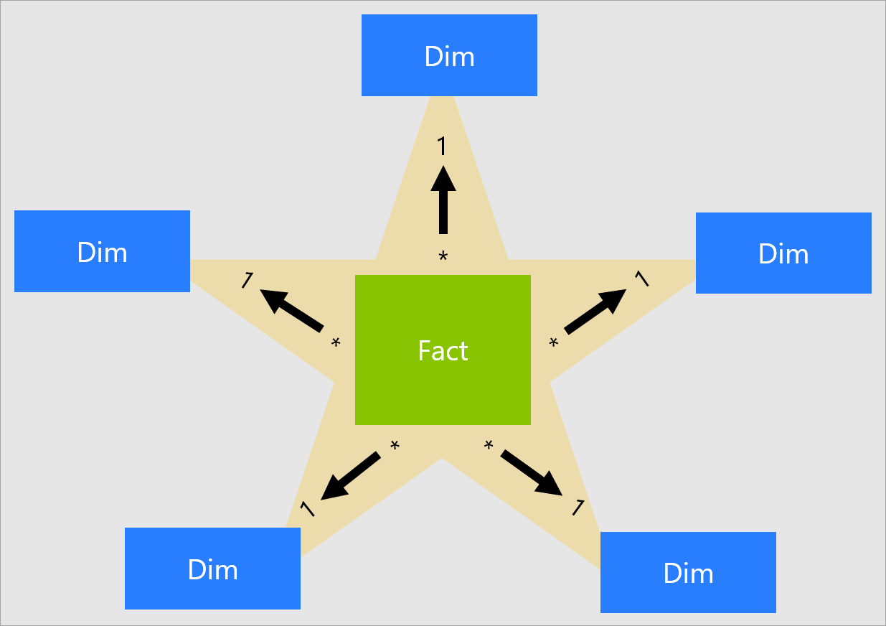
Star Schema

Slide 35
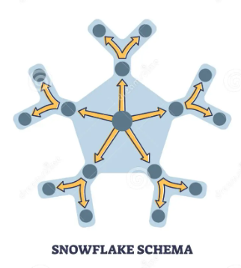
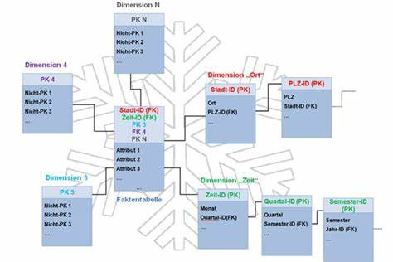
SNOWFLAKE SCHEMA

