Slide 1
Evaluation Metric Log Loss (Cross Entropy Loss)
-- Dr. Zhao Qifang
DEXTRA

Slide 2
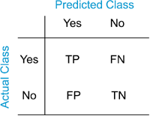
Introduction
Classification problems
E-mail classification: spam or non-spam
Tumor classification: benign or malignant
Evaluation metrics
Accuracy
Precision, Recall, F-1 Score
Area under ROC curve
Log Loss
Notes:
Before we talk about the evaluation metric, I will give a simple introduction to the use cases of this metric. F-1 score is the harmonic mean of precision and recall.

Slide 3
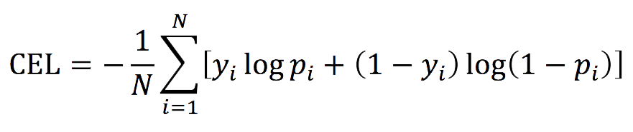
Log Loss -- What it is?
CEL = Cross Entropy Loss (Log Loss), where the lower is better
N = the number of rows in the dataset
y_i = the true value of i-th row
p_i = the predicted probability value of i-th row
log(x) is the common logarithm log10(x)
NOTE: p_i is replaced with max(min(p_i, 1 – 10^-15), 10^-15)
Notes:
Minimize the log loss score is equivalent to maximize the likelihood between prediction and ground truth

Slide 4
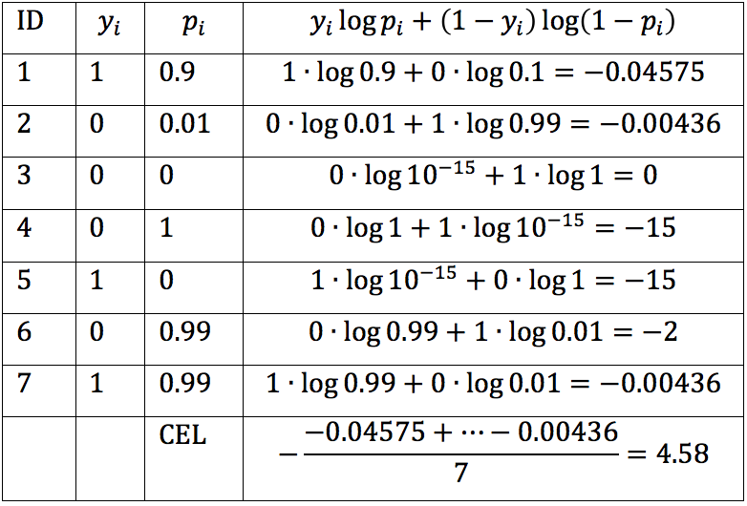
Log Loss -- What it is?
Notes:
Minimize the log loss score is equivalent to

Slide 5
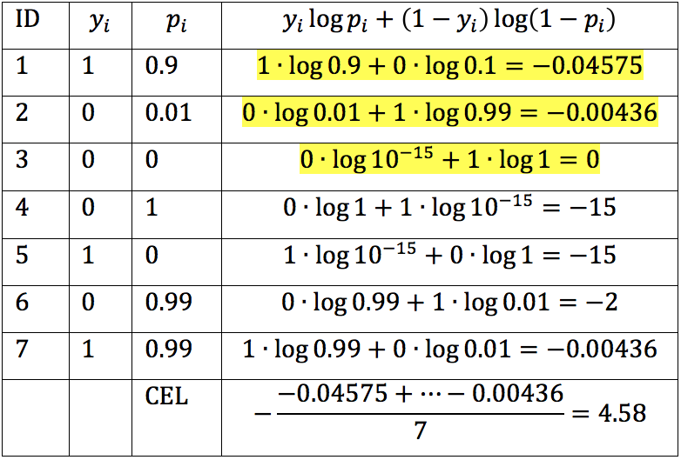
Log Loss -- What it is?
Notes:
Minimize the log loss score is equivalent to

Slide 6
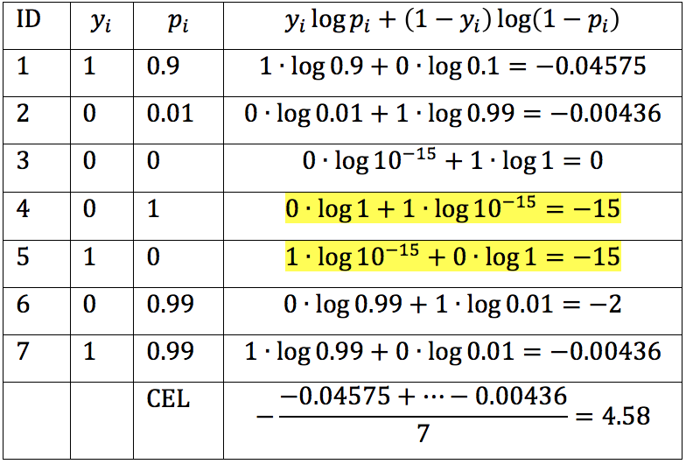
Log Loss -- What it is?
Notes:
Minimize the log loss score is equivalent to

Slide 7
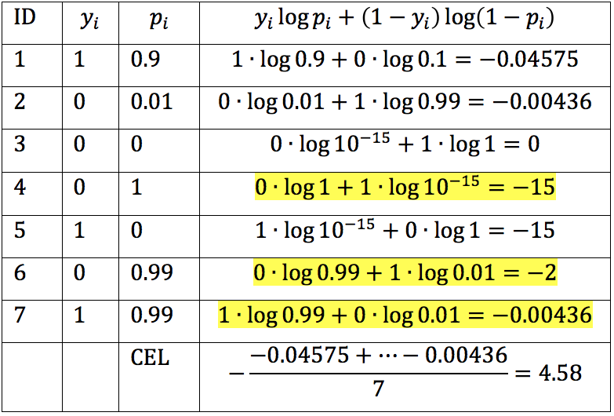
Log Loss -- What it is?
Notes:
Minimize the log loss score is equivalent to

Slide 8
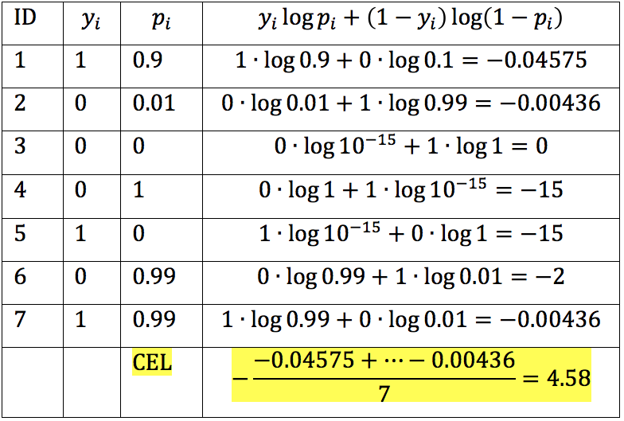
Log Loss -- What it is?
Notes:
Minimize the log loss score is equivalent to

Slide 9
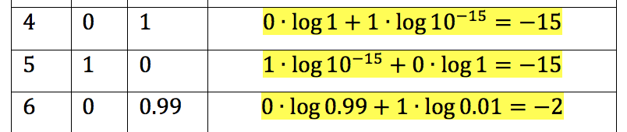
Log Loss -- Why we choose it?
Penalize confident wrong prediction high
Spend resources correctly to retain employees

Slide 10
Suggested algorithms
Top suggestions:
Gradient Boosting Classifier
Random Forest
Support Vector Machine
Ensemble
Medium suggestions:
Neural network
Logistic Regression
Others:
Naïve Bayes
Decision Tree

Slide 11
Resources
Getting start with Python in Data Science from Harvard’s free online course CS 109:
Lecture Videos
Lecture Notes
Getting start with R in Data Science from free courses by Johns Hopkins University in Coursera:
The Data Scientist's Toolbox
R Programming
Logistic Regression, Neural Network, Support Vector Machine by Andrew Ng
Week 3 to Week 7
Decision Tree video series for beginners:
Video series
Random Forest video for beginners:
Video
Gradient Boosted Regression Trees in Python video for beginners:
Video
Naive Bayes video for beginners:
Video

Slide 12
Thank you
http://www.slideshare.net/zhaoqf123/log-lossformindef

