Slide 1
Hierarchy
CSCI 101

Slide 2
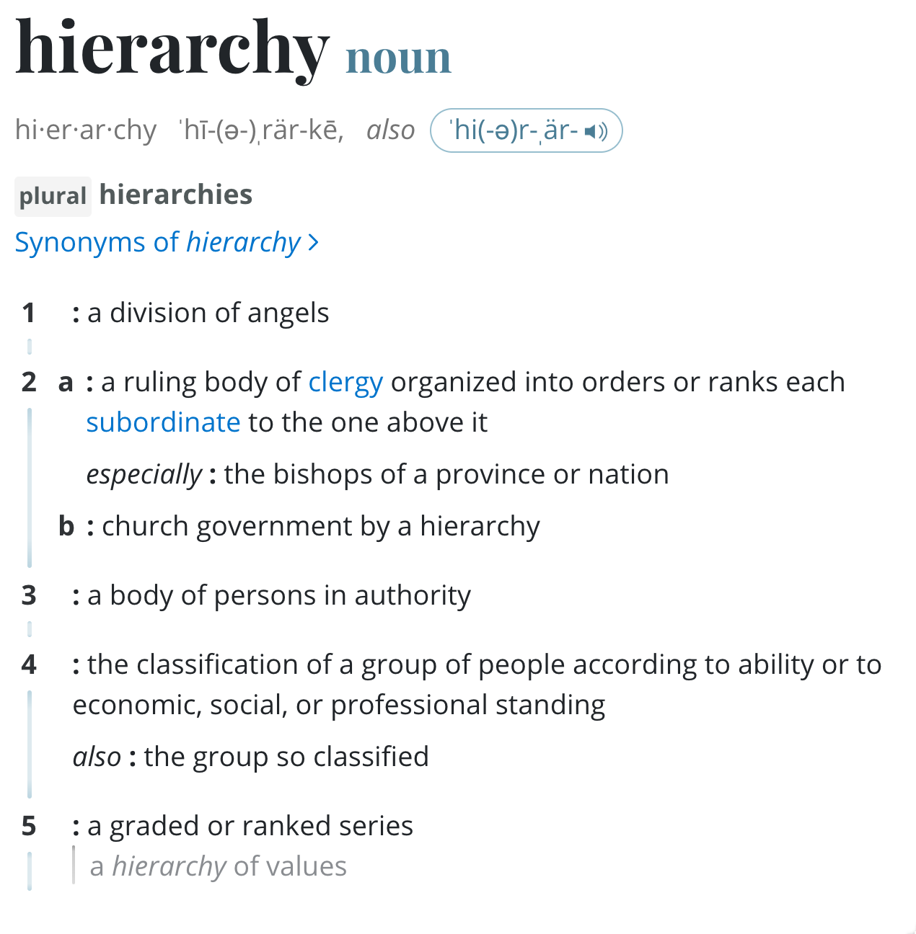
In computer science, hierarchy refers to the arrangement of system components or elements in a structured order.

Slide 3
Sample of Computer Science related Hierarchies
File System Hierarchy: Organization of files and directories
Class Hierarchy: in object-oriented programming, the relationship between base class and derived class
Networking Hierarchy: Structure of networks and subnetworks
DNS Resolution Hierarchy: Resolving domain names
Memory Hierarchy: Arrangement of storage in terms of speed and size

Slide 4
File System Hierarchy

Slide 5
Benefits of File System Hierarchy:
Organization (logical structure)
Categorization (logical structure)
Reduced search time
Simplified maintenance
Improved security
Scalability

Slide 6
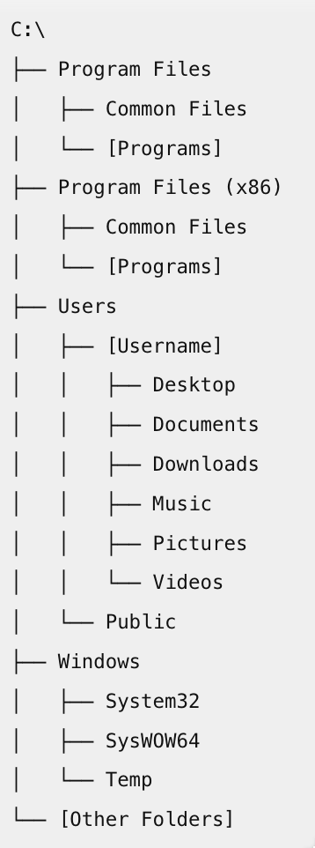
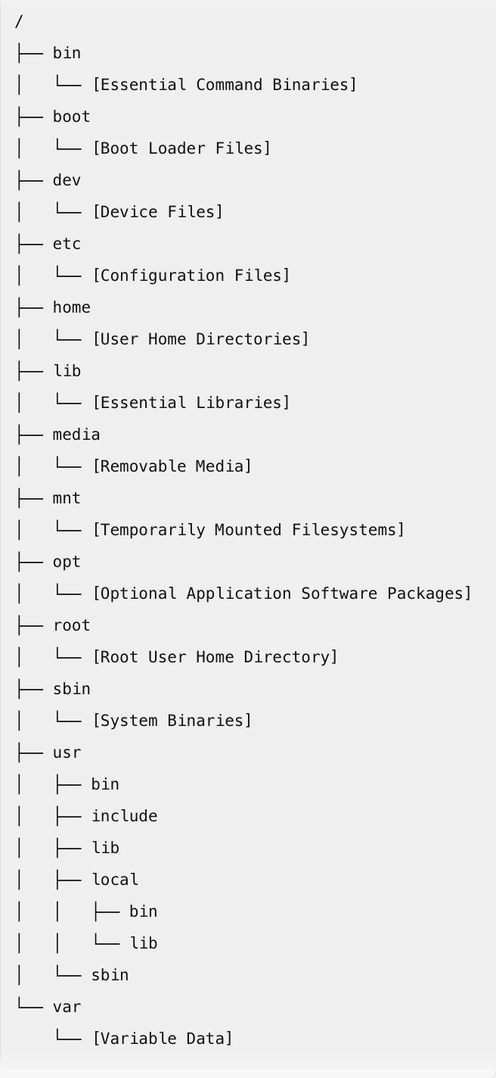
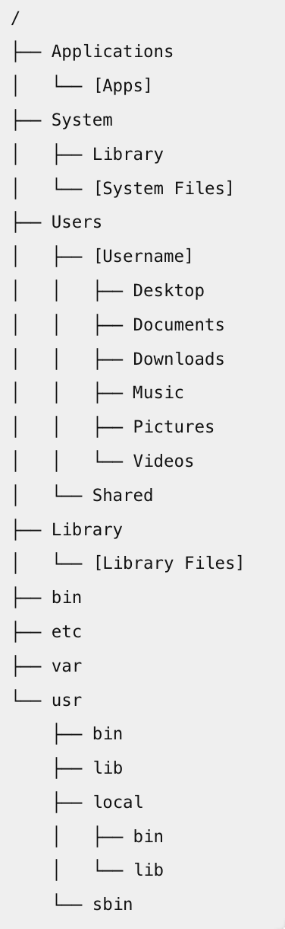
File System Hierarchy
Windows
Linux
Mac
Typical file system tree structure
  Root
  Parent
  Child
  Sibling directories
Left: side by side comparison Windows, Linux, and Mac file structure

Slide 7
File System Navigation: Command Line
Function | Windows | Mac / Linux
List contents of current directory | dir | ls
Change Directory | cd <dir name>, cd.., cd\ | cd, cd .., cd /
Create directory | cd <dir name> | mkdir <dir name>
Remove Directory | rd <dir name> | rm –r <dir name>
Delete file | del <file.txt> | rm <file.txt>
Copy file | copy <file.txt> C:\NewFolder\ | cp <file.txt> </new folder>
Copy files AND directories | xcopy <source> <destination> /s /e | cp –r <source> <target>
Display dir structure | tree
Find file | dir /s /b *.txt | find . –name “file.txt”

Slide 8
Exercise 1: Working from Terminal or Command Prompt
Create a text file or document and save termTestDoc.txt on your desktop (remember the name!)
next:
Open Command Prompt/Terminal
Using the CLI:
  Display contents of current directory
  Create new folder in your documents called termTestFolder
  Navigate to desktop, and
  Copy termTestDoc.txt to your termTestFolder.

Slide 9
Class Hierarchy (OOP)

Slide 10
Class Hierarchy in OOP
Object-Oriented Programming (OOP): “objects” represent data, and methods manipulate data.
Two key concepts used in Class hierarchy:
  Inheritance: One class (child or derived class) inherits properties or methods from another class (parent or base class)
  Polymorphism: Allows methods in different classes to have the same name but behave
Benefits:
  code reusability
  modularity, and
  scalability

Slide 11
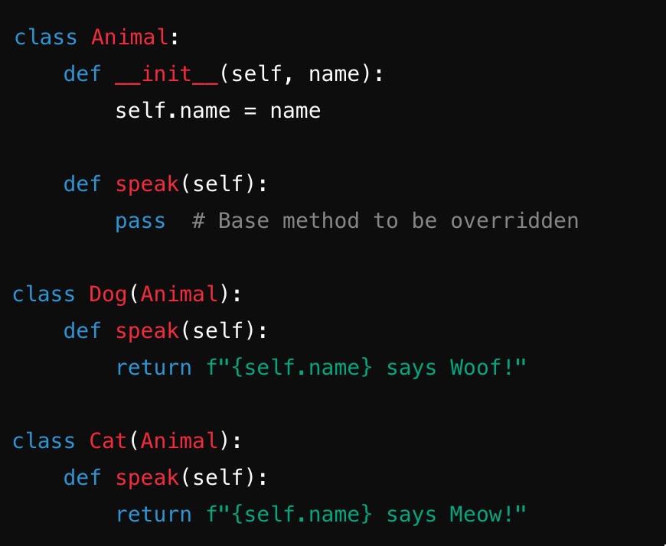
Example of Inheritance:
Animal is the base class (parent class)
Dog and Cat are derived from animal (child class, derived class)
Both Dog and Cat have their own implementation (inheritance) of the speak method

Slide 12
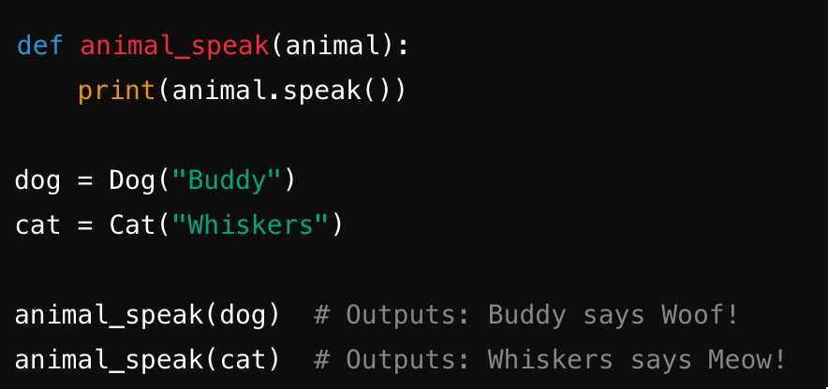
Example of Polymorphism:
animal_speak function demonstrates polymorphism. It takes any animal class object (Dog, Cat) and calls the speak method.

Slide 13
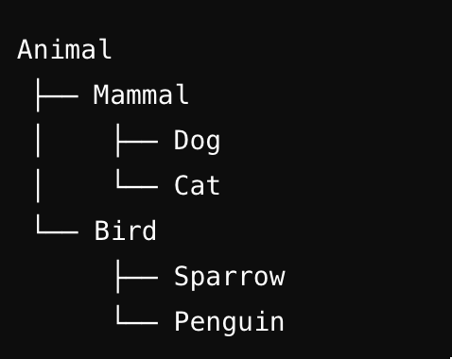
Example of Hierarchy Structure and Benefits:
Code Reusability: Inherited classes can use code already defined in base class
Extensibility: new functionalities can be added to existing class hierarchy w/out modifying existing code
Maintenance: Easier to maintain and update code since changes in base class are propagated to derived classes.
Polymorphic behavior: supports flexible and reusable code by allowing objects to be processed differently depending on their data type or class

Slide 14
Network Infrastructure Hierarchy*
*We’ll take a closer look at the history of the OSI and TCP/IP model next class

Slide 15
Network Infrastructure Hierarchy
Networks can be divided (based on size) into WANs, MANs, and LANs.
Infrastructure of WANs:
  Tier I Networks – The backbone of the Internet. Large (Global) ISPs) that connect directly with each other through private peering agreements and public peering points.
Importance for managing large-scale networks

Slide 16
Tier 1 Networks.
Description: Core Layer. Backbone networks of the Internet. Large Global ISPs that connect directly with each other through private peering agreements and public peering points. Arrangement offers redundancy, reliability, and performance.
Example:
  AT&T
  Verizon,
  CenturyLink,
  NTT Communication
Characteristics:
  No cost for data exchange with other Tier 1 Networks
  Provide global routing information
  High-speed data transfer
  Form core of the Internet’s infrastructure

Slide 17
Tier 2 Networks
Description: Distribution layer. Used to connect one or more Tier I networks and Tier 2 networks. They pay Tier 1 networks for access to broader internet, but have peering agreements with other Tier 2 networks
Example:
  Comcast
  British Telecom,
  Vodafone,
Characteristics:
  Regional or national coverage
  Aggregation of traffic from multiple access points
  May engage in peering and transit agreements to reduce costs and improve

Slide 18
Tier 3 Networks
Description: Access Layer. Local ISPs that provide Internet access to end users (homes and businesses), they connect to Tier 2 or Tier 1 networks to access broader Internet.
Example (small regional providers):
  Sonic
  Frontier
  Mediacom
Characteristics:
  Focus on the last mile connectivity
  Provide DSL, Cable Internet, Fiber

Slide 19
Data Flow in Hierarchical Internet Structure
End User to Access Layer: End users connect to their local ISP (Tier 3) through various technologies like DSL, cable, fiber, or wireless. This ISP handles the initial data transmission.
Access Layer to Distribution Layer: The local ISP aggregates user traffic and forwards it to a Tier 2 network, which provides regional or national connectivity. The Tier 2 network manages data routing between multiple ISPs and the core layer.
Distribution Layer to Core Layer: The Tier 2 network forwards data to a Tier 1 network when it needs to be routed globally. The core layer handles high-speed data transfer across international borders and major regions.
Core Layer to Distribution Layer: Once data reaches the appropriate region or country, it is handed off from a Tier 1 network to a Tier 2 network for further routing within the region.
Distribution Layer to Access Layer: The Tier 2 network forwards data to the relevant Tier 3 networks, which then deliver it to the end users.
Tier I
Tier 2
Tier 3
Tier 3
Tier 2
Tier 3
Tier 3

Slide 20
Domain Name System (DNS) Hierarchy
Chuck@PartnersForCommunity.org
Specific General
Charles Charleston
Partners For Community
1666 Main Street
Springfield, MA 12345
Specific
General

Slide 21
Domain Name System (DNS) Hierarchy
Sending computer sends DNS query
Local DNS Resolver (Caching DNS server) replies or sends query to Recursive Resolver
Recursive DNS Resolver: (recursive)
  Queries Root Name Server for TDL
  Queries return Top-Level Domain Servers returns Authoritative Name Server found)
  Queries Authoritative Name Server
  Returns address to Local DNS Resolver
Local DNS Resolver sends address to Sending Computer
Sending computer uses returned address as needed
Low
High
Low

Slide 22
Memory Hierarchy

Slide 23
Memory Hierarchy
Faster / $$$
Slower / $
Registers – Inside CPU, fastest speed (related to clock speed), most expensive (per bit), smallest capacity. Holds data that CPU is currently processing.
Cache memory – on or near the CPU, very fast, high cost (but less than registers), larger than than register, smaller than main memory. Stores frequently accessed data and instructions. Reduces CPU fetch time.
  L1 Cache smallest and fastest, located on CPU
  L2 Cache larger than L1, slightly slower, can be on or near CPU
  L3 Cache even larger and slower than L2, SHARED AMONG MULTIPLE CPU CORES
Main Memory (RAM) – located on motherboard, fast, but slower than cache. Moderate cost, larger capacity than cache. Holds the data and instructions that the CPU needs while executing programs. Volatile.
Secondary storage – HDDs, SSDs, CDs, Internal or external, slower than RAM, lower cost per bit, much larger than main memory.
Tertiary – slow, inexpensive, large capacity (tape backup)
Cloud – variable speed, variable cost, unlimited size.

Slide 24
Exercise 2: What’s in your computer?
Determine the type and amount of memory, including RAM and cache in your computer system.
  Processor?
  Cache?
  RAM
  Storage
Is it possible/worth upgrading your computer?

