Slide 1
Computer Networking: a brief history
CSCI 101

Slide 2
Central Challenge:
Now that computers do stuff, how do you get computers to talk to each other?
Different manufacturers – different hardware
Different operating systems – different data formats
Geographical distances – unreliable transmission media
Clear need for standardization and collaboration

Slide 3
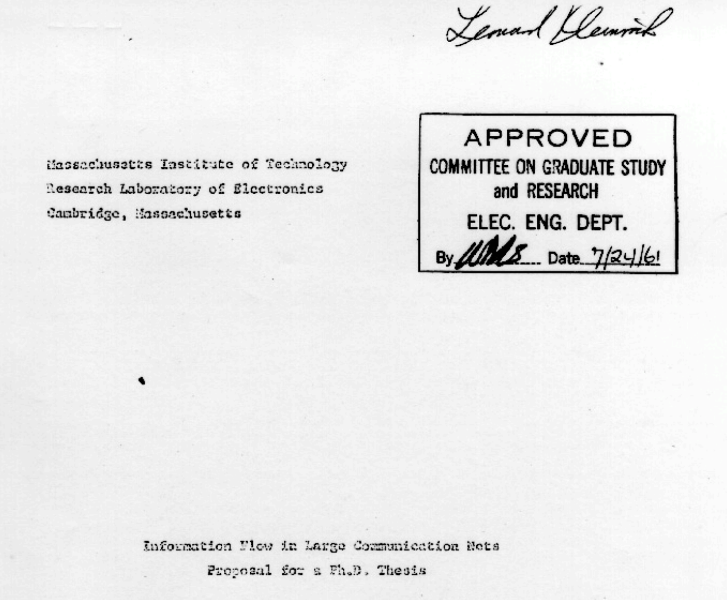
Packet Switching
1961: Leonard Kleinrock publishes
his first paper on packet switching theory

Slide 4
Leonard’s Big Idea:
The problem: Circuit switching wastes resources
  Dedicated paths sit idle during processing
  Expensive network infrastructure underused
The solution: Break messages into packets
  Small independent pieces
  Share network infrastructure
  Automatic rerouting around failures
Foundation: Information Flow in Large Communication
  Mathematical proof using queuing theory

Slide 5
Circuit vs Packet Switching: Book Analogy
Circuit Switching:
  Reserve entire mail truck for one book
  Wasteful, but guaranteed delivery
Packet Switching:
  Mail each page separately
  Efficient use of postal system
  Pages reassembled at destination

Slide 6
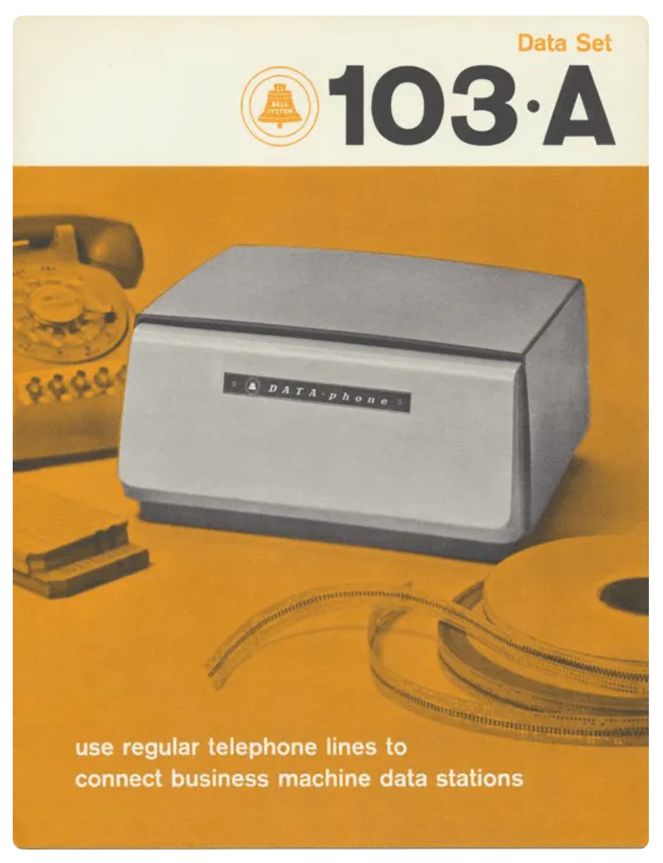
First Connection (1965): MIT to California
1965: The first computer-to-computer communication over a telephone line is achieved by Lawrence G. Roberts and Thomas Merrill
  Bell 103A Modem (Similar specs to what was used)
  Data Rate: 300 bits per second (bps)
  About 37 characters of text per second
  Connection Type: Dial-up, using analog telephone lines
Took several tries, finally worked!
Proved remote computer communication was feasible

Slide 7
Birth of ARPANET (1969)
First Packet-Switched Network
Funded by the U.S. Department of Defense
Goal: to develop a resilient (withstand nuclear attack), decentralized communication network
It becomes the first packet-switched network
Uses Network Control Protocol (NCP) for communication between nodes.
precursor to the Internet.
Leadership: Steve Crocker, Vincent Cerf
Notes:
Steve Crocker: contributed to development of email systems standards, Host-Host protocol, initiating the RFC (Request for Comments) for the development of network protocols
Vincent Cerf: contributed to development of TCP

Slide 8
ARPANET Design Principles
Building for Resilience
Interface Message Processors (IMPs) at each node
Network Control Protocol (NCP)
Distribute routing (no central control)
Automatic adaptation to failures
Open standards for growth

Slide 9
ARPANET 1969
UCLA
(Kleinrock’s lab)
Stanford
Research Institute
UC
Santa Barbara
University
of Utah
UCLA – SRI
SRI – UCSB
UCLA UCSB
UCSB – Utah

Slide 10
ARPANET 1970
1. UCLA (Sept 1969)
2. Stanford Research Institute (SRI) (Oct 1969)
3. UC Santa Barbara (UCSB) (Nov 1969)
4. University of Utah (Dec 1969)
5. BBN (Bolt, Beranek & Newman, Cambridge, MA) - Early 1970
6. MIT (Massachusetts Institute of Technology) - Mid 1970
7. RAND Corporation (Santa Monica) - Mid 1970
8. SDC (Systems Development Corporation, Santa Monica) - Mid 1970
9. Harvard University - Mid 1970
10. Lincoln Laboratory (Lexington, MA) - Late 1970
11. Stanford University - Late 1970
12. Carnegie Mellon University - Late 1970
13. Case Western Reserve University - Late 1970

Slide 11
ARPANET 1971 (15 Nodes, 23 Hosts – Email!)
1. UCLA (University of California, Los Angeles)
2. SRI (Stanford Research Institute)
3. UCSB (University of California, Santa Barbara)
4. University of Utah
5. BBN (Bolt, Beranek and Newman, Cambridge, MA)
6. MIT (Massachusetts Institute of Technology)
7. RAND (RAND Corporation, Santa Monica)
8. SDC (System Development Corporation, Santa Monica)
9. Harvard University
10. Lincoln Lab (MIT Lincoln Laboratory, Lexington, MA)
11. Stanford University
12. UIU(C) (University of Illinois at Urbana-Champaign)
13. CWRU (Case Western Reserve University)
14. CMU (Carnegie Mellon University)
15. NASA/Ames (NASA Ames Research Center)

Slide 12
ARPANET 1972
First public demonstration of ARPANET
Network Control Protocol (NCP) enables host-to-host communication
Proves packet switching works at scale

Slide 13
ARPANET 1973 (40+ Nodes/Hosts)
1. UCLA - Multiple systems (Sigma 7, IBM 360/91, PDP-10)
2. SRI (Stanford Research Institute) - PDP-10 systems
3. UCSB (UC Santa Barbara) - IBM 360/75, PDP-11
4. University of Utah - PDP-10, TIP
5. Stanford University - PDP-10, PDP-11
6. MIT - Multiple systems (Multics, PDP-10s)
7. Harvard - PDP-10, PDP-1, PDP-11
8. Lincoln Lab (MIT) - IBM 360/67, TX-2, PDP-11
9. CMU (Carnegie Mellon) - Multiple PDP-10s, IBM 360/67
10. Case Western Reserve
11. University of Illinois - PDP-11 systems
12. UC Berkeley - PDP-11/45
13. UCSD (UC San Diego) - B6700
14. Rutgers University
15. BBN (Bolt, Beranek & Newman) - Multiple systems
16. RAND Corporation - IBM 370/158
17. SDC (System Development Corp) - IBM 370s
18. USC-ISI (USC Information Sciences Institute) - Multiple systems
19. Xerox PARC - MAXC, Nova 800, PDP-11
20. SRI International - Multiple systems
21. ILLIAC IV - PDP-10, PDP-11
22. LBL (Lawrence Berkeley Lab) - CDC 7600
23. SCI - SCL-85
24. NASA Ames - IBM 360/67, PDP-11, TIP
25. NBS (National Bureau of Standards) - PDP-11, TIP
26. LLL (Lawrence Livermore Lab) - PDP-11
27. BRL (Ballistics Research Lab) - PDP-11
28. ARPA - PDP-15, TIP
29. RADC (Rome Air Development Center) - TIP
30. ETAC (Environmental Technical Applications) - TIP
31. GWC (Global Weather Central) - TIP
32. FNWC (Fleet Numerical Weather Central) - CDC 6500, TIP
33. AFWL (Air Force Weapons Lab) - TIP
34. WPAFB (Wright-Patterson AFB) - TIP
35. BELVOIR - CDC 6600
36. SDAC - IBM 360/44, TIP
37. MITRE Corporation - TIP
38. CCA (Computer Corporation of America) - PDP-10, TIP
39. UNIVAC - 1616
40. Tymshare - TIP
41. DOCB - TIP
42. NORSAR (Norway) - TIP
43. UKICS (University College London) - IBM 360/195, TIP
44. University of Hawaii (ALOHA) - HP 2100, BCC 500, TIP
Note: TIP (Terminal Interface Processor) allowed direct terminal connections without a host computer

Slide 14
HOSTS.TXT Problem
ARPANET grew, name resolution became a challenge
The solution (initial)
  HOSTS.TXT file – mapped hostnames to IP addresses
  Maintained centrally by SRI-NIC (Stanford Research Institute's Network Information Center)
  Administrators emailed changes to NIC
  Updated once or twice weekly
  All hosts downloaded the file via FTP from SRI-NIC
  This will come back as a security issue . . .

Slide 15
Growing Pains (late 1970s)
File size grew with each new host (40+ nodes = management nightmare)
Network traffic from updates overwhelming SRI-NIC
Single point of failure – if SRI-NIC down, name resolution stops
Updates only weekly – delays in adding new hosts

Slide 16
The Fix (1983)
DNS (Domain Name System) introduced
Decentralized, hierarchical solution
Dynamic query resolution instead of static file distribution

Slide 17
Wide Area Networks (WANS) Solved
ARPANET’s success connected distant computer
Packet switching over long-distance telephone lines
Worked well for research institutions
Email!

Slide 18
Local Area Networks (LANs) Unsolved
How to connect multiple computers in the same building or campus
Different requirements than long=distance network
Need: cost-effective way to share resources locally

Slide 19
LAN problem (it’s own history):
ARPANET’s IMP technology expensive for local use
Needed simpler, cheaper solution for connecting nearby computers
Businesses and universities wanted local networking

Slide 20
ALOHAnet (1971)
Used radio waves to connect computers across Hawaiian island
Random access protocol – devices transmit when they have data
  If collision occurs, wait and retry
  Inspired Ethernet's design

Slide 21
Xerox PARC (1973)
Palo Alto Research Center working on “Office of the future”
  Vision: multiple computers, printers, servers sharing resources
  Need: reliable local area networking technology
  Robert Metcalfe assigned to solve this problem
  Foundation set for Ethernet!

Slide 22
Early 70s:
What was working
  Packet switching proven in ARPANET
  Distributed routing demonstrated
  Remote resource sharing enabled
  Open protocols showing value
What was missing
  No standards for local area networks
  No standardized way to interconnect different networks
  Each organization developed custom solutions
  Limited interoperability between system

Slide 23
The need:
Universal protocols that work across different network types
Standards for internetworking (connecting networks)
These two need drove innovations throughout the 1970s

Slide 24
1970s: Development of Early Networking Protocols
1974: Vint Cerf and Bob Kahn publish the first specification of the Transmission Control Protocol (TCP)
  Network Agnosticism: reliable inter-network communication (satellite, radio, wired)
  Packet Switching: small packets independently routed and reassembled
  End-to-end Communication: receiving end acknowledged receipt of data on receiving end and mechanism for retransmission of lost packets
  Layered Architecture: Separation of data transmission (TCP) from addressing and routing (IP)

Slide 25
1970s: Development of Early Networking Protocols
1976: IBM introduces Systems Network Architecture (SNA),
  proprietary networking protocol for connecting IBM mainframe computers.
  Used 7-layer architecture (similar to, but not the same as OSI model)
  Logical Unit (LUs): endpoints representing devices/applications communicating with each other
  Physical Units (PUs): control points managing communication between network parts
  Transmission Control Units (TCU): Data flow management (incuding error checking and data sequencing)
  Influenced design of future protocols

Slide 26
1970s: Development of Early Networking Protocols
1978: TCP is split into TCP and IP (Internet Protocol)
  Scalability: Handling both transmission control and routing withing single protocol very complex (became issue with increasing number of connected networks and devices
  Modularity and Flexibility: different aspects of communication handled by different protocols
  Network Agnosticism: Separating responsibilities, transmission control(TCP) could focus on reliable delivery, and IP could focus on routing.

Slide 27
The LAN Protocol Wars (1980s – 1990s)
Multiple competing solutions for Local Area Networks

Slide 28
Novell NetWare (1983)
IPX/SPX Internetwork Packet Exchange / Sequenced Packet Exchange
Dominated market late 198s – early 1990s
Designed for LANS
Easy configuration – no manual IP address setup
Small memory footprint (critical for DOS / early Windows)
Fast and efficient for LANs

Slide 29
Microsoft’s Answer:
NetBIOS (Network Basic Input/Output System) – IBM/Sytek, 1983
NetBEUI (NetBIOS Extended User Interface) – IBM/Microsoft, 1985
Simple protocol for small networks (up to 200 stations)
No routing capability – broadcast domain only
Used in early Microsoft networking (MS-Net, LAN Manager)

Slide 30
The Problem
All proprietary or limited-scope solutions
IPX/SPX couldn't scale to Internet
NetBEUI not routable beyond local network
Multiple protocols = complexity and incompatibility

Slide 31
The Landscape (late 1980s early 1990s)
Limitations of Alternatives:
  IPX/SPX: Excellent for LANs, but didn't scale to Internet
  NetBEUI: Fast and simple, but unroutable (local only)
  AppleTalk: Apple-specific
- Each required separate network stacks

Slide 32
TCP/IP Advantages
Universal standard (not vendor-specific)
Routable across networks of any size
Already proven on Internet/ARPANET
Scalable from LAN to WAN to Internet
Free and open specifications

Slide 33
The Network Security Challenge (1980s – 1990s)
LANs grew, problems emerged:
  Multiple users accessing shared resources
  Who should access what?
  How to prevent unauthorized access?
  How to track who accessed what?
  So, now security is an issue . . .

Slide 34
The Security Questions
Authentication (Who are you?)
Authorization (What are you allowed to do?)
Access Control (How do we enforce permissions?)
Auditing (How do we track access?)

Slide 35
Early Solutions
Simple passwords
File-level permissions
No centralized management
Each server maintained its own user database

Slide 36
Novell NetWare Directory Services (NDS) 1993
Single sign-on – On login for entire network
Hierarchical directory: Tree structure (Organization, departments, Users)
Central management: All users, permissions in one place
Fine-grained access control: Control access at file/folder level
Public-key authentication: RSA encryption (since 1994)

Slide 37
What NDS Solved
Eliminated multiple passwords for multiple servers
Centralized security management
Scalable to large organizations
Based on X.500 directory standard

Slide 38
Impact of NDS
Set the standard for network directory services
Showed the value of centralized identity management
Influenced future directory services (including Active Directory)

Slide 39
Microsoft’s Active Directory (AD)
Windows NT domain model (enhanced)
DNS integration (not proprietary like NDS initially)
LDAP (Lightweight Directory Access Protocol) standard
Kerberos authentication

Slide 40
Why AD Succeeded
Integrated with Windows operating system
Leveraged existing DNS infrastructure
Microsoft's market dominance in business computing
Easier migration from NT domains

Slide 41
Evolution of Network Security
1970s ARPANET:
  Trust-based, small community, minimal security concerns
1980s Early LANS:
  Simple passwords, server-based security, limited access controls
1990s Directory Services:
  Centralized authentication (NDS, AD), single sign-on, role-based access control, public-key cryptography
2000 – Present: MFA, cloud-based identify services, Advanced threat detection

Slide 42
Overview: Open Systems Interface (OSI)

Slide 43
Before Standardized Protocols
Ad Hoc and Custom Networks:
  Custom implementations: Each company developed their own solutions (built from ground up)
  Limited interconnectivity: Custom nature meant isolation and limited interconnectivity across organizations or regions.

Slide 44
Review: Proprietary Protocols and Structures
Vendor-Specific Solutions:
  IBM: Systems Network Architecture used for connecting IBM mainframes
  DEC: Decnet for connecting peer-to-peer network
  Xerox: Xerox Network System (XNS) for LANs and WANS
Incompatible:
  Difficult or impossible for different systems to communicate with each other
  Lack of standardization led to fragmented network environment.

Slide 45
1980s: Standardization and Emergence of Networking Models
1980: The International Organization for Standardization (ISO) begins developing the OSI model
  Goal: create a universal networking framework.
  OSI Model: A conceptual framework used to understand and implement network communication between systems

Slide 46
1980s: Standardization and Emergence of Networking Models
1983: ARPANET formally adopts TCP/IP as its standard networking protocol, marking the beginning of the modern Internet.

Slide 47
1980s: Standardization and Emergence of Networking Models
1984: The OSI model is published by ISO
  A seven-layer framework for networking. (theoretical model)
  useful for understanding how components and applications fit networking model
  Becomes a key educational tool.

Slide 48
OSI Model
OSI | Role
7 Application | Enable users to access network
6 Presentation | Translates, encrypts, compresses data
5 Session | Create, terminate, and manages sessions
4 Transport | Manages delivery and error checking of packets
3 Network | Identify shortest path
2 Data Link Layer | Data packed into frames
1 Physical | Forms a physical medium for transport

Slide 49
Application Layer (Layer 7)
Function:
  Closest to the end-user and interacts with software applications to implement networking functions like email, file transfer, and web browsing.
  Network Hardware:
    Proxies: Can operate at Layer 7 by making content decisions.
    Layer 7 Switches: Also known as application-aware switches, they can make decisions based on application data.
    Firewalls: Advanced firewalls can operate at this layer, filtering traffic based on application content.

Slide 50
Presentation Layer (Layer 6)
Function:
  The Presentation layer translates data between the application layer and the network format, handling data encryption, compression, and translation.
Network Hardware:
  Encryption Devices: Hardware that provides data encryption/decryption.
  Some Gateways: If involved in protocol conversion or data translation.

Slide 51
Session Layer (Layer 5)
Function:
  The Session layer manages sessions between applications, including establishing, maintaining, and terminating connections.
Network Hardware:
  Application Gateways: Some devices that handle complex interactions between different systems may operate at this layer. Note: most session management is handled by software.

Slide 52
Transport Layer (Layer 4)
Function:
  The Transport layer is responsible for end-to-end communication, data flow control, error recovery, and segmentation. It ensures that data is transferred reliably and in the correct order.
Network Hardware:
  Gateways: Devices that connect networks using different protocols (though they can operate across multiple layers).
  Load Balancers: Often work at Layer 4 by distributing incoming traffic based on transport layer information like TCP/UDP ports.

Slide 53
Network Layer (Layer 3)
Function:
  The Network layer is responsible for routing packets across network boundaries, logical addressing, and path determination.
Network Hardware:
  Routers: Direct data packets between different networks based on IP addresses.
  Layer 3 Switches: Switches that perform routing functions.
  Firewalls: Some firewalls also operate at this layer to filter traffic based on IP addresses.

Slide 54
Data Link Layer (Layer 2)
Function:
  The Data Link layer is responsible for node-to-node data transfer and error detection and correction in frames. It also controls how data is placed on the medium.
Network Hardware:
  Switches: Operate at Layer 2 by forwarding frames based on MAC addresses.
  Bridges
  Network Interface Cards (NICs): Fully operates at this layer for handling MAC addresses and framing.

Slide 55
Physical Layer (Layer 1)
Function:
The Physical layer is responsible for the physical connection between devices. It handles the transmission and reception of raw bitstreams over a physical medium (e.g., cables, radio frequencies).
Network Hardware:
  Cables (Ethernet cables, fiber optics)
  Connectors
  Hubs
  Network Interface Cards (NICs) (partially)
  Repeaters
  Modems (for some types of communication)

Slide 56
OSI vs TCP/IP
OSI |  | TCP/IP (Suite of protocols)
7 Application | Enable users to access network | 4 Application | Enable user (human or software) to access network
6 Presentation | Translates, encrypts, compresses data
5 Session | Create, terminate, and manages sessions
4 Transport | Manages delivery and error checking of packets | 3 Transport | Manages delivery and error checking of packets
3 Network | Identify shortest path | 2 Internet | Identify shortest path
2 Data Link Layer | Data packed into frames | 1 Network Interface | Data packed into frames. Forms a physical medium for delivery of bits
1 Physical | Forms a physical medium for transport

Slide 57
Direct Comparison
 | TCP/IP | OSI
Expands to | Transmission Control Protocol | Open System Interconnect
Meaning | Client Server model used for transmission of data over internet | Theoretical model used for computing system
Number of layers | 4 layers | 7 layers
Developed by | DoD (Department of Defense) | ISO (International Standards Organization)
Tangible | Yes | No
Usage | Mostly used | Never used
Obeys | Horizontal approach | Vertical approach

Slide 58
TCP/IP Protocols
Application Layer:
  HTTP / HTTPS FTP SMTP POP3/IMAP DNS
  Telnet/SSH SNMP DHCP NTP
Transport Layer:
  TCP UDP
Internet Layer:
  IP (IPv4, IPv6) ICMP ARP ,RARP
Link Layer (Network Interface Layer):
  Ethernet Wi-Fi PPP Frame Relay MAC

Slide 59
TCP/IP Hardware
Application Layer:
Servers (web servers, email servers, application servers that host / manage services like HTTP, FTP, SMTP, and DNS)
Transport Layer:
Gateways
Load balancers
Internet Layer:
Routers
Layer 3 Switches
Link Layer (Network Interface Layer):
NICs Switches Hubs Bridges Access Points Modems
fiber optic cables Physical media (Cat5e, Cat6),

Slide 60
1990s: Internet Growth and Adoption of TCP/IP
1990: ARPANET is officially decommissioned, but the Internet continues to grow, with TCP/IP as its core protocol.
OSI model used for academic purposes

Slide 61
1990s: Internet Growth and Adoption of TCP/IP
1991: The World Wide Web is introduced by Tim Berners-Lee, rapidly accelerating the adoption of TCP/IP globally.

Slide 62
2000s and Beyond:
2000s:
  The OSI model remains a fundamental part of networking education,
  TCP/IP continues to be the dominant protocol suite for Internet communication.

Slide 63
2000s and Beyond:
2010s-2020s:
Continued growth of the Internet of Things (IoT), cloud computing, and mobile networks,
TCP/IP remains central to global connectivity,
OSI model continues to influence protocol development and network design.

Slide 64
Done
Thoughts? Questions?

