Slide 1
Computer Networking: a brief history
CSCI 101

Slide 2
Central Challenge:
Now that computers do stuff, how do you get computers to talk to each other?
Different manufacturers – different hardware
Different operating systems – different data formats
Geographical distances – unreliable transmission media
Clear need for standardization and collaboration

Slide 3
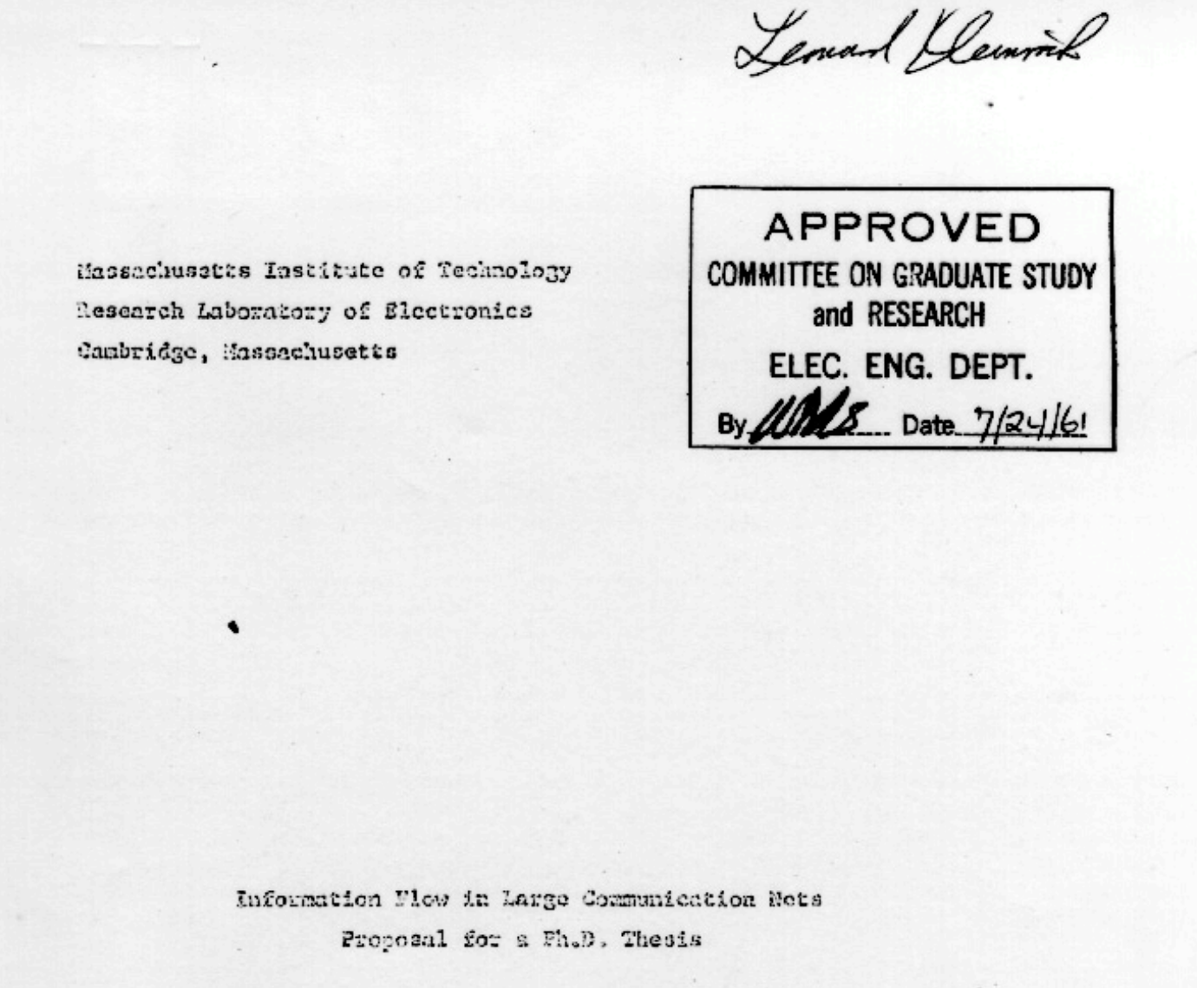
Packet Switching
1961: Leonard Kleinrock publishes
his first paper on packet switching theory

Slide 4
Leonard’s Big Idea:
The problem: Circuit switching wastes resources
  Dedicated paths sit idle during processing
  Expensive network infrastructure underused
The solution: Break messages into packets
  Small independent pieces
  Share network infrastructure
  Automatic rerouting around failures
Foundation: Information Flow in Large Communication
  Mathematical proof using queuing theory

Slide 5
Circuit vs Packet Switching: Book Analogy
Circuit Switching:
  Reserve entire mail truck for one book
  Wasteful, but guaranteed delivery
Packet Switching:
  Mail each page separately
  Efficient use of postal system
  Pages reassembled at destination

Slide 6
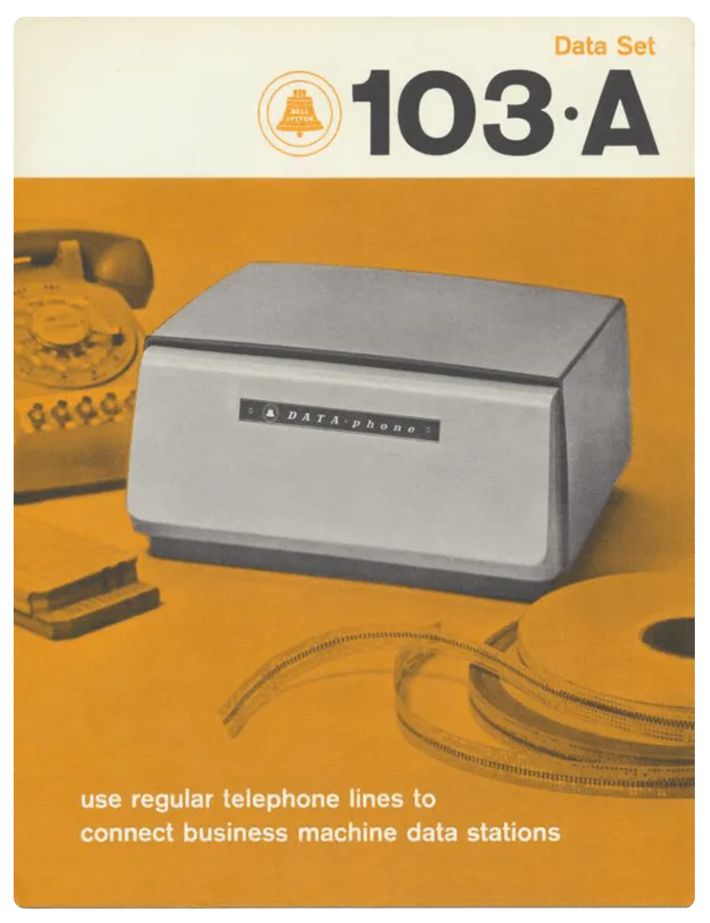
First Connection (1965): MIT to California
1965: The first computer-to-computer communication over a telephone line is achieved by Lawrence G. Roberts and Thomas Merrill
  Bell 103A Modem (Similar specs to what was used)
  Data Rate: 300 bits per second (bps)
  About 37 characters of text per second
  Connection Type: Dial-up, using analog telephone lines
Took several tries, finally worked!
Proved remote computer communication was feasible

Slide 7
Birth of ARPANET (1969)
First Packet-Switched Network
Funded by the U.S. Department of Defense
Goal: to develop a resilient (withstand nuclear attack), decentralized communication network
It becomes the first packet-switched network
Uses Network Control Protocol (NCP) for communication between nodes.
precursor to the Internet.
Leadership: Steve Crocker, Vincent Cerf
Notes:
Steve Crocker: contributed to development of email systems standards, Host-Host protocol, initiating the RFC (Request for Comments) for the development of network protocols
Vincent Cerf: contributed to development of TCP

Slide 8
ARPANET
UCLA
(Kleinrock’s lab)
Stanford
Research Institute
UC
Santa Barbara
University
of Utah
UCLA – SRI
SRI – UCSB
UCLA UCSB
UCSB – Utah

Slide 9
ARPANET Design Principles
Building for Resilience
Interface Message Processors (IMPs) at each node
Network Control Protocol (NCP)
Distribute routing (no central control)
Automatic adaptation to failures
Open standards for growth

Slide 10
1970s: Development of Early Networking Protocols
1973: Development of the Ethernet protocol begins at Xerox PARC, led by Robert Metcalfe.
  Inspired by ALOHAnet’s Random Access Protocol (allowed multiple devices to use single communication channel)
  Designed to send data packets over coaxial cables
  Multiple hosts could communicate on same ”medium”
  CSMA/CD (Carrier Sense Multiple Access with Collision Detection) managed data collisions
  Ethernet becomes a standard for local area networks (LANs).

Slide 11
1970s: Development of Early Networking Protocols
1974: Vint Cerf and Bob Kahn publish the first specification of the Transmission Control Protocol (TCP)
  Network Agnosticism: reliable inter-network communication (satellite, radio, wired)
  Packet Switching: small packets independently routed and reassembled
  End-to-end Communication: receiving end acknowledged receipt of data on receiving end and mechanism for retransmission of lost packets
  Layered Architecture: Separation of data transmission (TCP) from addressing and routing (IP)

Slide 12
1970s: Development of Early Networking Protocols
1976: IBM introduces Systems Network Architecture (SNA),
  proprietary networking protocol for connecting IBM mainframe computers.
  Used 7-layer architecture (similar to, but not the same as OSI model)
  Logical Unit (LUs): endpoints representing devices/applications communicating with each other
  Physical Units (PUs): control points managing communication between network parts
  Transmission Control Units (TCU): Data flow management (incuding error checking and data sequencing)
  Influenced design of future protocols

Slide 13
1970s: Development of Early Networking Protocols
1978: TCP is split into TCP and IP (Internet Protocol)
  Scalability: Handling both transmission control and routing withing single protocol very complex (became issue with increasing number of connected networks and devices
  Modularity and Flexibility: different aspects of communication handled by different protocols
  Network Agnosticism: Separating responsibilities, transmission control(TCP) could focus on reliable delivery, and IP could focus on routing.

Slide 14
Overview: Open Systems Interface (OSI)

Slide 15
Before Standardized Protocols
Ad Hoc and Custom Networks:
  Custom implementations: Each company developed their own solutions (built from ground up)
  Limited interconnectivity: Custom nature meant isolation and limited interconnectivity across organizations or regions.

Slide 16
Review: Proprietary Protocols and Structures
Vendor-Specific Solutions:
  IBM: Systems Network Architecture used for connecting IBM mainframes
  DEC: Decnet for connecting peer-to-peer network
  Xerox: Xerox Network System (XNS) for LANs and WANS
Incompatible:
  Difficult or impossible for different systems to communicate with each other
  Lack of standardization led to fragmented network environment.

Slide 17
1980s: Standardization and Emergence of Networking Models
1980: The International Organization for Standardization (ISO) begins developing the OSI model
  Goal: create a universal networking framework.
  OSI Model: A conceptual framework used to understand and implement network communication between systems

Slide 18
1980s: Standardization and Emergence of Networking Models
1983: ARPANET formally adopts TCP/IP as its standard networking protocol, marking the beginning of the modern Internet.

Slide 19
1980s: Standardization and Emergence of Networking Models
1984: The OSI model is published by ISO
  A seven-layer framework for networking. (theoretical model)
  useful for understanding how components and applications fit networking model
  Becomes a key educational tool.

Slide 20
OSI Model
OSI | Role
7 Application | Enable users to access network
6 Presentation | Translates, encrypts, compresses data
5 Session | Create, terminate, and manages sessions
4 Transport | Manages delivery and error checking of packets
3 Network | Identify shortest path
2 Data Link Layer | Data packed into frames
1 Physical | Forms a physical medium for transport

Slide 21
Application Layer (Layer 7)
Function:
  Closest to the end-user and interacts with software applications to implement networking functions like email, file transfer, and web browsing.
  Network Hardware:
    Proxies: Can operate at Layer 7 by making content decisions.
    Layer 7 Switches: Also known as application-aware switches, they can make decisions based on application data.
    Firewalls: Advanced firewalls can operate at this layer, filtering traffic based on application content.

Slide 22
Presentation Layer (Layer 6)
Function:
  The Presentation layer translates data between the application layer and the network format, handling data encryption, compression, and translation.
Network Hardware:
  Encryption Devices: Hardware that provides data encryption/decryption.
  Some Gateways: If involved in protocol conversion or data translation.

Slide 23
Session Layer (Layer 5)
Function:
  The Session layer manages sessions between applications, including establishing, maintaining, and terminating connections.
Network Hardware:
  Application Gateways: Some devices that handle complex interactions between different systems may operate at this layer. Note: most session management is handled by software.

Slide 24
Transport Layer (Layer 4)
Function:
  The Transport layer is responsible for end-to-end communication, data flow control, error recovery, and segmentation. It ensures that data is transferred reliably and in the correct order.
Network Hardware:
  Gateways: Devices that connect networks using different protocols (though they can operate across multiple layers).
  Load Balancers: Often work at Layer 4 by distributing incoming traffic based on transport layer information like TCP/UDP ports.

Slide 25
Network Layer (Layer 3)
Function:
  The Network layer is responsible for routing packets across network boundaries, logical addressing, and path determination.
Network Hardware:
  Routers: Direct data packets between different networks based on IP addresses.
  Layer 3 Switches: Switches that perform routing functions.
  Firewalls: Some firewalls also operate at this layer to filter traffic based on IP addresses.

Slide 26
Data Link Layer (Layer 2)
Function:
  The Data Link layer is responsible for node-to-node data transfer and error detection and correction in frames. It also controls how data is placed on the medium.
Network Hardware:
  Switches: Operate at Layer 2 by forwarding frames based on MAC addresses.
  Bridges
  Network Interface Cards (NICs): Fully operates at this layer for handling MAC addresses and framing.

Slide 27
Physical Layer (Layer 1)
Function:
The Physical layer is responsible for the physical connection between devices. It handles the transmission and reception of raw bitstreams over a physical medium (e.g., cables, radio frequencies).
Network Hardware:
  Cables (Ethernet cables, fiber optics)
  Connectors
  Hubs
  Network Interface Cards (NICs) (partially)
  Repeaters
  Modems (for some types of communication)

Slide 28
OSI vs TCP/IP
OSI |  | TCP/IP (Suite of protocols)
7 Application | Enable users to access network | 4 Application | Enable user (human or software) to access network
6 Presentation | Translates, encrypts, compresses data
5 Session | Create, terminate, and manages sessions
4 Transport | Manages delivery and error checking of packets | 3 Transport | Manages delivery and error checking of packets
3 Network | Identify shortest path | 2 Internet | Identify shortest path
2 Data Link Layer | Data packed into frames | 1 Network Interface | Data packed into frames. Forms a physical medium for delivery of bits
1 Physical | Forms a physical medium for transport

Slide 29
Direct Comparison
 | TCP/IP | OSI
Expands to | Transmission Control Protocol | Open System Interconnect
Meaning | Client Server model used for transmission of data over internet | Theoretical model used for computing system
Number of layers | 4 layers | 7 layers
Developed by | DoD (Department of Defense) | ISO (International Standards Organization)
Tangible | Yes | No
Usage | Mostly used | Never used
Obeys | Horizontal approach | Vertical approach

Slide 30
TCP/IP Protocols
Application Layer:
  HTTP / HTTPS FTP SMTP POP3/IMAP DNS
  Telnet/SSH SNMP DHCP NTP
Transport Layer:
  TCP UDP
Internet Layer:
  IP (IPv4, IPv6) ICMP ARP ,RARP
Link Layer (Network Interface Layer):
  Ethernet Wi-Fi PPP Frame Relay MAC

Slide 31
TCP/IP Hardware
Application Layer:
Servers (web servers, email servers, application servers that host / manage services like HTTP, FTP, SMTP, and DNS)
Transport Layer:
Gateways
Load balancers
Internet Layer:
Routers
Layer 3 Switches
Link Layer (Network Interface Layer):
NICs Switches Hubs Bridges Access Points Modems
fiber optic cables Physical media (Cat5e, Cat6),

Slide 32
1990s: Internet Growth and Adoption of TCP/IP
1990: ARPANET is officially decommissioned, but the Internet continues to grow, with TCP/IP as its core protocol.
OSI model used for academic purposes

Slide 33
1990s: Internet Growth and Adoption of TCP/IP
1991: The World Wide Web is introduced by Tim Berners-Lee, rapidly accelerating the adoption of TCP/IP globally.

Slide 34
2000s and Beyond:
2000s:
  The OSI model remains a fundamental part of networking education,
  TCP/IP continues to be the dominant protocol suite for Internet communication.

Slide 35
2000s and Beyond:
2010s-2020s:
Continued growth of the Internet of Things (IoT), cloud computing, and mobile networks,
TCP/IP remains central to global connectivity,
OSI model continues to influence protocol development and network design.

