Slide 1
Parsing IPFIX Messages Using DFDL (converting a binary data format to XML)
Roger L. Costello
May 13, 2015

Slide 2
Table of Contents
What is IPFIX? What is its purpose?
Security considerations
IPFIX message format
Sample IPFIX message and XML output using DFDL

Slide 3
What is IPFIX? What is its purpose?

Slide 4

The meter in front of my house monitors how much gas is used
A gas meter in front of ahouse that monitors how much gas is used. The power company collects the data that the meter records and the billing department uses it to charge the customer.

Slide 5
IPFIX: metering the web
Analogously, meters are attached to network devices (e.g., routers) to monitor the traffic flow through them.
Network administrators collect the data from these flow meters.

Slide 6
IPFIX: metering the web (cont.)
The administrators use the data for:
Traffic profiling/trend analysis
Traffic engineering/capacity planning
Quality of Service (QoS) monitoring: Service Level Agreement (SLA) compliance checking
Attack/intrusion detection (identify suspicious flow patterns)
Usage-based accounting: auditing/billing

Slide 7
IPFIX: metering the web (concluded)
The data collected includes these flow attributes:
source IP address
destination IP address
source-port and destination-port
count of transferred packets
number of bytes
The data collected also includes information about the metering process:
sampling rate
packet observation point
flow timeout interval

Slide 8
"IPFIX Information Elements" registry
This registry contains the complete list of flow items that the IPFIX protocol can collect and transmit: number of bytes, source IP address, destination IP address, etc.

Slide 9
IPFIX (IP Flow Information Export): a standard data format for representing flow data

Slide 10
Security Considerations

Slide 11
Disclosure of Flow Information Data
IPFIX defines a set of attributes that may, for privacy or business reasons, be considered sensitive information.
Observation of IPFIX flow records can give an attacker information about the active flows in the network, communication endpoints, and traffic patterns.
This information can be used not only to spy on user behavior but also to plan and conceal future attacks.
The content of data exchanged via an IPFIX protocol should be kept confidential between the involved parties (exporting process and collecting process). The underlying protocol used to exchange the information must therefore apply appropriate procedures to guarantee the integrity and confidentiality of the exported information.

Slide 12
Forgery of Flow Records
If accounting and/or security applications use flow records, adversaries have potentially strong incentives to forge exported IPFIX flow records (for example, to save money or prevent the detection of an attack).
This can be done either by altering flow records on the path or by injecting forged flow records that seem to emanate from the original exporting process.

Slide 13
Forgery of Flow Records (cont.)
Special caution is required if security applications rely on flow measurements. Adversaries can use forged flow records to trick security applications.
For example, if such an injection of IPFIX traffic flow records causes the security application to erroneously conclude that a denial-of-service (DoS) attack is underway, then the countermeasures employed by the security application may actually deny useful, non-malicious services.

Slide 14
Denial of Service (DoS) Attacks
DoS attacks on routers or other middleboxes that have the IPFIX protocol implemented would also affect the IPFIX protocol and impair the transmission of IPFIX records.

Slide 15
IPFIX Message Format
Warning: lots of low-level details in the following sections

Slide 16
An IPFIX Message consists of a Message Header, followed by zero or more Sets. The Sets can be any of these three possible types: Template Set, Options Template Set, or Data Set.
Message Header
Set
Set
. . .
Set

Slide 17
Message Header
Version Number
Length
Export Time
Sequence Number
Observation Domain ID
Version Number (16 bits)
Length (16 bits): Total length of the IPFIX Message, measured in bytes, including Message Header and Set(s).
Export Time (32 bits)
Sequence Number (32 bits)
Observation Domain ID (32 bits)
Length of Message Header: 128 bits

Slide 18
A Set consists of a Set Header, followed by zero or more Records. The Records can be any of these three possible types: Template Record, Options Template Record, or Data Record.
Set Header
Record
The record types MUST NOT be mixed within a Set.
Record
. . .
Record
Padding (optional)
The Exporting Process MAY insert some padding octets, so that the subsequent Set starts at an aligned boundary. For security reasons, the padding octet(s) MUST be composed of octets with value zero (0). The padding length MUST be shorter than any allowable record in this Set. If padding of the IPFIX Message is desired in combination with very short records, then the padding Information Element 'paddingOctets' can be used for padding records such that their length is increased to a multiple of 4 or 8 octets. Because Template Sets are always 4-octet aligned by definition, padding is only needed in the case of other alignments, e.g., on 8-octet boundaries.

Slide 19
Set Header
Set ID
Length
if Set ID = 2 then Template Set
else if Set ID = 3 then Options Template Set
else Data Set
Set ID (16 bits): Identifies the Set. A value of 2 is reserved for Template Sets. A value of 3 is reserved for Options Template Sets. Values from 4 to 255 are reserved for future use. Values 256 and above are used for Data Sets. The Set ID values of 0 and 1 are not used, for historical reasons
Length (16 bits): Total length of the Set, in bytes, including the Set Header, all records, and the optional padding. Because an individual Set MAY contain multiple records, the Length value MUST be used to determine the position of the next Set.
Length of Set Header: 32 bits

Slide 20
A Template Record consists of a Template Record Header and one or more Field Specifiers.
Template Record Header
Field Specifier
Field Specifier
. . .
Field Specifier

Slide 21
Template Record Header
Template ID
Field Count
Template ID (16 bits): A unique identifier for the record
Field Count (16 bits): Number of fields in this Template Record (the number of Field Specifiers in this record)
Length of Template Record Header: 32 bits

Slide 22
Field Specifier format
E
Information Element Identifier
Field Length
Enterprise Number
E (1 bit): Enterprise bit. If E=0 then Enterprise Number must not be present. If E=1 then Enterprise Number must be present.
Information Identifier Element (15 bits): If E=0 then this contains the code of a standard-defined flow item (see IANA-IPFIX for the list of standard flow data items). If E=1 then this contains the code of a non-standard (proprietary) flow data item; the code is understood within the Enterprise, but might not be understood outside the Enterprise (see IANA-PEN for the list of Private Enterprise Numbers).
Field Length (16 bits): the length, in bytes, of the Information Element. This is the number of bytes in the corresponding Field Value in a Data Record.
Enterprise Number (32 bits): This is a code of the authority defining the Information Element identifier.
Length of Field Specifier: either 32 bits or 64 bits
IANA = Internet Assigned Numbers Authority

Slide 23
Field Specifier format
E=0
Information Element Identifier
Field Length
Information Identifier Element | Meaning
1 | Number of bytes (octets) of the Flow (octetDeltaCount)
2 | Number of packets of the Flow (packetDeltaCount)
8 | IPv4 source IP address (sourceIPv4Address)
12 | IPv4 destination IP address (destinationIPv4Address)
15 | Next-hop IP address (IPv4)

Slide 24
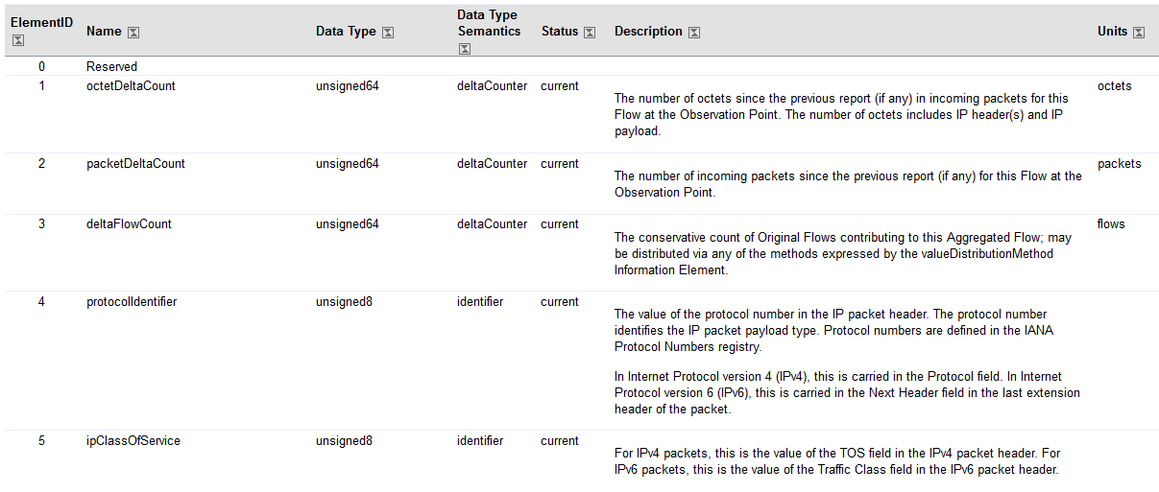
IANA-IPFIX
Plus hundreds more ...
IANA-IPFIX = http://www.iana.org/assignments/ipfix/

Slide 25
Field Specifier format
E=1
Information Element Identifier
Field Length
Enterprise Number
Enterprise Number | Enterprise
1 | NxNetworks
2 | IBM
3 | Carnegie Mellon
115 | MITRE
981 | NSA

Slide 26
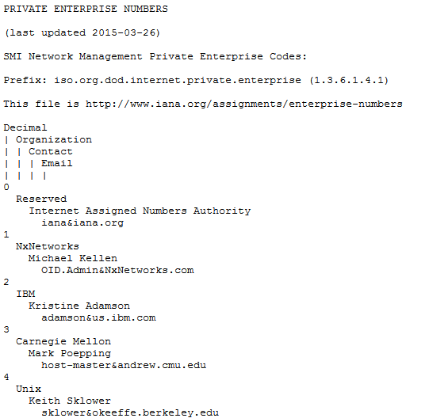
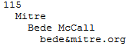
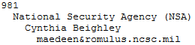
IANA-PEN (Private Enterprise Numbers)
Plus hundreds more ...
IANA-PEN = http://www.iana.org/assignments/enterprise-numbers/

Slide 27
Version Number
Length
Export Time
Message Header
Sequence Number
Observation Domain ID
Set Header
Set ID
Length
Template Record Header
Template ID
Field Count
E
Information Element Identifier
Field Length
Field Specifier
Enterprise Number
. . .
Record
Set
E
Information Element Identifier
Field Length
Field Specifier
Enterprise Number
. . .
Record

Slide 28
An Options Template Record consists of an Options Template Record Header and one or more Field Specifiers.
Options Template Record Header
Field Specifier
Field Specifier
. . .
Field Specifier

Slide 29
Options Template Record Header
Template ID
Field Count
Scope Field Count
Template ID (16 bits)
Field Count (16 bits): Number of all fields in this Options Template Record, including the Scope Fields. (The number of Field Specifiers in the record)
Scope Field Count (16 bits): Number of scope fields in this Options Template Record. The Scope Fields are normal Fields, except that the Collector interprets them as scope. A scope field count of N specifies that the first N Field Specifiers in the Template Record are Scope Fields. The Scope Field Count MUST NOT be zero.

Slide 30
A Data Record consists only of one or more Field Values.
Field Value
Field Value
. . .
Field Value
The Template ID to which the Field Values belong is encoded in the Set Header field "Set ID," i.e., "Set ID" = "Template ID."
Note that Field Values do not necessarily have a length of 16 bits. Field Values are encoded according to their data type as specified in [RFC7012]. (The length is given in the Field Specifier in the Template Record.)
The Data Record format can only be interpreted if the Template Record corresponding to the Template ID is available at the Collecting Process.

Slide 31
<IPFIX> <Message-header> <Version-number>10</Version-number> <Length>36</Length> <Export-time>1425576673</Export-time> <Sequence-number>2</Sequence-number> <Observation-domain-id>10</Observation-domain-id> </Message-header> <Set> <Template-Set> <Template-Set-header> <Set-id>2</Set-id> <Length>21</Length> </Template-Set-header> <Template-Records> <Template-record> <Template-record-header> <Template-id>2</Template-id> <Field-count>2</Field-count> </Template-record-header> <Field-specifier> <Enterprise-bit>0</Enterprise-bit> <Information-element-identifier>300</Information-element-identifier> <Field-length>2</Field-length> </Field-specifier> <Field-specifier> <Enterprise-bit>1</Enterprise-bit> <Information-element-identifier>0</Information-element-identifier> <Field-length>2</Field-length> <Enterprise-number>255</Enterprise-number> </Field-specifier> </Template-record> <Padding>0</Padding> </Template-Records> </Template-Set> </Set> </IPFIX>
Message Header
00 0A 00 24 54 F8 92 E1 00 00 00 02 00 00 00 0A
Set-header
Template-record-header
Field-specifier
Field-specifier
Set-id=2 means it's a Template-Set
Set-id
Length
Template-id
Field-count
00 02 00 15 00 02 00 02 01 2C 00 02 80 00 00 02
padding
continued →
00 00 00 FF 00
This is what is generated

Slide 32
More details on the IPFIX format

Slide 33
Message-header
0
0
0
A
0
0
2
4
5
4
F
8
9
2
E
1
0
0
0
0
0
0
0
2
0
0
0
0
0
0
0
A
version-number
length
export-time
sequence-number
observation-domain-id
# of bytes in the message, including message header and set(s)
Set-header
set-id: 2 means template set
3 means options template set
4-255 reserved
256 and above means data set
length: the # of bytes in the set
0
0
0
2
0
0
1
5
set-id
length
Template-record-header
field-count: indicates how many Field-specifier elements follow the Template-record-header.
0
0
0
2
0
0
0
2
template-id
field-count

Slide 34
Field-specifier
0
1
2
C
0
0
0
2
Since enterprise-bit=0 there must not be an enterprise-number.
field-length: the # of bytes for information-element-identifier
enterprise-bit (1 bit),
information-element-identifier
field-length
Field-specifier
8
0
0
0
0
0
0
2
0
0
0
0
0
0
F
F
Since enterprise-bit=1 there must be an enterprise-number.
enterprise-bit (1 bit),
information-element-identifier
field-length
enterprise-number
Padding
0
0
octet

Slide 35
IPFIX messages converted to XML using DFDL

Slide 36
IPFIX messages source
This web site has a file that contains a dump of IPFIX messages:
https://www.ietf.org/mail-archive/web/ipfix/current/msg05212.html

Slide 37
template-record.binary

Slide 38
Message-header
0
0
0
A
0
0
4
8
4
A
F
C
4
5
7
C
0
0
0
0
0
0
0
0
0
0
0
0
0
0
0
1
version-number
length
export-time
sequence-number
observation-domain-id
72 bytes in the message
IPFIX version 10
Thursday, November 12, 2009 12:27:24 PM GMT-5:00
Set-header
set-id 2 means it's a template set
length of the set, including the header, is 56 bytes
0
0
0
2
0
0
3
8
set-id
length
There are 56 bytes in the set. The message header uses 16 bytes. 56 + 16 = 72, which the length field in the message header says is the length of the message. Therefore, there is just 1 set in the message.
Template-record-header
field-count = 12 means there are 12 Field-specifier elements following the Template-record-header.
0
3
E
6
0
0
0
C
template-id
field-count

Slide 39
Field-specifier
Since enterprise-bit=0 there is no enterprise-number.
field-length=4 means that there are 4 bytes in the first Data Value in the corresponding Data Set (the "corresponding Data Set" is a Data Set in a message that has the same template-id value as the template-id value of the current set).
0
0
0
8
0
0
0
4
1
enterprise-bit (1 bit),
information-element-identifier
field-length
Field-specifier
2
0
0
0
9
0
0
0
1
enterprise-bit (1 bit),
information-element-identifier
field-length
Field-specifier
3
0
0
0
C
0
0
0
4
enterprise-bit (1 bit),
information-element-identifier
field-length

Slide 40
Field-specifier
0
0
0
D
0
0
0
1
4
enterprise-bit (1 bit),
information-element-identifier
field-length
Field-specifier
5
0
0
0
4
0
0
0
1
enterprise-bit (1 bit),
information-element-identifier
field-length
Field-specifier
6
0
0
0
7
0
0
0
2
enterprise-bit (1 bit),
information-element-identifier
field-length

Slide 41
Field-specifier
0
0
0
B
0
0
0
2
7
enterprise-bit (1 bit),
information-element-identifier
field-length
Field-specifier
8
0
0
9
8
0
0
0
8
enterprise-bit (1 bit),
information-element-identifier
field-length
Field-specifier
9
0
0
9
9
0
0
0
8
enterprise-bit (1 bit),
information-element-identifier
field-length

Slide 42
Field-specifier
0
0
0
1
0
0
0
8
10
enterprise-bit (1 bit),
information-element-identifier
field-length
Field-specifier
11
0
0
0
2
0
0
0
8
enterprise-bit (1 bit),
information-element-identifier
field-length
Field-specifier
12
0
0
0
6
0
0
0
1
enterprise-bit (1 bit),
information-element-identifier
field-length

Slide 43
<IPFIX> <Message-header> <Version-number>10</Version-number> <Length>72</Length> <Export-time>1258046844</Export-time> <Sequence-number>0</Sequence-number> <Observation-domain-id>1</Observation-domain-id> </Message-header> <Set> <Template-Set> <Template-Set-header> <Set-id>2</Set-id> <Length>56</Length> </Template-Set-header> <Template-Records> <Template-record> <Template-record-header> <Template-id>998</Template-id> <Field-count>12</Field-count> </Template-record-header> <Field-specifier> <Enterprise-bit>0</Enterprise-bit> <Information-element-identifier>8</Information-element-identifier> <Field-length>4</Field-length> </Field-specifier> <Field-specifier> <Enterprise-bit>0</Enterprise-bit> <Information-element-identifier>9</Information-element-identifier> <Field-length>1</Field-length> </Field-specifier> ... </Template-record> </Template-Records> </Template-Set> </Set> </IPFIX>
This is the XML that is generated:

Slide 44
data-record.binary

Slide 45
Message-header
0
0
0
A
0
1
F
4
4
A
F
C
4
5
7
C
0
0
0
0
0
0
0
0
0
0
0
0
0
0
0
1
version-number
length
export-time
sequence-number
observation-domain-id
500 bytes in the message
IPFIX version 10
Thursday, November 12, 2009 12:27:24 PM GMT-5:00
Set-header
set-id = 3E6 means it's a data set
length of the set, including the set header, is 484 bytes
0
3
E
6
0
1
E
4
set-id
length
There are 484 bytes in the set. The message header uses 16 bytes. 484 + 16 = 500, which the length field in the message header says is the length of the message. Therefore, there is just 1 set in the message.
The bytes that follow Set-header are the Field-value bytes (480 Field-values).

Slide 46
<IPFIX> <Message-header> <Version-number>10</Version-number> <Length>500</Length> <Export-time>1258046844</Export-time> <Sequence-number>0</Sequence-number> <Observation-domain-id>1</Observation-domain-id> </Message-header> <Set> <Data-Set> <Data-Set-header> <Set-id>998</Set-id> <Length>484</Length> </Data-Set-header> <Data-Records> <Data-record> <IE8-sourceIPv4Address> <Octet>125</Octet> <Octet>103</Octet> <Octet>245</Octet> <Octet>155</Octet> </IE8-sourceIPv4Address> <IE9-sourceIPv4PrefixLength>32</IE9-sourceIPv4PrefixLength> <IE12-destinationIPv4Address> <Octet>34</Octet> <Octet>195</Octet> <Octet>34</Octet> <Octet>33</Octet> </IE12-destinationIPv4Address>
... </IPFIX>
This is the XML that is generated:

