Slide 1
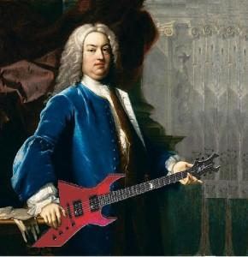
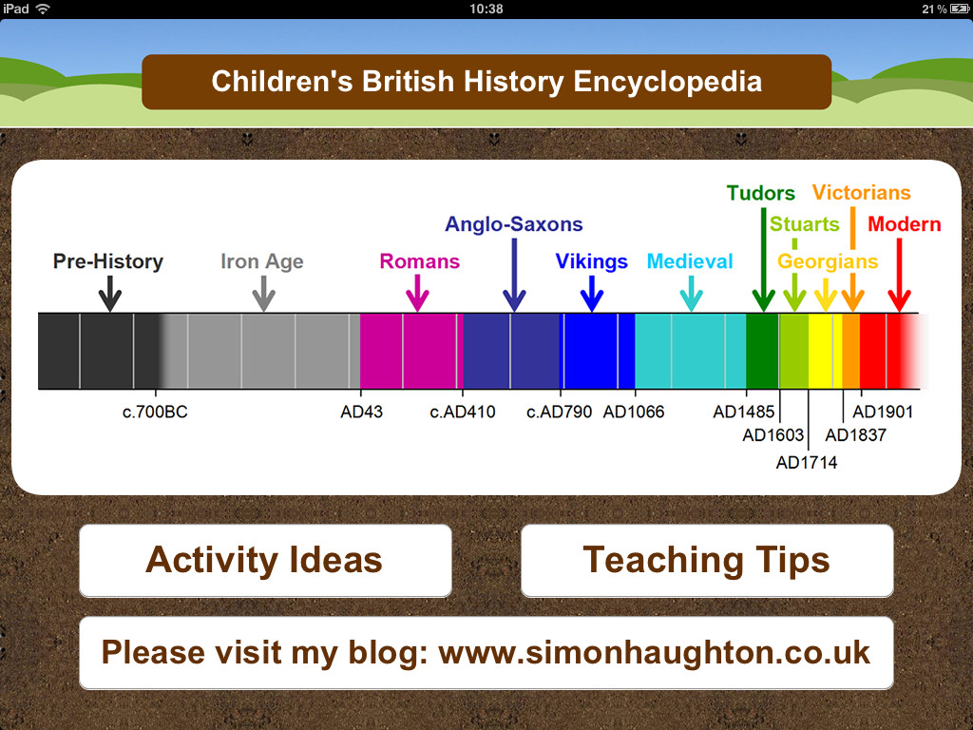
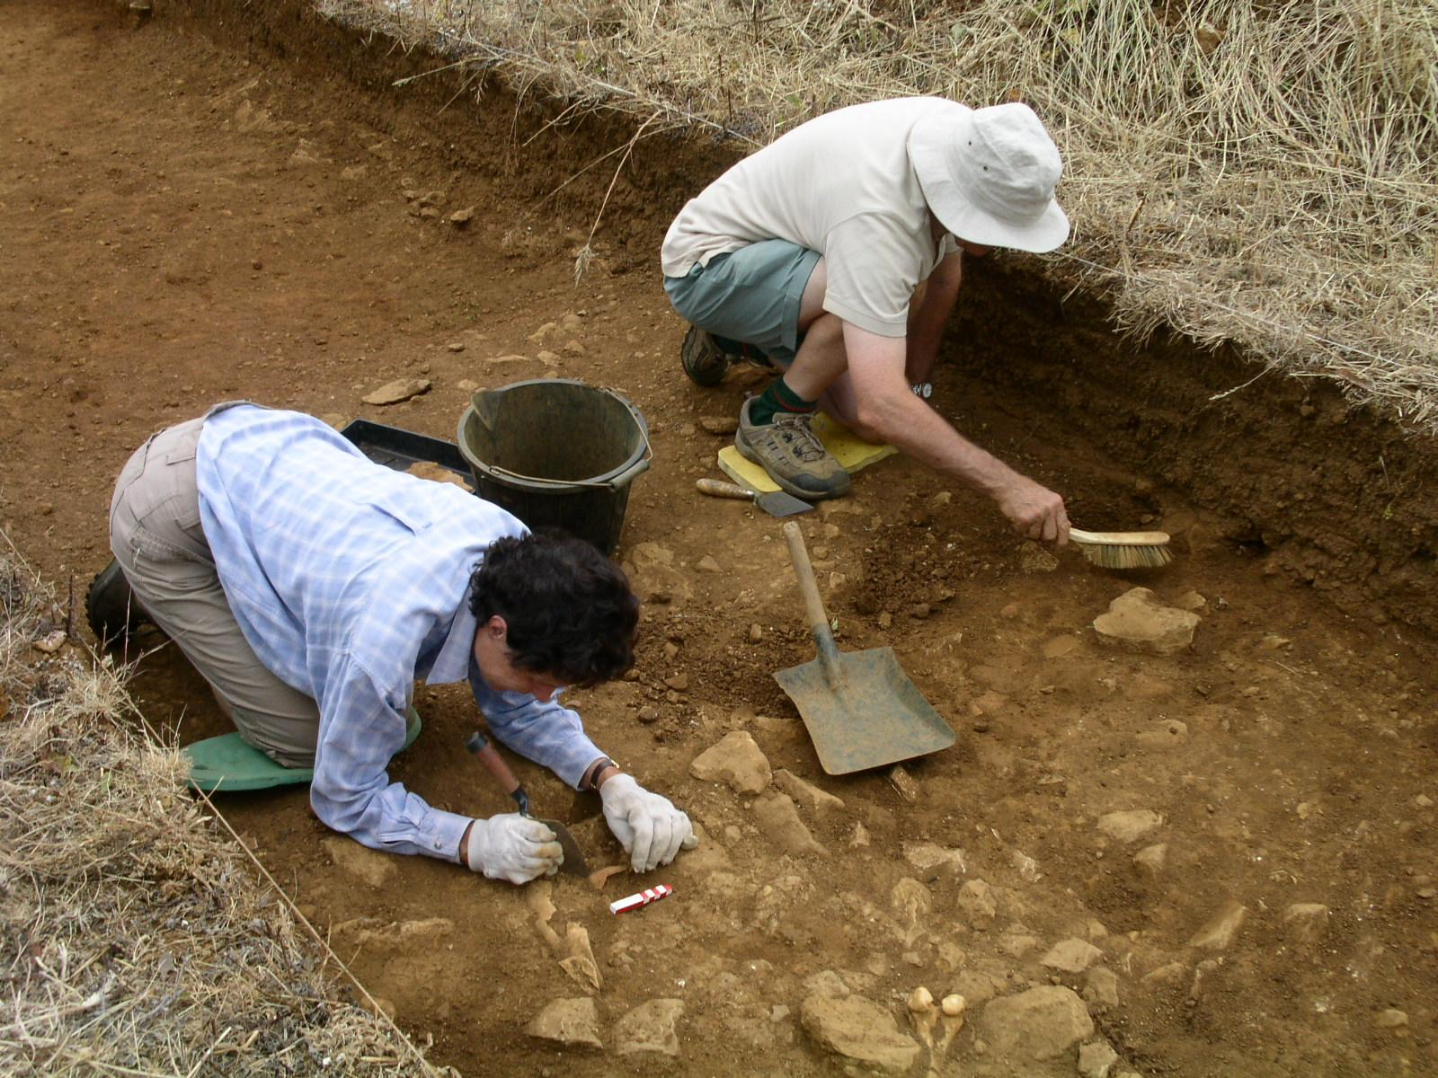
Do it now:
Do it now keyword quiz
This is an example of an…
ANACHRONISM
The order in which a series of events happened is called…
BC and AD stand for…
CHRONOLOGY
BEFORE CHRIST AND ANNO DOMINI
These people are finding out about the past through…
ARCHAEOLOGY

