Slide 1
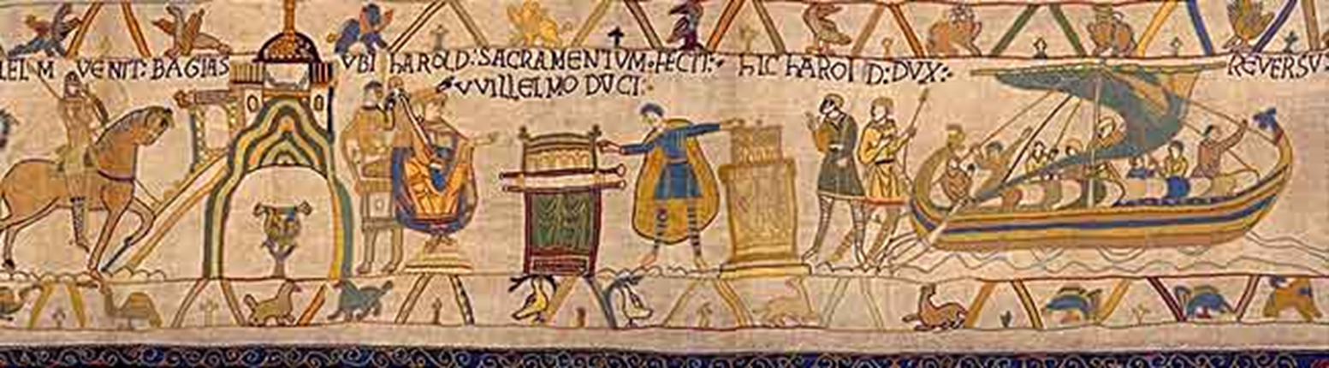
Do it now:
https://en.wikipedia.org/wiki/Anglo-Saxons#/media/File:Anglo.Saxon.migration.5th.cen.jpg
Do it now Bayeux Tapestry
Think, pair, share:
What can you see in the picture?
What do you think might be happening?
What specific details in the picture make you think this?

