Slide 1
Key Enquiry Question
Enquiry Question
Who wanted to be King of England in 1066?

Slide 2
Lesson Objective
Lesson objective
To evaluate the main contenders for the throne of England in 1066

Slide 3
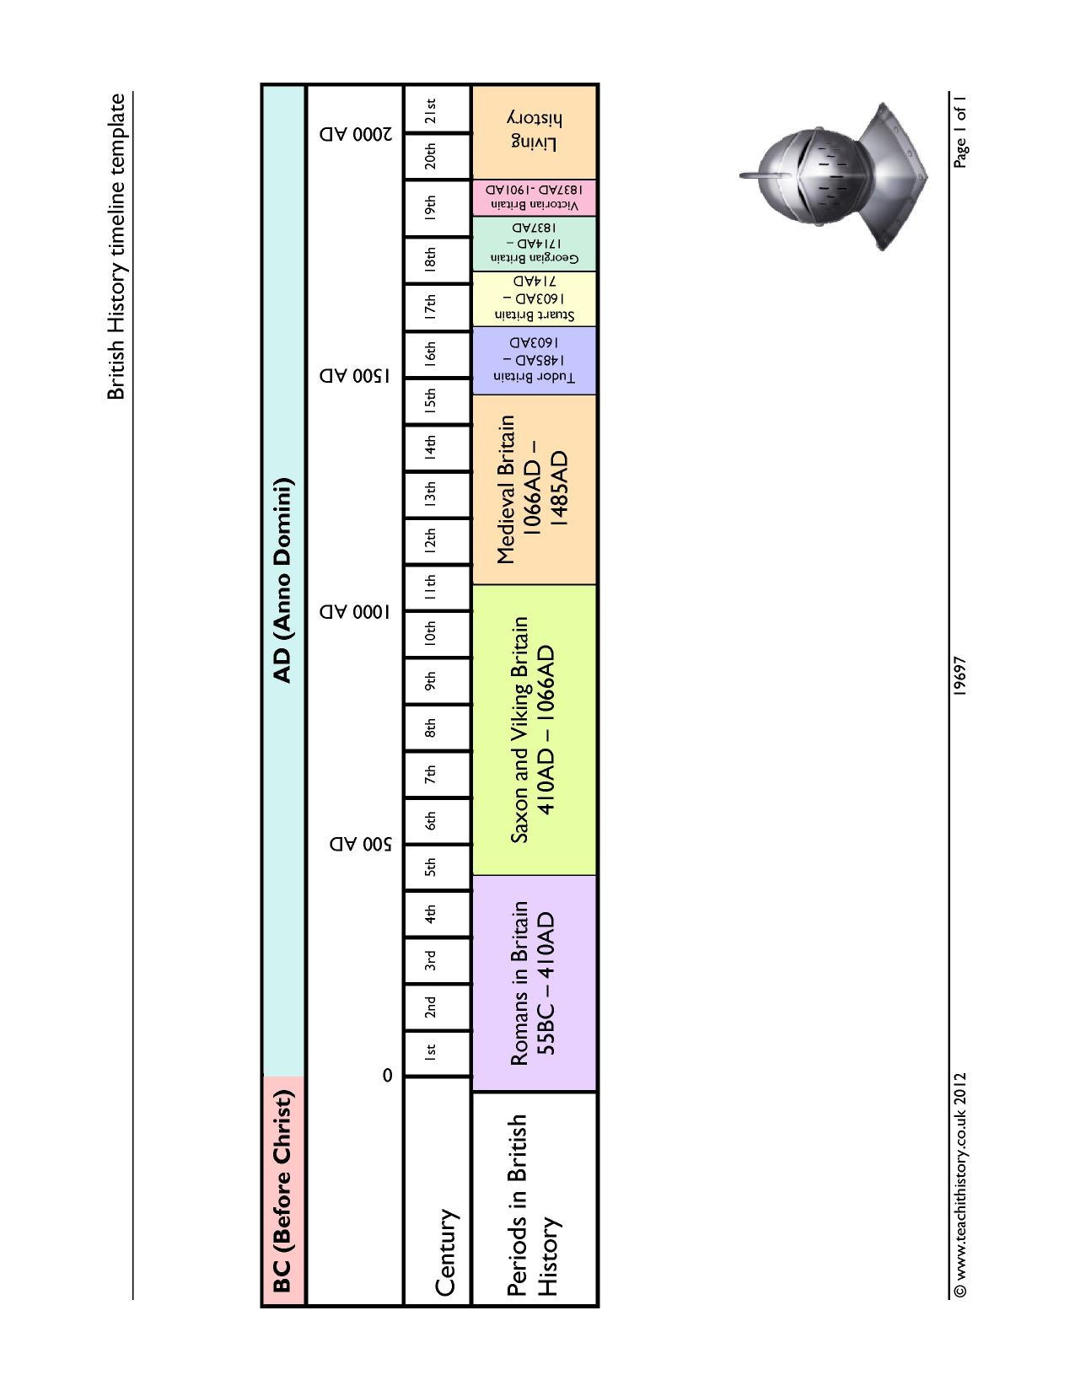
https://www.teachithistory.co.uk/?resource=19697
Timeline

Slide 4
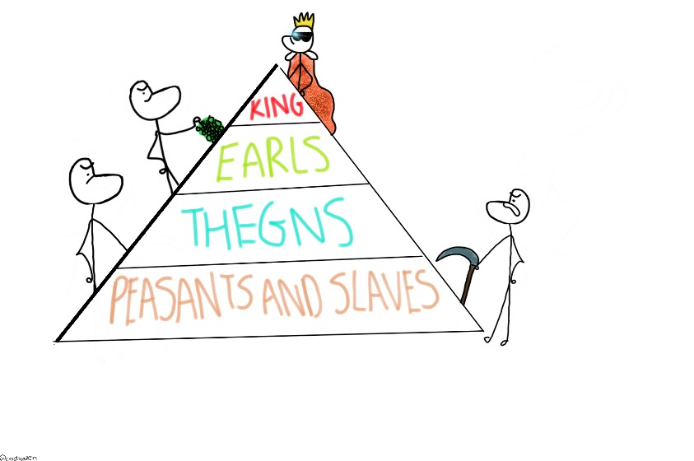
Anglo-Saxon society
https://steemit.com/anglo-saxons/@codyallen/anglo-saxon-society-ocr-gcse-history
Anglo-Saxon England
Most people in Anglo-Saxon England lived in the countryside. There were towns, but they were small and served as places for trade to take place. At the top of the social system was the royal family which was made up of the king and his relatives. Although the right to be king often passed from father to son, it was more complicated than that. The king was expected to name his successor and the Witan, or council of leaders, also had the right to choose the person they thought should be the next King from the royal house.
Earls helped the king rule England and were his deputies around the country. Below the earls there were thegns, who formed the main part of the Anglo-Saxon army. If the king wanted to reward them for their service they could rise up to become an earl.
Most people did not form part of these groups and instead were commoners. The most well-off commoners held land freely and did not pay rent to a lord. They made a living by selling or exchanging crops or by following a trade such as blacksmithing. Serfs held no land and had to work for others in exchange for food and shelter. By the time of the late Anglo-Saxon period, England was a Christian country. It was also relatively rich in comparison with other countries in Europe at the time.

Slide 5
Background
Background
In January 1066, King Edward the Confessor of England died. He did not have any children.
Two people claimed Edward had promised them that they could be the next King of England whilst he was still alive. These men were William of Normandy and Harold Godwinson, an English nobleman.
Two further candidates felt they also had a claim to the throne. These individuals were the Viking Harald Hardrada and Edgar Atheling, the closest surviving relative of Edward.
The Witan, a council of leaders responsible for helping the king to make decisions in Anglo-Saxon England, had to choose who they thought should be king.

Slide 6
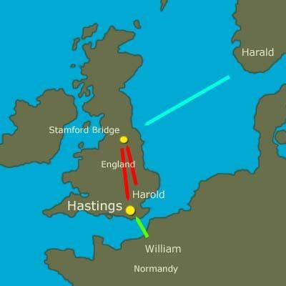
Contenders map
https://3dhistory.co.uk/timeline-british/images/medieval01.jpg

