Slide 1
Contenders table
Contender | Advantages | Disadvantages
Harald Hardrada
William of Normandy
Harold Godwinson
Edgar Atheling

Slide 2
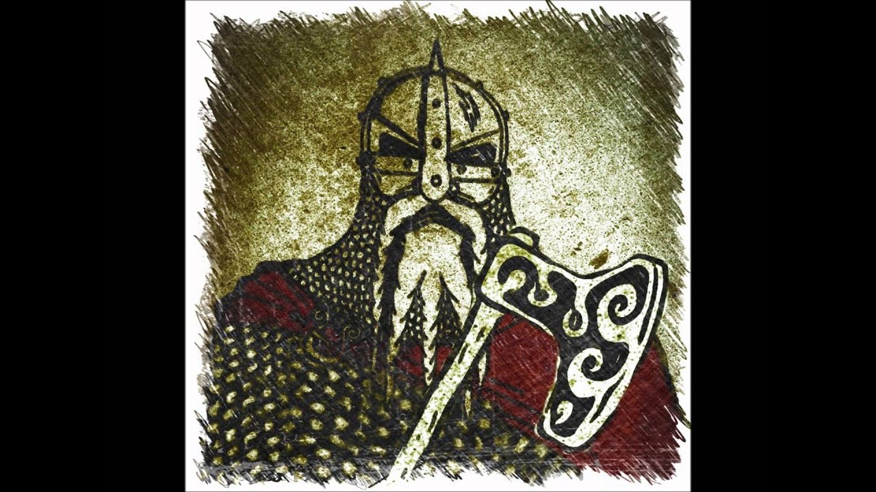
Harald Hardrada
Harald Hardrada
Harald Hardrada was the King of Norway. He was feared as a tough Viking warrior.
He was not related to Edward the Confessor but his ancestors had once ruled England and he felt this gave him a strong claim to the throne. In particular, a Viking King called Cnut had ruled Norway and England from 1016-1035.
He had fought alongside several Norwegian Kings and had taken part in raids on the English coast. Harald was now King of Norway which meant he had experience of ruling but had spent a lot of time away from home fighting various military campaigns which cost a lot of money.
Harald’s claim was supported by Tostig, Harold Godwinson’s brother. The two brothers had fallen out and Tostig wanted revenge.

Slide 3
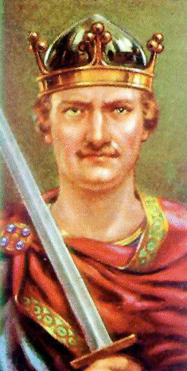
William of Normandy
William was related to Edward the Confessor but not as closely as Edgar Atheling. Edward the Confessor had spent a lot of time in Normandy and was brought up there. In 1051 Edward had visited William in Normandy and apparently promised him the throne.
In 1064 Harold Godwinson was shipwrecked in Normandy, and although treated with respect by William was basically his prisoner. During this time, William claimed that Harold swore an oath of loyalty to him and also said he would support him in becoming King of England when Edward died.
William had the reputation of a tough ruler; he improved law and order in Normandy in northern France and had fought in a number of military campaigns. He had been Duke of Normandy since the age of seven.
William of Normandy

Slide 4
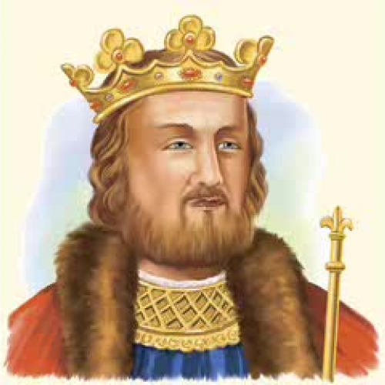
Harold Godwinson
Harold Godwinson was one of the most powerful Anglo-Saxon nobles. He wasn’t related to Edward the Confessor by blood, but he was connected through his marriage to Edward’s sister. He had helped Edward run England for a number of years. Harold claimed that Edward had promised that he could be the next king as he lay dying.
Harold and his family were well known in England. They were popular with other important nobles.
Harold did not recognise any promise made to William as he had been a prisoner at the time.
Harold’s father argued a lot with King Edward. At one time Harold and his father were banished from England, but they returned a year later.
Harold could be a tough warrior, which he had demonstrated when Edward sent him to crush a rebellion on the Welsh border.
Harold Godwinson

Slide 5
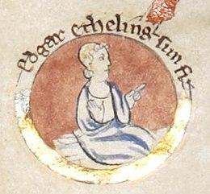
Edgar Atheling
Edgar Atheling
Edgar was the closest surviving relative of Edward the Confessor. He was Edward’s great nephew and had been invited back to England from exile in Hungary where he had been sent with his father by a previous Viking king of England. When Edward found out Edgar and his father were alive he invited him to return possibly because he wanted a member of his bloodline to become the next king.
Edgar was a member of the House of Wessex who had a strong claim to rule England. However, following the death of his father and Edward the Confessor, Edgar was still only around 14 years old. He also wasn’t considered by most of the Anglo-Saxon nobility to have the necessary toughness to be king.
Blood ties were considered important but not essential for succession to the English throne at this time.

