Slide 1
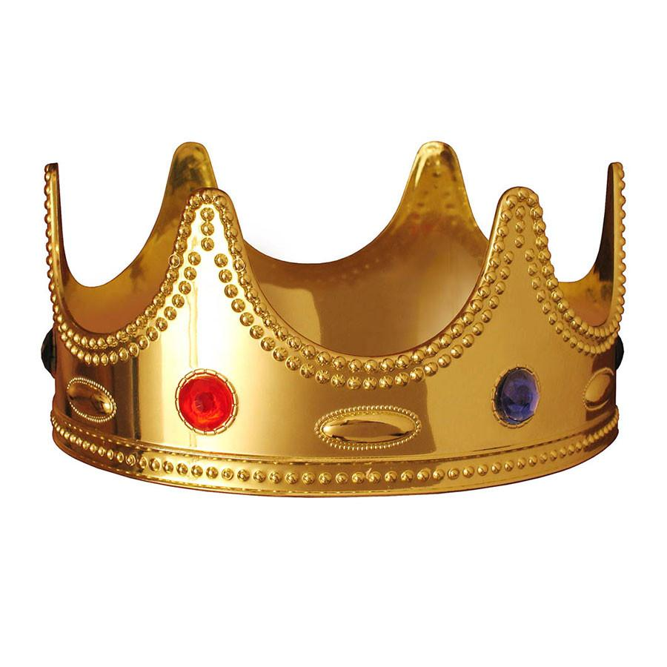
Qualities of a Medieval King
What qualities were required
of a Medieval King?

