Slide 1

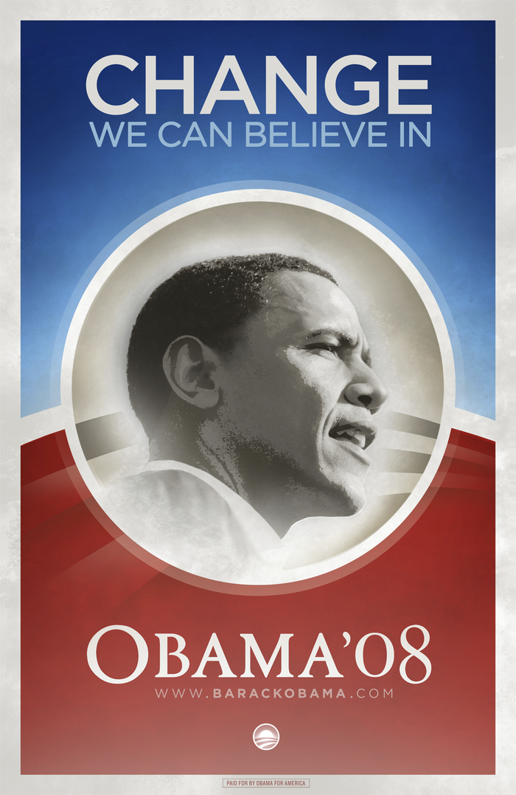


Poster
What message are each of these posters trying to communicate to voters?
Which do you think is the most effective? Why?
Either:
Sketch out the design of a poster or come up with a slogan to persuade the Witan that your choice of candidate is the right man to be King of England.
As above, but try to persuade the Witan not to choose the candidate you think is weakest.

