Slide 1
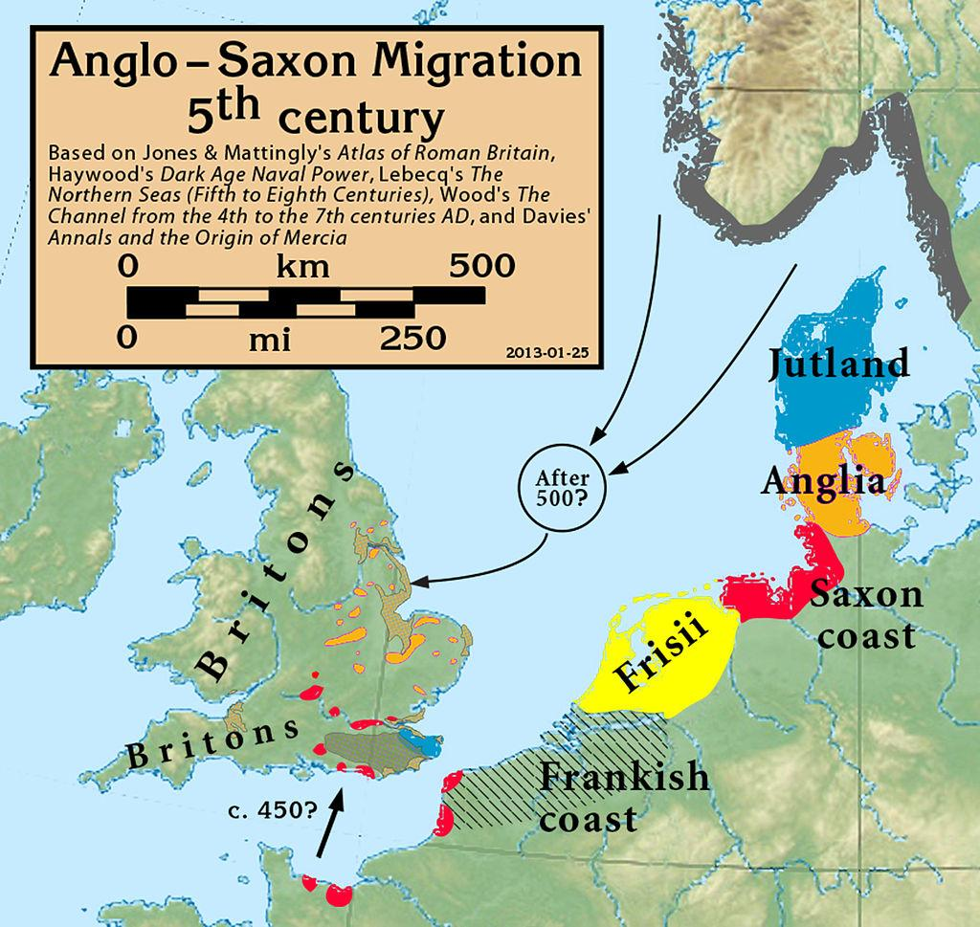
Do it now:
https://en.wikipedia.org/wiki/Anglo-Saxons#/media/File:Anglo.Saxon.migration.5th.cen.jpg
Do it now migration map
Think, pair, share:
What does the map show? Can you sum this up in your own words, in one or two sentences?
Can you think of any other groups who have migrated to Britain over the last two thousand years?
Can you think of any examples of where you have heard migration mentioned in the news recently?

