Slide 1
DfE
W12 hackathon
Incident Response Tool
An AI-assisted incident lifecycle for DfE digital services
Turning panic into procedure.
David Feetenby · Serena Abbott · and one Claude

Slide 2
An incident today hits our teams…
The first 20 minutes
What's missing
09:14
CDT content API starts returning 503s. GHBfS drop-in cross-service calls start failing too.
• Agreed severity — so comms cadence is guesswork.
• Named tech / comms / support lead — instead everyone's investigating.
• One timeline being kept — so the retro has no facts to work from.
• One shared page — status lives across four chat threads.
• A defined escalation path — instead it depends on who's online.
• A runbook to follow — instead of ad-hoc pod restarts.
09:15
Someone posts in #cdt-support. Someone else posts in #ghbfs-team. A third person DMs Alex directly.
09:17
Two people quietly try 'restart the pod'. Nobody says out loud that they're doing it.
09:22
Delivery manager asks in Teams: "Is this a P1 or P2? Who's the tech lead? Are we telling schools?"
09:28
No answer. Three chats, no timeline, no named leads. Users are starting to email.
10:02
Someone finally finds the fix. The incident closes. The retro is scheduled for "next week" — and never happens.
The tool gives the incident a shape from minute one: named leads, an agreed severity, a runbook to follow, a timeline being kept, and every step landing in one Teams thread.
Incident Response Tool · DfE · W12 hackathon
2 / 6

Slide 3
The on-caller's journey through the tool
1
Report the incident
2
Get the process artefact
3
Find the runbook
GOV.UK-styled form: title, service, free-text description. PromptSanitizer strips secrets before anything leaves the app.
Immediate Claude call → severity, immediate actions, comms actions, escalation path. Rendered as a GOV.UK task list.
Cached corpus search → retrieved (green), drafted (yellow) or refused (red). Every branch cites its source or explains itself.
4
Fix the incident
5
Mark resolved + fill the short form
6
Retro from a real starting point
The tool does not act. It gives the on-caller structure. The human keeps the keys, the terminal and the judgment call.
Leads, timeline notes, resolution notes. That's it. Claude does the boring header + timeline in the DfE template shape.
The reflective questions (root cause, what went well, prevention) stay blank on purpose — those are the meeting's job, not AI's.
7
Every step also lands in the Teams incident thread
8
Every call is measured and evaluated
Adaptive Cards posted automatically — no copy-paste. When corp policy blocks Power Automate, falls back cleanly to skip.
Token + cache-hit-rate telemetry per artefact. spec/evals harness runs 10 scenarios against real Claude to score behaviour.
Guiding principle: the tool helps. It does not decide, and it does not run commands.
Incident Response Tool · DfE · W12 hackathon
3 / 6

Slide 4
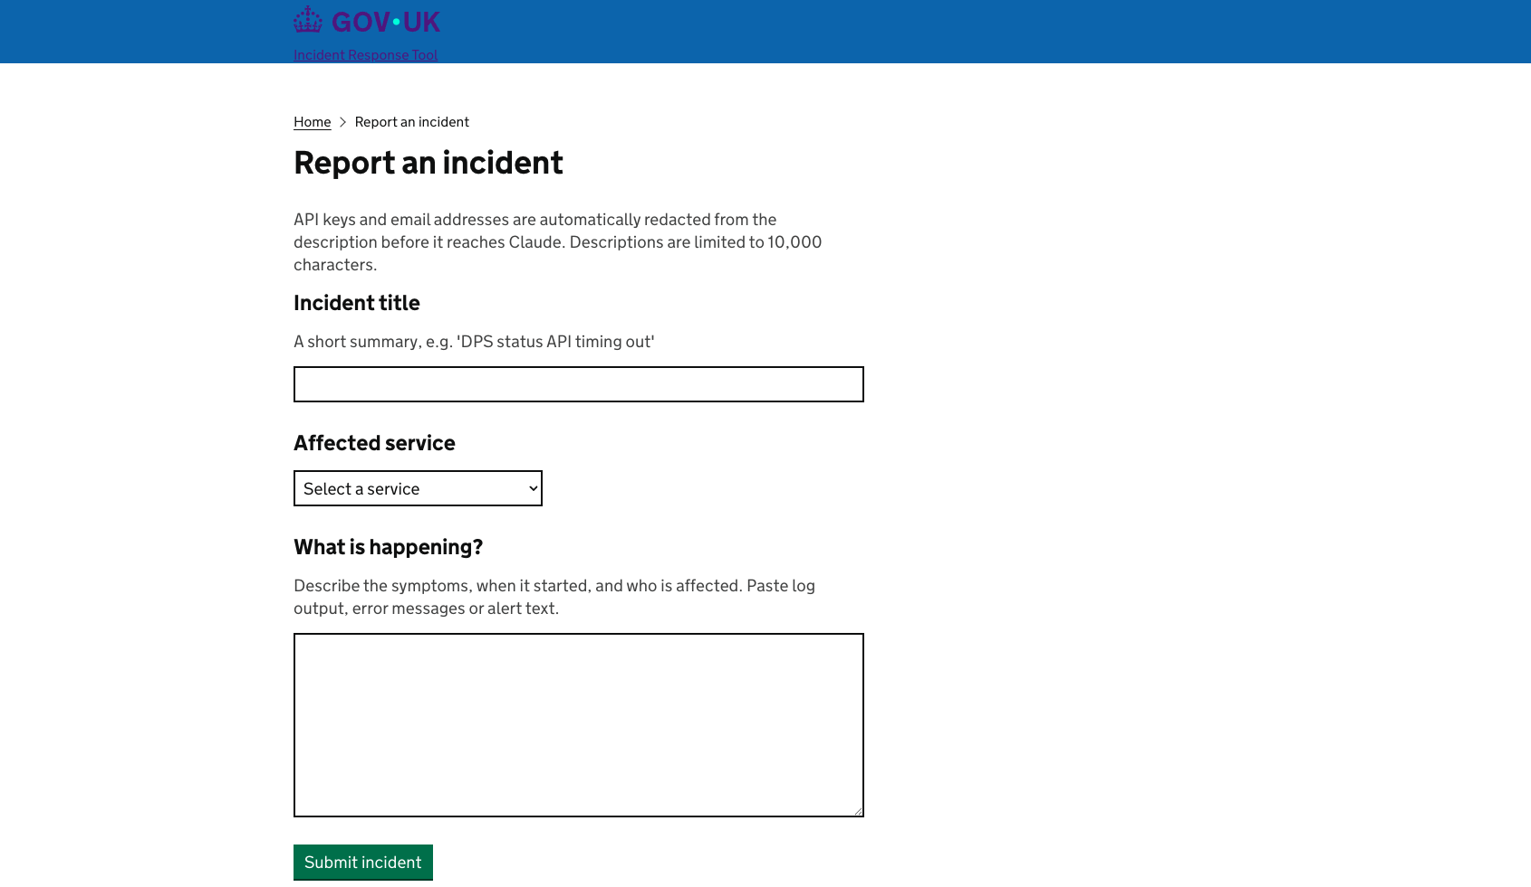
See it in action
Paste live screenshots into the boxes below before presenting.
Incident intake form (GOV.UK styling, redaction hint)
Incident Response Tool · DfE · W12 hackathon
4 / 6
Runbook artefact — retrieved with citation, or drafted from scratch
Post-incident review (or Teams Adaptive Card in webhook.site)

Slide 5
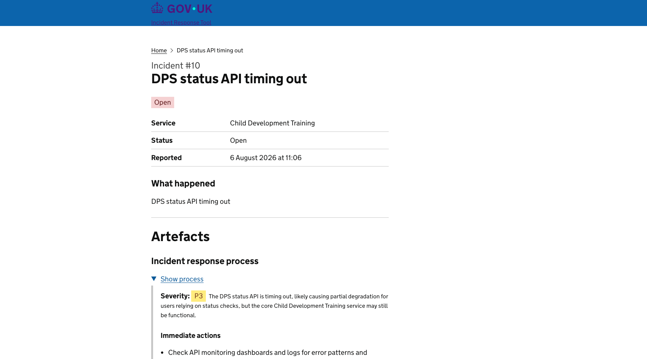
See it in action
Paste live screenshots into the boxes below before presenting.
Show page — process artefact (severity + task list)
Incident Response Tool · DfE · W12 hackathon
4 / 6
Runbook artefact — retrieved with citation, or drafted from scratch
Post-incident review (or Teams Adaptive Card in webhook.site)

Slide 6
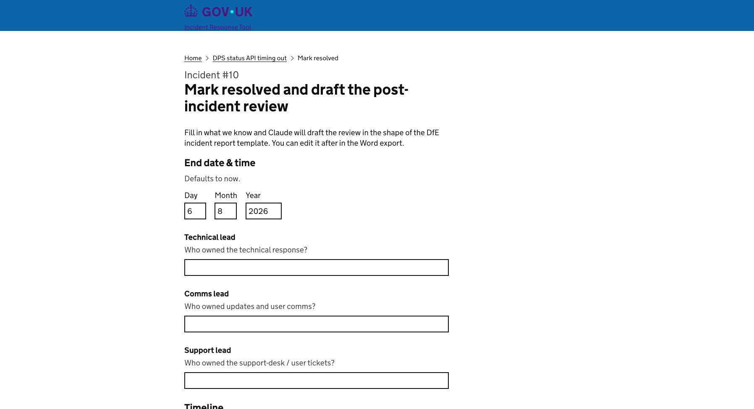
See it in action
Paste live screenshots into the boxes below before presenting.
Incident resolved form (GOV.UK styling)
Incident Response Tool · DfE · W12 hackathon
4 / 6
Runbook artefact — retrieved with citation, or drafted from scratch
Post-incident review (or Teams Adaptive Card in webhook.site)

Slide 7
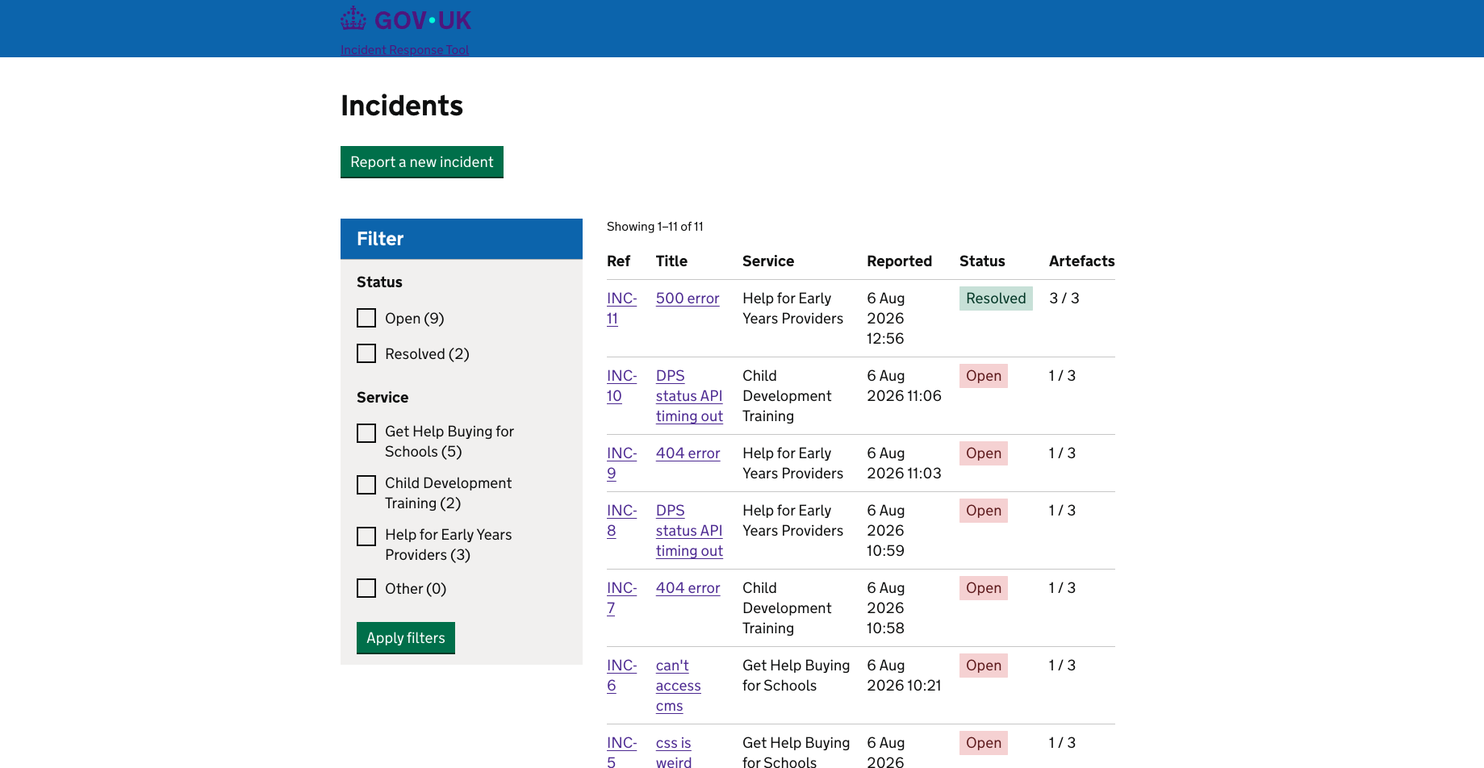
See it in action
Paste live screenshots into the boxes below before presenting.
Incidents list with filtering
Incident Response Tool · DfE · W12 hackathon
4 / 6
Runbook artefact — retrieved with citation, or drafted from scratch
Post-incident review (or Teams Adaptive Card in webhook.site)

Slide 8
What shipped
Sprint outcome
By the numbers
• Step 1 — Incident intake form (GDS formbuilder)
• Step 2 — Process artefact (severity + actions)
• Step 3 — Runbook artefact (retrieved/drafted/refused)
• Step 4 — Post-incident review (fill-in-the-blanks template)
• Step 5 — Teams integration (Adaptive Cards)
• Step 6 — Incidents dashboard + filters
• Step 7 — Guardrails, cost panel, eval harness
• Stretch S3 — ISO 42001 compliance mapping
10/10
0
eval scenarios passed
hallucinated runbook_ids
~95%
~$0.06
cache-hit rate on runbooks
cost per full incident
3
0
artefacts per incident
vector DBs deployed
Incident Response Tool · DfE · W12 hackathon
5 / 6

Slide 9
What we'd do next
Product
Trust and scale
• Teams integration to post a thread to an incident channel
• MCP server — expose the same three tools to Claude Desktop so the copilot lives where on-callers already are.
• Integrate with monitoring tools (e.g. Rollbar, Sentry, Splunk) so incidents can be opened automatically from an alert.
• Human-editable artefacts — right now Claude drafts and you re-run; ideally you can tweak inline.
• Grow the eval corpus (spec/evals) beyond 10 scenarios; add an adversarial prompt bucket.
• Continuous eval on production inputs — drift detection for prompts + Claude behaviour.
• Aggregate cost / cache-hit dashboard (per-service, per-day) — schema is already there.
• Migrate corpus to RAG once it grows past ~200 000 tokens (currently ~5 000, plenty of headroom).
• Formal impact assessment + standalone AI-usage policy to close the remaining ISO 42001 gaps.
• Bias testing on outputs — the corpus is uniform in voice; needs diverse-authorship sampling.
Incident Response Tool · DfE · W12 hackathon
6 / 6

