Slide 1
Do it now:
1. Harald Hardrada
A. King of England who died in January 1066
2. Edward the Confessor
B. A serious promise, often made to God by religious people.
3. The Witan
C. Brother of Harold Godwinson.
4. Oath
D. King of Norway. Defeated at the Battle of Stamford Bridge.
5. Tostig
E. A council whose job it was to advise the King of England.

Slide 2
Do it now:
What was the name of the King of England who died in January 1065?
Which English Earls were killed at the Battle of Fulford?
Which football club shares the name of where they play with a battle that took place in 1066?
Who betrayed his brother to fight for Harald Hardrada in 1066?
What are soldiers who fight on foot called?
Edward the Confessor
Edwin and Morcar
Chelsea (Stamford Bridge; not in the same place as the battle!)
4. Tostig
5. Infantry

Slide 3
Do it now:
Keyword Anagrams
foldfur
carhers
drymanno
kinvig
Dowsingno
Answers
Fulford
archers
3. Normandy
4. Viking
5. Godwinson

Slide 4
Key Enquiry Question
Why did William win the Battle of Hastings?

Slide 5
Lesson Objective
To be able to explain why William won the Battle of Hastings.

Slide 6
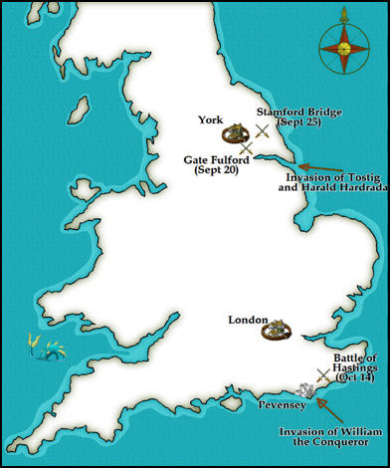
https://spartacus-educational.com/NORhastings.htm

Slide 7
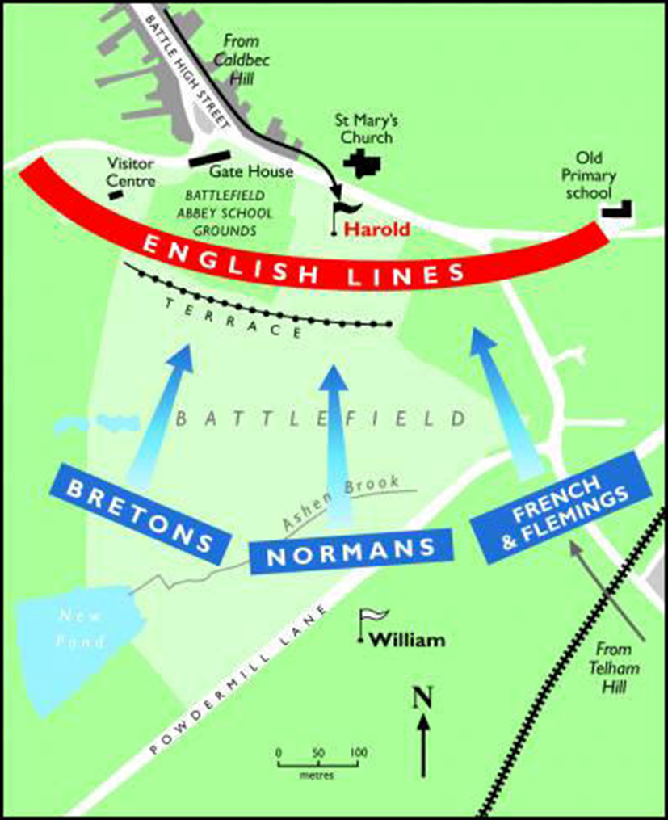
https://spartacus-educational.com/NORhastings.htm

Slide 8
Video Clip
In your book, as you watch the video, make a bullet pointed list of things it tells you that might help answer the question “Why did William win the Battle of Hastings?”.
https://www.youtube.com/watch?v=zigjVCFzZ38

Slide 9
The cards give you a number of things that help answer the question “Why did William win the Battle of Hastings”. Write this question in the middle of your A3 paper. Place the cards on the paper.
Read the cards. Only cards that are RELEVANT to the question are allowed on the paper. Remove any cards that are not relevant.
In each corner of the paper, write either your own categories, or use LUCK, STRATEGY, EQUIPMENT and LEADERSHIP.
Divide the cards up using these headings. Some cards may fit under more than one heading. You can put these cards between two different headings, or under the one where you think they fit best.

Slide 10
What is wrong with this paragraph?
An important reason that William was able to achieve victory at Hastings was his strong leadership. He planned ahead and did not leave things to chance; even before the battle he persuaded the Pope to back his invasion of England. He was fearless which is shown when he took his helmet off to show his troops that he was still alive, and he was able to adapt his tactics as the battle went on. All of these things show the leadership skills that helped him to defeat the Anglo-Saxons.
It is just description. The paragraph is a list of facts which are accurate, but there is no EXPLANATION of how this helped William to win the Battle of Hastings.

Slide 11
This paragraph is better because…
The overall point is identified: William was a good leader.
An important reason that William was able to achieve victory at Hastings was his strong leadership. For example, he gained the support of the Pope before the invasion of England. This shows that he understood the importance of religion and wanted to make his soldiers feel that God was on their side. His hope was that this would inspire them to fight harder which may well have contributed to his victory at Hastings. Furthermore…
A specific example is given that supports the overall point. This is an example of William making a clever decision as leader.
This is the explanation. It connects the overall point and the specific example with the question, explaining how those things helped William to win the battle.

Slide 12
Your turn…
Make an overall point about why William won the battle (think about the categories you’ve divided your more detailed reasons into).
One important reason William won the Battle of Hastings was…
Support your overall point with a specific fact(s).
For example…
Explain how those things helped William to achieve victory.
This helped William to win the battle because…

Slide 13
Peer assessment
Has your partner given a reason William won the Battle of Hastings?
Have they given an example of where this reason can be seen before or during the battle?
Have they explained how this helped William to win?
Have they said anything you disagree with? Why?

