Slide 1
Brass Board Dimensions

Slide 2
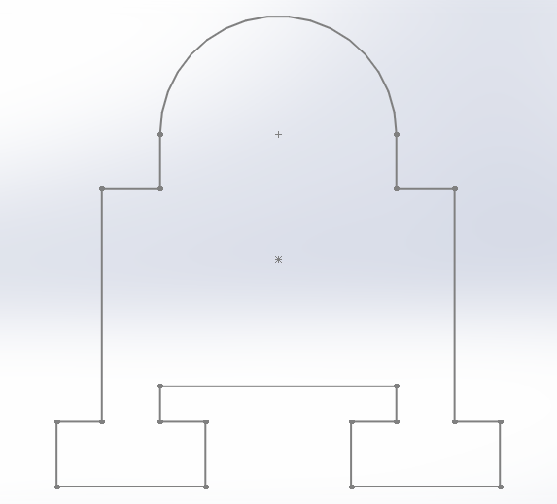
Wood Board Design

Slide 3
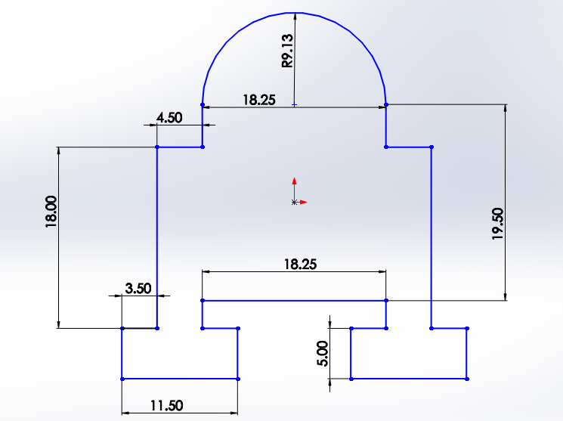
Wood Board Dimensions

Slide 4
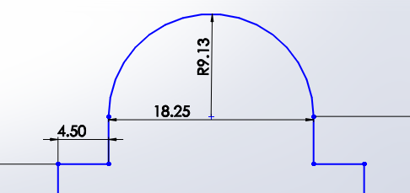
Board Dome Dimensions

Slide 5
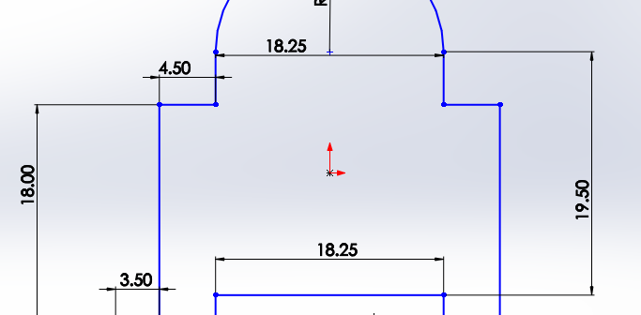
Board Body Dimensions

Slide 6
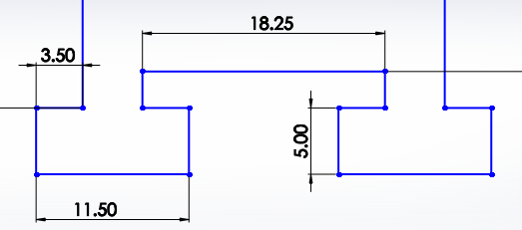
Board Leg Dimensions

Slide 7
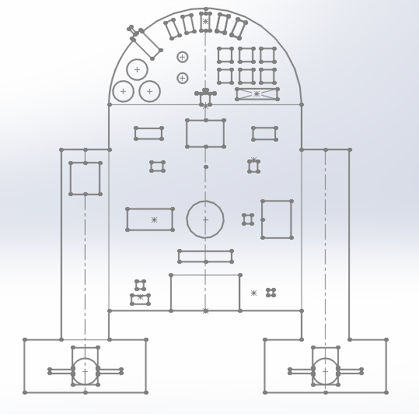
Brass Board Electronics Layout

Slide 8
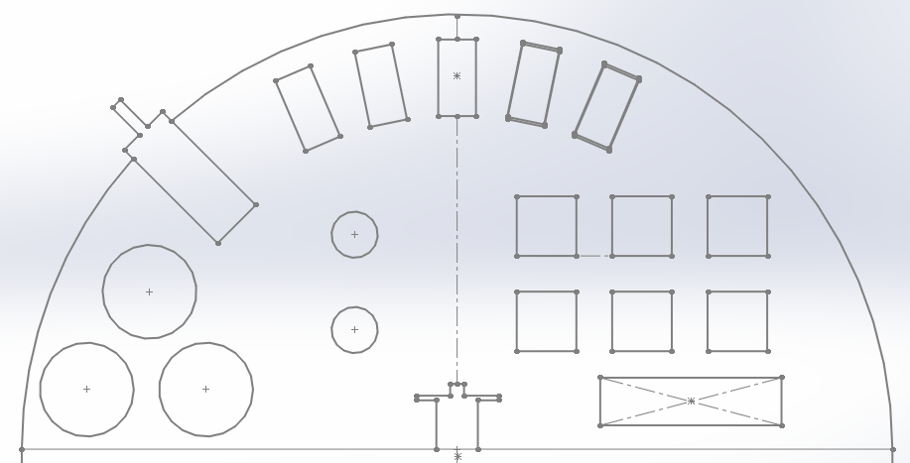
Dome Electronics Layout
Servos
Dome Motor
8x8 LED Color Matrices
Flashlight LEDs
LED Driver
Pushbuttons
Slip Ring

Slide 9
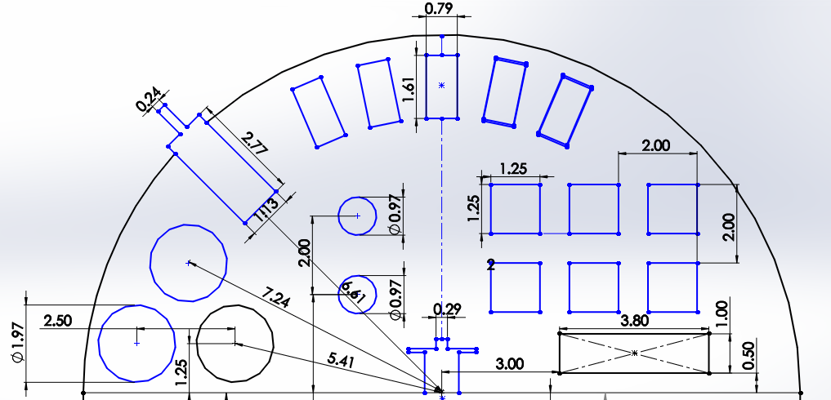
Dome Electronics Dimensions

Slide 10
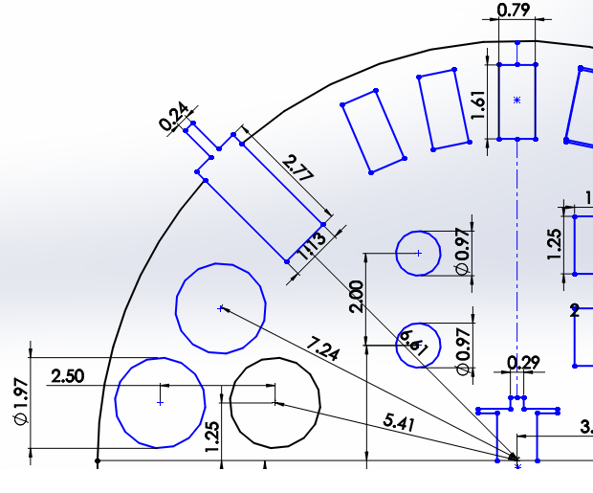
Dome Electronics Dimensions (Left)

Slide 11
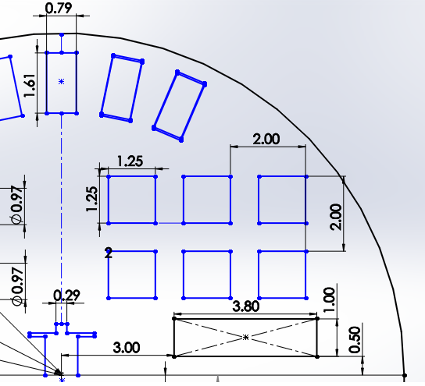
Dome Electronics Dimensions (Right)

Slide 12
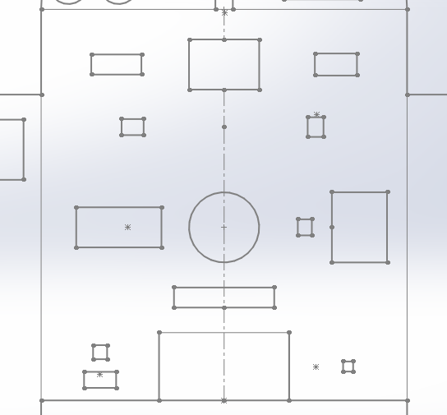
Body Electronics Layout
PWM-Servo Controller
Raspberry Pi
Pololu Motor Controller
Orientation Sensor
Raspberry Pi
Camera
Amplifier
Arduino
Speaker
Sabertooth Motor Controller
Fan
3.3 Voltage Regulator
Current Sensor
5.0 Voltage Regulator
Battery

Slide 13
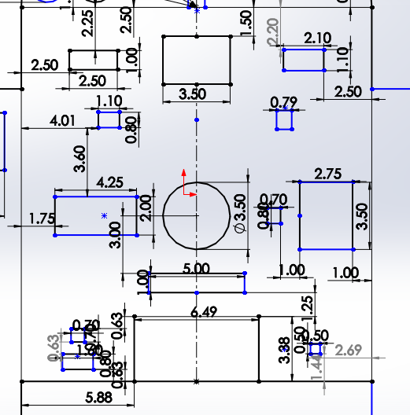
Body Electronics Dimensions

Slide 14
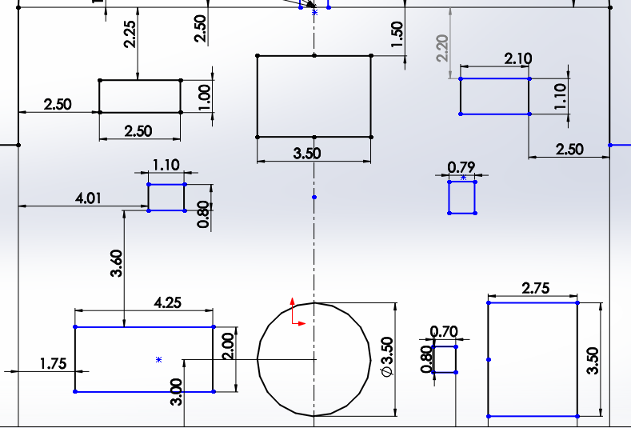
Body Electronics Dimensions (Top Half)

Slide 15
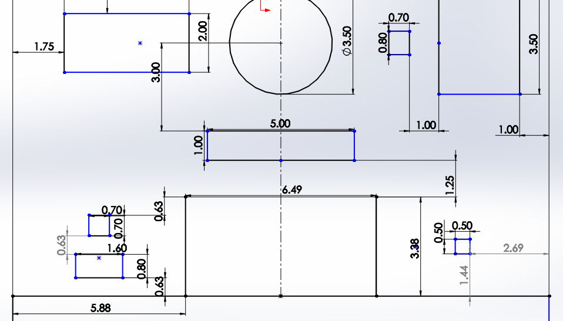
Body Electronics Dimensions (Bottom Half)

Slide 16
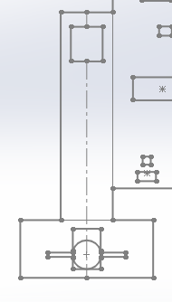
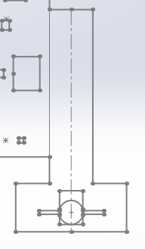
Leg Electronics Layout
LEFT LEG
RIGHT LEG
Keypad
Leg Motor & Gear Box

Slide 17
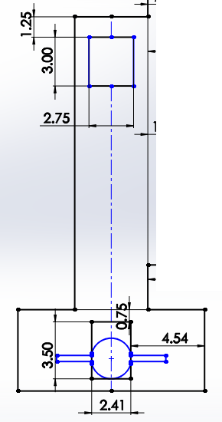
Leg Electronics Dimensions (LEFT)

Slide 18
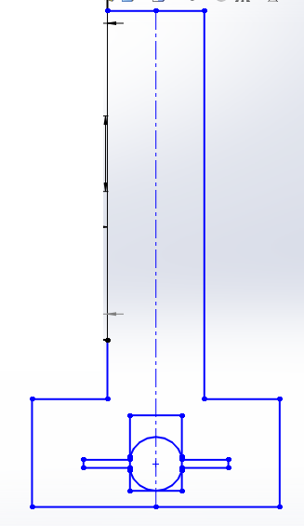
Leg Electronics Dimensions (RIGHT)
All dimensions same as left leg.

