Slide 1

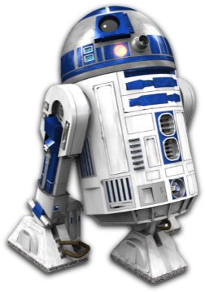

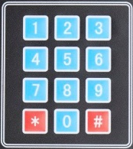
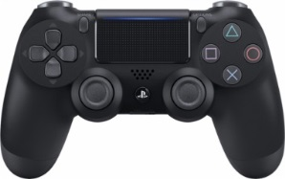
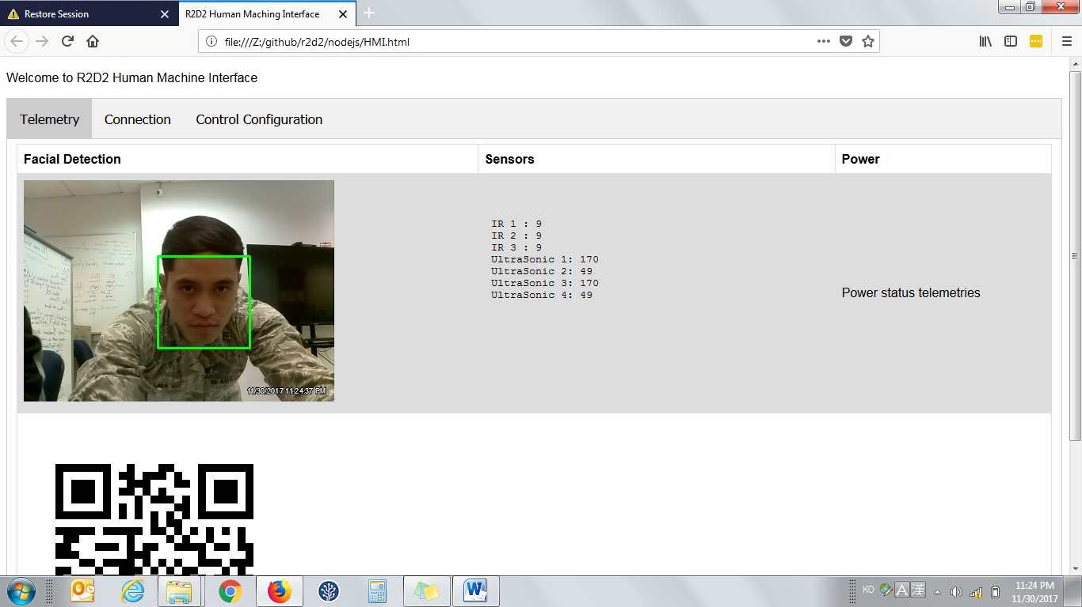

Camera
Dome motors
R2D2 Capstone
OV-3
29-Nov-17 | V2.0
LEDs
Speakers
Servos
EMS Button
Wifi Network
Leg Motors
PS4 Controller
Bluetooth

