Slide 1
How Not to Have a Bad Time with Risky Data
Ben K. (they) @dfirnotes
B-Sides Atlanta Sept 2024

Slide 2

characters
  us, y’all,
stories
  some bad times
assertions
  negations
recommendations
  guidance

Slide 3

私たちは？[ about us? ]
shy nerd, avid reader
  easily distractable
10+ years IT & CyberSecurity
security architect, CTI
community instructor, mentor
Ben K.(they/them) ACE-T, CISSP, GIAC**0x10, GSE**2, KLCP, MAD CTI
Cybersecurity Leader & Educator | @dfirnotes , dfirnotes.net

Slide 4



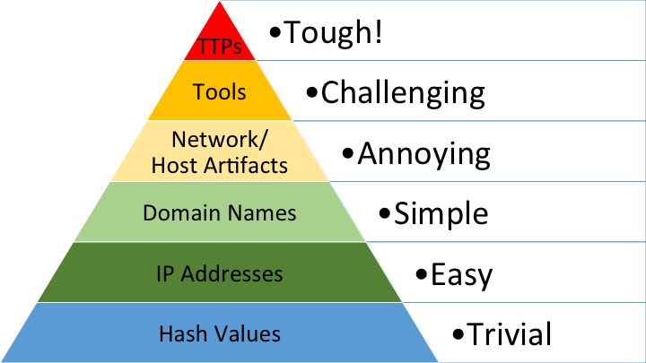
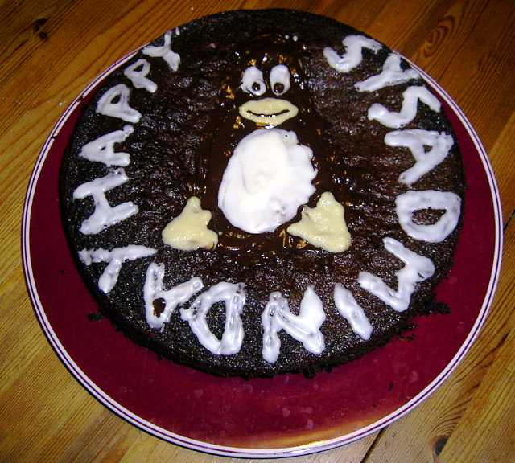
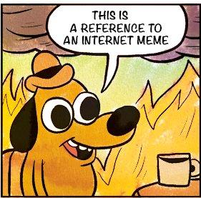
You might be ...

Slide 5
things to avoid
Risks
sharing incorrect or false data (misinfo, disinfo)
oversharing / data spills
malicious or destructive computer code, aka "malware"
legal concerns (civil, criminal, corporate ...)
Bad Outcomes
getting yelled at, deposed, fired, sued, and/or arrested
losing data or computers to hostile hacking or judicial acts
becoming interesting to criminals, law enforcement, and spies

Slide 6
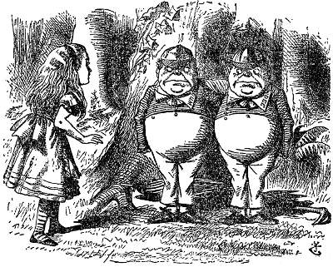
Tweedle: an unintentional threat
Alice
Bob
Tweedle

Slide 7
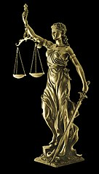
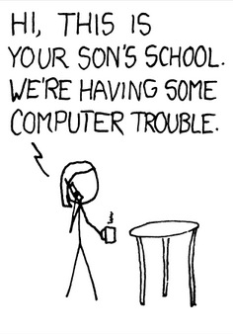
disclaimers

Slide 8
some bad times

Slide 9



Tweedle: Social Media
McDuck Group Breached: We Stole Everything!
- APackofCrims [10 min ago]
To: <everyone>
From: <Tweedle>
Subject: McDuck was Hacked!! What do we do???

Slide 10
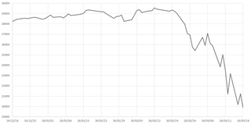
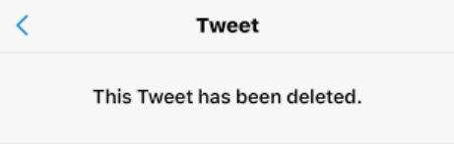
Be Careful What You Report
Your peers: 😿
Your boss: “?!?!”
$McDUCK
No lawyers this time *whew*
Maybe don’t trust avowed criminals
  To be honest and ethical

Slide 11
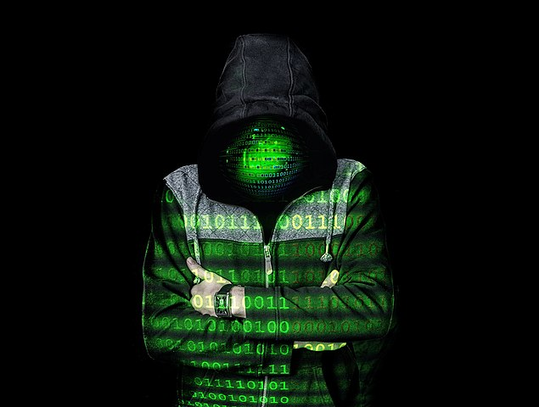
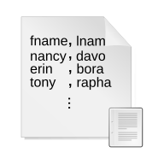
Тшеедле: Marketplace Post
Remote Access to МкДУЦК servers !
  Billions of records!
  Millions of members!
  Bids start at 10 Simoleans
  Free sample ! [Click Here]
hacked_data.csv

Slide 12
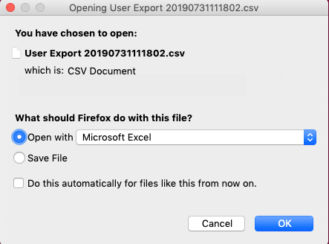
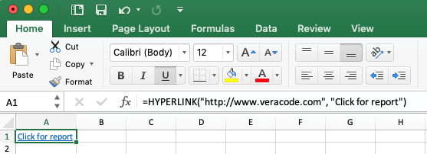
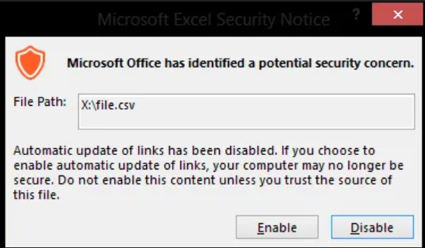

Just a CSV? : bugs and shells
Привет!
Stager
C2

Slide 13
how not to ...

Slide 14

Reduce Risk with Rs
AwaReness
Reduce
  Contact
  Data
Reuse and Recycle ?
Reach out
Transfer Risk

Slide 15
AwaReness

Slide 16
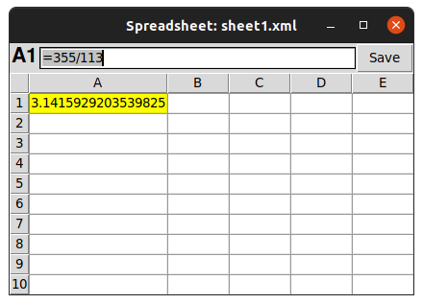

No such thing as: safe file types

Slide 17
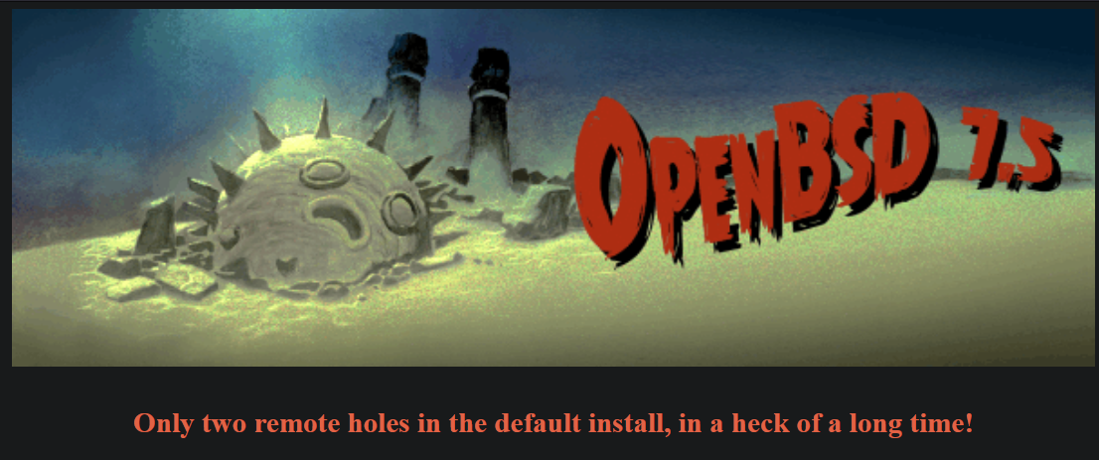
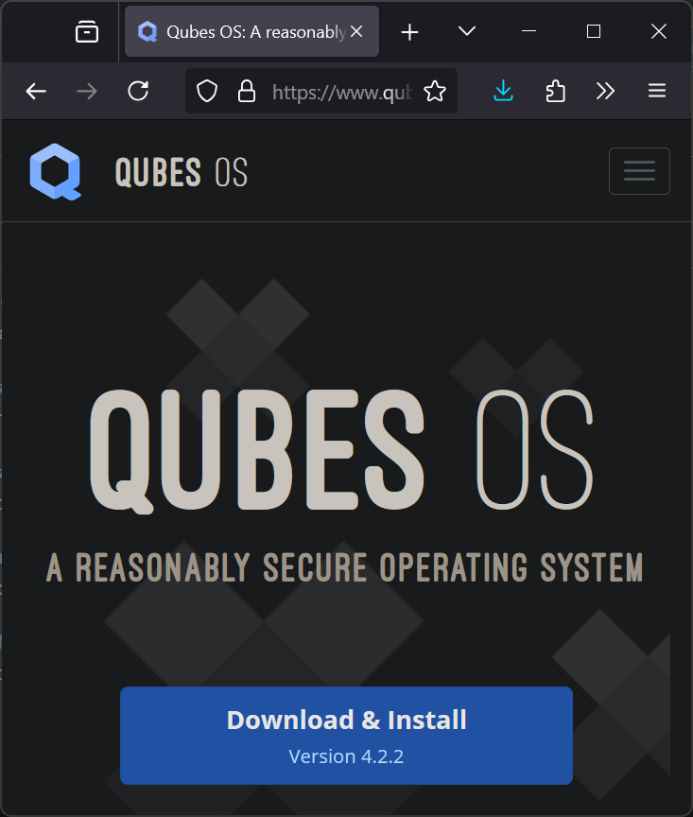
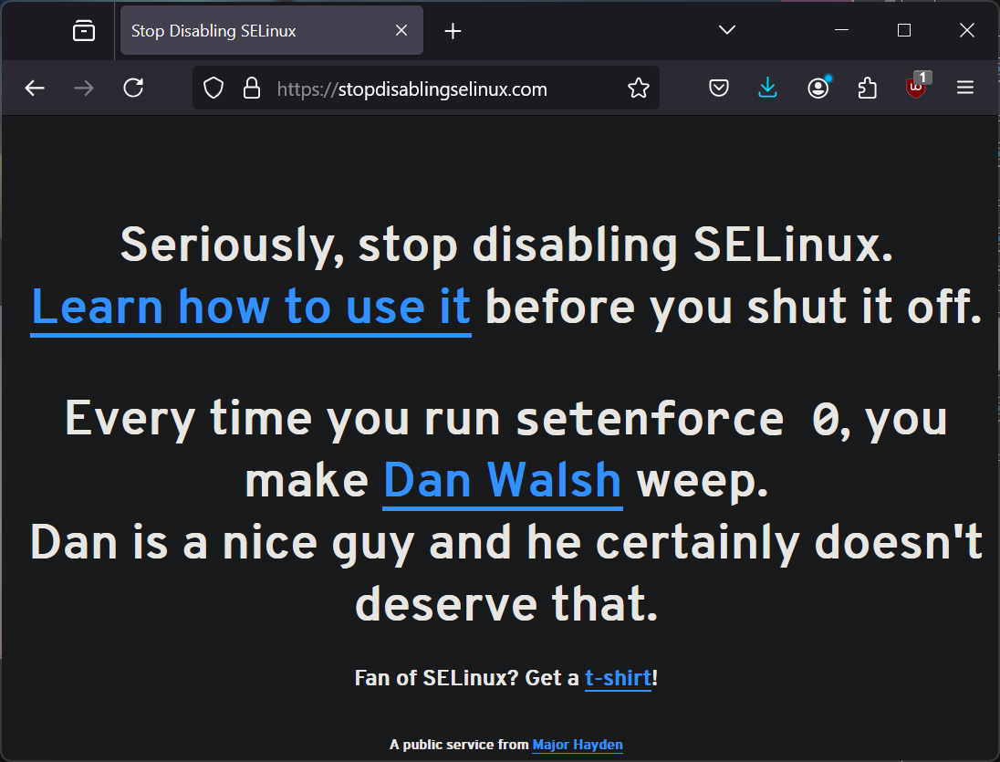
No such thing as: “perfectly secure” system

Slide 18
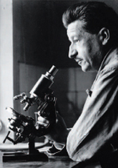
Contact and Exchange (Forensics)
“every contact leaves a trace”
-E. Locard (1877 - 1966)
Whose
user ID, cookies, computer
IP addresses, payment card,
phone, phone number
Location, GPS coords
visited that suspicious site?

Slide 19

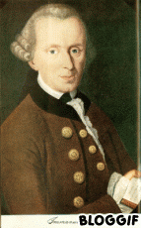
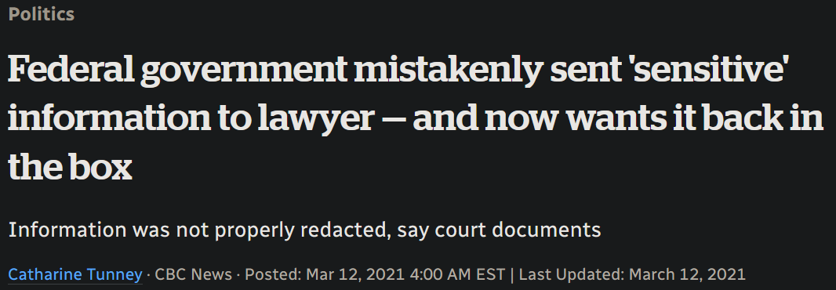
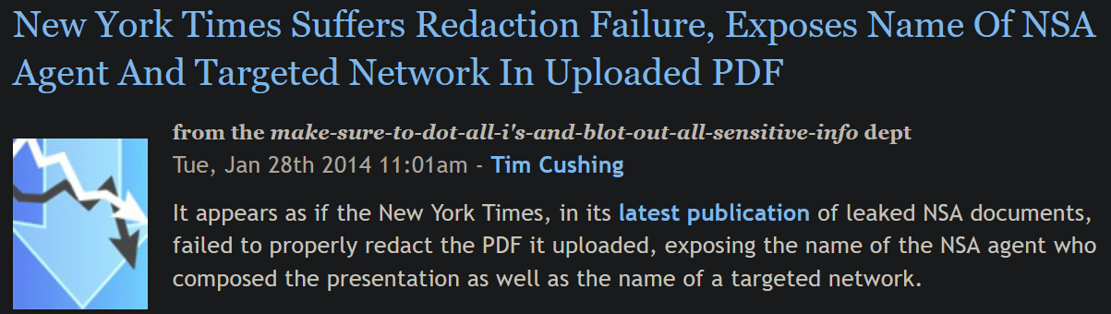

Redaction is tricky

Slide 20

Data can be dangerous
Other peoples’ email, chats
  Is Private!
  Can be gross
Other people / org’s data
  May be legally protected
  Could be trouble
Other peoples’ creds
  DO NOT WANT

Slide 21
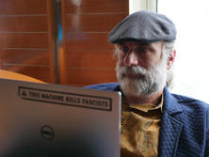
Bruce Schneier: Security is a process (2000)
Security is a process, not a product. Products provide some protection, but the only way to effectively do business in an insecure world is to put processes in place that recognize the inherent insecurity in the products. The trick is to reduce your risk of exposure regardless of the products or patches.
https://www.schneier.com/essays/archives/2000/04/the_process_of_secur.html

Slide 22
Reduce!

Slide 23
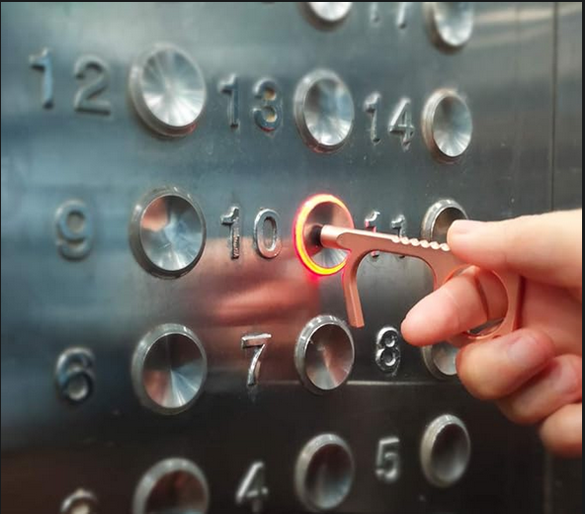
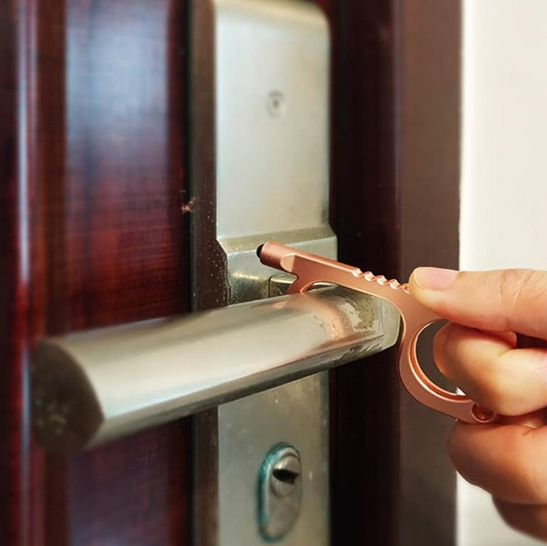

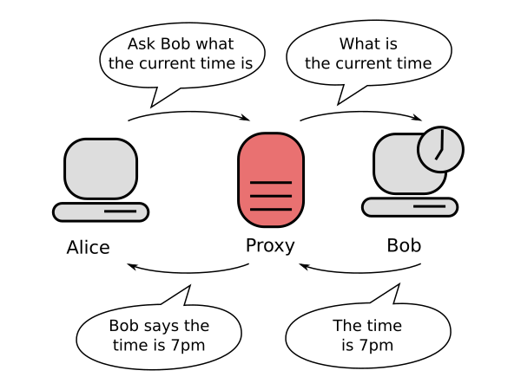

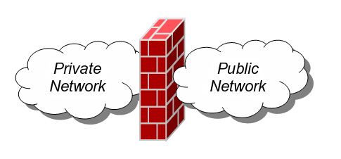
reduce contact

Slide 24

reduce data: other answers
Focus on your key question:
  “Is example.com (still) online, what’s it look like?”
  “Was example.com included in <dataset>?”
  “How many unique records were stolen in <crime>?”
Can you find the answers elsewhere?
  Did someone else already do the work?
  Would a free or affordable service do it for you?
If you don’t need to touch it, much less store it
  … maybe don’t ? 🤷🏽‍♀️

Slide 25
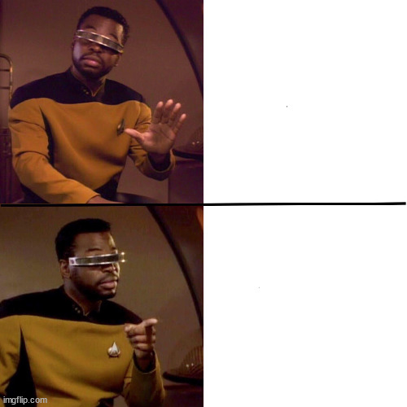


reduce data: sift, filter, flatten
Remove unneeded data
  Positive filter it in
Reduce metadata
  Rewrite it or exclude it
doc
xls
docx
xlsx
Simpler is often better
  Plain text
  flat images, printed PDFs
Beware complex formats
  Check files with 7-Zip, notepad, $HEXEDITOR
bmp
tiff
JPEG
txt

Slide 26
More Rs ?!

Slide 27
Reuse and Recycle ?
Don’t Reuse ...
  If you can help it
Try not to “cross the streams”
  Plan for spills
Do Recycle carefully:
rotate secrets
data wiping …
  media destruction !
cool things:
  disposable containers
  VM snapshot rollback

Slide 28
Reach Out
Connect
Relationships
Collaborate
Mentor ?
Transfer Risk ($)
Confirm facts, claims
Second opinion
Sanity checks
“deconfliction”

Slide 29
Good luck, good hunting, 頑張ってよ！
Thank You! よろしくお長居します！

Slide 30
about:slides
Graphics from Wikimedia Commons under CC and PD
  … with a few exceptions:
    XKCD #327, US Gov, website header logos for Qubes, OpenBSD
    David Bianco’s Pyramid of Pain v2, knowyourmeme, Amazon listings
made with: LibreOffice Impress, VSCodium, Firefox, Windows Snipping Tool
audio included: Ava Max, Dark Adventure Radio Theatre, Barbie soundtrack
video included: BtVS Season 1, Bitten S1, Lexx
Talk contents and deck available (soon) at dfirnotes.net
  Copyleft ( MIT license ) 2024

