Slide 1

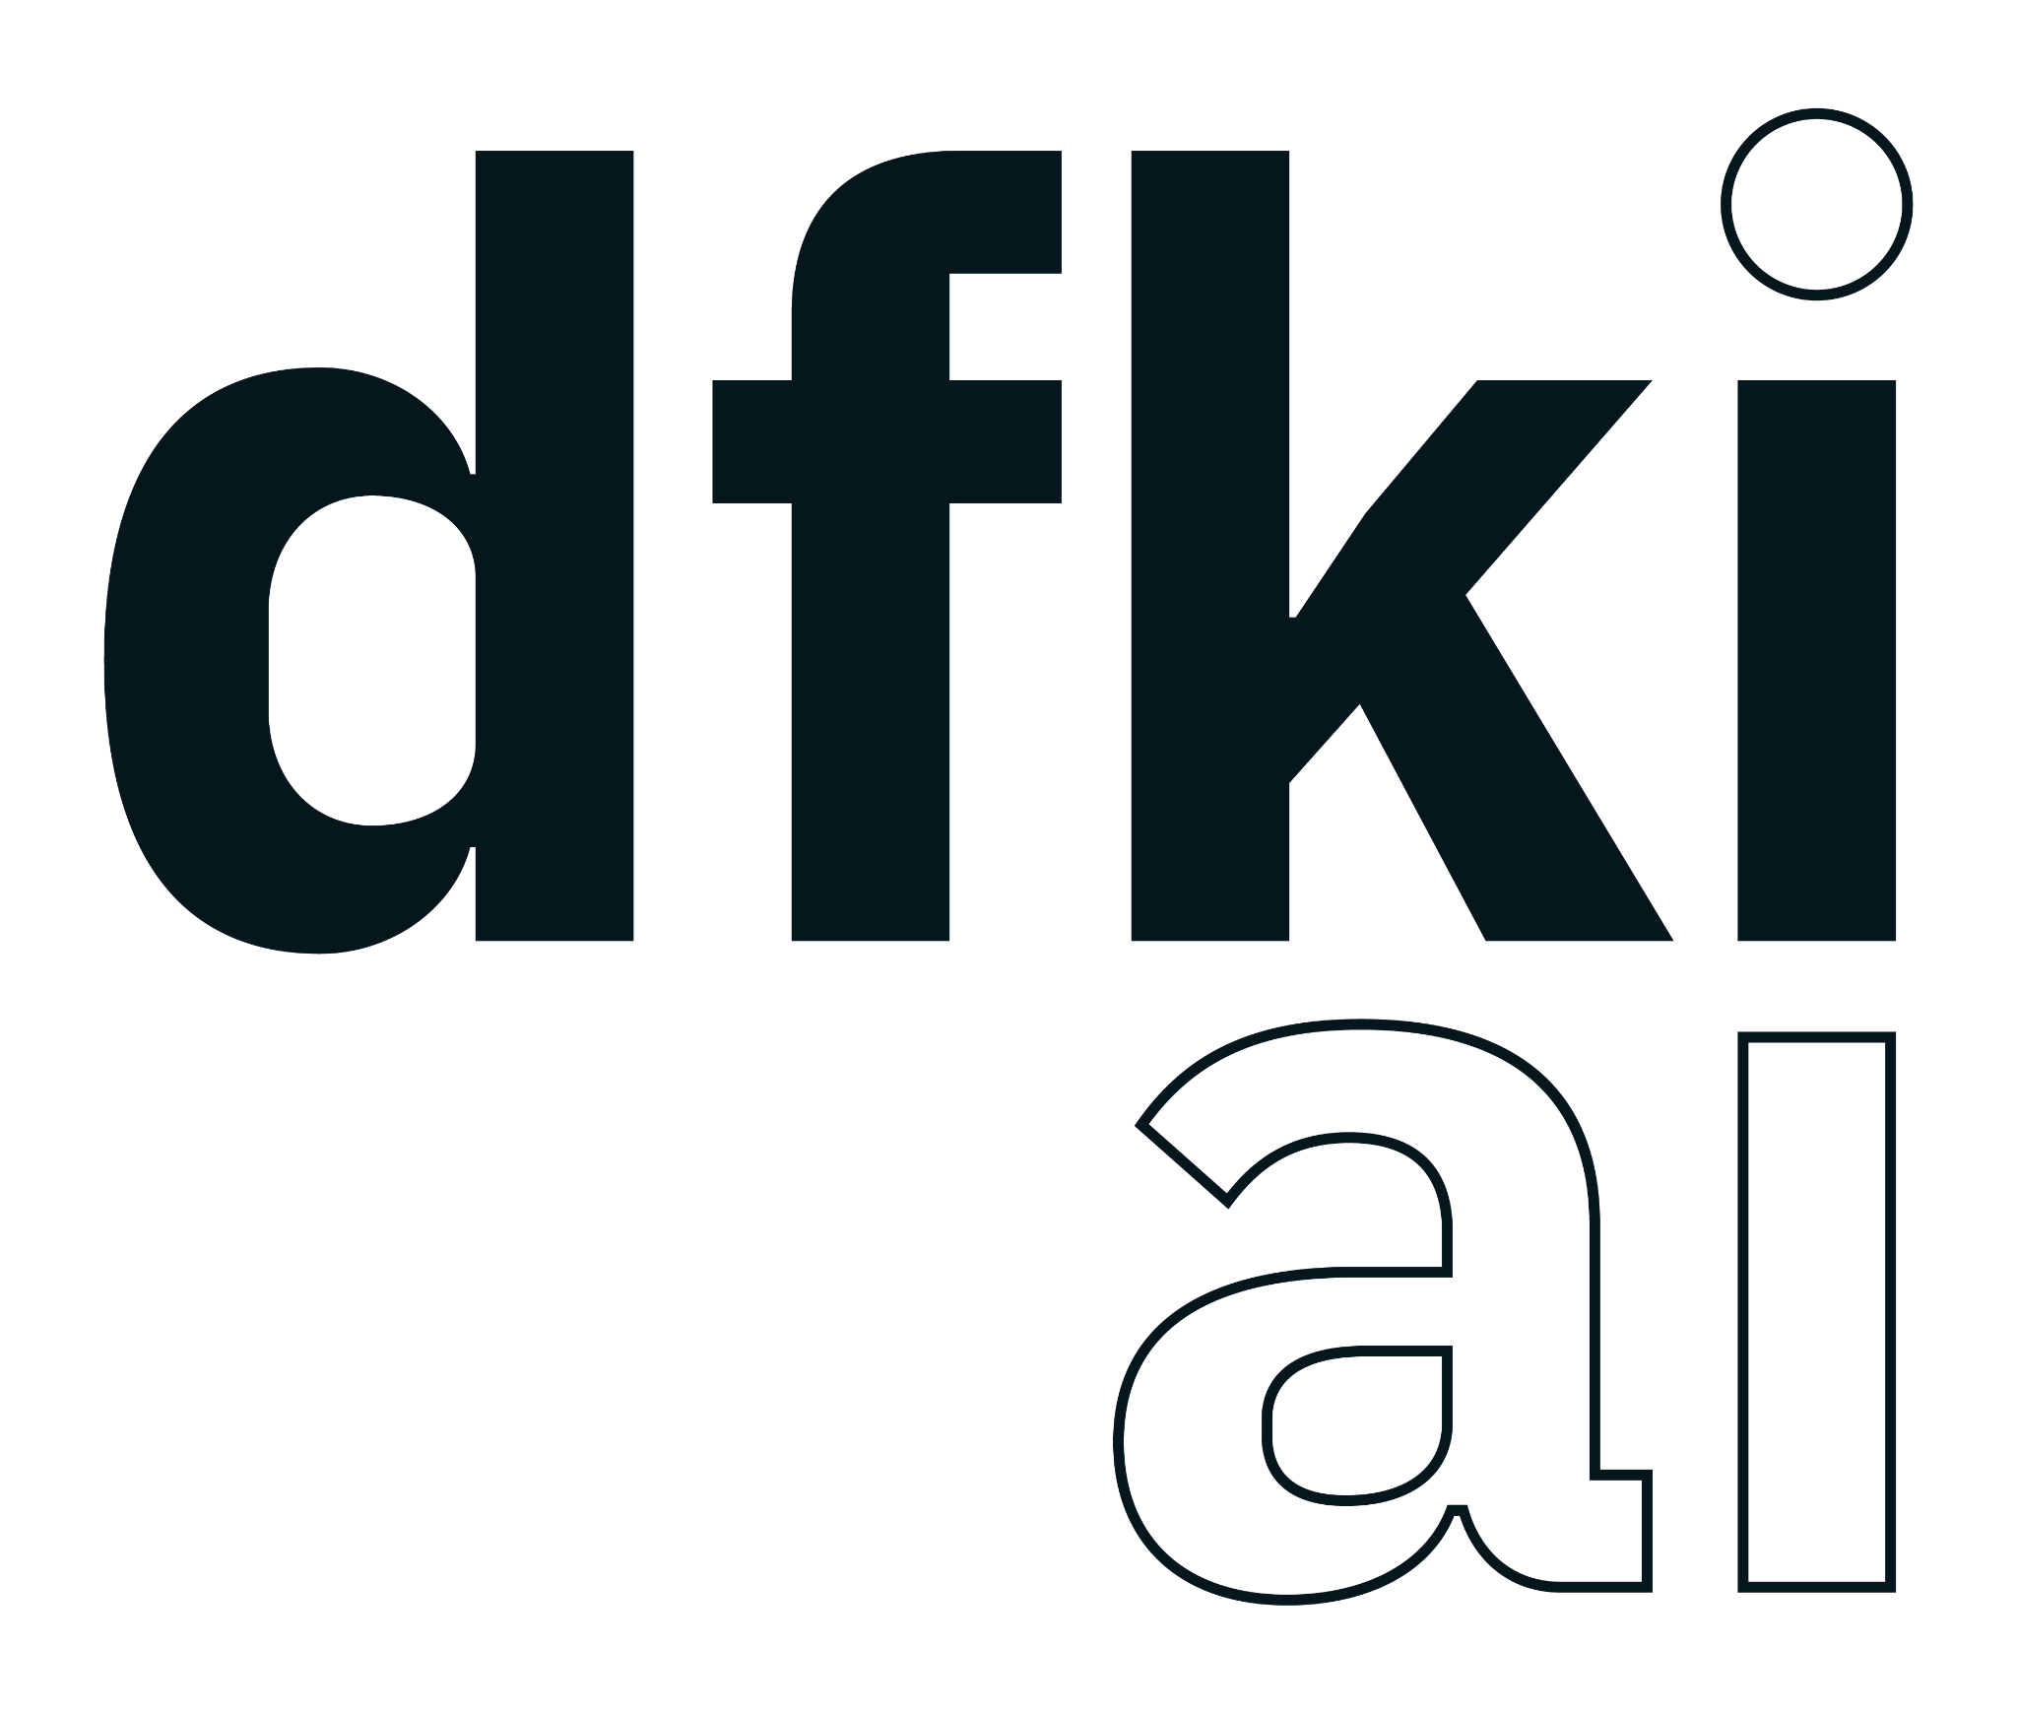


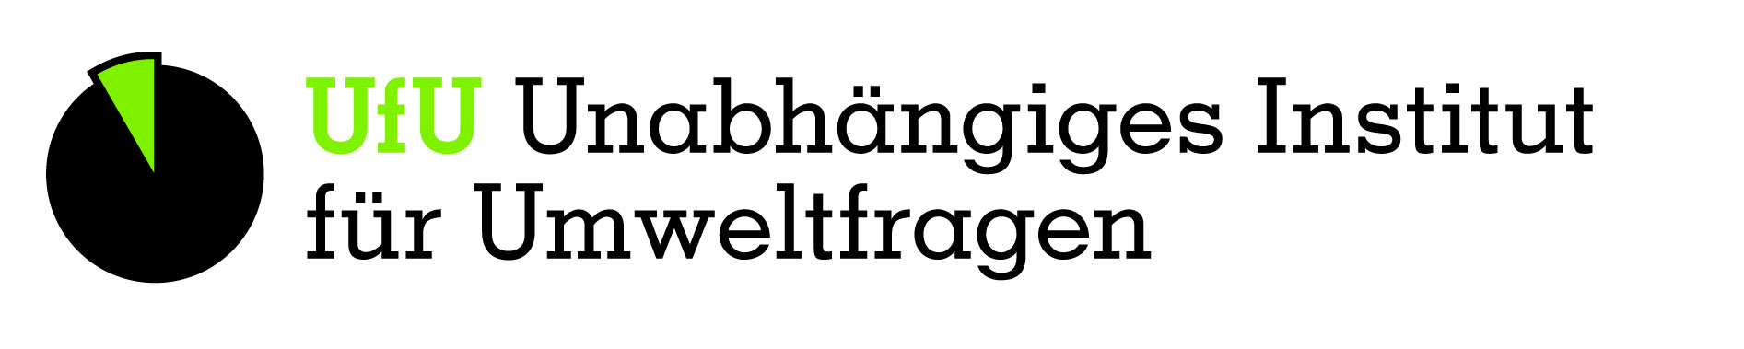
KIBA-D
AI in scientific work and monitoring: LLMs for continuous biodiversity assessments
FEdA Status Conference 2026
Arne Binder, DFKI
Julia S. Ellerbrok, iDiv e.V.
Notes:
Welcome. This talk presents KIBA-D, an accompanying research project within the FEdA research initiative. Guiding question: can generative AI – large language models – help keep a national biodiversity assessment such as the German 'Faktencheck Artenvielfalt' continuously up to date? We'll look at why this is needed, how our approach works, what a large-scale test showed, and where the limits are.

Slide 2




AI in scientific work: mostly analysis of images and sound
Creation and analysis of big data
But:
much of what we know lies in text
Camera traps
Species identification in millions of images
For most of history, findings were published as text only – original data often lost
Monitoring data cover mostly recent decades
They rarely explain drivers of change or the effect of measures
Large language models (LLM) can read digitized literature on a large scale
Bioacoustics
Birds, bats, insects in sound recordings
Remote sensing
Habitat change from satellite and drone data
Notes:
When we talk about AI in biodiversity monitoring, we usually think of images and sound: camera traps, bioacoustics, remote sensing, eDNA. These are huge successes. But monitoring time series only cover some taxa and mostly the last few decades – where much of the loss already happened. They also tell us little about drivers or about which conservation measures work. That knowledge sits in decades of articles, reports and books. Large language models are the first AI tools that can read this text at scale. This is where KIBA-D comes in.

Slide 3
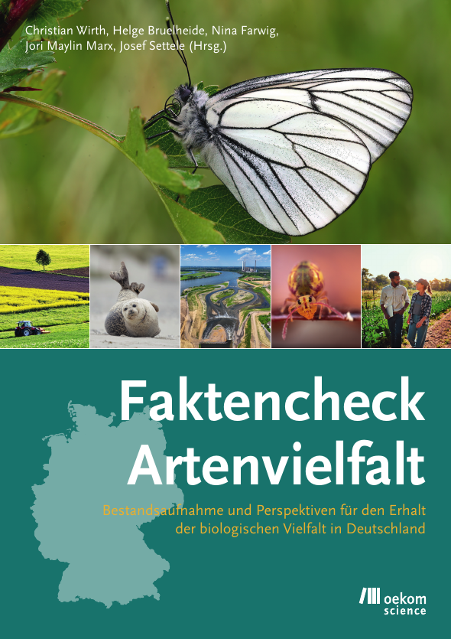

Germany‘s biodiversity assessment: a huge collective effort
145
3.5
More and more publications
authors
years of work
+3,769
>1,200
4,757
new publications in 3.5 years – on biodiversity & ecosystem services in Germany alone
pages of report
literature sources evaluated
Repeating this manually on a regular basis is very challenging
Sources: Faktencheck Artenvielfalt (Wirth et al. 2025); Web of Science search July 2022 vs. January 2026
Notes:
The Faktencheck Artenvielfalt is Germany's national biodiversity assessment, published in 2024. 145 authors worked for 3.5 years, wrote more than 1,200 pages and screened thousands of sources. The problem: literature grows fast. A search on biodiversity and ecosystem services in Germany returned about 11,700 hits in 2022; repeating it in January 2026 found 3,769 new papers. If we want to detect negative trends early, we need help to keep up with this volume.

Slide 4



How is an assessment made – and where can AI help?
Find literature
Read & annotate
Analyse trends
Report & review
Search queries, screening of titles and abstracts, check for relevance
Habitat, species, methods, drivers, measures …
16,208 trend statements → vote counts per habitat and species group
Synthesis, consensus, peer review
AI can support
human expertise important
high low
AI contribution
Notes:
Roughly, an assessment works like this: search and filter the literature, read the texts and note key information, compute trends, and finally write and review the report. AI can support the first three steps; synthesis and judgement remain with experts. A lucky situation for us: because the Faktencheck documented everything carefully, we have reference data against which we can measure AI honestly.

Slide 5
KIBA-D goals: Evaluate the AI potential in the assessment process
Interdisciplinary team
1. Literature search
Crawler to retrieve literature
Trained semantic filter
2. Text annotation
LLM-pipeline for named entity recognition (NER)
Text annotation to Faktencheck literature database
DFKI: AI & language technology
iDiv: biodiversity, Faktencheck authors
UfU, Öko-Institut: law & data governance
Research within the FEdA initiative, 07/2025–03/2027
3. Trend identification
LLM-pipeline for relation extraction (RE)
Find biodiversity trends
Expand the corpus, towards repeated assessments
Evaluate AI output against Faktencheck data as a reference
Notes:
KIBA-D has three goals: first, make the Faktencheck knowledge digital and machine-readable; second, test whether language models can reproduce the experts' annotations – and where they fail; third, lay the groundwork for a continuous assessment. AI researchers at DFKI, biodiversity researchers at iDiv – including Faktencheck authors – and legal experts from UfU and Öko-Institut work together on this.

Slide 6
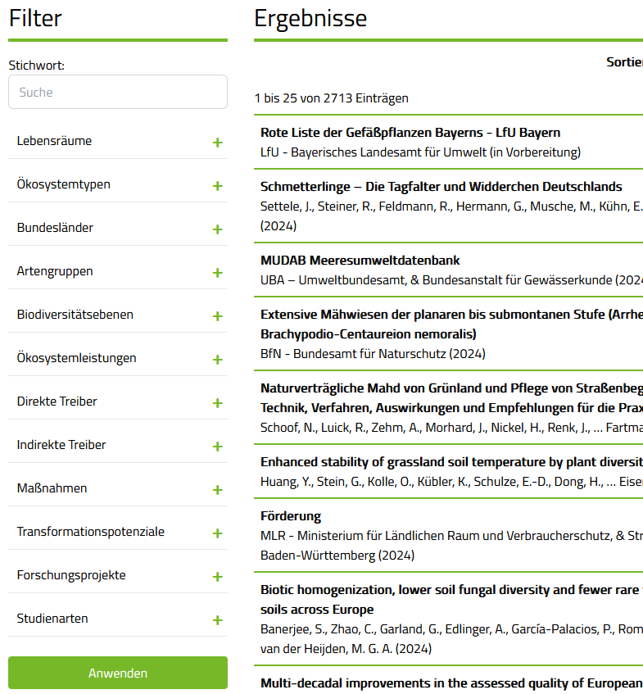
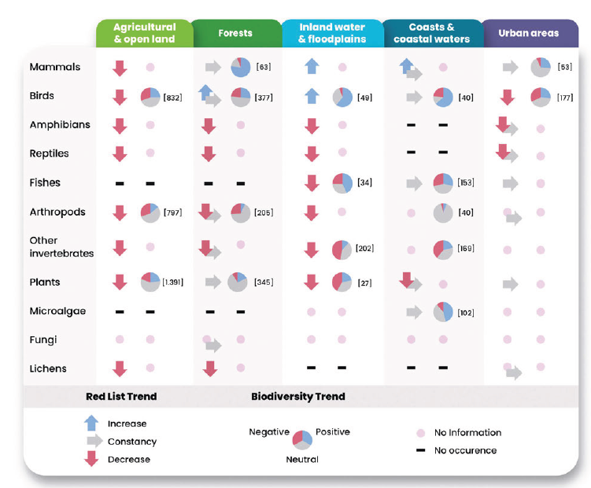
Faktencheck serves as reference
Literature database with annotation
Literature lists
List of biodiversity trends
Results of systematic keyword search
+
Lists of literature categorized as relevant / irrelevant
Notes:
KIBA-D has three goals: first, make the Faktencheck knowledge digital and machine-readable; second, test whether language models can reproduce the experts' annotations – and where they fail; third, lay the groundwork for a continuous assessment. AI researchers at DFKI, biodiversity researchers at iDiv – including Faktencheck authors – and legal experts from UfU and Öko-Institut work together on this.

Slide 7
Keeping the literature base up to date
Find new literature
Screen for relevance
Support assessment
→
→
Search for new biodiversity
literature every two weeks
Build on the search queries
used in Faktencheck
Provide full texts for
extraction and expert review
Overlap with the original Faktencheck literature
95%
of the literature retrieved
97%
of literature classified
as relevant
WIP: semantic filtering learns from experts’ relevance decisions.
Internal evaluation on original forest bibliography lists.
Notes:
Keep this short: discovery leads into extraction. The crawler retrieves Semantic Scholar metadata, supports incremental updates, screens titles and abstracts using Faktencheck keyword queries, and provides PDF download utilities. The operating schedule is every two weeks. The learned semantic relevance classifier is work in progress, not an implemented ranking stage.
The team confirmed the internal evaluation on subsets of original Faktencheck forest bibliography lists: 95% overlap for literature overall and 97% for relevant literature. These are internal subset results, not a general recall benchmark.
The intended assessment workflow continues with extraction and expert review. We focus on extraction and evaluation in the rest of the talk. Sources: neighboring kibad-crawler README and main.py, basic_filter.py, relevance.py, crawler.py; team clarification in the finalization handover.
Revision: opening keynote for FEdA researchers and practice partners. Emphasise keeping biodiversity evidence up to date, reuse of expert screening decisions and repeated assessments. API and implementation details belong in these notes. Semantic filtering remains work in progress; overlap is limited to the evaluated forest subset.

Slide 8

Buried information: What do we want to extract?
Values come with
traceable evidence.
Taxon English
Taxon Scientific
The Alpine Ring Ouzel Turdus torquatus alpestris is a typical mountain bird that has recently declined in most of its breeding range. In this study we compared the historical (1986–1987) and recent (2017) distribution of breeding Ring Ouzels in 62 randomly selected 750 × 750 -m plots and analysed local colonization and extinction patterns in 558 subunits (= ‘grid cells’) in the southern Black Forest (south-western Germany). Our study revealed that habitat occupancy has decreased by about one-third, mainly at lower elevations and in depressed landforms, during the past three decades.
The Alpine Ring Ouzel Turdus torquatus alpestris is a typical mountain bird that has recently declined in most of its breeding range. In this study we compared the historical (1986–1987) and recent (2017) distribution of breeding Ring Ouzels in 62 randomly selected 750 × 750 -m plots and analysed local colonization and extinction patterns in 558 subunits (= ‘grid cells’) in the southern Black Forest (south-western Germany). Our study revealed that habitat occupancy has decreased by about one-third, mainly at lower elevations and in depressed landforms, during the past three decades.
Study Type
Time range
Time range
Biodiversity Variable
Spatial Measurements
Spatial Extent / Resolution
Spatial Extent / Resolution
Location
Location
Biodiversity Trend
Biodiversity Trend
Taxon · English
Taxon · scientific
Time
Location
Trend relation
⋯
Ring Ouzel
T. torquatus alpestris
1986–1987
Black Forest
(birds, forest, abundance, negative)
2017
Germany
Illustrative output from the broader extraction schema
Notes:
Builds: initially show the unannotated excerpt; first click reveals the extracted values; second click reveals all excerpt annotations and the provenance callout. English and scientific taxon names occupy separate columns. Output boxes use white semibold text on darker variants of their annotation hues. The abbreviated relation concerns habitat occupancy, not abundance. This is an illustration, not a newly evaluated prediction.
The architecture supports the broad extraction schema. We have run it before, but the resulting performance was difficult to interpret; evaluation therefore focused on CoreSchema and simplified trend tuples. Broader-schema evaluation remains work in progress. Explain this verbally when moving from the demonstration to the two evaluated tasks. Document-level matching is used because the reference is document-level; evidence passages support checking.

Slide 9
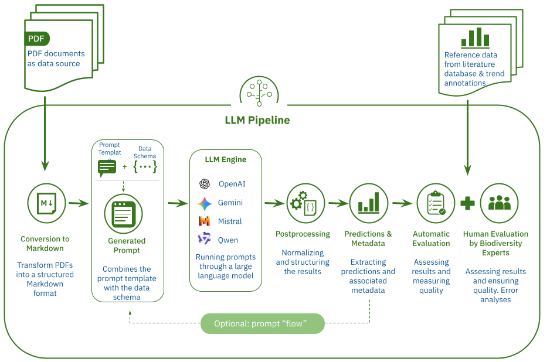
Pipeline: document wise, schema guided extraction
Details
Data schema: model all data in one place
Guided decoding: response
is always valid JSON following the schema
Prompt = template + generated schema description
Evidenz anchor: provide extraction provenenance
Chunking (20.000 chars): context limit and „lost in the middle“
vLLM (lokal) or OpenAI-API; LlamaIndex, Hydra, Pydantic
PDF → Markdown (PyMuPDF4LLM), full text incl. appendices

Slide 10

Two tasks, evaluated on real biodiversity literature
≈ 1,500 document inputs across development and testing
Task 1: What is the study about?
Task 2: Which trend is reported?
Classification as in the literature database,
independent information
All four parts must fit together
Habitat
Species group
Biodiversity level
Habitat
Species group
Variable
Direction
Ecosystem type / category
Ecosystem type / term
…
Test: 500 documents
Test: 430 documents
agricultural & open land, with and without trends
Corpus characteristics
Source types
German & English; 21–37% in German
57%
23%
17%
Up to 2,218 pages in a single book
Articles
Reports
Books / chapters
Other 3%
Deduplicated test sets · metadata: 865/869 PDFs · shares of converted-text characters.
Notes:
Task 1: independent document annotation fields in CoreSchema, tested on 500 documents. Task 2: complete habitat + species group + variable + direction tuple in OrganismTrends, tested on 430 agricultural/open-land documents, including documents without reference trends. The original task panels are retained; an outline groups all four trend fields.
Scale: 100 + 500 + 468 + 430 = 1,498 document inputs across development and testing. This is not a count of distinct publications or test documents. The language range 21–37% describes document shares in the two test sets. Longest input: up to 2,218 pages.
The source-type bar combines the two TEST sets and deduplicates shared PDFs: 930 inputs, 61 shared byte-identical PDFs, 869 unique PDFs; exclude four missing metadata records. Retained: 865 documents, 24,853 pages, 87,913,353 converted Markdown characters. Journal articles: 50,183,056 chars (57.08%); reports 20,490,541 (23.31%); books/chapters 14,536,356 (16.53%); other 2,703,400 (3.08%). These are metadata source types, not a verified peer-reviewed/grey-literature classification.
Sources: manuscript Table 2; verified combined statistics in the finalization handover; https://github.com/DFKI-NLP/kibad-llm/pull/636#issuecomment-6526264782 . Shared Markdown conversion priority: retain CoreSchema; no source data modified.
Revision: neutral scale teaser and source-type palette; percentages rounded for display while segment widths retain exact shares. The maximum of 2,218 pages is one book, highlighting the unusually heterogeneous inputs. Corpus characteristics separates language from document length.

Slide 11
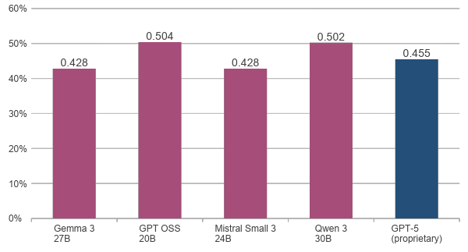
Result 1: open-weight models reach about 50% F1
Open-weight models
GPT-5 · proprietary
F1 (%) · higher is better
≈50%
F1 for document annotations
on 500 unseen documents
open-weight ≈ GPT-5
Best open model: 50.4% F1
GPT-5: 45.5% F1
F1 balances finding reference information with avoiding unmatched answers.
100% means complete agreement with the reference.
Notes:
F1 is displayed as a percentage, not as accuracy or the share of correct answers. 100% F1 means complete agreement with the reference; unmatched predictions can include reference omissions.
CoreSchema test: 500 documents, original reference. F1: Gemma 42.8%, GPT OSS 50.4%, Mistral 42.8%, Qwen 50.2%, GPT-5 45.5%. Open-model means over three seeds; GPT-5 one run. Magenta denotes Task 1 open models, blue GPT-5. Native chart and embedded workbook use ratios with percentage formatting. Source: manuscript Fig. 4a.

Slide 12
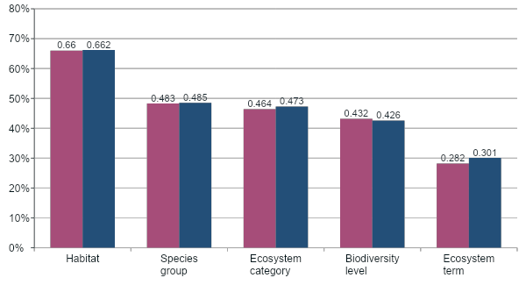
A closer look: AI is not equally good for all topics
Open-weight model mean
GPT-5 · proprietary
F1 (%) · document annotations · 500 test inputs
Performance varies
by annotation type.
Habitat is easier to identify than detailed ecosystem terms.
Manuscript Fig. 6a · open-weight mean across four models, each averaged over three runs; GPT-5: one run.
Notes:
The information types differ in difficulty. Values in F1 (%): open-weight model mean / GPT-5: habitat 66.0 / 66.2, species group 48.3 / 48.5, ecosystem category 46.4 / 47.3, biodiversity level 43.2 / 42.6, ecosystem term 28.2 / 30.1. These are original test results from manuscript Fig. 6a, not version-B trend diagnostics. This figure was converted to an English native chart to maintain the talk’s F1-percentage scale and model colours.
Open means here average the four model families after averaging each model’s three runs. Slide 17, by contrast, reports Qwen alone over its three seeds. Data are the reported manuscript means; no new error bars are inferred.
Oral explanation only; do not add class counts to the slide: more classes may partly explain the difficulty (around 40 ecosystem terms versus a handful of broad habitats). Immediately qualify this: habitat and ecosystem category both have six allowed classes but differ markedly in F1, so concept complexity, abstraction level, frequency and reference completeness may also matter. These are possible explanations, not isolated causal findings.

Slide 13
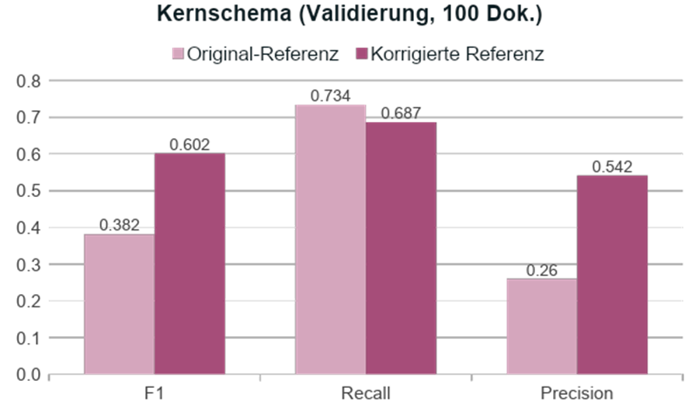
Result 2: the AI finds most reference information – and more
73%
completeness (recall): about three quarters of the experts’ annotations are found
26%
precision: many additional answers – real errors, or gaps in the reference?
410 → 914
annotations after correcting the reference
Especially in long texts, AI can find information missed by human annotators.
Test set (500 docs), mean of open models; re-check: validation set (100 docs)
Notes:
Original slide layout and reference-quality argument restored from backup-0, including its chart image. Headline test means: recall 74.1%, precision 34.2% over open-weight models on 500 documents. These are distinct from the development re-check on 100 documents.
Correction expanded evaluated reference annotations from 410 to 914. The original development chart shows F1 0.382→0.602, recall 0.734→0.687, precision 0.260→0.542. Its original ratio axis and German legend are deliberately retained as part of the requested restoration. Values 0.382/0.602 correspond to 38.2%/60.2%. This is a change in measured agreement with the reference, not in model predictions.
For expert screening, recall is valuable because experts can reject extra candidates, while recovering missed evidence requires reading/searching again. Precision still matters, particularly for policy-facing synthesis. Longer texts exposed reference omissions; this is not a universal claim that AI reads better than people. The manuscript separately extrapolates a roughly 82% test F1 under a comparable correction effect; this was not measured on a corrected test reference.

Slide 14




Where do LLMs go wrong? - Annotations (NER)
15%
Missed information
(False Negative I)
13%
Technical failure
(False Negative II)
different topics in one study → LLM focuses on one
text too long (solved with chunking)
5%
Irrelevant information
(False Positive I)
4%
Misinterpretation
(False Positive II)
information are not part of the actual texts, e.g. literature list
Assignments to wrong categories,
e.g. “structure” too often assigned to
“structural diversity”
Manual error analysis on validation data, share of all predictions; manuscript Tab. 3
Notes:
Our biodiversity experts went through the errors by hand. The most frequent: the model simply misses information, e.g. when a study covers many species. Second: technical failures – the model actually found the answer, but didn't output it. Third: irrelevant information – my favourite example is habitats extracted from a donation appeal on the same page. And finally genuine misinterpretations, like 'structure'. Most of these errors can be addressed with better prompts, splitting long documents and step-wise questions – which is what we are working on.

Slide 15
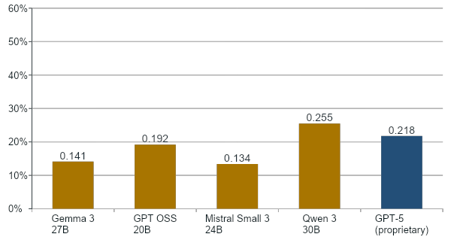
Result 3: complete trend extraction remains difficult
Open-weight models
GPT-5 · proprietary
F1 (%) · higher is better
Habitat
Species group
Variable
Direction
forest
birds
abundance
negative
25.5%
Best F1 · Qwen 3 30B
Versus about 50% F1
for document annotations
Qwen achieved the highest observed F1
(GPT-5: 21.8%).
GPT-5 has the highest recall; Qwen has the highest precision and F1.
430 agricultural/open-land test inputs · exact match of habitat + species group + variable + direction · manuscript Fig. 4b.
Notes:
Complete trend extraction requires an exact document-level habitat + species group + biodiversity variable + direction tuple. Mean F1 (%): Gemma 3 27B 14.1; GPT OSS 20B 19.2; Mistral Small 3 24B 13.4; Qwen 3 30B 25.5; GPT-5 21.8. The original raster and cross-model mean bar have been replaced by a native editable chart with embedded values. Both result charts use the same 0–60 plotting axis for comparison, with F1 defined on a 0–100 scale.
Qwen is highest in precision and F1; GPT-5 is highest in recall. Recall: GPT-5 48.6%, Qwen 37.8%, Gemma 3 45.5% (also comparable to GPT-5). Precision: Qwen 19.3%, GPT-5 14.0%. Recall remains relevant for the expert-screening workflow discussed on slide 14. Low precision must be interpreted against an incomplete reference, so these numbers do not directly measure scientific correctness. Keep these details oral to avoid overloading the slide.
Source: manuscript Fig. 4b / 5c-d, corrected PR #586 test experiment, 430 inputs including documents without reference trends. Individual open models are means over three seeds; GPT-5 has one run. Reserve the diagnostic task breakdown for slide 17.
Revision: ochre denotes Task 2 open-model results; blue remains GPT-5. Highest observed F1 does not establish statistical superiority. Both main model charts retain the same plotting range, now 0–60%, and the metric is defined on 0–100%.

Slide 16
Where do LLMs go wrong? - Biodiversity trends (RE)
16%
Missed information
(False Negative I)
10%
Technical failure
(False Negative II)
21%
Irrelevant information
(False Positive I)
3%
Misinterpretation
(False Positive II)
“If conditions are favorable, centipedes may reach comparatively high densities[...]”
Why is this so challenging?
Four pieces of information, often scattered across the text
(“long distance relations”)
Reference relies on tables/ figures - LLM on text
Language style, e.g. hedged wording, diversity of phrasings
lower
declined
decrease
disappeared
Manual error analysis on validation data, share of all predictions; manuscript Tab. 3
Notes:
Our biodiversity experts went through the errors by hand. The most frequent: the model simply misses information, e.g. when a study covers many species. Second: technical failures – the model actually found the answer, but didn't output it. Third: irrelevant information – my favourite example is habitats extracted from a donation appeal on the same page. And finally genuine misinterpretations, like 'structure'. Most of these errors can be addressed with better prompts, splitting long documents and step-wise questions – which is what we are working on.

Slide 17
What does large-scale extraction cost?
Resource
Per document
Full corpus · 3,917 PDFs
Open-weight models: GPU time
40–150 s
84 GPU hours
Open-weight models: hosting estimate
≈€0.06
≈€235
GPT-5: estimated API expenditure
€0.08
€313
Both incur costs: GPU hosting or usage-based API charges.
Approximate estimates for one run; representative configuration. Rental equivalent: €2.80/H100-hour excl. VAT (OVHcloud, 30 Oct 2026).
The runtime range spans models/tasks; 84 hours is one configuration. Costs vary by model, text length and provider.
Notes:
These are accepted project estimates, not a newly measured identical-workload benchmark. Open-weight extraction takes 40–150 seconds per document across models/tasks. The representative full-corpus configuration is about 84 GPU hours for 3,917 PDFs, consistent with manuscript Table 4 GPT OSS CoreSchema timing of 76.84 seconds/document. Do not extrapolate 84 hours from the entire runtime range.
Rental reference: OVHcloud h100-380, one H100 80 GB, €2.80/hour excluding VAT, checked 30 October 2026: https://www.ovhcloud.com/en-ie/public-cloud/prices/ . 84 × €2.80 = €235.20, or €0.06005/document. This is a rental equivalent, not recorded project expenditure. GPT-5 API expenditure of €0.08/document and €313 for the corpus is the accepted project-report TL3 estimate. No comparable GPT-5 runtime was supplied.
Sources: manuscript Table 4; project report TL3; finalization handover. The repository licence is omitted.
Revision: both routes incur monetary costs. The open-model estimate prices GPU hosting at a rental-equivalent rate; the proprietary estimate prices API usage. Open-weight access does not imply free hosting. These exclude the full human review and assessment workflow. The slide follows the extraction results and error analysis, before key findings.

Slide 18
Key findings
LLMs can analyse biodiversity literature at scale – zero-shot, without training, with open models.
1
LLMs reach performances of 50% for simple annotations (NER), 25% for more complex trend extraction (RE).
With a similar reference-correction effect, F1 could reach ≈80% for NER.
2
3
LLMs make mistakes. So do human researchers.
Notes:
Three take-home messages. First, language models can analyse biodiversity literature at scale – without training and with openly available models. Second, they read thoroughly but also return noise – experts remain indispensable. Third, simple classifications work well; complex trend statements are not yet reliable. Next, we automate literature search, extend to ecosystem services and improve trend extraction. Our goal: a continuous, AI-supported biodiversity assessment.

Slide 19


(How) can LLMs support the literature work for assessments?
1
LLMs can analyse biodiversity literature at scale – zero-shot, without training, with open models.
LLMs reach performances of 50% for simple annotations (NER), 25% for more complex trend extraction (RE).
The correction of reference data may raise performance to values around 80% for NER.
LLMs make mistakes. So do human researchers.
2
3
AI first, human check
In parallel
Division of labour
AI and humans both annotate; differences are checked
AI takes on long texts such as books and reports; humans the rest
AI analyses everything; experts check random samples and estimate uncertainty
+ maximum completeness
– no ressources saved
+ time saved where it costs most
– some risk of errors
+ maximum time saved
– increased risk of errors
In all options: experts stay in the loop – the AI provides evidence, humans judge and interpret.
Notes:
What does this mean in practice? We see three options. First, in parallel: AI and humans both annotate and differences are checked – maximally complete but no time saved. Second, division of labour: the AI takes on the long books and reports that cost humans the most time. Third, AI first: the AI analyses everything and experts check random samples – the biggest time saving, but it must be disclosed. In all cases humans stay in the loop; the evidence passages make checking fast.

Slide 20
Outlook
Next steps
Continuous error analyses
& prompt improvements
Semantic filtering for literature crawling
Relation extraction for biodiversity and ecosystem services
Digitize old reports
Planned experiments
Multi-query workflows & LLM-as-a-judge
Domain-adapted models
Harmonise species names (e.g. via GBIF)
Notes:
Three take-home messages. First, language models can analyse biodiversity literature at scale – without training and with openly available models. Second, they read thoroughly but also return noise – experts remain indispensable. Third, simple classifications work well; complex trend statements are not yet reliable. Next, we automate literature search, extend to ecosystem services and improve trend extraction. Our goal: a continuous, AI-supported biodiversity assessment.

Slide 21
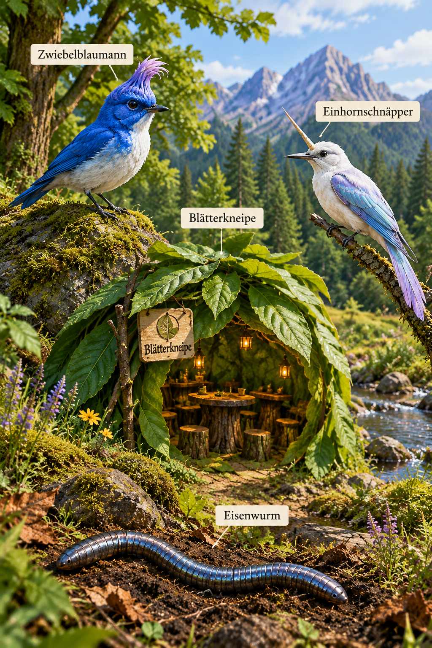


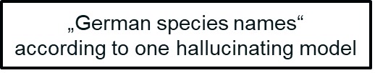
Thank you!
KIBA-D Team
Leonhard Hennig, Diego Arenas, Arne Binder, David Harbecke •
Julia S. Ellerbrok, Annalena Lenk, Tobias Proß, Jori Maylin Marx, Maria Sporbert •
Luisa Schneider, Peter Gailhofer •
Helge Bruelheide, Nina Farwig, Josef Settele, Christian Wirth
Manuscript
„AI meets Biodiversity: How Large Language Models can Support Continuous Biodiversity Assessments“ (in preparation)
Code
github.com/DFKI-NLP/kibad-llm
Notes:
Thank you – to the whole team, and to you for your attention. Happy to take questions.

Slide 22
Backup

Slide 23
Where does complete trend extraction become difficult?
Qwen 3 30B · same extracted outputs, three evaluation views
Detecting trend statements
Classify the trend direction
37.3 ± 1.1%
66.9 ± 1.5%
Habitat + species group + variable
Missed and extra combinations count as errors.
Only correctly matched combinations
Missed and extra combinations are excluded.
Complete four-field extraction: 25.5 ± 1.2% F1
Trend detection remains difficult;
stable and reversing trends are also less reliably recovered.
Matched-combination recall: declines 97%, increases 82%, neutral 52%, reversals 29–39% (few examples).
F1: mean ± sample SD over three seeds · diagnostic views; do not add or multiply the scores.
Notes:
Version B, Qwen ONLY. Checkpoint Qwen/Qwen3-30B-A3B-Thinking-2507; corrected agricultural/open-land PR #586 experiment. Seeds 42, 1337, 7331, 430 prediction records per seed. No new inference.
Detection evaluates the document-level habitat + species group + variable triple, ignoring direction. Missing and extra triples both count. Mean F1 37.282134 ±1.060120% (sample SD across run-level scores).
Conditional direction categorisation compares direction LABEL SETS only for triples present in prediction AND reference. Mean F1 66.916476 ±1.522469%. Missed/extra triples are excluded, so this is not direction performance over all targets or a separate classifier supplied with gold targets.
Complete four-field extraction: 25.519062 ±1.204949 F1 (%), reproducing the original evaluation exactly. These diagnostic views cannot be added or multiplied. The variable is part of the detected identity: abundance and species richness can have different trends for one habitat and species group.
Example: reference agricultural land / birds / abundance / negative. Predicting the same triple with positive direction succeeds at detection but fails direction and complete extraction. Predicting species richness instead of abundance produces a missing target plus an extra target; that triple is excluded from the conditional direction analysis. There are 270 reference triples and 294 complete tuples; 22 triples have multiple direction labels.
These replace version A (habitat-group identity and variable-direction payload); do not use the former 49.6, 47.7 or 71.5 values under version-B labels. Source and reproducible derivation: finalization handover Appendix B. The new backup slide after the divider gives the full five-category direction diagnostic.
Revision: these are evaluations of the same outputs, not two sequential inference stages. Ecological context means the document-level habitat–species-group–variable combination. Trend category includes negative, neutral, positive and both reversal categories; neutral need not be called a direction. F1 ± SD is displayed in percentage units, not a confidence interval.
The stronger takeaway combines the detection diagnostic with the five-category backup: matched-combination recall is 97.4% negative, 82.5% positive, 51.5% neutral, 38.9% positive→negative and 28.6% negative→positive. Reversal reference support is only 2–3 and 7 labels per seed. These conditional findings do not establish full-corpus category recall, causality or the benefit of a separately implemented two-stage pipeline.

Slide 24
Which trend categories does Qwen recover?
Trend classification on correctly matched combinations · Qwen 3 · three seeds
Alignment-averaged, multi-label · matched targets only
Exact per-direction diagnostics
Reference ↓ Predicted → | Negative | Neutral | Positive | Positive → negative | Negative → positive | Missing direction
Negative | 62.67 | 0.00 | 0.44 | 0.00 | 0.00 | 1.22
Neutral | 2.44 | 15.33 | 3.56 | 0.00 | 0.00 | 8.33
Positive | 1.11 | 1.00 | 30.00 | 0.28 | 0.00 | 3.94
Positive → negative | 0.67 | 0.17 | 0.00 | 1.00 | 0.00 | 0.83
Negative → positive | 1.11 | 0.00 | 0.94 | 0.00 | 2.00 | 2.94
Unassigned prediction | 25.67 | 13.17 | 28.06 | 1.06 | 1.00 | 0.00
Direction | Precision | Recall | Ref. labels per seed
Negative | 66.9% | 97.4% | 64–65
Neutral | 52.5% | 51.5% | 29–31
Positive | 47.6% | 82.5% | 35–39
Positive → negative | 44.4% | 38.9% | 2–3
Negative → positive | 66.7% | 28.6% | 7
Mean counts per seed; off-diagonals are expected error allocations.
Missing / unassigned labels occur within matched triples.
Few reference examples for reversals.
Precision / recall: means of per-seed ratios.
Qwen recovers increases and declines more reliably than stability or trend reversals.
Matched-combination recall: declines 97%, increases 82%, neutral 52%, reversals 29–39%. Conditional F1: 66.9 ± 1.5%.
Notes:
Backup supporting main slide 16. Qwen/Qwen3-30B-A3B-Thinking-2507, version B, seeds 42, 1337, 7331 from corrected PR #586. Direction categorisation on correctly matched habitat + species group + variable triples only. Overall conditional micro-F1 is 66.9 ±1.5% (mean ± sample SD). No new inference.
All five schema categories are retained: Negative, Neutral (schema label no), Positive, Positive → negative, Negative → positive. Each transition is a single category describing a direction change over time.
The complete 6×6 matrix is the existing ConfusionMatrixCollection alignment-averaged multi-label diagnostic; rows are reference, columns predicted. After exact matches are assigned to the diagonal, unmatched labels are distributed uniformly across all partial one-to-one alignments. Example reference {negative}, prediction {positive}: 0.5 negative→positive, 0.5 negative→missing, 0.5 unassigned→positive. Off-diagonals are expected error allocations, not observed label swaps; diagonal/total is not accuracy, and the sum of matrix cells is not a conventional sample count. Counts on this slide are means across seeds, not pooled independent observations.
Missing direction and unassigned prediction occur WITHIN matched triples. Missed and extra triples are excluded by conditioning and are covered by detection on slide 16.
The accompanying table uses exact binary presence/absence diagnostics, independent of the off-diagonal convention. Precision and recall are means of three per-seed ratios. Reference support ranges: Negative 64–65, Neutral 29–31, Positive 35–39, Positive→negative 2–3, Negative→positive 7. These count reference direction labels within each seed’s matched triples, not documents.
Negative labels have 97.4% recall but 66.9% precision; positive labels 82.5% recall but 47.6% precision. Stability is less reliably recovered (51.5% recall). Positive→negative recall 38.9% on 2–3 references per seed; Negative→positive recall 28.6% on 7. Few reference examples for reversals: avoid a strong ranking of the transition classes or a general conclusion about complex trends. Unmatched predictions are not necessarily scientifically incorrect because the reference is incomplete.
Verification: per-seed diagonal sums 109,117,107; real reference-row sums 138,143,139; prediction-column sums 186,200,189 match conditional F1 counts. Source: finalization handover Appendix C, including the durable full matrix and reproduction code.

Slide 25
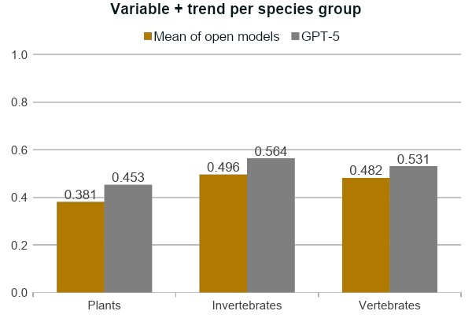
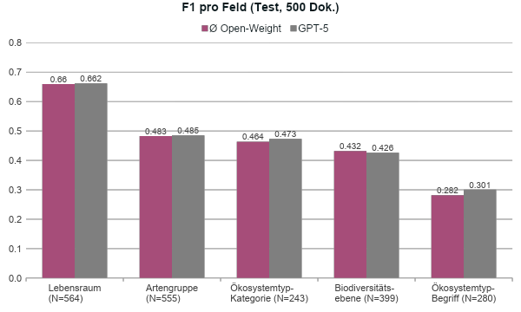
A closer look: AI is not equally good for all topics
Beware of bias: information extraction does not work equally good for all topics.
Notes:
Looking at the details: the bottleneck is step one. Habitat and species group of a trend statement are recognised correctly only about 40 percent of the time. If this base is right, the model assigns the measured variable correctly in over 70 percent of cases, and variable plus trend direction in a bit over 40 percent. So the actual assignment works reasonably well. On the right: it works clearly worse for plants than for invertebrates and vertebrates. That's a warning – AI is not equally reliable for all topics, and we need to know such biases.

Slide 26
Thank you!
Team
Julia S. Ellerbrok, Leonhard Hennig, Diego Arenas, Arne Binder, David Harbecke, Annalena Lenk, Jori Maylin Marx, Tobias Proß, Josef Settele, Maria Sporbert, Helge Bruelheide, Nina Farwig, Christian Wirth
Manuscript
„AI meets Biodiversity: How Large Language Models can Support Continuous Biodiversity Assessments“ (in preparation)
Code
github.com/DFKI-NLP/kibad-llm
Accompanying research of the German Research Initiative for Biodiversity Conservation (FEdA)
Notes:
Thank you – to the whole team, and to you for your attention. Happy to take questions.

Slide 27

Legal and governance questions
Copyright & text and data mining
EU AI Act
Is mining allowed? Opt-out clauses (§ 44b German Copyright Act), licences, paywalls of sources
Obligations for developing and using the models; documentation and transparency
Data governance
Re-use of outputs
Roles and responsibilities for data quality and compliance; provenance for every extracted item
Licensing of extracted data, correct attribution of sources, liability
Legal assessment and data governance concept by UfU and Öko-Institut (work in progress)
Notes:
For public institutions the legal side is as important as the technology. Our legal partners examine whether and how literature may be mined – including opt-out clauses under German copyright law – what the EU AI Act requires, and how responsibilities for data quality are organised. A key design decision follows from this: every extracted item carries its source and evidence, so that results remain traceable.

Slide 28
Result 3: trend statements are much harder
≈ 25%
Beware of bias
Assignment works worse for plants than for animals. AI is not equally good for all topics.
of trend statements are extracted fully correctly (best model)
Why?
Four pieces of information, often scattered across the text
Numbers in tables and figures
Hedged wording, significance, sub-areas
Test set agricultural & open land (430 docs); mean of open models
Notes:
Third result: trend statements are much harder – only about a quarter are extracted fully correctly. Four pieces of information must fit together, often scattered across the text; many trends sit in tables and figures, and researchers phrase results cautiously. If habitat and species group are correct, the trend is assigned better – but clearly worse for plants than for animals. That's a warning: AI is not equally reliable for all topics, and we need to know such biases.

Slide 29
KIBA-D: rebuilding the Faktencheck with AI
Unlock knowledge
Interdisciplinary team
Faktencheck literature, annotations and trends as a digital reference corpus
Test AI
Can language models reproduce expert annotations? Where do they fail?
Become continuous
DFKI: AI & language technology
iDiv: biodiversity, Faktencheck authors
UfU, Öko-Institut: law & data governance
Accompanying research of the FEdA initiative, 07/2025–03/2027
Find and analyse new literature automatically – with humans in the loop
Notes:
KIBA-D has three goals: first, make the Faktencheck knowledge digital and machine-readable; second, test whether language models can reproduce the experts' annotations – and where they fail; third, lay the groundwork for a continuous assessment. AI researchers at DFKI, biodiversity researchers at iDiv – including Faktencheck authors – and legal experts from UfU and Öko-Institut work together on this.

Slide 30
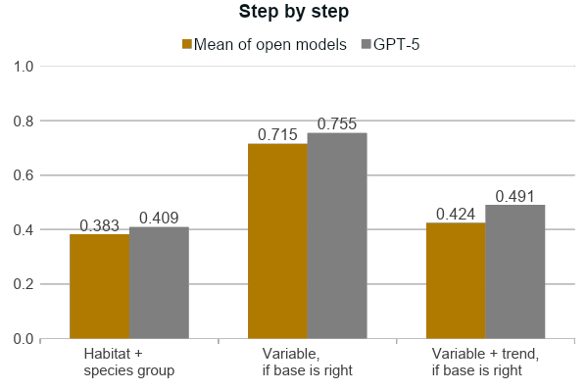
A closer look: habitat and species group are the bottleneck
The bottleneck is step one: habitat and species group are right only about 40% of the time. If they are, the variable is assigned correctly in over 70%.
Beware of bias: worse for plants than for animals – AI is not equally good for all topics.
Notes:
Looking at the details: the bottleneck is step one. Habitat and species group of a trend statement are recognised correctly only about 40 percent of the time. If this base is right, the model assigns the measured variable correctly in over 70 percent of cases, and variable plus trend direction in a bit over 40 percent. So the actual assignment works reasonably well. On the right: it works clearly worse for plants than for invertebrates and vertebrates. That's a warning – AI is not equally reliable for all topics, and we need to know such biases.

Slide 31


How it works: a language model fills in a questionnaire
Publication
Questionnaire
Language model
Experts
PDF → text, full document
What to extract? Allowed answers
Reads, answers in a structured way, cites evidence
check and add to the database
„… we compared the historical (1986–1987) and recent (2017) distribution of breeding Ring Ouzels … in the southern Black Forest … habitat occupancy has decreased by about one-third …“
Habitat · species group · variable · trend
Open land
Birds
Abundance
negative
No training needed · openly available models, run locally · German and English · every answer with evidence
Notes:
This is the only technical slide. For reading and extracting, the idea is simple: we give the language model a full publication plus a digital questionnaire – which information we want and which answers are allowed. The model answers in a structured format and cites the text passage supporting each answer. Example: a study on Ring Ouzels in the Black Forest becomes the trend statement open land, birds, abundance, negative. Important: we don't train anything, we use openly available models on our own hardware, and humans check the results.

