Slide 1
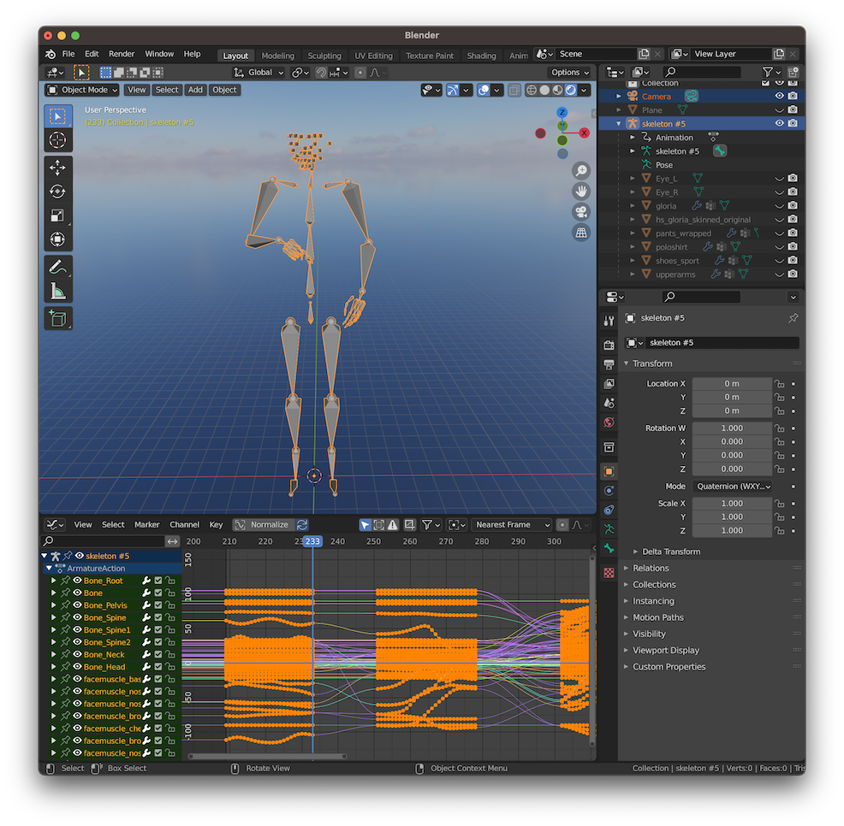
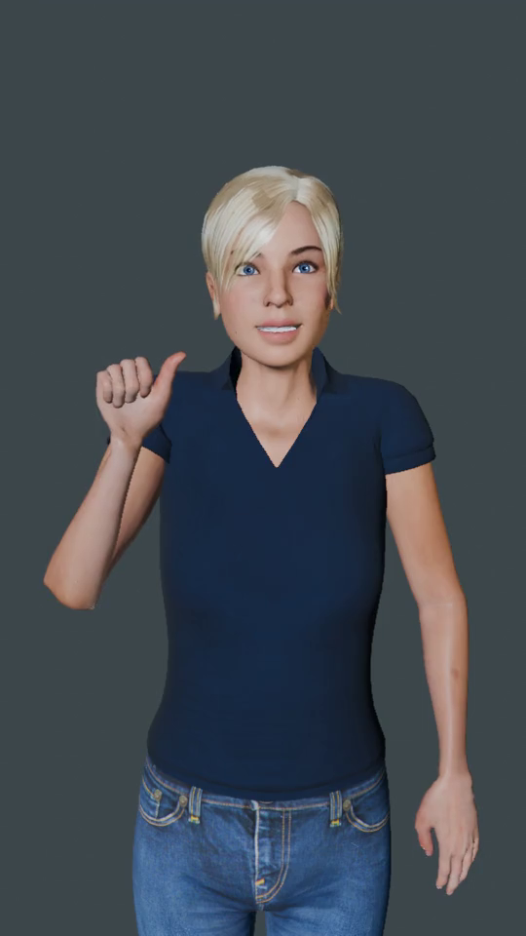
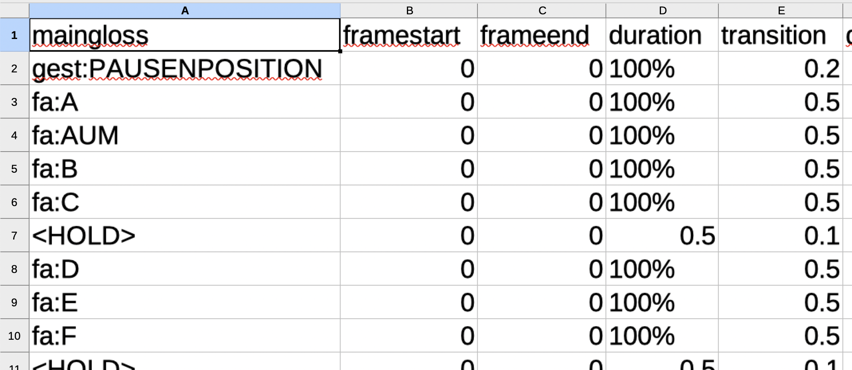



MMS-Player
Render
Video
MMS instance
(Glosses + timing + inflections)
Animated
Blender scene
Export animation
Sign animations

