Slide 1
Sprint 2: FanAssist
Daily Fantasy Sports Optimizer
Charity Brown, Andy Johnson, Elizabeth Payne, Gage Wassweiler
Notes:
Charity

Slide 2
Project Focus
The purpose of the FanAssist app is to assist daily fantasy sports users create a optimized lineup for competitions by leveraging FanDuel and DraftKings. Users can optimize their lineup based on detailed player statistics, player salary, salary cap.
Notes:
Charity

Slide 3
Sprint 2 Goal & Major Sprint Achievements
Set up Login & Register page using Firebase
Host web server on AWS
Launched an EC2 instance that runs Ubuntu and utilizes an Apache web server
Flask web app is hosted on the web server
Generating a list of players directly from the DraftKings API
App grabs Sunday’s slate for NFL in real time and displays to users
Other sports are out of season, but app notifies users when they try to pull slates for them
Notes:
Andy Johnson

Slide 4
Sprint 2 Goal & Major Achievements (cont)
Functional optimization for NFL implemented
Works exactly like NBA from last sprint, but is now using real time data
Works for both Fanduel and Draftkings
Search Bar Functionality for the List of Players
Implemented 10 Unit Test Cases
Notes:
Gage Wassweiler

Slide 5
Test Cases
Register Class (3)
Checks the length of Password meets requirements
Login Class (4)
Checks the visibility of GUI components when text is typed in the login fields (email / password)
Get Slate Class (2)
Tests the URL for the desired API, Fanduel or Draftkings, to make sure a valid URL has been given a String Request, and a response has been received.
Backend (4)
If desired sport is out of season
Optimization around desired players to select
Notes:
Charity Brown

Slide 6
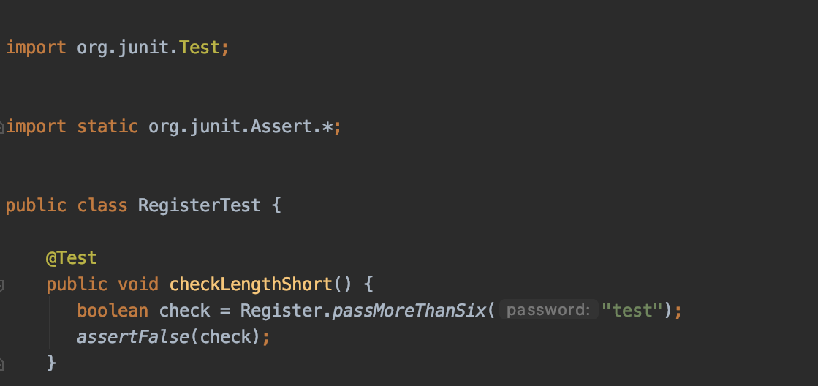
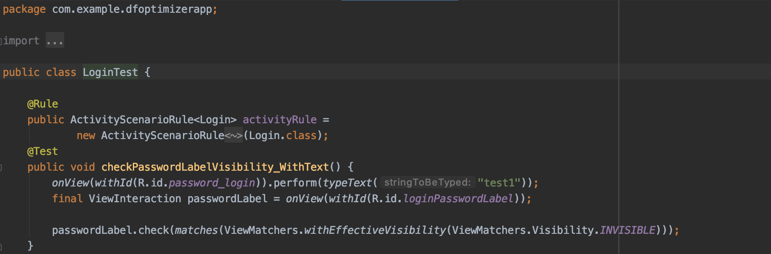
Test Cases : Register & Login Classes
Register
Login
Notes:
Elizabeth

Slide 7
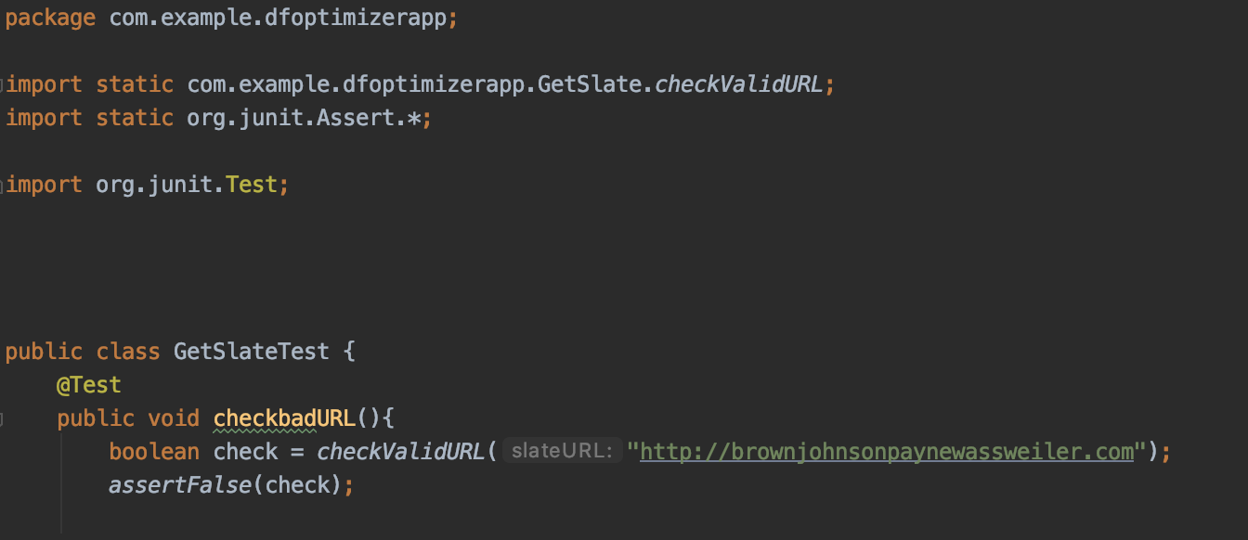
Test Cases : Get Slate Class (API)
Notes:
Elizabeth

Slide 8
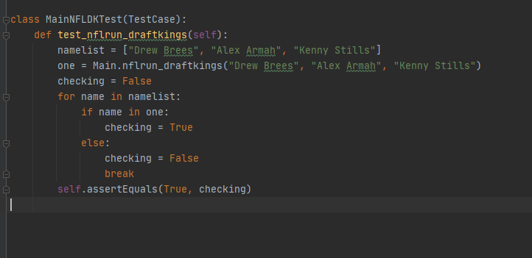
Test Case: Lineup optimization
Notes:
Gage Wassweiler

Slide 9
Not Completed & Lessons Learned
Error Checking
Filter by player position or by team
Selecting too many players
Switch to grabbing ESPN projections for NFL and MLB
NBA will still be our custom projections
Eventually have the option to choose our projections or ESPN’s
Notes:
Gage Wassweiler

Slide 10
Next Steps
Website Completion - Video, Deliverables, etc.
Home Page with Player Edit/View Options
Improvements on user interface and design
Settings Page
Export Option
Finish MLB additions and grabbing projected scores
Final customization of app
Notes:
Elizabeth

Slide 11
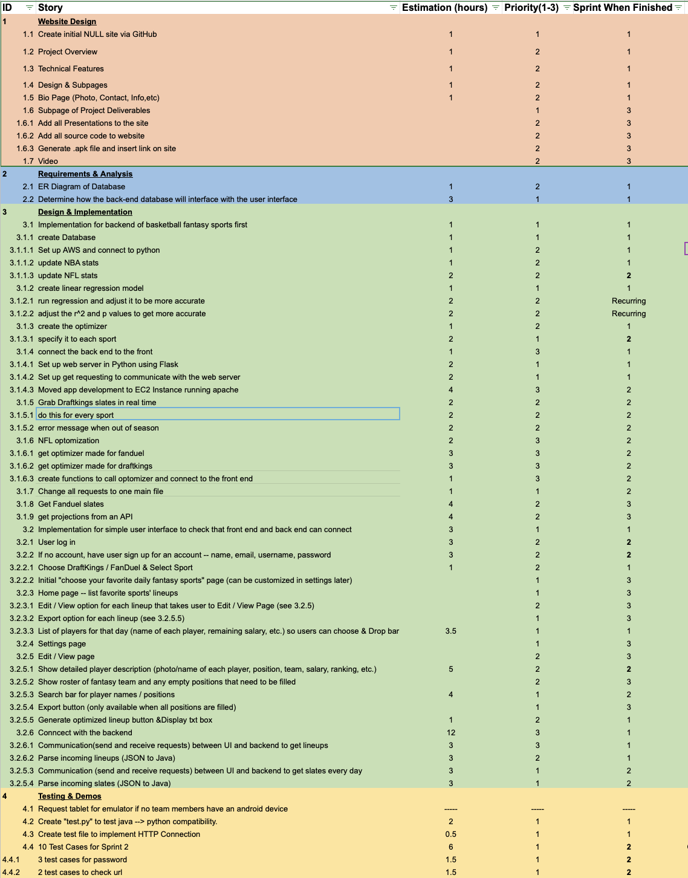
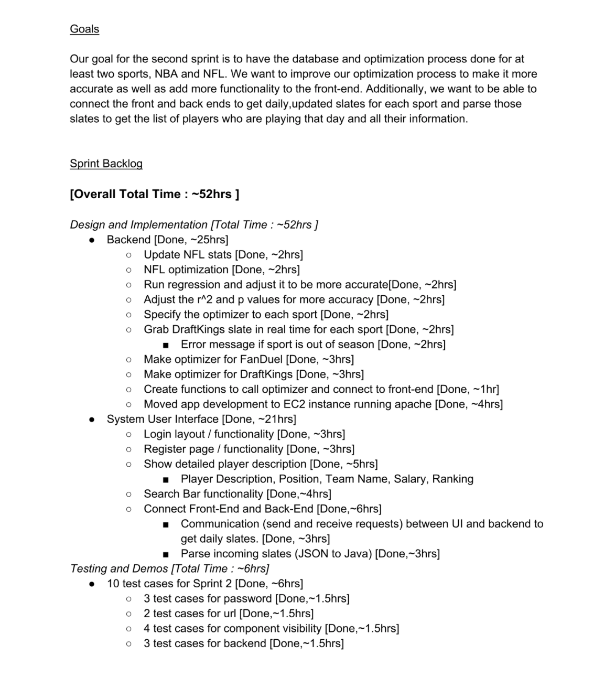
Project & Sprint Backlog

