Slide 1
Sprint 3: FanAssist
Daily Fantasy Sports Optimizer
Charity Brown, Andy Johnson, Elizabeth Payne, Gage Wassweiler
Notes:
Charity

Slide 2
Project Focus
The purpose of the FanAssist app is to assist daily fantasy sports users create a optimized lineup for competitions by leveraging FanDuel and DraftKings. Users can optimize and save their lineups which are based on detailed player statistics, player salary, and salary cap.
Notes:
Charity

Slide 3
Sprint 3 Goal & Major Achievements (cont)
Website Completion - Video, Deliverables, etc.
Home Page
Display general best lineups on it
Save desired lineups to user specific data on Firebase Firestore
Customization of App
Multiple Lineups
Finish MLB additions
Now grabs the actual FD/DK salaries for each contest
Switch to grabbing ESPN projections for NFL and MLB
NBA will still be our custom projections
Filter by player position or by team
Notes:
Andy Johnson

Slide 4
Test Cases
2 tests to check spinner visibility
1 test to check for saved lineup activity
1 test to check multiple lineups
1 test to check to make sure slates being grabbed properly
Notes:
Andy Johnson

Slide 5
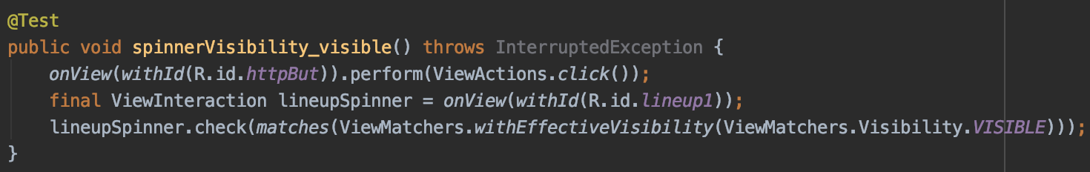
Test Case: Check Spinner Visibility
Notes:
Elizabeth

Slide 6
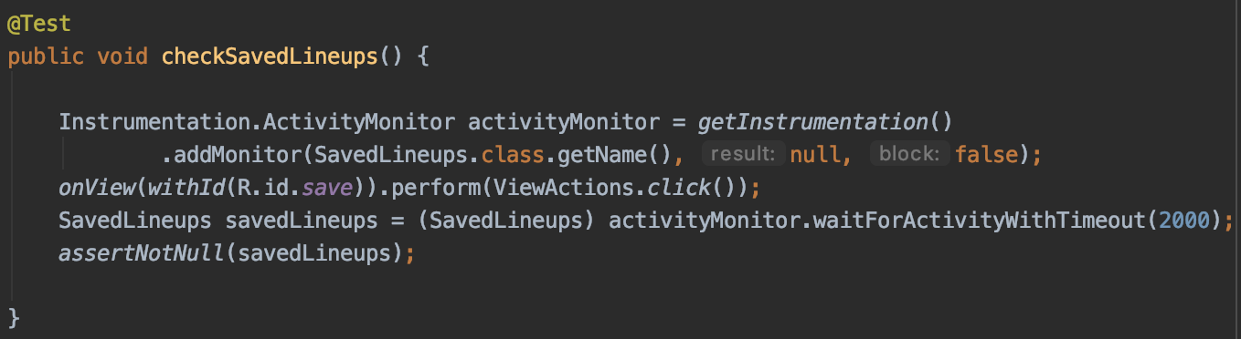
Test Case: Check for Next Activity
Notes:
Elizabeth

Slide 7
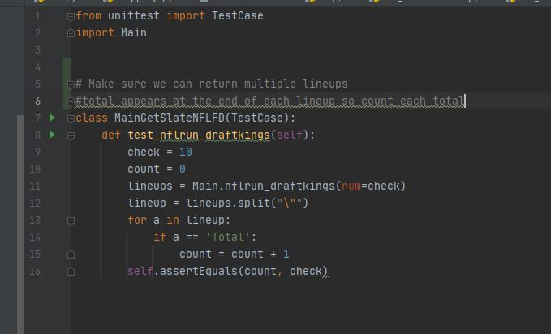
Test Case: Check Multiple Lineups
Notes:
Gage Wassweiler

Slide 8
Not Completed & Lessons Learned
Export Button
Favorite Sport
Sorting by team
Creating our own models for MLB/NFL
Eventually have the option to choose our projections or ESPN’s
More intuitive user interface
________________________________________________
Make sure to thoroughly understand systems being leveraged in case of an unknown error (AWS connectivity error)
Notes:
Gage Wassweiler

