Slide 1
Effects of COVID-19 on the homeless population in the state of California
By DFT (Racheal, Elijah and Mark)

Slide 2
Overview of the Presentation
What is COVID-19
What are the impacts of COVID-19 to the world in General
Why we chose California

Slide 3
Overview
Title Slide
Your Background
Project Introduction / Background
Methods
Results
Summary
Conclusions
Questions

Slide 4
Background

Slide 5
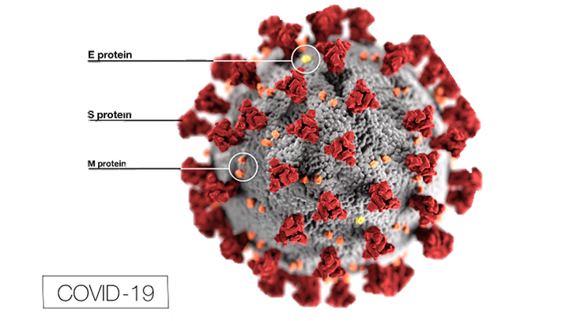
What is COVID-19
COVID-19 is caused by a coronavirus …
WAIT!! What is a coronavirus?
Coronaviruses are viruses that are name fir the crown-like spikes on their surfaces.
There are coronaviruses that cause disease in humans and in animals.
Sometimes animal corona viruses evolve and become a new human coronavirus.
For example SARS from 2003 and now COVID-19

Slide 6
What is COVID-19
It is caused by a novel coronavirus, named Severe Acute Respiratory Syndrome coronavirus 2 (SARS-CoV-2).
It was identified as the cause of an outbreak of respiratory illness first detected in Wuhan China in 2019.
The illness caused by the virus has been named coronavirus disease 2019 (COVID-19).

Slide 7
What is COVID-19
SARS-CoV-2 is presumed to have been transmitted through bats, but this has not been confirmed. So the origin is still unknown
There is currently no vaccine for coronaviruses.

Slide 8
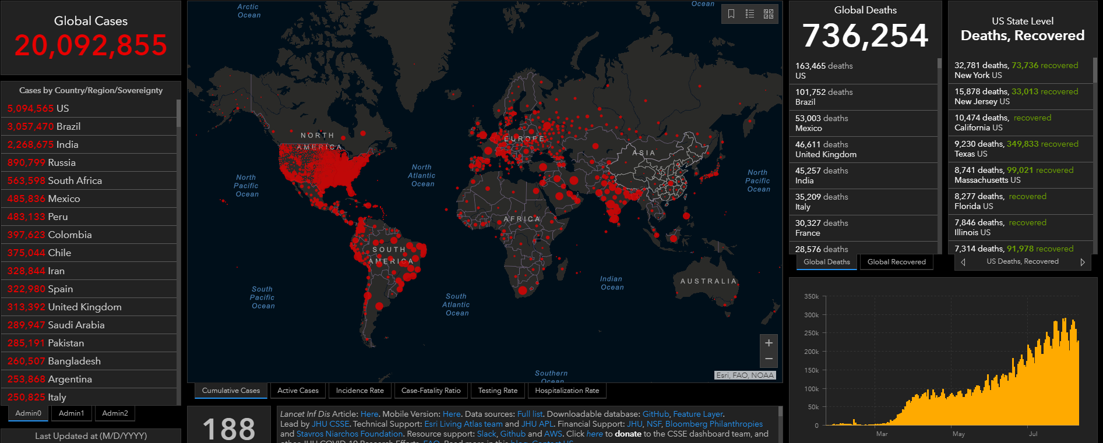
IMPACT OF COVID-19
Notes:
Over 20 million cases, over 700k death worldwide as of Aug 2020.
Every country was affected, in most ways, (economically, financially, socially etc.)

Slide 9
Sources
Coronavirus
https://www.cdc.gov/coronavirus/types.html
https://www.cdc.gov/media/subtopic/images.htm
https://coronavirus.jhu.edu/map.html

